Slide 1
Jean Palate
Paris, 5 December 2024

Slide 2
Description of the problem
Extended airline model
Extension to non-integer and multiple periodicities
Canonical decomposition and estimation by means of the Kalman smoother
Basic structural model
Trigonometric seasonal component (TBATS)
(Cubic) Splines (Harvey-Koopman-Riani)

Slide 3
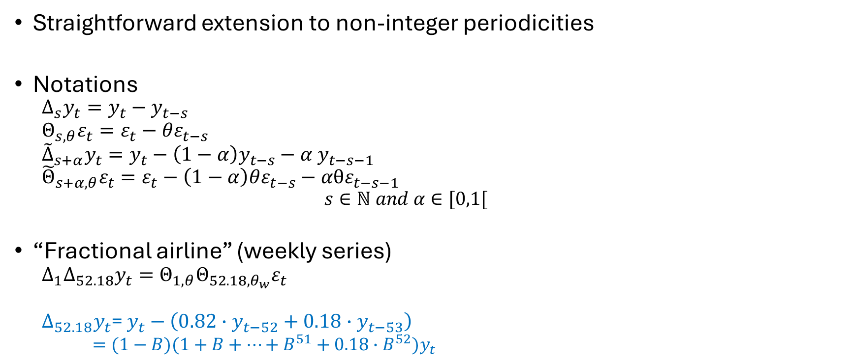
Extended airline model (I)
Straightforward extension to non-integer periodicities
Notations
$$∆_{s}y_{t}=y_{t}−y_{t−s}$$
$$Θ_{s,θ}ε_{t}=ε_{t}−{θε}_{t−s}$$
${\tilde{∆}}_{s+α}y_{t}=y_{t}−\left(1−α\right)y_{t−s}−α$ $y_{t−s−1}$
$${\tilde{Θ}}_{s+α, θ}ε_{t}=ε_{t}−\left(1−α\right)θε_{t−s}−αθε_{t−s−1}$$
$$s∈ℕ and α∈[0,1[$$
“Fractional airline” (weekly series)
$$∆_{1}∆_{52.18}y_{t}=Θ_{1,θ}Θ_{52.18,θ_{w}}ε_{t}$$
$∆_{52.18}y_{t}$= $y_{t}−\left(0.82∙y_{t−52}+0.18∙y_{t−53}\right)$
$=(1−B)(1+B+⋯+B^{51}+0.18{∙B}^{52})y_{t}$

Slide 4
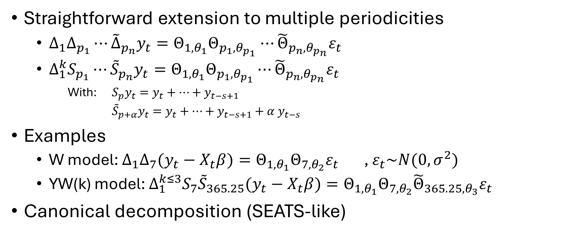
Extended airline model (II)
Straightforward extension to multiple periodicities
$∆_{1}{∆_{p_{1}}⋯{\tilde{∆}}_{p_{n}}y}_{t}=Θ_{1,θ_{1}}Θ_{p_{1},θ_{p_{1}}}⋯{\tilde{Θ}}_{p_{n},θ_{p_{n}}}ε_{t}$
$∆_{1}^{k}{S_{p_{1}}⋯{\tilde{S}}_{p_{n}}y}_{t}=Θ_{1,θ_{1}}Θ_{p_{1},θ_{p_{1}}}⋯{\tilde{Θ}}_{p_{n},θ_{p_{n}}}ε_{t}$
With: $S_{p}y_{t}=y_{t}+⋯+y_{t−s+1}$
${\tilde{S}}_{p+α}y_{t}=y_{t}+⋯+y_{t−s+1}+α$ $y_{t−s}$
Examples
W model: $∆_{1}∆_{7}(y_{t}−X_{t}β)=Θ_{1,θ_{1}}Θ_{7,θ_{2}}ε_{t}$ , $ε_{t}\sim N(0, σ^{2})$
YW(k) model: $∆_{1}^{k≤3}S_{7}{\tilde{S}}_{365.25}(y_{t}−X_{t}β)=Θ_{1,θ_{1}}Θ_{7,θ_{2}}{\tilde{Θ}}_{365.25,θ_{3}}ε_{t}$
Canonical decomposition (SEATS-like)

Slide 5
Basic structural model
Usual Components
Local level / local linear trend
Weekly periodic component
Annual periodic component
Noise
Periodic components (West-Harrison form)
Composed of latent variables corresponding to each period
Follow a multivariate random walk (different spec for the covariance matrix of the innovations
The sum of the latent variables is 0 at each point time.

Slide 6
Issues with extended airline/bsm
Theoretical issues
Quasi-independent seasonal factors for each period (week, day…)
- Why should 7 December be very different from 8 December ?
+ Very specific periods (around Christmas…)
Huge risk of overfitting
Technical issues
Large state array ( # ≈ 375 for daily series → ≈ 10 Giga bytes for a smoothing on 12 years )
Ordinary (diffuse) filtering/smoothing too expensive
Chandraskhar filtering only (→ no time-varying features)
No direct solution for smoothing (disturbance smoothing too unstable when the differencing order > 2)
→ iterative decomposition (with Chandraskhar filtering and disturbance smoothing)

Slide 7
Issues with extended airline/bsm
Theoretical issues
Quasi-independent seasonal factors for each period (week, day…)
- Why should 7 December be very different from 8 December ?
+ Very specific periods (around Christmas…)
Huge risk of overfitting
Technical issues
Large state array ( # ≈ 375 for daily series → ≈ 10 Giga bytes for a smoothing on 12 years )
Ordinary (diffuse) filtering/smoothing too expensive
Chandraskhar filtering only (→ no time-varying features)
No direct solution for smoothing (disturbance smoothing too unstable when the differencing order > 2)
→ iterative decomposition (with Chandraskhar filtering and disturbance smoothing)

Slide 8
Periodic spline components

Slide 9
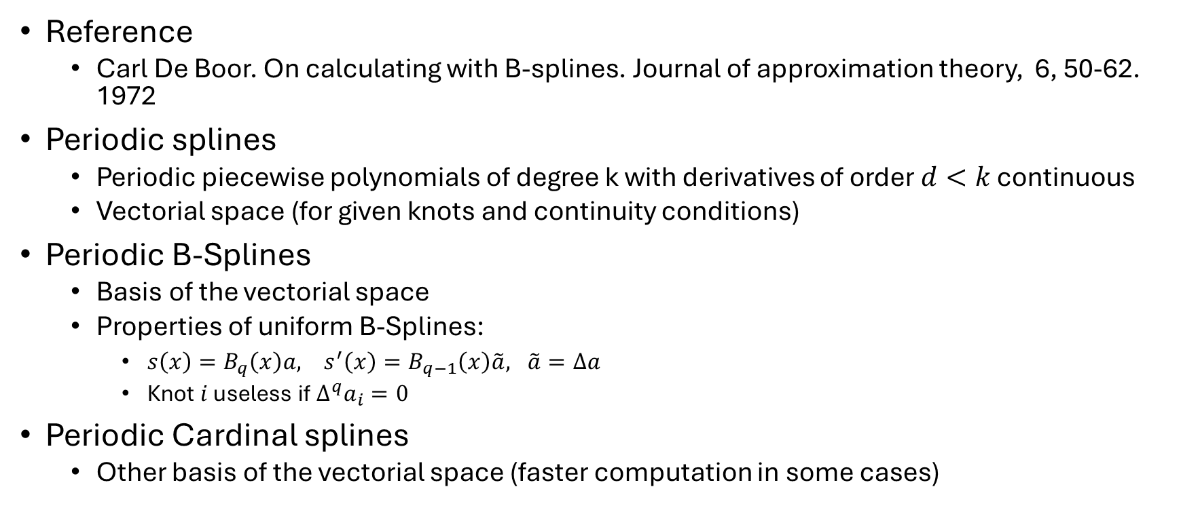
Periodic splines
Reference
Carl De Boor. On calculating with B-splines. Journal of approximation theory, 6, 50-62. 1972
Periodic splines
Periodic piecewise polynomials of degree k with derivatives of order $d<k$ continuous
Vectorial space (for given knots and continuity conditions)
Periodic B-Splines
Basis of the vectorial space
Properties of uniform B-Splines:
$s\left(x\right)=B_{q}\left(x\right)a, s^{′}\left(x\right)=B_{q−1}\left(x\right)\tilde{a}, \tilde{a}=∆a$
Knot $i$ useless if $∆^{q}a_{i}=0$
Periodic Cardinal splines
Other basis of the vectorial space (faster computation in some cases)

Slide 10
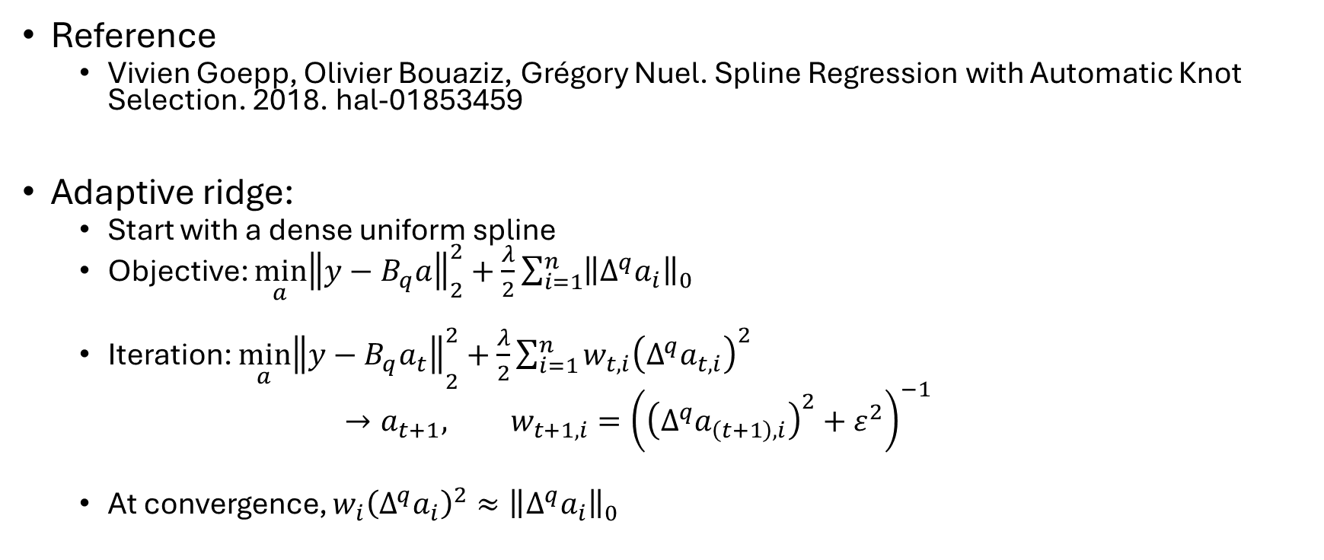
Adaptive periodic splines
Reference
Vivien Goepp, Olivier Bouaziz, Grégory Nuel. Spline Regression with Automatic Knot Selection. 2018. hal-01853459
Adaptive ridge:
Start with a dense uniform spline
Objective: $\min_{a}{{\left\|y−B_{q}a\right\|}_{2}^{2}+\frac{λ}{2}\sum_{i=1}^{n}{{\left\|Δ^{q}a_{i}\right\|}_{0}}}$
Iteration: ${\min_{a}\left\|y−B_{q}a_{t}\right\|}_{2}^{2}+\frac{λ}{2}\sum_{i=1}^{n}{w_{t,i}{\left(Δ^{q}a_{t,i}\right)}^{2}}$
$$→a_{t+1}, w_{t+1,i}={\left({\left(Δ^{q}a_{\left(t+1\right),i}\right)}^{2}+ε^{2}\right)}^{−1}$$
At convergence, $w_{i}{\left(Δ^{q}a_{i}\right)}^{2}≈{\left\|Δ^{q}a_{i}\right\|}_{0}$

Slide 11
Adaptive periodic splines

Slide 12
Complete processing

Slide 13
Examples

Slide 14
Examples

Slide 15
Examples

Slide 16
Examples

