Slide 1
Absolute frequencies and tree diagrams
Let’s see the two methods of computing probabilities using an example:
A study of the presence of cutaneous malignant melanoma at a single body location among the Italian population found that 15% of skin cancers are located on the head and neck area, another 41% on the trunk and the remaining 44% on the limbs. 44% of individuals with skin cancer on the head are men, as are 63% of those with skin cancer on the trunk but only 20% of those with skin cancer on the limbs. What percent of all individuals with skin cancer are women?
AKA
P(head) = 0.15 P(trunk) = 0.41 P(limbs) = 0.44
P(man | head) = 0.44 P(man | trunk) = 0.63 P(man | limbs) = 0.20

Slide 2
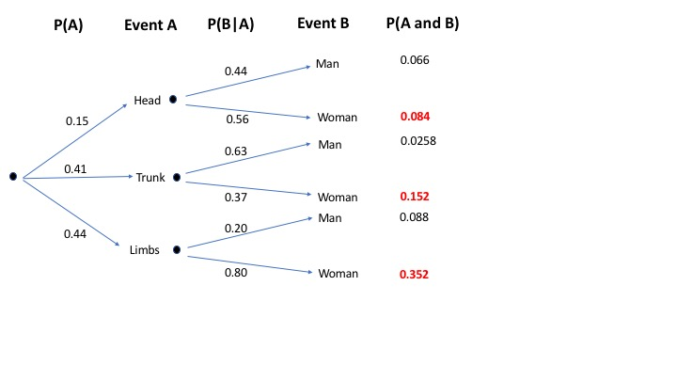
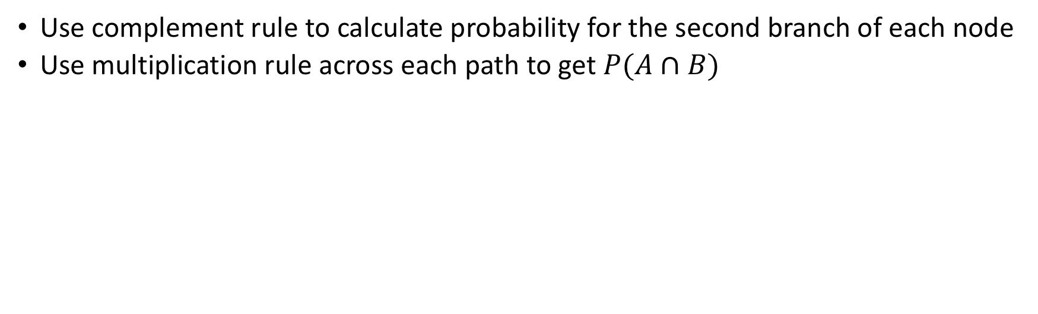
Solution using tree diagram
Use complement rule to calculate probability for the second branch of each node
Use multiplication rule across each path to get $P(A∩B)$
Sum the probabilities of $A∩B$ for Event B = Woman: P(woman) = 0.588

Slide 3
Solution using absolute frequencies
P(man | head) = 44% P(woman | head) = 100- 44 = 56%
Similarly, P(woman | trunk) = 37%
P(woman | limbs) = 80%
P(woman) = P(head)P(woman | head) + P(trunk)P(woman | trunk) + P(limbs)P(woman | limbs) = (15% * 56%) + (41% * 37%) + (44% * 80%) = 58.8%
~59% of individuals with skin cancer are women

