Slide 1
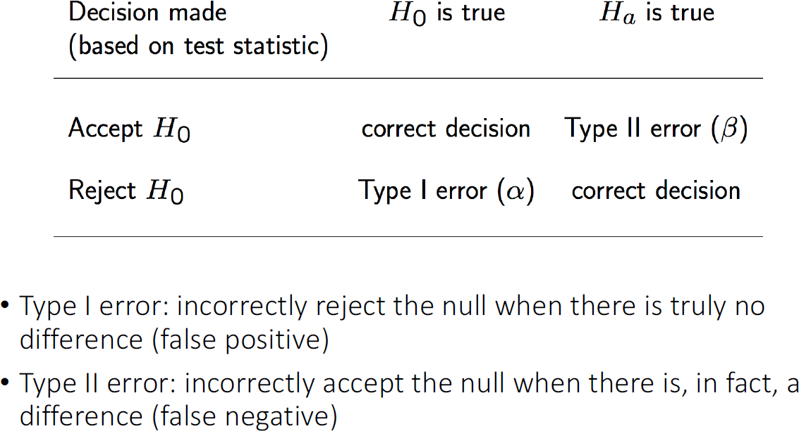
Type I and Type II Errors

Slide 2
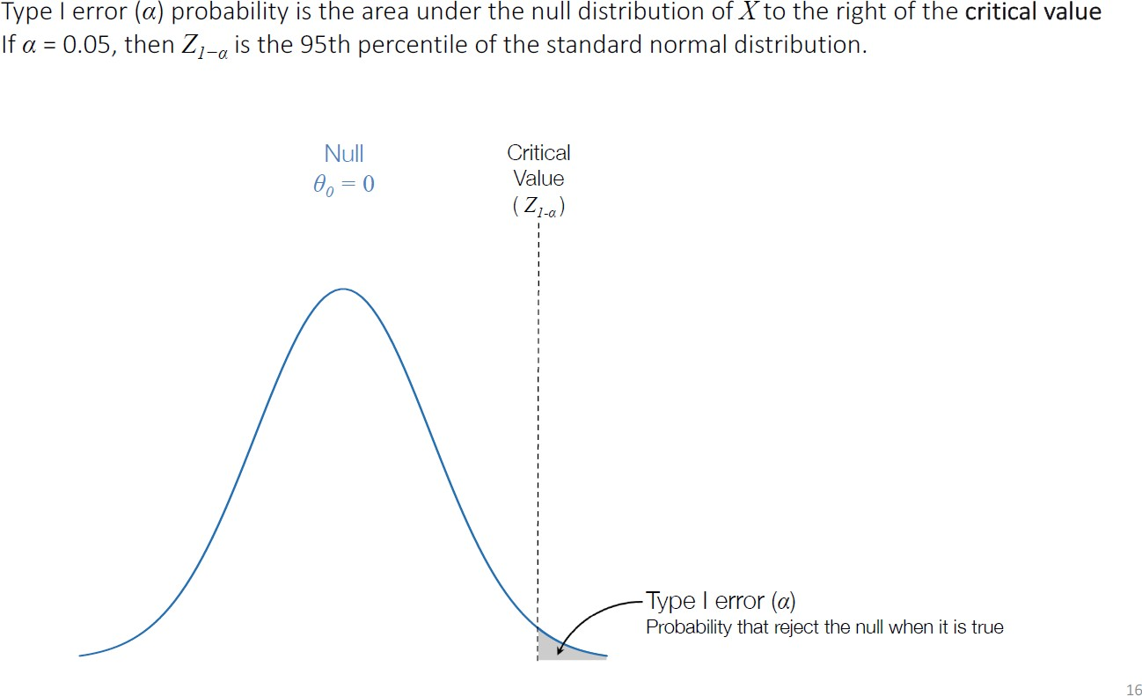
Type I Error

Slide 3
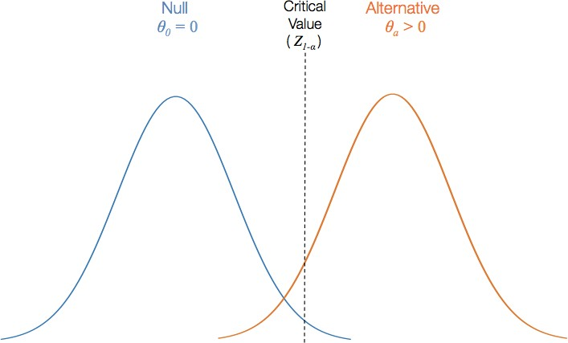

Slide 4
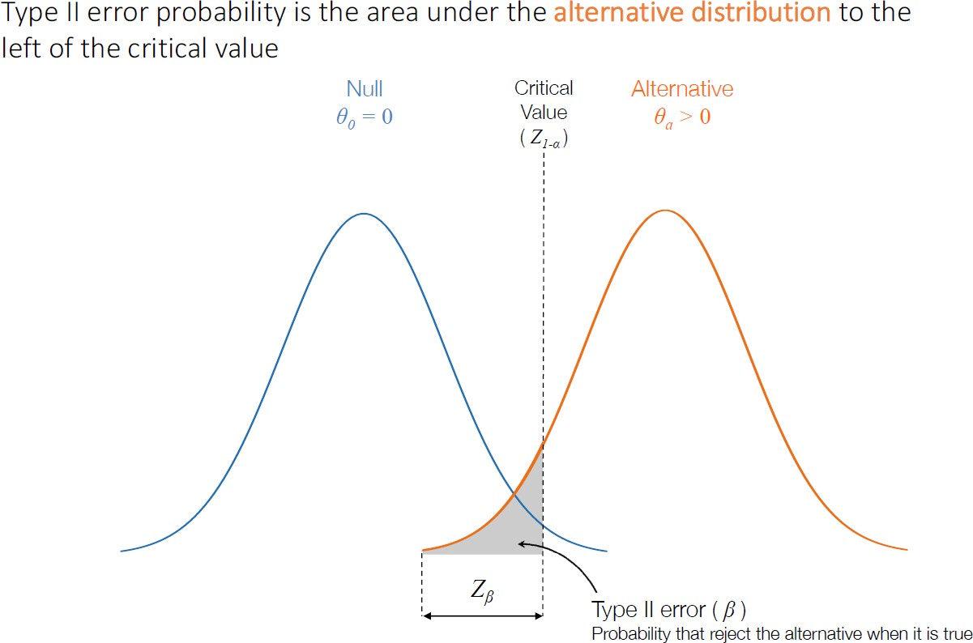
Type II Error

Slide 5
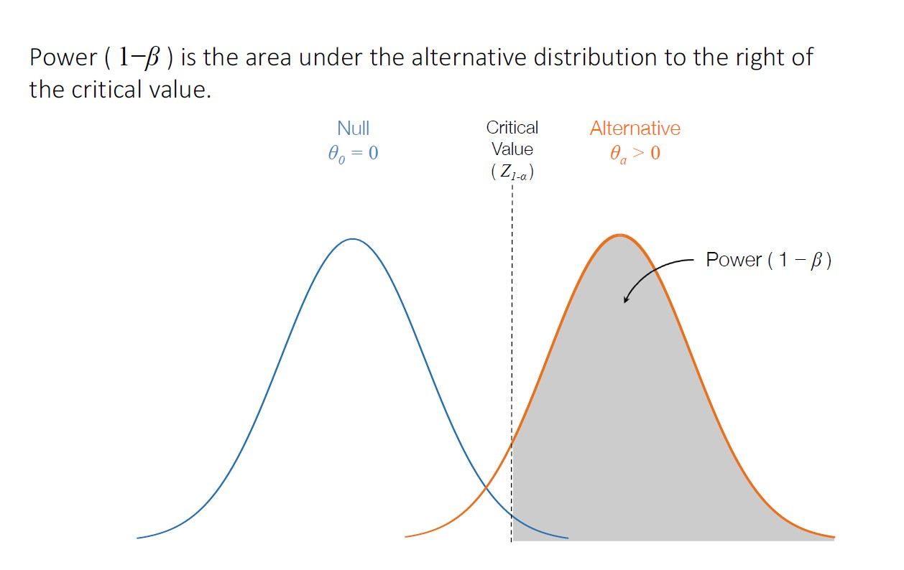
Power
Power (1- beta) is the area under the alternative distribution to the right of the critical value.

Slide 6
Power
To Increase Power:
Increase the effect size
Increase sample size (shrinks standard error)
Increase Type I Error
Power (1- beta) is the area under the alternative distribution to the right of the critical value.

