Slide 1
Hotel Booking Occupancy
Manager
PBL · JAVA · TEAM 18
26SC1101E — PROBLEM SOLVING THROUGH PROGRAMMING (JAVA) · SECTION 14
A console Java application that validates guest details, prices a stay by room category and prints a booking summary.
TEAM 18
Srijan
2620030689
Sudheer
2620090081
Notes:
Title slide — Hotel Booking Occupancy Manager, Team 18, Section 14.

Slide 2
Abstract
DISPATCH 01
The Hotel Booking Occupancy Manager is a console-based Java application that simulates the front desk of a hotel. It records a guest's name and 12-digit Aadhaar number, validates the length of stay, presents four room categories (Basic, Luxury, Deluxe and Platinum) and computes the total bill for the booking.
Rooms are modelled as objects: a Room parent class holds the type and nightly price, while a LuxuryRoom subclass overrides the billing method to apply an automatic 10% discount. Overloaded methods, arrays, loops, String operations and exception handling for invalid input bring together every module of the course in one practical program.
4
room categories with a nightly price each
10%
automatic discount on Luxury rooms via method overriding
12
digit Aadhaar check before a booking is accepted
Notes:
Abstract of the project.

Slide 3
Understanding Problem Statement
DISPATCH 02
THE PROBLEM
SYSTEM WORKFLOW
A small hotel needs a quick way to register a walk-in guest, verify identity, let the guest pick a room category and produce an accurate bill — without manual calculation errors and without accepting bad input such as an invalid ID, zero days or a non-numeric choice.
01
Guest input
name, Aadhaar, days
02
Validate
length & range checks
03
Choose room
menu from arrays
INPUTS
OUTPUTS
Guest name
Aadhaar number (12 digits)
Number of days
Room choice (1–4)
Room menu with prices
Validation messages
Booking summary
Total bill in Rs.
04
Create object
Room / LuxuryRoom
05
Bill & summary
calculateBill(days)
Notes:
Problem statement, inputs, outputs and the workflow of the program.

Slide 4
CO 1 Topics — Java Fundamentals
CO 1 · MODULE 1
TOPICS USED IN THE PROJECT
FROM THE CODE
01
Data types & variables
String name, int price, int days, double bill
Scanner sc = new Scanner(System.in);
System.out.print("Enter your name: ");
String name = sc.nextLine();
System.out.print("Number of days: ");
int days = sc.nextInt();
int price = 2000;
double bill = price * days
* (100 - discount) / 100.0;
System.out.println("Days : " + days);
02
Operators
arithmetic (*, -, /), relational (<, >, <=), logical (||)
03
Scanner input
nextLine() for text, nextInt() for numbers
04
Type casting / promotion
dividing by 100.0 promotes int math to double
05
Formatted output
System.out.println() for menu and summary
Notes:
CO1: Java basics used — data types, operators, Scanner input, type promotion.

Slide 5
CO 2 Topics — Control Flow
CO 2 · MODULE 2
TOPICS USED IN THE PROJECT
FROM THE CODE
01
if statement
rejects an Aadhaar number that is not 12 characters
if (aadhar.length() != 12) {
System.out.println("Invalid Aadhar number.");
return;
}
for (int i = 0; i < roomTypes.length; i++) {
System.out.println((i + 1) + ". "
+ roomTypes[i] + " - Rs." + roomPrices[i]);
}
while (choice < 1 || choice > 4) {
System.out.print("Invalid. Choose again: ");
choice = sc.nextInt();
}
02
if / else selection
LuxuryRoom vs Room object based on the choice
03
while loop
re-prompts until the room choice is between 1 and 4
04
for loop
prints the numbered room menu from the arrays
05
Early return
stops the program when days <= 0
Notes:
CO2: Selection and iteration — if, if/else, while, for.

Slide 6
CO 3 Topics — Methods & Arrays
CO 3 · MODULE 3
TOPICS USED IN THE PROJECT
FROM THE CODE
01
Method definition & invocation
calculateBill() defined in Room, called from main
String[] roomTypes =
{"Basic", "Luxury", "Delux", "Platinum"};
int[] roomPrices = {1500, 2000, 2700, 4000};
// Method overloading: same name,
// different parameter lists
double calculateBill(int days) {
return price * days;
}
double calculateBill(int days, int discount) {
return price * days
* (100 - discount) / 100.0;
}
02
Parameters & return values
takes int days, returns double
03
Method overloading
calculateBill(days) and calculateBill(days, discount)
04
1D arrays
roomTypes[] and roomPrices[] hold the menu data
05
Array traversal & indexing
roomTypes[choice - 1] picks the selected room
Notes:
CO3: Methods, overloading and arrays.

Slide 7
CO 4 Topics — OOP & Inheritance
CO 4 · MODULE 4
TOPICS USED IN THE PROJECT
FROM THE CODE
01
Classes & objects
Room class; room object created in main
class Room {
String type; int price;
Room(String type, int price) {
this.type = type; this.price = price;
}
double calculateBill(int days) {
return price * days;
}
}
class LuxuryRoom extends Room {
LuxuryRoom() { super("Luxury", 2000); }
@Override
double calculateBill(int days) {
return price * days * 0.9; // 10% off
}
}
02
Parameterized constructor
Room(String type, int price) with this keyword
03
Inheritance
class LuxuryRoom extends Room, calls super(...)
04
Method overriding
@Override calculateBill() applies 10% discount
05
Runtime polymorphism
Room room = new LuxuryRoom(); picks the override
Notes:
CO4: OOP — classes, constructors, inheritance, overriding, polymorphism.

Slide 8
CO 5 Topics — Strings
CO 5 · MODULE 5
TOPICS USED IN THE PROJECT
FROM THE CODE
01
String objects
name and aadhar read with nextLine()
String aadhar = sc.nextLine();
if (aadhar.length() != 12) {
System.out.println("Invalid Aadhar number.");
return;
}
System.out.println("Name : "
+ name.toUpperCase());
System.out.println("Room : " + room.type);
System.out.println("Total Bill: Rs." + bill);
02
length()
validates the 12-digit Aadhaar number
03
toUpperCase()
prints the guest name in capitals in the summary
04
Concatenation (+)
builds menu lines and summary rows
05
Immutability
toUpperCase() returns a new String; name is unchanged
Notes:
CO5: String class and its methods.

Slide 9
CO 6 Topics — Exception Handling
CO 6 · MODULE 6
TOPICS USED IN THE PROJECT
FROM THE CODE
01
try block
wraps all user input and billing logic
import java.util.InputMismatchException;
try {
System.out.print("Number of days: ");
int days = sc.nextInt(); // may throw
...
double bill = room.calculateBill(days);
} catch (InputMismatchException e) {
System.out.println(
"Error: Please enter numbers only.");
}
sc.close();
02
catch InputMismatchException
text typed where a number is expected
03
Graceful recovery
friendly error message instead of a crash
04
Resource management
sc.close() releases the Scanner
05
Validation vs exceptions
if-checks for logic errors, catch for runtime errors
Notes:
CO6: Exception handling with try/catch.

Slide 10
Conclusion
DISPATCH 10
WHAT WE BUILT
FUTURE SCOPE
The Hotel Booking Occupancy Manager turns the whole PSPJ syllabus into one working program. A guest is registered, validated and billed in a few steps, and every course outcome — from Scanner input and loops to inheritance, Strings and exception handling — is exercised by real code rather than isolated examples.
Live occupancy
track which rooms are free or booked
Dates
check-in / check-out and date overlap checks
Persistence
store bookings in a file or database
KEY LEARNINGS
Overriding lets a subclass change behaviour without touching the parent
Validating input early keeps the billing logic simple
try/catch protects the program from unexpected user input
Reports
daily occupancy and revenue summaries
Interface
move from console to a GUI or web front end
Notes:
Conclusion and future scope.

Slide 11
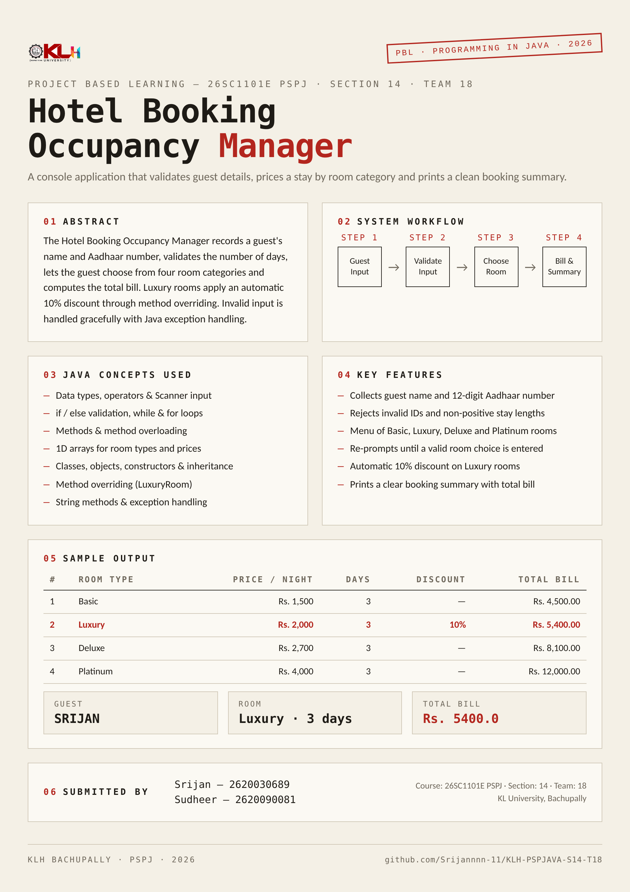
Screen Shots
POSTER
PROJECT POSTER
Hotel Booking Occupancy Manager — Project Based Learning poster for 26SC1101E PSPJ (Section 14, Team 18).
SAMPLE CONSOLE RUN
Enter your name: Srijan
Aadhar Card Number (12 digits): 123456789012
Number of days: 3
1. Basic - Rs.1500
2. Luxury - Rs.2000
3. Delux - Rs.2700
4. Platinum - Rs.4000
Choose room (1-4): 2
===== Booking Summary =====
Name : SRIJAN
Room : Luxury
Days : 3
Total Bill: Rs.5400.0
Notes:
Screenshots: project poster and a sample console run.

Slide 12
Geo Tag Photo and GitHub Link
DISPATCH 12
GITHUB REPOSITORY
KLH-PSPJAVA-S14-T18
github.com/Srijannnn-11/KLH-PSPJAVA-S14-T18
CONTENTS
HotelBookingManagerSystem.java — source code
Project poster
Notes:
Geo-tagged photo to be added on the left; GitHub repository link on the right.

