Slide 1
E-Commerce Sales Analysis
Presented By: Avinash Kumar Pal
Domain: Data Analytics
Tools Used: Python, SQL, Pandas, Plotly, Matplotlib

Slide 2
Objective :
The objective of this project is to analyze e-commerce sales data to identify revenue trends, customer purchasing behavior, top-performing products, and profit-driving regions, in order to generate data-driven insights that support better business decision-making and improve overall sales performance.
I had worked on more than 9000+ customer information data.

Slide 3
Problem Statement :
The e-commerce company is generating strong sales but facing inconsistent profitability due to high discounts, loss-making products, and regional performance gaps. There is limited visibility into customer behavior and category-wise contribution. This project analyzes sales data to identify key issues and provide data-driven solutions to improve overall business performance.

Slide 4
Dataset & Tools Used
Dataset: Superstore E-Commerce Sales Dataset
Tools: Python, SQL, Pandas, NumPy, Matplotlib, Plotly, EDA
Key Columns: Order Date, Sales, Profit, Discount,
Category, Region, Customer Name

Slide 5
Exploratory Data Analysis (Key Insights)
Sales Trend: Seasonal spikes, overall upward trend
Category Analysis: Technology highest revenue, Furniture lower profit margins
Regional Performance: West highest sales, Central lower profitability

Slide 6
Profitability & Discount Analysis
Higher discounts reduce profit
Some products sold at a loss
Overall profit margin calculated

Slide 7
Customer & Business Insights
Top 10 customers contributed major revenue:
Average Order Value measured
KPIs: Total Revenue, Total Profit, Profit Margin, Regional Contribution, Sales Growth Rate

Slide 8
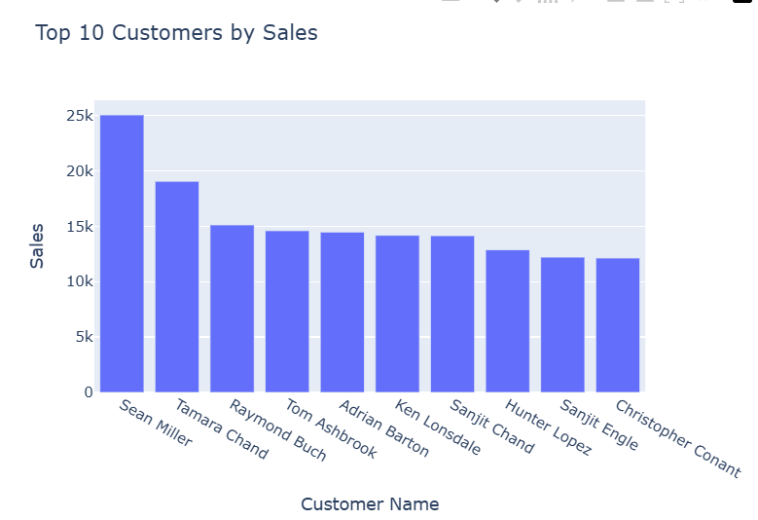
Top 10 customers contributed major revenue:
top_customers = (
data.groupby("Customer Name")["Sales"]
.sum()
.sort_values(ascending=False)
.head(10)
.reset_index()
)
SQL Query:
Select customer Name, sum(sales) as total sales from superstores
Group by Customer Name
order by total sales desc limit 10;

Slide 9
Solutions & Recommendations
Optimize discount strategy
Focus on high-profit categories (Technology)
Improve operations in low-performing regions
Discontinue/reprice loss-making products

Slide 10
Conclusion
Data analytics solves real-world business problems
Insights improve decision-making, profitability, and growth strategy
Closing Statement: “Data-Driven Decisions Lead to Business Growth”

Slide 11
KPIs: Total Revenue, Total Profit, Profit Margin, Regional Contribution, Sales Growth Rate
Total Revenue: 2297200.8603000003
Total Profit: 286397.0217
Profit Margin: 12.47 %
Sales Growth Rate: +15% YoY Year-over-year growth

Slide 12
THANK YOU !!!

