Slide 1

Team Icefyre2
Web Fundamentals Funny Team Project

Slide 2
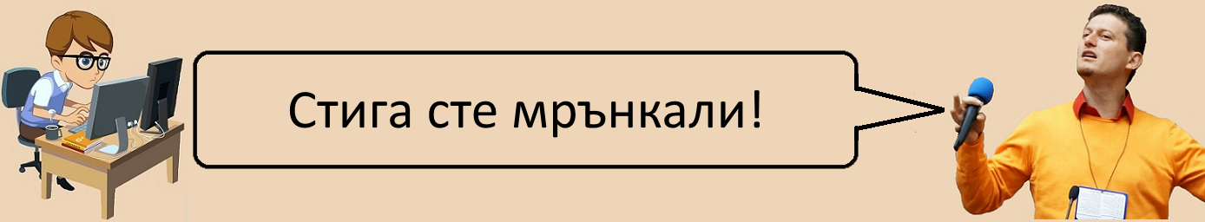
Project purpose:
Creating simple HTML page with jokes about programmers and SoftUni students, exams, lectures and team-projects

Slide 3
Using HTML, CSS and JavaScript
Compatible to all devices – laptops, desktop PCs, mobile phones and tablets
Uploaded on the web: http://kbabacheva.softuni-friends.org/icefyre/index.html

Slide 4
What pages does the site contains of?
Home page
Students
Exams
Team project
About the university
Courses – HTML/CSS, Java and C#

Slide 5
Members:
g.stoyanov – Georgi S
katya86 – Katya
JiVeNcE – Jivko
aramle – Elena
georgeangelov93 – George A
palazliev – Sevdi
rados22 – didn’t participate

Slide 6
Contributions of the members:
g.stoyanov – created responsive design
katya86 – pages Home, Team-project and Exams, social media buttons
JiVeNcE – page Students

Slide 7
Contributions of the members(2):
aramle – created the falling numbers with JavaScript
Georgeangelov93 – worked on the courses, 3 pages – HTML/CSS, Java and C#

Slide 8
Contributions of the members(3):
palazliev – pages About the university, Software university, Foundation, Plans, Certificates, Scholarships, Classrooms, Contacts
Everyone worked on the CSS

Slide 9
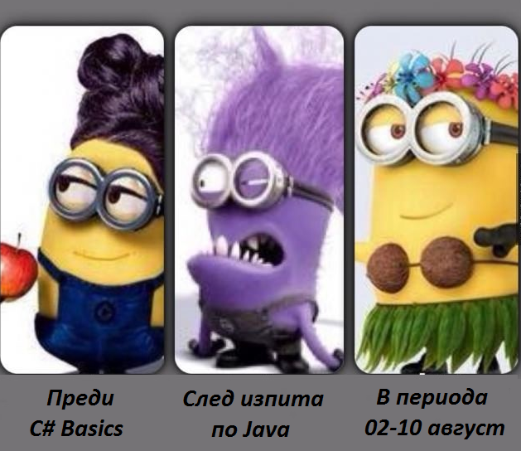
Thank you!
A picture of us!

