Slide 1
ACME_SPD
File created on: 4/15/2024 9:37:59 AM

Slide 2
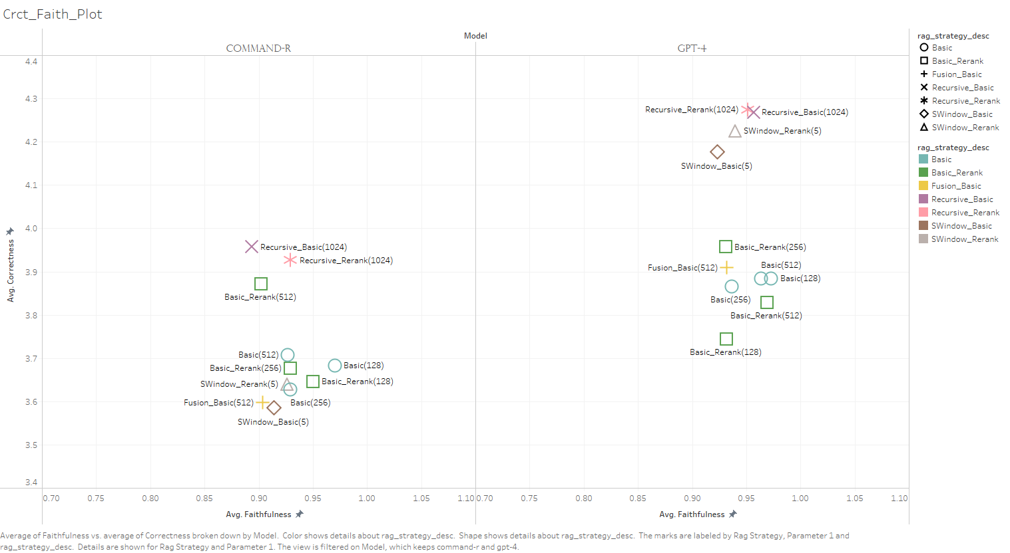

Slide 3
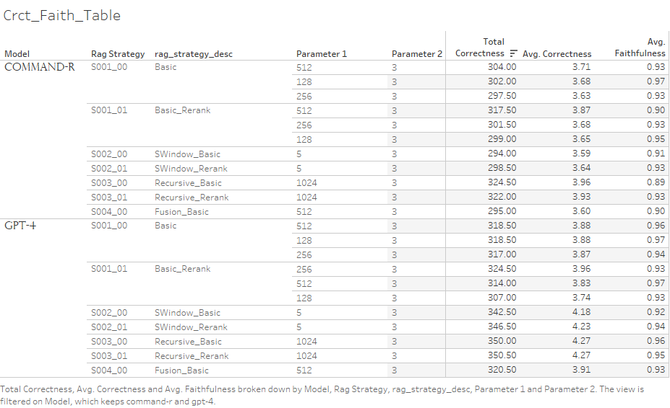

Slide 4
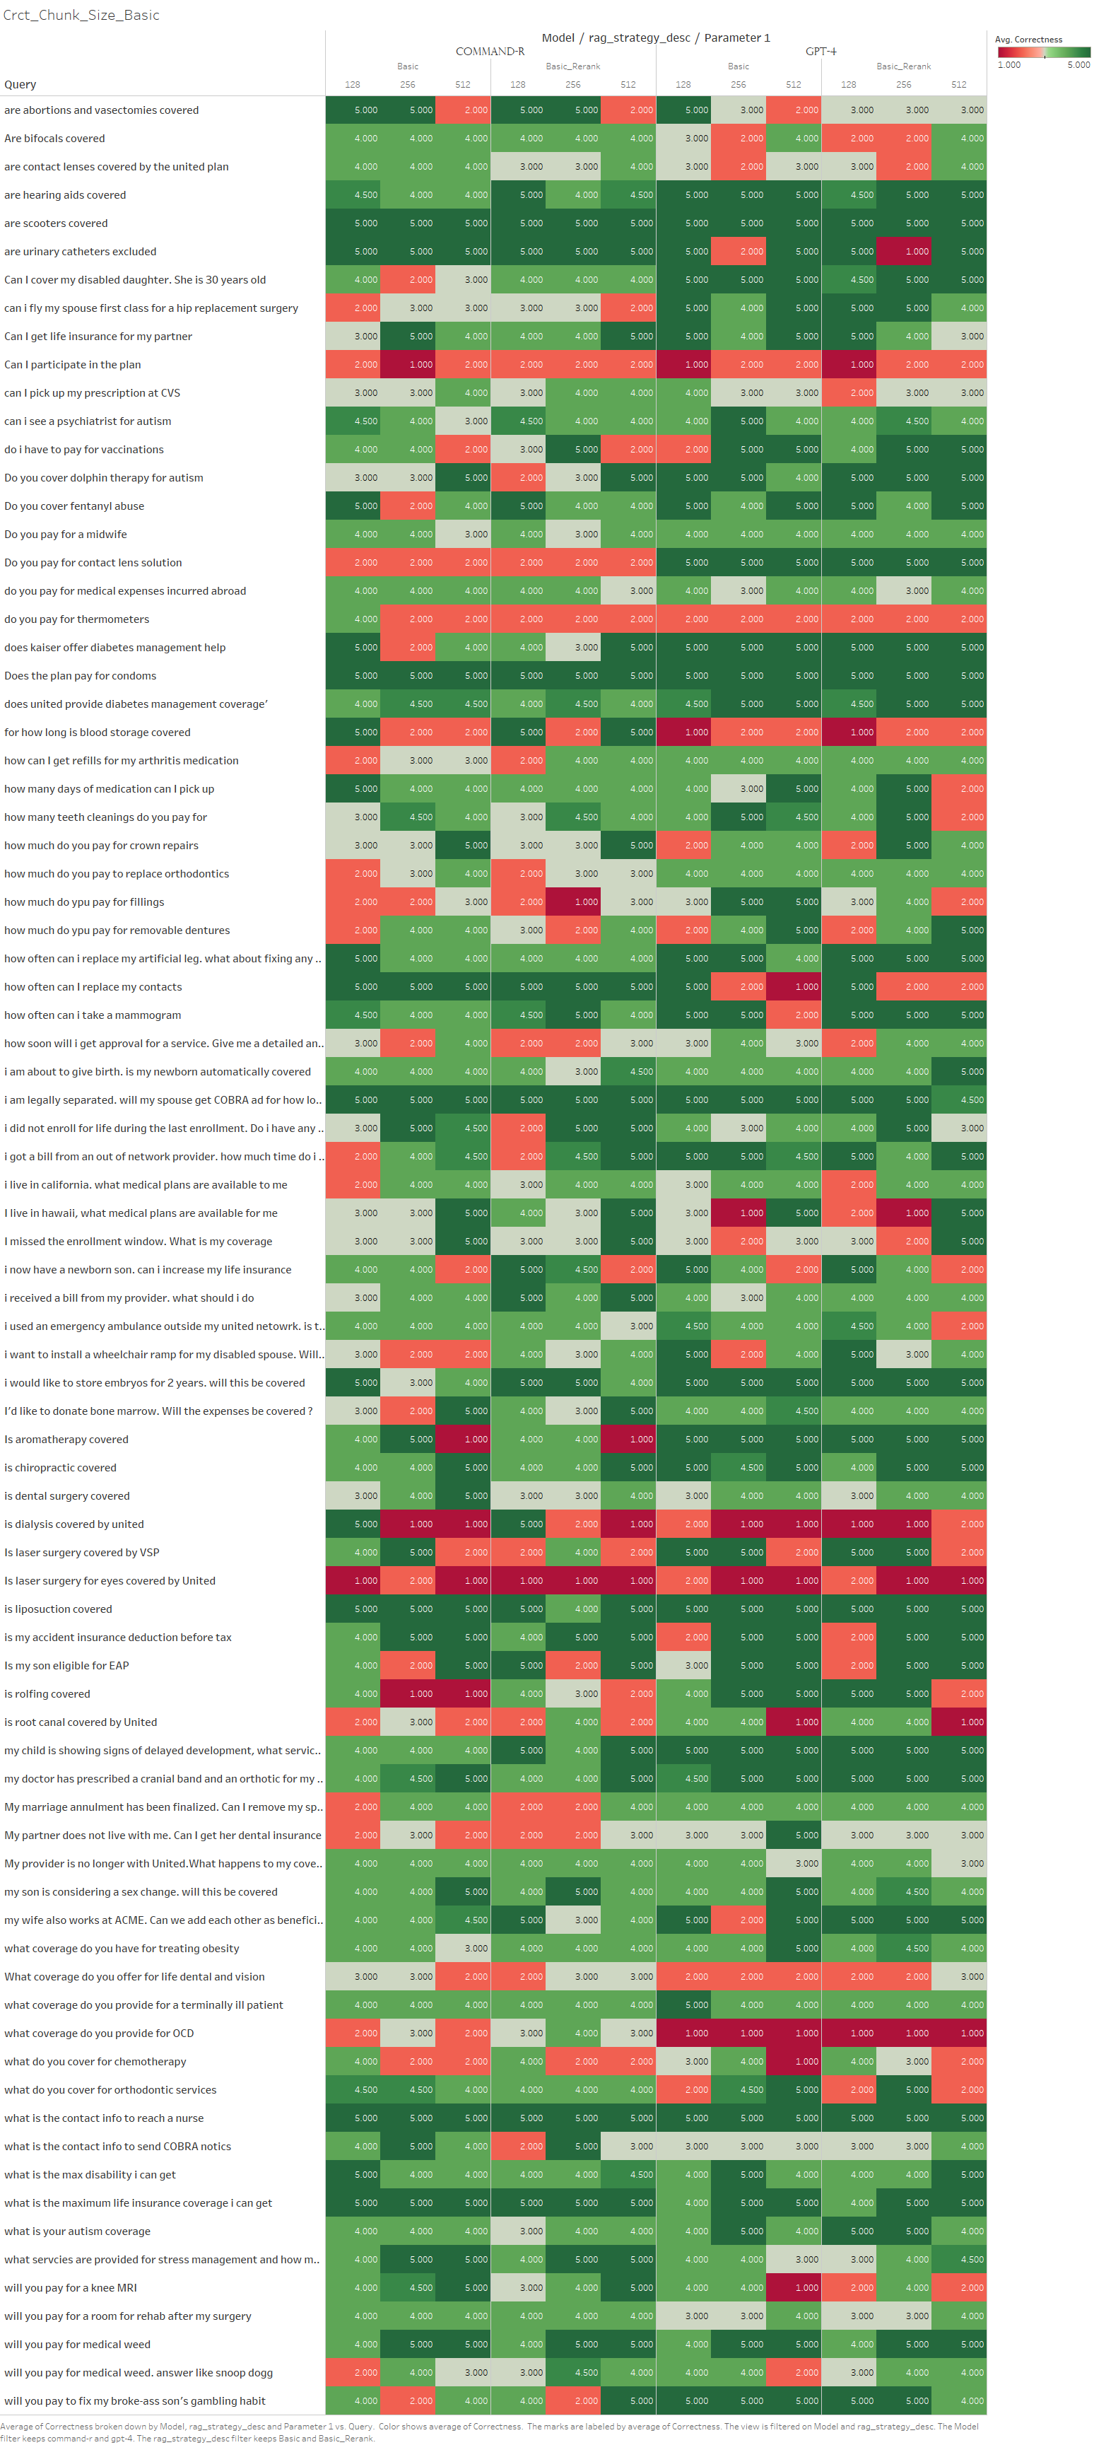

Slide 5
