Slide 1
Clinical Data Science Course 2 Module 5 Programming Assignment Assignment is to ETL MIMIC data into the OMOP CONDITION_OCCURRENCE table
Detailed instructions with Slide Notes
Palchamy Elango
October 19, 2024

Slide 2
ETL Steps
Assignment is to ETL MIMIC data into the OMOP CONDITION_OCCURRENCE table
Understand source/target data models
Profile source tables
Create ETL mappings
Write transformation code
Execute transformation
Perform data quality assessment
Package documentation
Notes:
This is an overview of the seven steps for ETL. The assignment focuses on Steps 1 thru 4 and Step 6
Place your finished deliverables into one or more slides. Add notes to provide additional information/context about what you have done

Slide 3
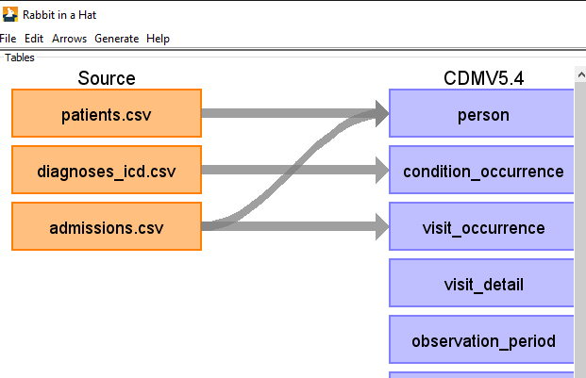
Step 1: Understand source/target data models
Source MIMIC –III Tables:
Patient
Diagnoses_ICD
Target OMOP Table:
1. CONDITION_OCCURRENCE
Notes:
Paste into one or more slides, the key table or tables from MIMIC that hold data that can be used to fill in the OMOP CONDITION_OCCURRENCE table.
Choose the MIMIC table screenshots from this slide to indicate which MIMIC table or tables would be used in the ETL process. Delete the MIMIC tables that you will not use.

Slide 4
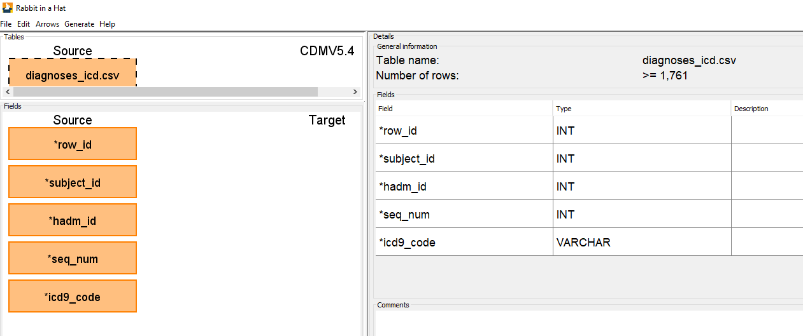
Step 1: Understand source/target data models
Fields selected from MIMIC Diagnoses_ICD Table

Slide 5
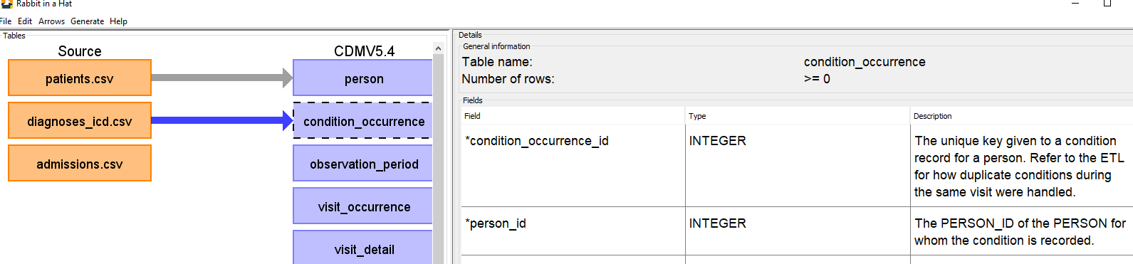
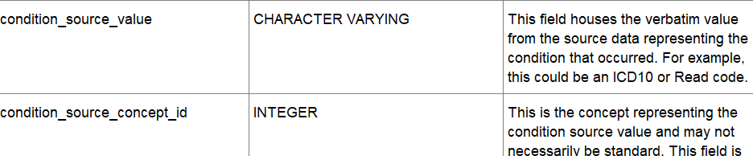
Step 1: Understand source/target data models
Fields selected from OMOP condition_occurrence Table

Slide 6
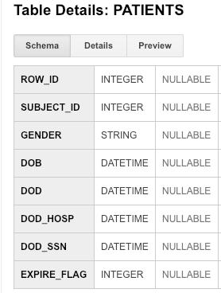
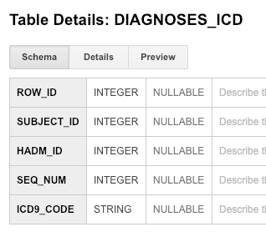
Step 1: Understand source/target data models
MIMIC table(s) that contain data for ETL into
OMOP CONDITION_OCCURRENCE
Notes:
Paste into one or more slides, the key table or tables from MIMIC that hold data that can be used to fill in the OMOP CONDITION_OCCURRENCE table.
Choose the MIMIC table screenshots from this slide to indicate which MIMIC table or tables would be used in the ETL process. Delete the MIMIC tables that you will not use.

Slide 7
Step 1: Understand source/target data models
Mapped fields across databases tables
MIMIC-III Table: Diagnoses_ICD | OMOP Table: Condition_Occurrence
subject_id | person_id
hadm_id | visit_occurrence_id
Icd9_code | Condition_source_value

Slide 8
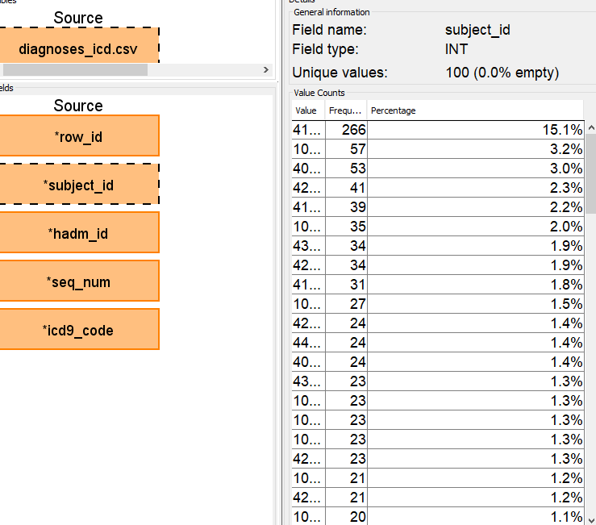
Step 2: Profile source table or tables
Using the White Rabbit profiling data from the 100 patient MIMIC database provided in the Assessment to comment on the distribution of the SUBJECT_ID field from one of the MIMIC tables selected in Step 1
One subject has 266 diagnosis events recorded, that is 15% of the total diagnosis records of this demo database.
Notes:
Use the White Rabbit data profiling Excel spreadsheet that is linked to the assignment to describe key profiling findings from the table or tables you identified in ETL Step 1. See rubric for the types of topics to include here.

Slide 9
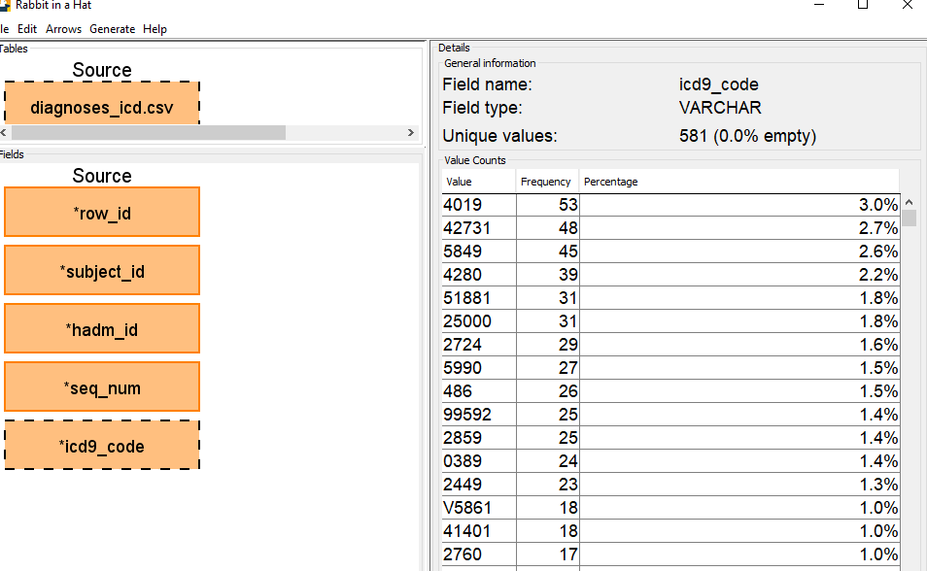
Step 2: Profile source table or tables
Using the White Rabbit profiling data from the 100 patient MIMIC database provided in the Assessment to comment on the distribution of the SUBJECT_ID field from one of the MIMIC tables selected in Step 1
Commonly coded diagnosis code is ‘4019’
Notes:
Use the White Rabbit data profiling Excel spreadsheet that is linked to the assignment to describe key profiling findings from the table or tables you identified in ETL Step 1. See rubric for the types of topics to include here.

Slide 10
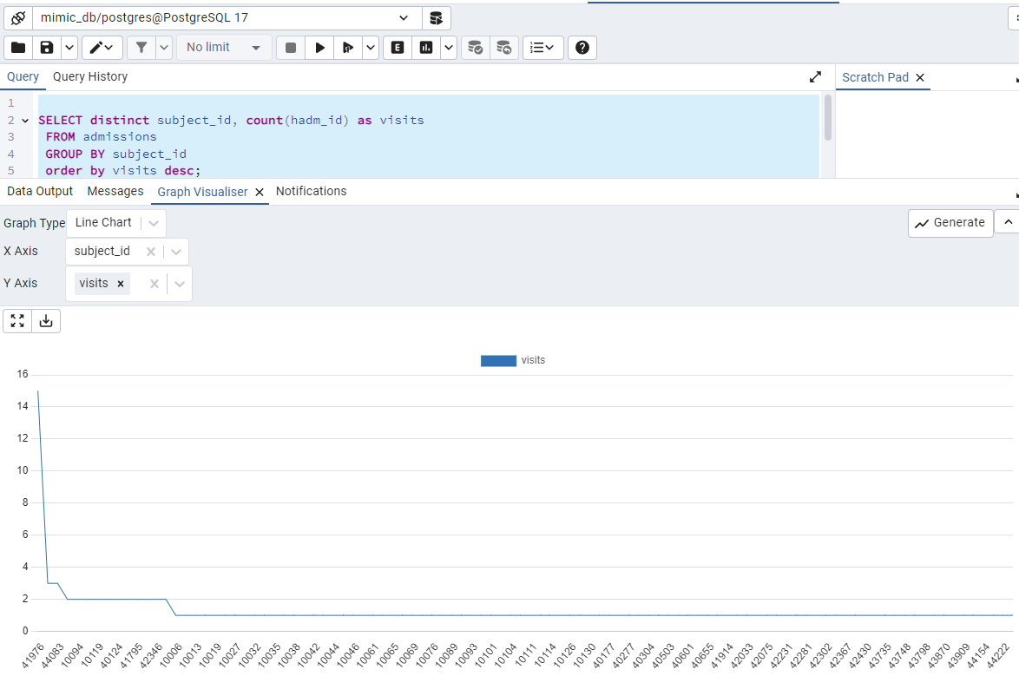
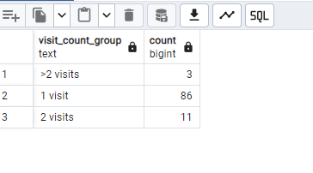
Step 2: Profile source table or tables
Very few subjects had two or more visits. Subject 41976 has 15 visits.
subject_id | Number of visits
41976 | 15
10088 | 3
44083 | 3
10059 | 2
10094 | 2
10117 | 2
10119 | 2
10124 | 2
40124 | 2
40310 | 2
41795 | 2
42135 | 2
42346 | 2
43881 | 2
Notes:
Use the White Rabbit data profiling Excel spreadsheet that is linked to the assignment to describe key profiling findings from the table or tables you identified in ETL Step 1. See rubric for the types of topics to include here.

Slide 11
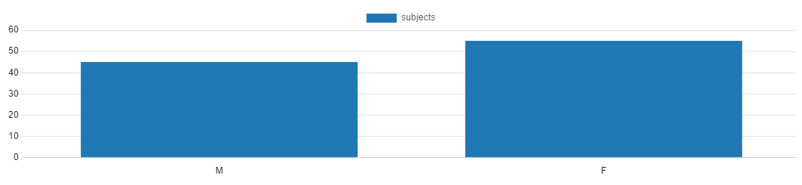
Step 2: Profile source table or tables
Number of subjects by Gender
gender | Number of subjects
M | 45
F | 55
Notes:
Use the White Rabbit data profiling Excel spreadsheet that is linked to the assignment to describe key profiling findings from the table or tables you identified in ETL Step 1. See rubric for the types of topics to include here.

Slide 12
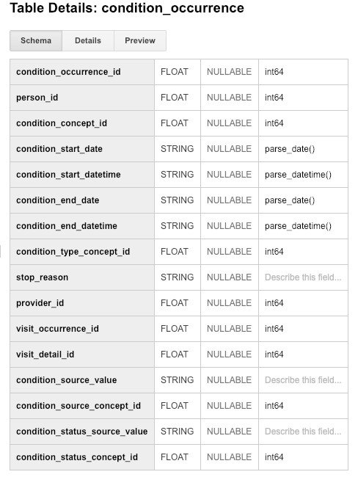
Step 3: Create ETL mappings
MIMIC TableName
subject_id
Hadm_id
Icd9_code
Row_id
Seq_num
Subject_id(int) data moved into person_id(int)
Hadm_id moved into visit_occurrence_id
Icd9_code(string) moved into condition_source_value(string).
No source data formatting was performed.
Technically icd9_code should have been formatted during the ETL.
Notes:
For each MIMIC table or tables (one table per slide) from Step 1, paste the screenshot of the MIMIC table on left side. Show field mappings from the MIMIC table to the OMOP CONDITION_OCCURRENCE table using arrows. Only provide mappings to the OMOP person_id, visit_occurrence_id, and condition_source_value. One MIMIC table may provide a mapping to all three OMOP tables as shown here.
Provide an explanation for each mapping why the MIMIC field relates to the OMOP field you selected on the slide

Slide 13
Step 4: Write transformation code
Paste the SQL statements that transform data from one or more MIMIC tables into the three OMOP CONDITION_OCCURRENCE fields (patient-id, visit_occurrence_id, condition_source_value) into the Coursera Submission Site
-- Extract data from DIAGNOSES_ICD table to for loading into the OMOP CONDITION_OCCURRENCE table
-- by SQL insert.
WITH
diag as (
select distinct mimic_db.subject_id as person_id
from DIAGNOSES_ICD m
),
CONDITION_OCCURRENCE as (
select d.person_id, mimic_db.HADM_ID as visit_occurrence_id,
mimic_db.ICD9_CODE as condition_source_value
from diag d
join DIAGNOSES_ICD m
on d.person_id = m.subject_id
)
Notes:
Paste the SQL statements that transform data in one or more MIMIC tables to the correct column or columns in OMOP CONDITION_OCCURRENCE into the Coursera Submission Site.

Slide 14
Step 5: Execute transformation code
Execute the ETL code from Step 4 but do not submit the output table.
Use the output table for Step 6.
There is no submission for this Step.
Notes:
Execute the ETL code from Step 4 but do not submit output table. Use output table for Step 6.
There is no submission for this Step.

Slide 15
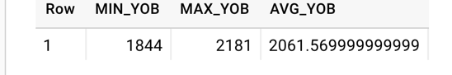
Step 6: Perform data quality assessment
Define, implement, execute one or more data quality measures.
Submit final DQ measure and an explanation why you created your measure(s).
Example output table from the Course 2 videos showing transformation of MIMIC PATIENTS to OMOP PERSON
OK to paste link to a GoogleDoc instead.
Notes:
Paste the output from your data quality SQL executed on the OMOP CONDITION_OCCURRENCE table generated in Step 5 into this slide.
OK to paste link to a GoogleDoc instead.

Slide 16
Step 6: Perform data quality assessment
select * from CONDITION_OCCURRENCE;
person_id | visit_occurrence_id | condition_source_value
-----------+---------------------+------------------------
10006 | 142345 | 99591
10006 | 142345 | 99662
10006 | 142345 | 5672
10006 | 142345 | 40391
10006 | 142345 | 42731
10006 | 142345 | 4280
select distinct subject_id as person_id, hadm_id as visit_occurrance_id,
icd9_code as condiction_source_value from diagnoses_icd;
person_id | visit_occurrance_id | condiction_source_value
-----------+---------------------+-------------------------
42066 | 171628 | 4275
10083 | 134993 | 27652
10035 | 110244 | 6000
40304 | 174997 | 32723
Output shows that the
ETL was successful
Notes:
Paste the output from your data quality SQL executed on the OMOP CONDITION_OCCURRENCE table generated in Step 5 into this slide.
OK to paste link to a GoogleDoc instead.

Slide 17
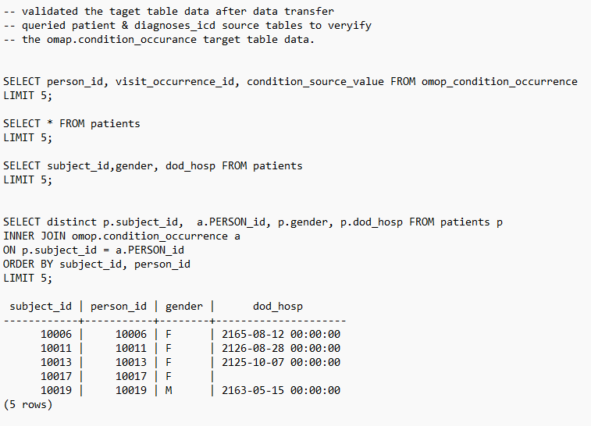
Step 6: Perform data quality assessment
Data validation shows that the ETL was successful
Notes:
Paste the output from your data quality SQL executed on the OMOP CONDITION_OCCURRENCE table generated in Step 5 into this slide.
OK to paste link to a GoogleDoc instead.

Slide 18
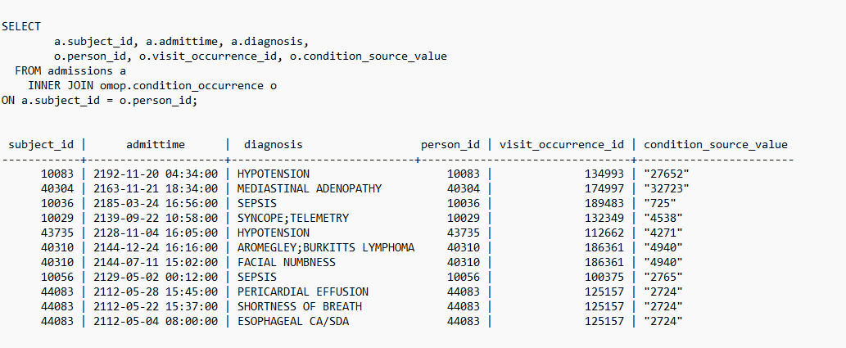
Step 6: Perform data quality assessment
Data validation shows that the ETL was successful
Notes:
Paste the output from your data quality SQL executed on the OMOP CONDITION_OCCURRENCE table generated in Step 5 into this slide.
OK to paste link to a GoogleDoc instead.

Slide 19
Step 7: Package documentation
Congratulations! The materials in the previous slides constitute a complete ETL package.
There is no submission for this Step.

