Slide 1
SCAPE
Rediscover Nature in Sydney's Bustling Metropolis
An Immersive, Experience-Driven Mapping and Blogging App

Slide 2
The Urban Exploration Dilemma
THE PROBLEM
• Scattered Information: Outdoor info is fragmented across travel blogs, social media, and navigation apps.
• Navigation vs. Experience: Traditional maps are designed for A-to-B driving navigation, not outdoor discovering.
• No Fitness or Amenity Context: Hard to find trails aligned to fitness levels, time constraints, or picnic needs.
• Disconnect from Nature: Students, tourists, and busy residents struggle to easily locate peaceful, restorative spaces nearby.
THE IMPACT & AUDIENCE
• Ineffective Planning: Users spend excessive hours planning hikes or outings, often ending up in crowded or unsuitable spots.
• Missed Local Attractions: Stunning trails (e.g., Bondi to Coogee, Royal National Park) are left unexplored due to lack of exposure.
• Target: Students & Youth
• Target: Tourists & New Residents

Slide 3
Introducing SCAPE: The Natural Escape App
OUR VISION: To bridge the gap between busy city life and Sydney's breathtaking natural landscapes through a visually calming, experience-focused web application.
AESTHETICS
Calming Nature Vibe
Designed with a serene color palette of light greens, blues, and pure white. Features high-quality blurred nature backgrounds to keep users relaxed while browsing.
EXPLORATION
Interactive Scenic Maps
Integrated Maplibre GL mapping focused on Sydney and its outskirts. Interactive sidebar listings sync directly with custom map pins for an experience-first exploration.
COMMUNITY
Community Stories
Built-in Nature Blogs & Stories platform. Users can write, upload, and read personal experiences and reviews to foster a community of outdoor enthusiasts.

Slide 4
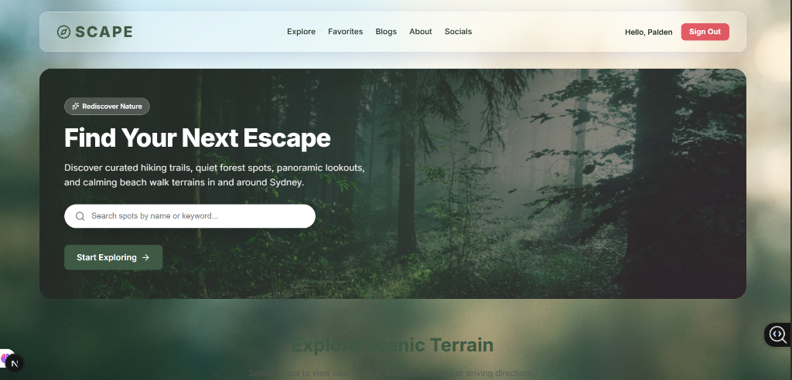
1. Immersive Home & Search Screen
Visual First Impression: Stunning blurred forest background creates a premium, grounding atmosphere right from the start.
Glassmorphism Header: Sleek navigation bar with modern blur effects containing quick links to Explore, Favorites, Blogs, About, and Socials.
Prominent Search Bar: Clean, rounded input centered in a translucent hero container allows users to quickly search spots by name or keyword.
Call-to-Action: A distinct green 'Start Exploring' button smoothly guides the user deeper into the interactive mapping interface.

Slide 5
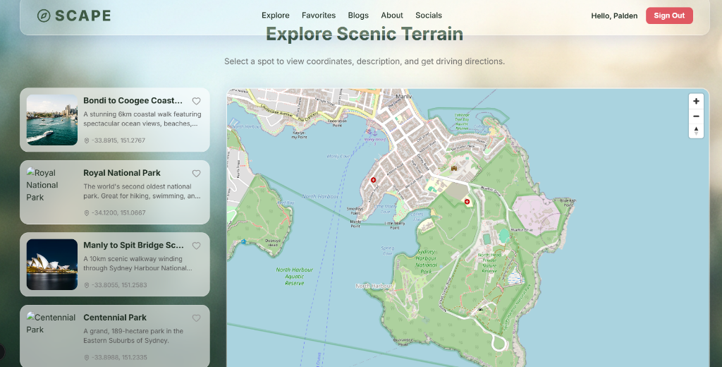
2. Interactive Scenic Terrain Explorer
Split-Screen Layout: A beautifully balanced dual-pane layout placing structured spot cards on the left and an expansive interactive map on the right.
Maplibre Map Integration: A custom high-performance map centered on Sydney, highlighting scenic trails, beaches, and parks via precise green and red coordinates.
Curated Terrains Sidebar: Includes descriptive cards for Sydney's top natural landmarks like Bondi to Coogee Coastal Walk, Royal National Park, Manly to Spit Bridge, and Centennial Park.
Seamless Synchronization: Selecting any location card in the sidebar instantly updates the map pin, provides exact GPS coordinates, and provides driving directions.

Slide 6
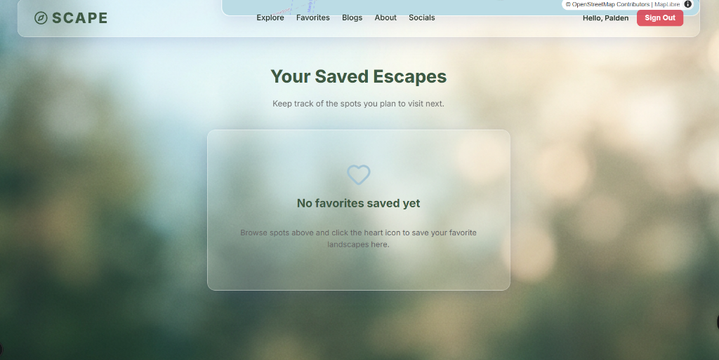
3. Your Saved Escapes (Favorites)
Personalized Planning: A dedicated space for users to keep track of their preferred destinations and organize future outdoor activities.
Translucent UI Elements: The favorites list resides inside an elegant glassmorphism container that floats beautifully over the blurred background.
Empty State Guidance: Clean, friendly heart illustration and simple helper text that instructs users how to save landscapes with a single click.
Heart Icon Toggle: Users can save or unsave spots on the fly directly from the main sidebar cards, synced in real-time.

Slide 7
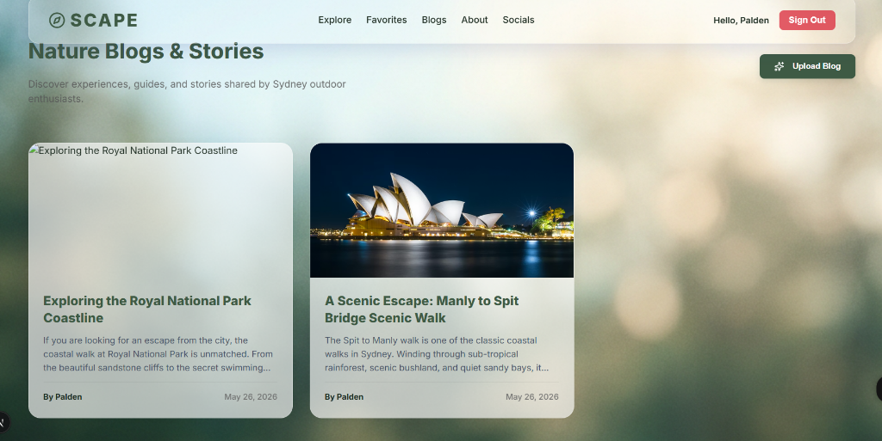
4. Nature Blogs & Shared Stories
Community Focus: Allows outdoor enthusiasts to share guides, safety tips, and personal memories of Sydney trails with others.
Responsive Cards Grid: Displays community posts in a modern card layout featuring high-resolution cover photos, descriptive headers, author names, and publication dates.
Upload Blog Flow: A prominent 'Upload Blog' button equipped with custom icons facilitates quick, painless blogging with photo uploads.
Dynamic Content: Empowers users to read detailed first-person experiences, such as traversing the Royal National Park cliffs or the scenic Manly coast.

Slide 8

5. Secure & Sleek Authentication
Premium Login Page: Minimalist and clutter-free form situated inside a floating frosted-glass card, avoiding intimidating corporate designs.
Input Aesthetics: Clean, modern form fields with subtle borders and clear placeholders for Email and Password.
Distinct Button Action: A solid dark-green call-to-action button anchored to the bottom, providing a satisfying hover and click feedback.
Alternative Options: Helpful sub-links for signing up new accounts and resetting lost passwords, ensuring no user is locked out.

Slide 9
Tech Stack & System Architecture
FRONTEND LAYER
• Framework: Next.js (React) in TypeScript for robust structure
• Styling: Vanilla CSS with glassmorphism variables & nature accents
• Theme: Grounding, nature-focused green & blue color palette
• Fonts: Clean, modern, responsive typography (Segoe UI/Inter)
MAPPING & API LAYER
• Map Engine: Maplibre GL for smooth vector tile rendering
• Basemaps: OpenStreetMap & Mapbox open layers
• Syncing: Client-side event syncing between sidebar lists & map pins
• Data Formats: GeoJSON for lightweight coordinate and path storage
BACKEND & DATA LAYER
• Server: Node.js Express & Next.js Serverless API endpoints
• Database: MySQL / SQLite (via Prisma schema)
• ORM: Prisma ORM for structured and rapid database queries
• Authentication: Secure password hashing & JWT cookie validation

Slide 10
Looking Ahead: Future of SCAPE
• Community Trails & Routes: Allow users to draw and submit custom hiking paths directly on the map.
• Mobile Companion App: Native iOS and Android versions using React Native for offline tracking and GPS alerts.
• Local Wildlife & Safety Data: Real-time alerts for weather, fire hazards, and flora/fauna information along trails.
• Social Group Hikes: Empower users to coordinate group outings and meetups directly through the platform.

