Slide 1
Critical questions to ask of studies,
press releases and scientific reports
NICAR 2015, Atlanta
Mar 6, 2015
Peter Aldhous
peter@peteraldhous.com
@paldhous

Slide 2
Some basic questions
What type of study?
  They are not all created equal
Was it peer-reviewed?
  If “yes,” be wary; if “no,” be very wary
Who paid for the work to be done?
  Studies have shown that it can make a difference to the reported findings

Slide 3
What type of study?
Confidence in the findings
Observational
Experimental
Double-blind, randomized controlled trial (RCT)
Systematic review/meta-analysis of RCTs

Slide 4
Was it peer reviewed?
“We portray peer review to the public as a quasi-sacred process that helps to make science our most objective truth teller. But we know that the system of peer review is biased, unjust, unaccountable, incomplete, easily fixed, often insulting, usually ignorant, occasionally foolish, and frequently wrong.”
Richard Horton, editor-in-chief, The Lancet

Slide 5
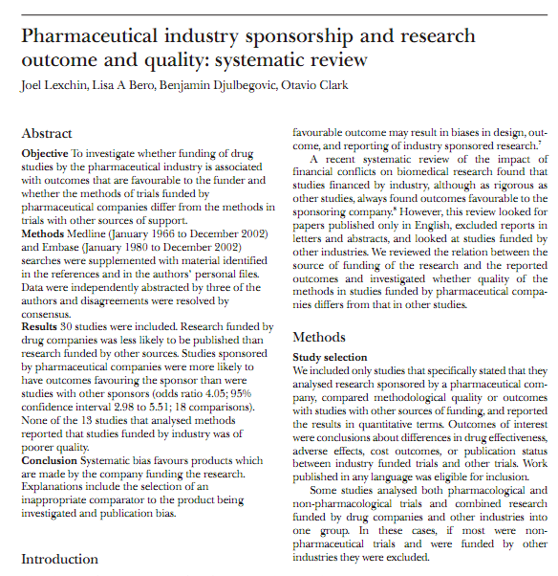
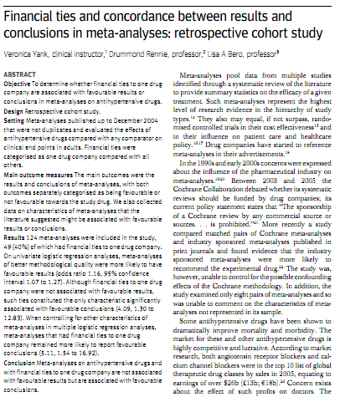
Who paid for the work to be done?

Slide 6
More questions
What was actually measured?
  Deaths from heart attack, or levels of “bad” cholesterol?
  (Also beware “mice cured” stories)
How large, and how long?
  Beware of small studies with short duration
Was the main finding statistically significant?
  The bar in many disciplines is low
How big was the effect?
  Or: How significant is this in the real world? You may need help with this …
Notes:
1 in 20 chance see these results if the null hypothesis correct.
if the Higgs Boson doesn't exist, that is the chance that coincidences would align to give results as striking is one in three and a half million – and they had two independed experiments

Slide 7
Questions for your expert sources
Do the results justify the conclusions?
Or is there an alternative explanation?
Was the analysis performed correctly?
Ask about flaws in statistical analysis or in the design of the study
How does this result fit with those from other studies?
How big is this effect?
Get them to help you put measures like “odds ratio,” “relative risk” and “number needed to treat” into phrases that everyone can understand.
(And don’t forget to ask all sources about their financial and other conflicts)

Slide 8
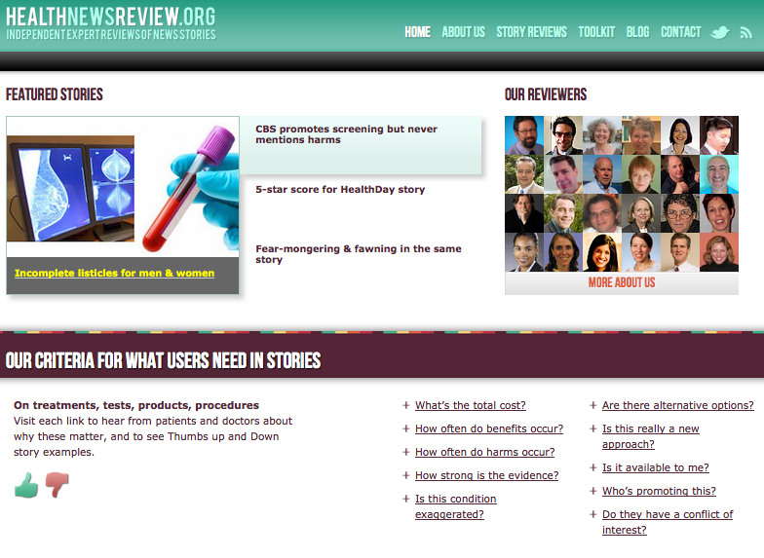
http://www.healthnewsreview.org//about-us/review-criteria/

Slide 9
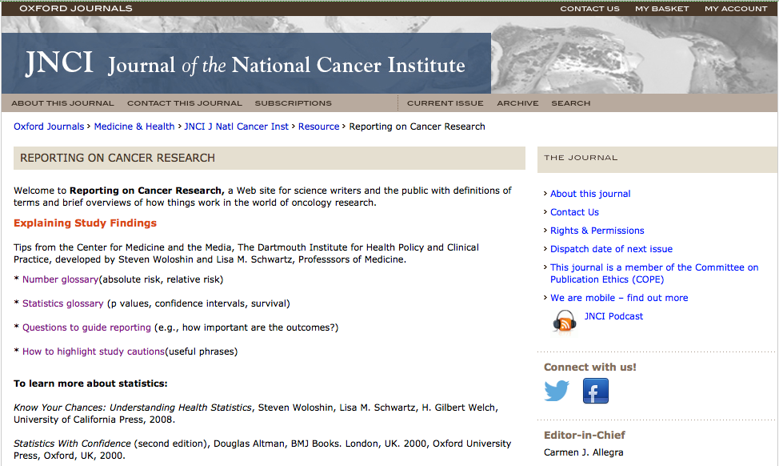
http://www.oxfordjournals.org/our_journals/jnci/resource/reporting_on_cancer.html

Slide 10
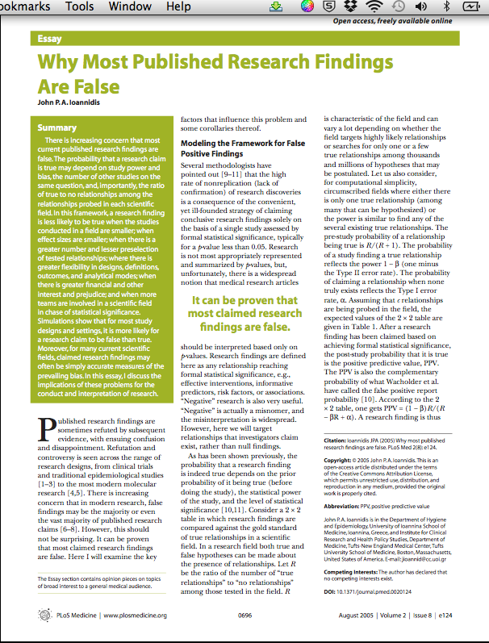
You should read this essay
(Even if you don’t show it to your editor)

Slide 11
Critical questions to ask of studies, press releases and scientific reports
NICAR 2015, Atlanta
Mar 6, 2015
Peter Aldhous
peter@peteraldhous.com
@paldhous

