Slide 1
Acquiring, cleaning and formatting data
Peter Aldhous
peter@peteraldhous.com
@paldhous
Notes:
Not so many years ago, data was hard to obtain. Often data journalists would have to painstakingly compile their own datasets from paper records, or make specific requests for electronic databases using freedom of information laws.
The Internet has changed the game. While those methods may still be needed, many government databases can now be queried online, and the results of those searches downloaded. Other public datasets can be downloaded in their entirety.
For data journalists, the main problem today is usually not finding relevant data, but in working out whether it can be trusted, spotting and correcting errors and inconsistencies, and getting it in the right format for analysis and visualization.
In this class, we will cover some tips and tricks for finding the data you need online, getting it onto your computer, and how to recognize and clean “dirty” data. We will also review some common data formats, and how to convert from one to another.

Slide 2
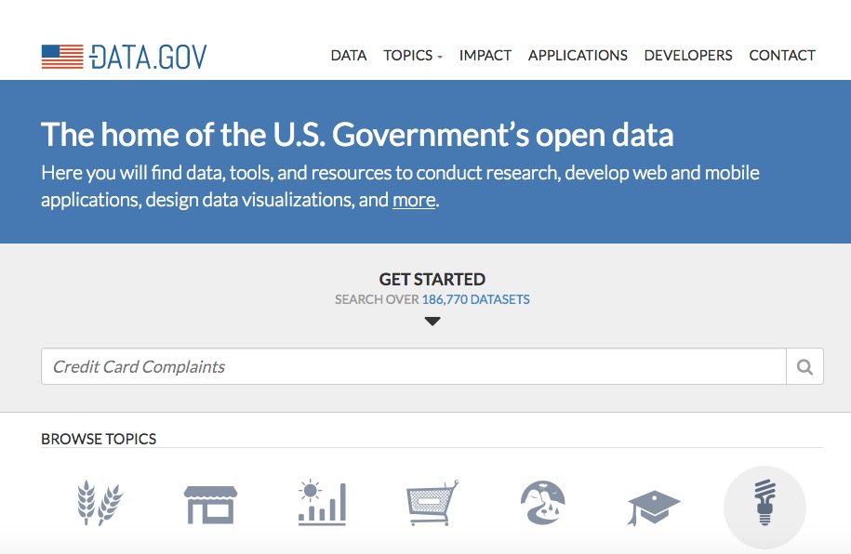
Data portals
Notes:
Life is much easier if you can find everything you need in one place. The main effort to centralize access to data by the U.S. federal government is Data.gov. You can search for data from the home page, or follow the Data and Topics links from the top menu.
Be warned, however, that Data.gov is a work in progress, and so far contains just a proportion of the U.S. government’s data. Some of the most useful datasets are still only available on the websites of individual federal agencies. FedStats is a good starting point for searching and browsing if you are unsure of which agency may hold the data you’re looking for.

Slide 3
Some federal agencies with useful data
U.S. Census Bureau: population, demographic, economic and other data, including trade and manufacturing statistics. The American FactFinder is especially useful for summary data about specific geographical areas..
Bureau of Labor Statistics: employment and unemployment, workplace injuries, time use, pay and consumer spending, including the Consumer Price Index, a key measure of inflation.

Slide 4
More federal agencies with useful data
Bureau of Justice Statistics: crime and law enforcement. The National Crime Victimization Survey, together with the Federal Bureau of Investigation’s Uniform Crime Reports national data on crime.
Centers for Disease Control and Prevention: The WONDER online databases provide information including causes of death. Other health datasets are available through the CDC’s National Center for Health Statistics.
National Oceanic and Atmospheric Administration: climate and weather, including forecasts, and historical records of hurricanes and other newsworthy severe weather events.

Slide 5
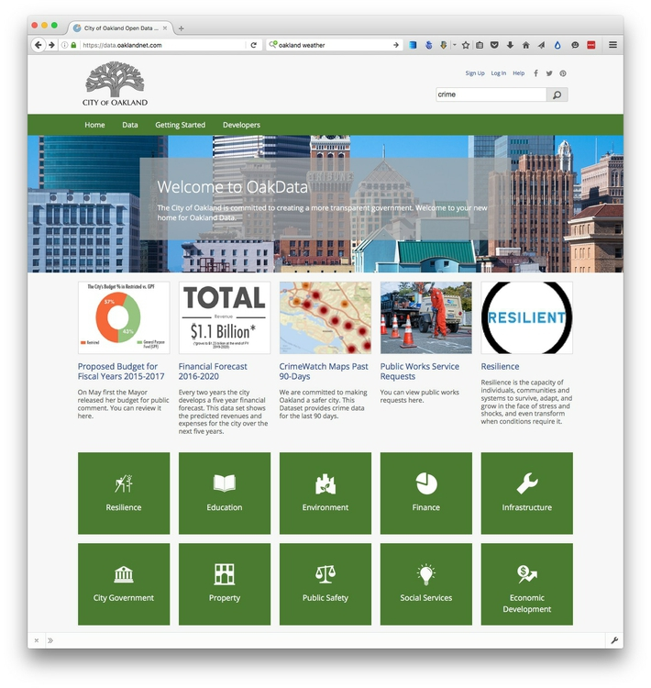
Data portals:
Local
Notes:
Other data portals at various levels of government are emerging. The City and County of San Francisco, for example, was at the forefront of the Open Data movement, establishing DataSF in 2009.

Slide 6
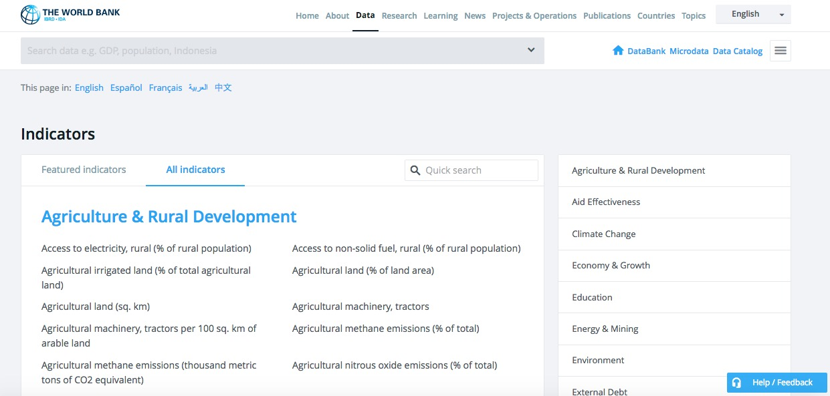
Data portals: International
Notes:
If you need to make comparisons between nations, the World Bank probably has what you need, its catalog containing data for more than 7,000 different measures, compiled by the bank and other UN agencies.
You can navigate the site using the “Find an indicator” search box or the By Topic link. When you click on a particular indicator, you are sent to a page that gives options to download the dataset from a link near the top right of the page. The data in some cases goes back as far as 1960, and is listed both by individual country and summarized by regions and income groups. We will work with some of this data in a later class.
Other useful sources of data for international comparisons are Gapminder and the
UN Statistical Division. For health data in particular, try the Organisation for Economic Co-operation and Development and the World Health Organization.

Slide 7
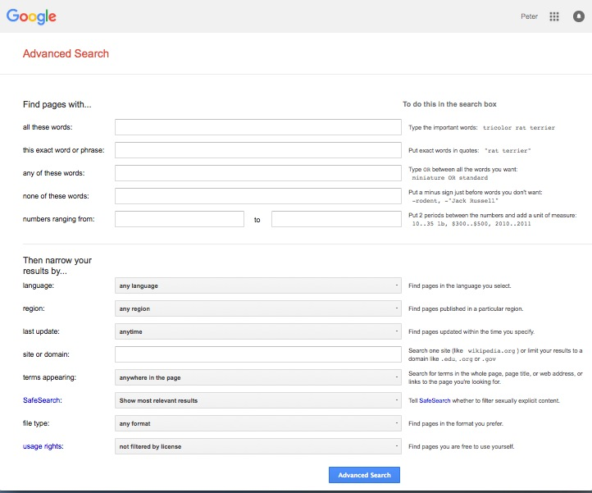
Google advanced search
Notes:
The options to search by site or domain and file type are can be very useful when looking for data. For example, the U.S. Geological Survey is the best source of data on earthquakes and seismic risk, so when searching for this information, specifying the domain usgs.gov would be a good idea. You can make the domains as narrow or broad as you like: .gov, for instance, would search a wide range of US government sites, while .edu would search the sites of all academic institutions using that top-level domain; journalism.berkeley.edu would search the web pages of the Berkeley J-School only.
The file type search offers a drop-down menu, with the options including Excel spreadsheets, and Google Earth KML and KMZ files. These are common data formats, but you are not limited to those on the menu. In a regular Google search, type a space after your search terms followed by filetype:xxx, where xxx is the suffix for the file type in question. For example, dbf will look for database tables in this format. Combining file type and domain searches can be a good way to find data an agency has posted online — some of which may not otherwise be readily accessible.
One common data format doesn’t show up file type searches. Geographical data is often made available as “shapefiles,” a format we will explore in our later mapping classes. Because they consist of multiple files that are usually stored in compressed folders, shapefiles can’t readily be searched using a file type suffix, but they can usually be found by adding the terms “shapefile” or “GIS data” to a regular Google search.

Slide 8
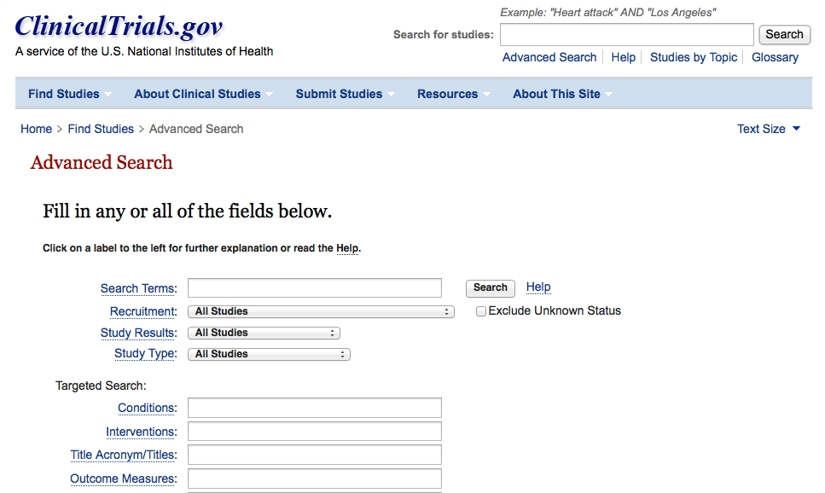
Search online databases
Notes:
Many important public databases can be searched online, and some offer options to download the results of your queries. Most of these databases give a simple search box, but it’s always worth looking for the advanced search page, which will offer more options to customize your search. Here, for example, is the advanced search page for ClinicalTrials.gov, a database of tests of experimental drugs and other medical treatments taking place in the U.S. and beyond:
When you start working with a new online database, take some time to familiarize yourself with how its searches work: Read the Help or FAQs, and then run test searches to see what results you obtain. Here, for example, is the “How To” section of ClinicalTrials.gov.
Many online databases can be searched using Boolean logic, which we touched upon in our database class, using the operators AND, OR and NOT to link search terms together. So find out how a particular database uses Boolean logic — and the default settings that it will use if you list search terms without any Boolean operators.
Putting search terms in quote marks often searches for a specific phrase. For example, searching for “heart attack” on ClinicalTrials.gov will give only give results in which those two words appear together; leaving out the quote marks will include any trial in which both words appear.
Also find out whether the database allows “wildcards,” symbols such as * or % that can be dropped into your search to obtain results with variations on a word or number. For example, in a database that may contain entries in both American and British English, you might use a wildcard to be sure you obtain results with both spelling variants, such as colo*r.
Look for download options — and know when you are hitting the wall
Having run a search on an online database, you will usually want to download the results, so look for the download links or buttons.
A common problem with online databases, however, is that they may impose limits on the number of results that are returned on each search. And even when a search returns everything, there may be a limit on how many of those results can be downloaded to your own computer.
If broad searches on a database keep returning the same number of results, that is a sign that you are probably running up against a search limit, and any download will not contain the complete set of data that you are interested in. However, you may be able to work out ways of searching to obtain all of the data in chunks.

Slide 9
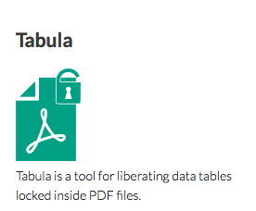
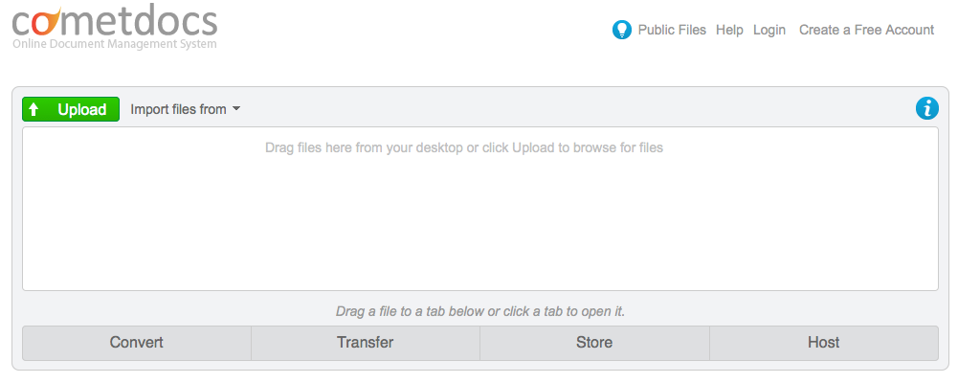
PDFs: the bane of data journalism
Notes:
Some organizations persist in making data available as PDFs, rather than text files, spreadsheets or databases. This makes the data hard to extract. While you should always ask for data in a more friendly format — ideally a simple text file — as a data journalist you are at some point likely to find yourself needing to pull data out of a PDF.
For digital PDFs, Tabula is a useful data extraction tool — however it will not work with PDFs created by scanning the original document, which have to be interpreted using Optical Character Recognition (OCR) software.
Also useful is the online service Cometdocs. While it is a commercial tool, members of Investigative Reporters and Editors can obtain a free account. Cometdocs can read scanned PDFs, however its accuracy will vary depending on how well the OCR works on the document in question.

Slide 10
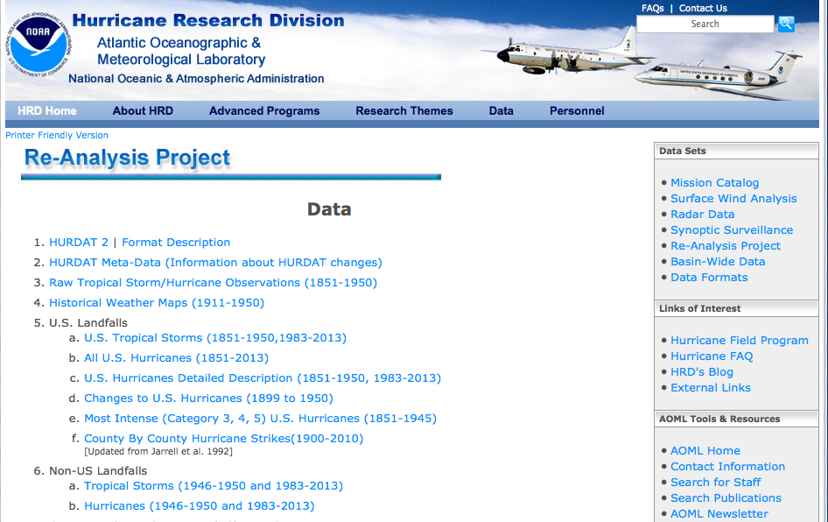
Can I trust this data?
Notes:
Having identified a possible source of data for your project, you need to ask: Is it reliable, accurate and useful? If you rush into analysis or visualization without considering this question, your hard work may be undermined by the maxim: “Garbage In, Garbage Out.”
The best rule of thumb in determining the reliability of a dataset is find out whether it has been used for analysis before, and by whom. If a dataset was put together for an academic study, or is actively curated so it can be made available for experts to analyze, you can be reasonably confident that it is as complete and accurate as it can be — the U.S. Geological Survey’s earthquake data is a good example.
While in general you might be more trusting of data downloaded from a .gov or .edu domain than something found elsewhere on the web, don’t simply assume that it is reliable and accurate. Be especially wary of databases that are compiled from forms submitted to government agencies, such as the Bioresearch Monitoring Information System (BMIS) database mentioned earlier.
Government agencies may be required by law to maintain databases such as BMIS, but that doesn’t mean that the information contained in them is wholly reliable. First, forms may not always be submitted, making the data incomplete. Second, information may be entered by hand from the forms into the database – and not surprisingly, mistakes are made.
So before using any dataset, do some background research to find out how it was put together, and whether it has been rigorously checked for errors. If possible, try to speak to the people responsible for managing the database, and any academics or other analysts who have used the data. They will be your best guide to a dataset’s strengths and weaknesses.
Even for well-curated data, make a point of speaking with experts who compile it or use it, and ask them about the data’s quirks and limitations. From talking with experts on hurricanes, for example, I know not to place too much trust in data on North Atlantic storms prior to about 1990, before satellite monitoring was well developed — even though the data available from NOAA goes back to 1851.
Always ask probing questions of a dataset before putting your trust in it. Is this data complete? Is it up-to-date? If it comes from a survey, was it based on a representative sample of people who are relevant to your project? Remember that the first dataset you find online may not be the most relevant or reliable.

Slide 11
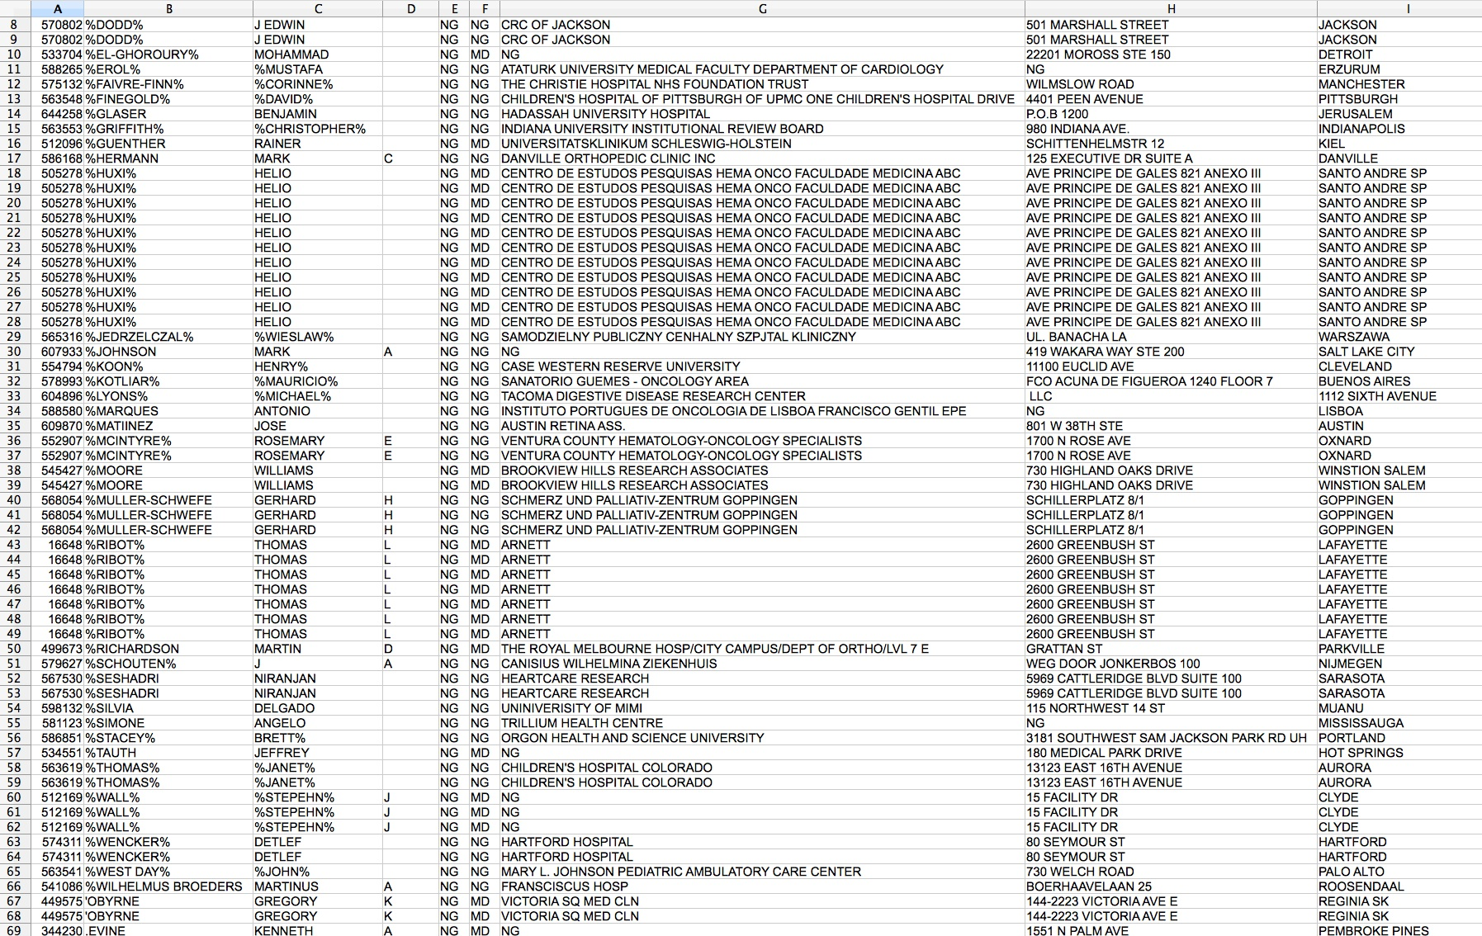
Recognize dirty data
Notes:
In an ideal world, every dataset we find would have been lovingly curated, allowing us to start analyzing and visualizing without worrying about its accuracy.
In practice, however, often the best available data has some flaws, which may need to be corrected as far as is possible. So before starting to work with a new dataset, load it into a spreadsheet or database and take a look for common errors. Here, for example, is a sample of records from the BMIS database, with names including non-alphabetical characters — which are clearly errors:
Look for glitches in the alignment of columns, which may cause data to appear in the wrong field.
For people’s names, look for variations in spelling, format, initials and accents, which may cause the same person to appear in multiple guises. Similar glitches may affect addresses, and any other information entered as text.
Some fields offer some obvious checks: if you see a zip code with less than 5 digits, for instance, you know it must be wrong.
Dates can also be entered incorrectly, so it’s worth scanning for those that fall outside the timeframe that should be covered by the data.
Also scan numbers in fields that represent continuous variables for any obvious outliers. These values are worth checking out. Are they correct, or did someone misplace a decimal point or enter a number in the wrong units?
Other common problems are white spaces before and after some entries, which may need to be stripped out.
At all stages of your work, pay attention to zeros. Is each one actually supposed to represent zero, or should the cell in fact be empty? Take particular care exporting data from one software tool and importing to another, and check how nulls have been handled.

Slide 12
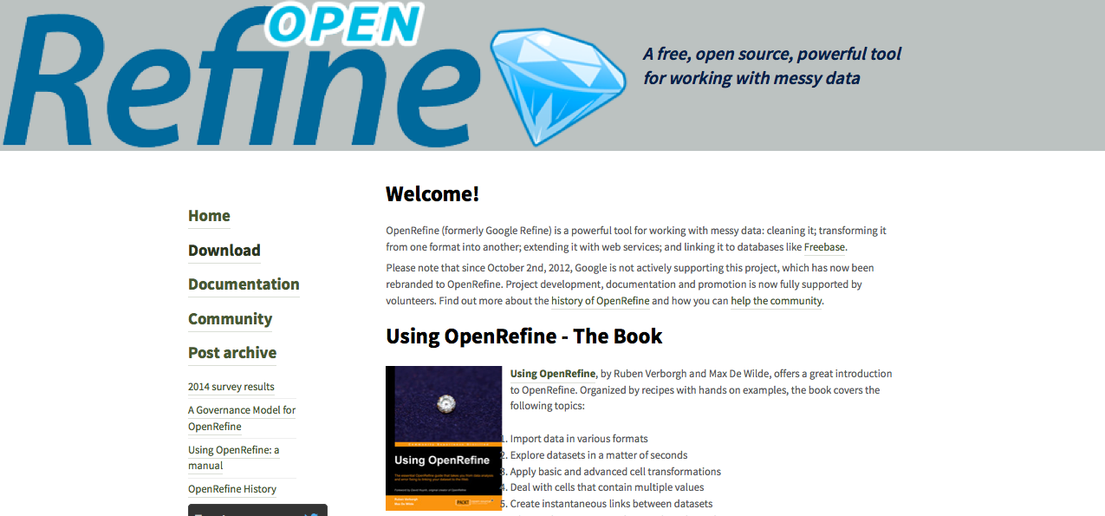
Clean and process data with Open Refine
Notes:
Checking and cleaning “dirty” data can be the most labor intensive part of many data journalism projects, but Open Refine (formerly Google Refine) can streamline the task — and also create a reproducible script to quickly repeat the process on data that must be cleaned and processed in the same way.
When you launch Open Refine, it opens in your web browser. However, any data you load into the program will remain on your computer — it does not get posted online.

Slide 13
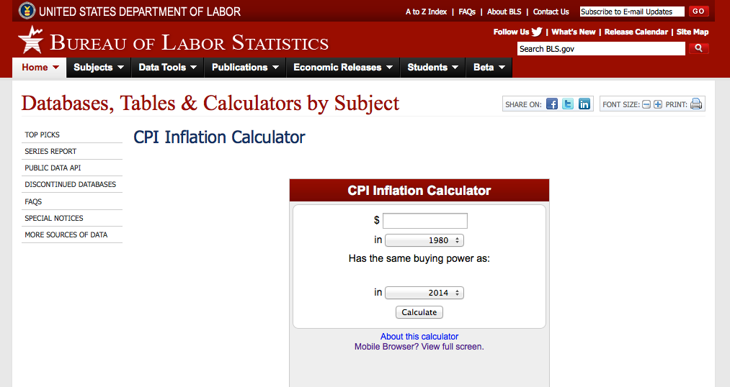
Correct for inflation
Notes:
So pay attention to whether currency values have already been corrected for inflation, or whether you will need to do so yourself. When correcting for inflation in the United States, the most widely-used method is the Consumer Price Index, or CPI, which is based on prices paid by urban consumers for a representative basket of goods and services. Use this online calculator for correcting a small number of values. If you need to correct for inflation in bulk, I can show you later how to do this in R.
For comparing currency values across nations, regions or cities, you may also need to correct for the cost of living — or differences in what a dollar can buy in different places. For World Bank indicators, look for the phrase “purchasing power parity,” or PPP, for data that includes this correction. PPP conversion factors for nations over time are given here.

Slide 14
Acquiring, cleaning and formatting data
Peter Aldhous
peter@peteraldhous.com
@paldhous

