Slide 1
Visualizing networks
Peter Aldhous
peter@peteraldhous.com
@paldhous

Slide 2
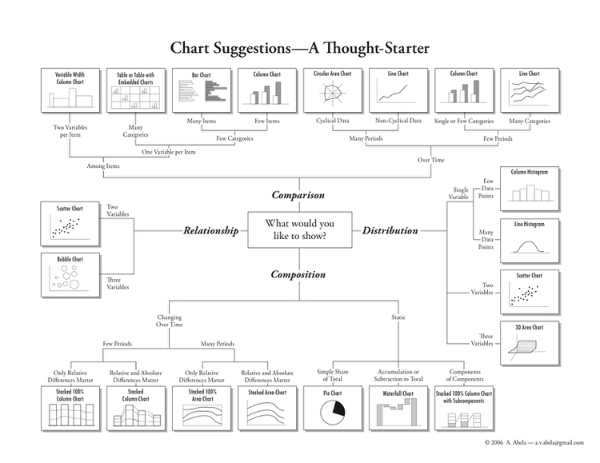
Missing answers
Notes:
Back in week 2, we addressed the question “Which chart type should I use?” by referring this this “chart of charts”. Its responses to the question “What would you like to show?” excluded two important responses: First, displaying the geographical distribution of data; and second, exploring connections between people and other entities.
We’ve spent the past three weeks working with maps, and today we will consider network graphs, which can be useful devices for understanding and visualizing all sorts of connections.

Slide 3
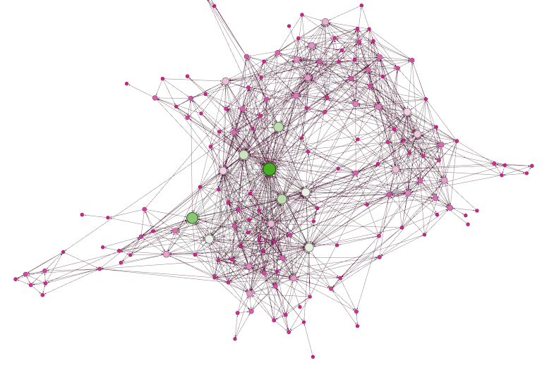
What is network analysis?
Visualizing and quantifying connections between people, organizations etc.
Network graphs consist of edges (the connections) and nodes (the entities connected)

Slide 4
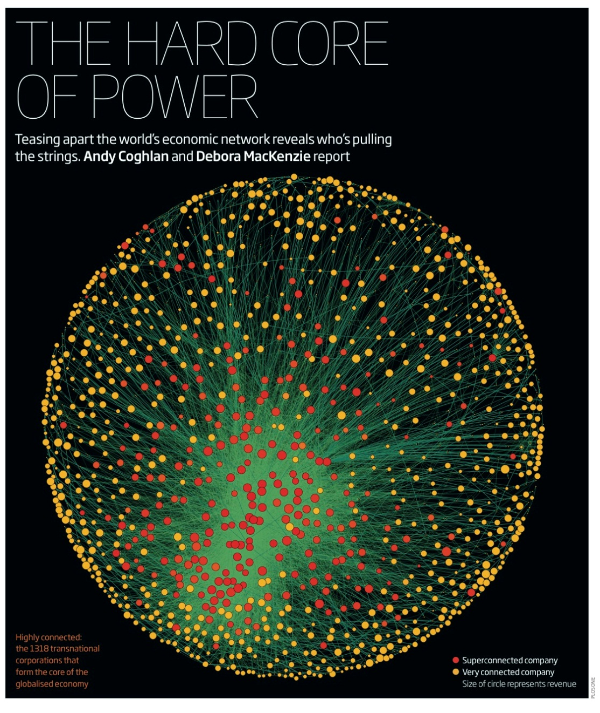
Who uses network analysis?
Researchers in many disciplines – it is being used to study everything from how networks of genes and proteins influence our health, to how connections between multinational companies affect the stability of the global economy:

Slide 5
OK, that sounds cool, but how can it help me?
Do any of these phrases sound familiar?
The problem with this city is that it’s run by X’s cronies.
Contracts in this town are all about kickbacks.
Follow the money!
It’s not what you know, it’s who you know.
Network analysis provides a means to display these and other connections in a way your audience (and your editors) can easily understand.
Notes:
Network graphs can also be used to great effect in journalism to explore and illustrate connections that are crucial to public policy, or directly affect the lives of ordinary people.
Do any of these phrases have resonance for you?
The problem with this city is that it’s run by X’s cronies.
Contracts in this town are all about kickbacks.
Follow the money!
It’s not what you know, it’s who you know.
If so, and you can gather relevant data, network graphs can provide a means to display the connections involved in a way that your audience (and your editors) can readily understand.

Slide 6
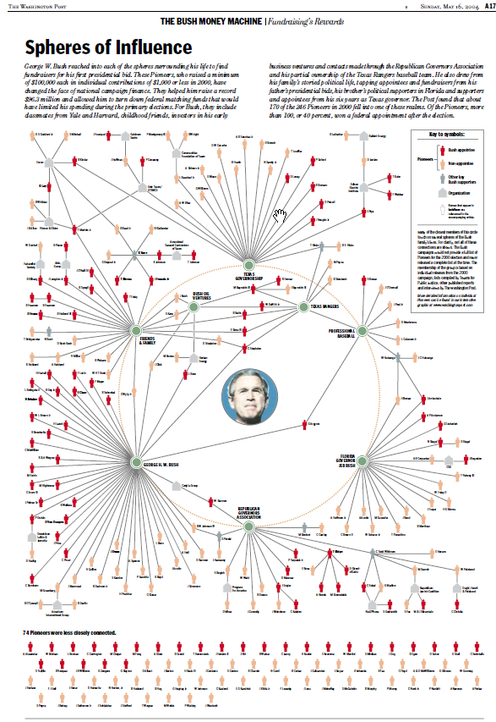

A classic example
Data: Built database of George W. Bush “Pioneers” – those who raised more than $100,000 to his 2000 presidential campaign.
Findings: Network showed who were the key Pioneers in the Bush campaign, who they were connected to, and what each Pioneer gained, if anything, from his or her association with Bush, such as ambassadorships and other federal appointments. Bush raised $96.3 million, a record at that time. More than 100, about 40%, of the Pioneers received some federal appointment after the election.
Notes:
Back in 2004, for instance, The Washington Post used this network graph to explore the connections among George W. Bush’s “Pioneers” — those who raised more than $100,000 for his 2000 presidential election campaign.
The network graph showed who the Pioneers were, and how they were connected to Bush, his professional and political interests, and other members of his family. The Post also found that 40% of these influential fundraisers received some sort of federal appointment after the election.

Slide 7
Is it difficult?
  At its simplest level, network analysis is very intuitive.
  Some basics:
  Networks can be undirected (e.g. X and Y went to the same school) or directed (e.g. donor X gave money to candidate Y).
  Network theorists have devised layout algorithms to draw network graphs; you can also lay out your network manually.
Notes:
At its simplest level, network analysis is very straightforward. Network graphs consist of edges (the connections) and nodes (the entities that are connected).
One important consideration is whether the network is “directed,” “undirected,” or a mixture of the two. This depends upon the nature of the connections involved. If you are documenting whether people are Facebook friends, for instance, and have no information who made the original friend request, the connections have no obvious direction. But when considering following relationships on Twitter, there is a clear directionality to each relationship: A fan might follow Taylor Swift, for example, but she probably doesn’t follow them back.

Slide 8
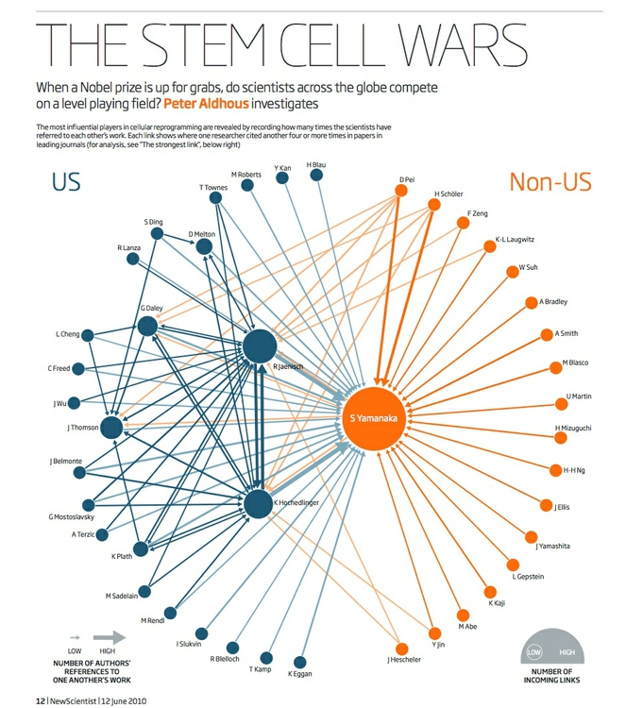
Directed vs undirected
Notes:
The connections in undirected graphs are typically represented by simple lines or curves, while directed relationships are usually represented by arrows.
On the right, I used a directed network graph to illustrate patterns of citation of one another’s work by researchers working on a type of stem cell that later won their discoverer a Nobel prize. Notice that in some cases there are arrows going in both connections, because each had frequently cited the other:

Slide 9
Encoding data in nodes and edges
Notes:
Nodes and edges can each have data attached to them. In the Bush fundraising network, whether or not the fundraiser was later appointed to a federal government job was a qualitiative variable used to give each individual a color. Notice also that some of the nodes in the network were not people, but organizations — another qualitative variable that was represented by the nodes’ shape.
If the Post had desired, it could also have scaled the size of each Pioneer by the continuous variable of how much money that fundraiser provided to Bush’s campaign.
Edges can similarly be associated with qualitative and quantitative variables. In my stem cell citation network, the edges were colored according to the qualitative variable of the location (United States, or elsewhere) of the citing and cited scientists. The thickness of each edge was drawn in proportion to the quantitative variable of the number of citations involved.
I also used that same quantitative variable to filter and simplify the network, only drawing a connection between two scientists if one had cited the other’s work at least four times.

Slide 10
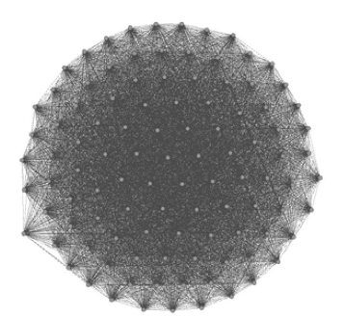
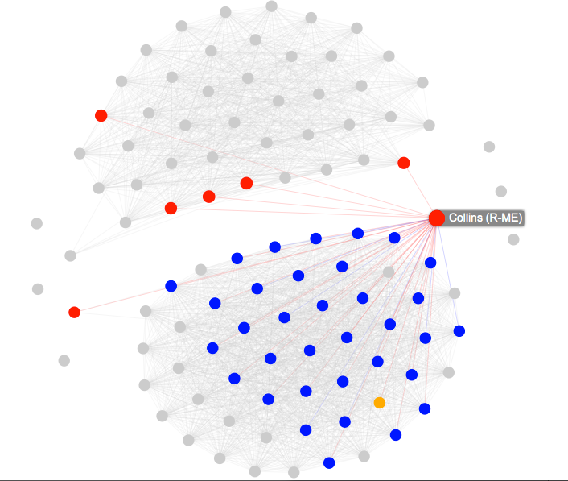
Avoiding the hairball
From this …
… to this
Notes:
Filtering networks based on some aspect of the data is often necessary to reveal their core structure and dynamics. This addresses what network theorists call the “hairball” problem: networks that are hard to understand because of their proliferation of connections.
How do you decide how to filter a network? There is no one-size-fits-all, right-or-wrong answer. My advice, in these circumstances, is to view network analysis as an exploratory tool: Sketch and experiment with different ways of visualizing and filtering a network, to see what stories emerge. When presenting the results to your audience, explain in simple terms how you filtered the data, so you do not mislead.

Slide 11
The science bit: network metrics
Degree is a simple count of the number of connections for each node. For directed networks, it is divided into In-degree, for the number of incoming connections, and Out-degree, for outgoing connections.
Eigenvector centrality accounts not only for the node’s own degree, the also the degrees of the nodes to which it connects. As such, it is a measure of each node’s wider “influence” within the network.
Betweenness centrality essentially reveals how important each node is in providing a “bridge” between different parts of the network. It counts the number of times each node appears on the shortest path between two other nodes –
highlighting the nodes that, if removed, would cause a network to fall apart.
Closeness centrality is a measure of how close each node is, on average, to all of the other nodes in a network. It highlights the nodes that connect to the others through a lower number of edges – think Kevin Bacon Game.
Notes:
There are also a series of metrics that can quantify aspects of a network. Here are some examples, which measure the importance of nodes within a network in slightly different ways:
Degree is a simple count of the number of connections for each node. For directed networks, it is divided into In-degree, for the number of incoming connections, and Out-degree, for outgoing connections. (In my stem cell citation network, In-Degree was used to set the size of each node.)
Eigenvector centrality accounts not only for the node’s own degree, but also the degrees of the nodes to which it connects. As such, it is a measure of each node’s wider “influence” within the network. Google’s PageRank algorithm, which rates the importance of web pages according the the links they recieve, is a variant of this measure.
Betweenness centrality essentially reveals how important each node is in providing a “bridge” between different parts of the network: It counts the number of times each node appears on the shortest path between two other nodes. It is particularly useful for highlighting the nodes that, if removed, would cause a network to fall apart.
Closeness centrality is a measure of how close each node is, on average, to all of the other nodes in a network. It highlights the nodes that connect to the others through a lower number of edges. The Kevin Bacon Game, in which you have to connect Bacon to other movie actors through the fewest number of movies, based on co-appearances, works because he has a high closeness centrality in this network.

Slide 12
Visualizing networks
Peter Aldhous
peter@peteraldhous.com
@paldhous

