Slide 1

IE 501: Optimization Models Network Flow Models for Optimal Survey Sampling and Fieldwork Allocation
Submitted By:
Dipendu Pal 25N0465
Under Guidance of
Prof. Vishnu Narayanan
Department of Industrial Engineering and Operations Research

Slide 2
Introduction:
In many real surveys, like household surveys or opinion polls, we have to collect data from different types of people or different regions. Usually, the population is divided into groups such as Urban/Rural, different zones, income groups, etc. These groups are called strata.
From statistics, we know that it is better to take more samples from the groups that vary a lot. This idea leads to a method called stratified sampling, and the formula for the best sample sizes is called Neyman allocation. It tells us exactly how many people should be taken from each group if we want the survey to be as accurate as possible.
But this ideal plan is not always possible in real life. Survey teams have limited capacity, travel might be expensive, and some areas are harder to reach than others. So even if statistics tells us the “best” sample size for each group, we still need a practical plan to assign field teams to those groups.
To solve this practical part, we can use a method from optimization called network flow. The idea is simple:
Teams are like “sources” of work
Strata are “destinations”
Interviews are like “flow units” moving from teams to strata
Every team has a maximum capacity
Each team has a cost for working in each stratum
Using these, we can find the cheapest and most feasible plan to collect the required number of samples.
This project shows how to combine both ideas — statistics for accuracy and optimization for practical feasibility.

Slide 3
Background Concepts:
Stratified Sampling Instead of taking samples randomly from the whole population, we divide the population into groups (strata).Then we take samples from each group separately. This reduces the overall error of the survey. Neyman Allocation This formula tells us how many samples to take from each group. It gives more weight to groups that: have a large population, have high variation. This allocation gives the minimum variance for the estimator.
Practical Fieldwork Problems Even if we know the ideal number of samples: Some teams cannot work in certain areas, Travel costs differ, Teams have capacity limits, Some strata take more effort So, the ideal plan must be adjusted.
Network Flow A network flow model helps us plan who should work where: Each team is a supply node, Each stratum is a demand node, Flow represents number of interviews, Costs are added for each assignment. The goal is to assign teams to strata in a way that: Matches the required sample sizes, Stays within team capacity, Minimizes total cost

Slide 4
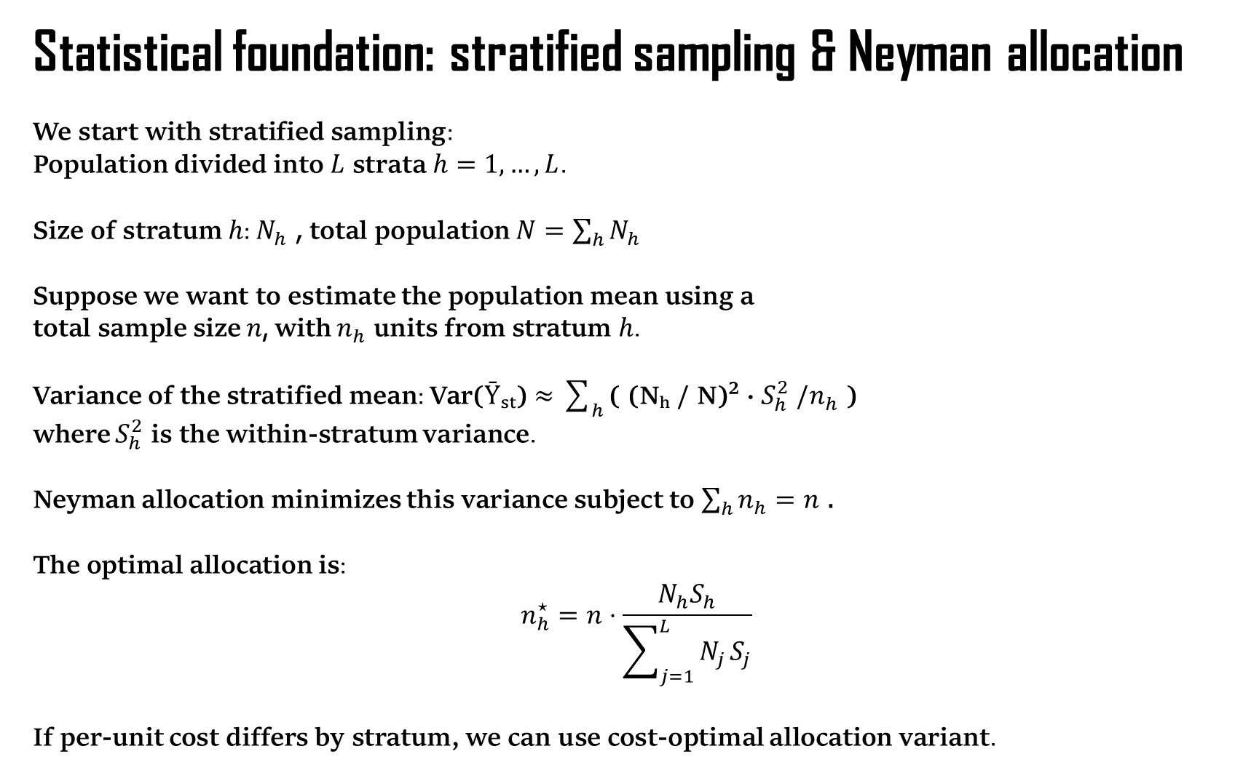
Statistical foundation: stratified sampling & Neyman allocation
We start with stratified sampling:
Population divided into $L$ strata $h=1,…,L$.
Size of stratum $h$: $N_{h}$, total population $N=\sum_{h}{N_{h}}$
Suppose we want to estimate the population mean using a total sample size $n$, with $n_{h}$ units from stratum $h$.
Variance of the stratified mean: Var(Ȳₛₜ) $≈$ $\sum_{h}{\text{( (}\text{N}\text{ₕ / }\text{N}\text{)}\text{² }\text{· }S_{h}^{2}\text{ /}n_{h}\text{ )}}$
where $S_{h}^{2}$ is the within-stratum variance.
Neyman allocation minimizes this variance subject to $\sum_{h}{n_{h}}=n$.
The optimal allocation is:
$$n_{h}^{⋆}=n⋅\frac{N_{h}S_{h}}{\sum_{j=1}^{L}{N_{j}}S_{j}}$$
If per-unit cost differs by stratum, we can use cost-optimal allocation variant.

Slide 5
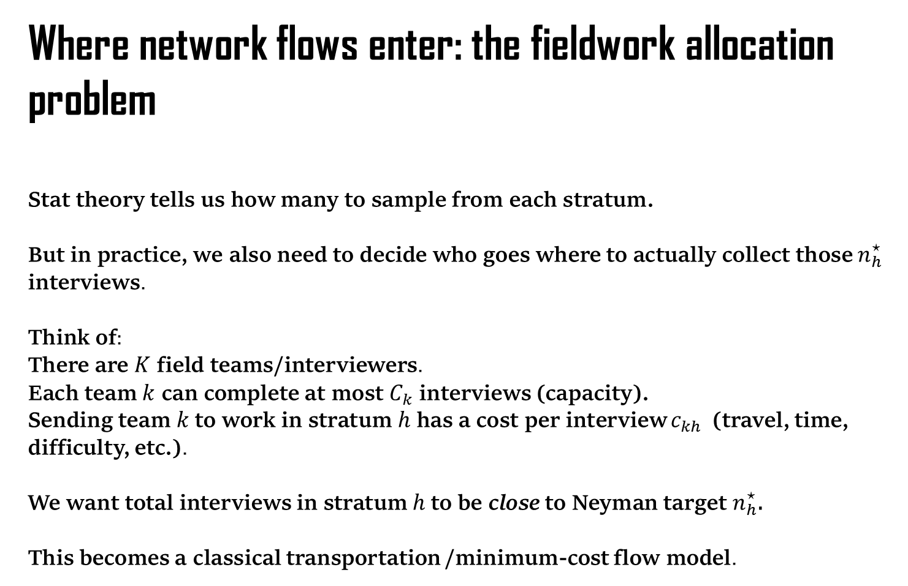
Where network flows enter: the fieldwork allocation problem
Stat theory tells us how many to sample from each stratum.
But in practice, we also need to decide who goes where to actually collect those $n_{h}^{⋆}$ interviews.
Think of:
There are $K$ field teams/interviewers.
Each team $k$ can complete at most $C_{k}$ interviews (capacity).
Sending team $k$to work in stratum $h$ has a cost per interview $c_{kh}$ (travel, time, difficulty, etc.).
We want total interviews in stratum $h$to be close to Neyman target $n_{h}^{⋆}$.
This becomes a classical transportation /minimum-cost flow model.

Slide 6
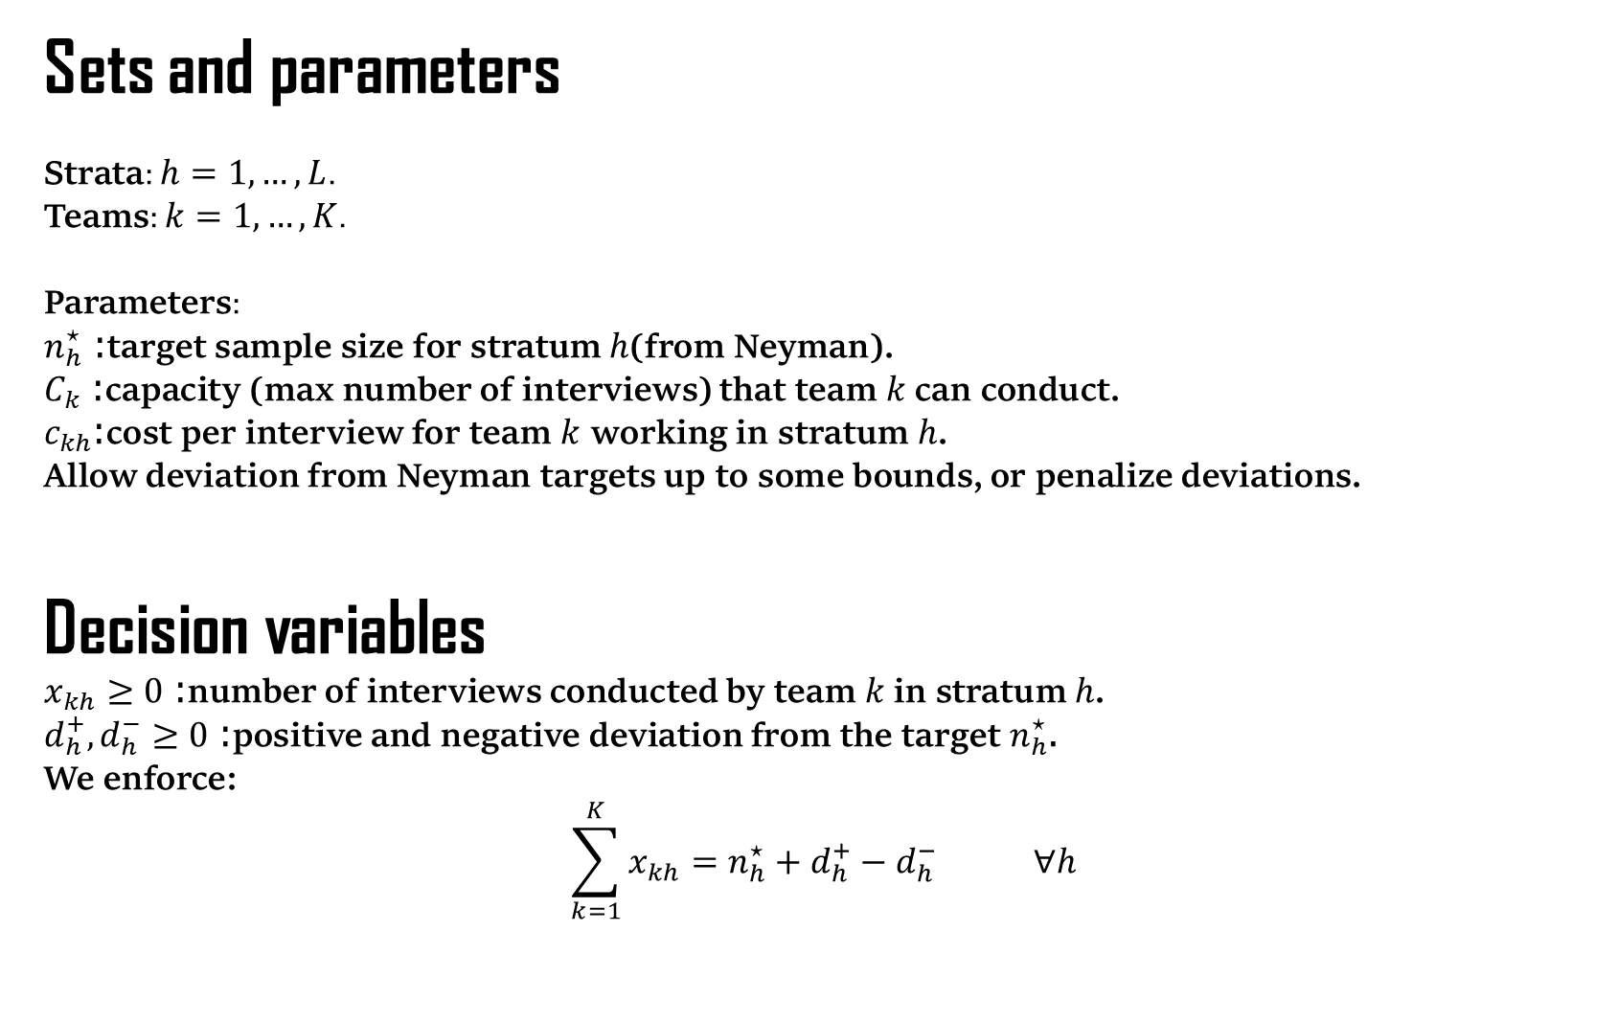
Sets and parameters
Strata: $h=1,…,L$.
Teams: $k=1,…,K$.
Parameters:
$n_{h}^{⋆}$: target sample size for stratum $h$(from Neyman).
$C_{k}$: capacity (max number of interviews) that team $k$can conduct.
$c_{kh}$:cost per interview for team $k$ working in stratum $h$.
Allow deviation from Neyman targets up to some bounds, or penalize deviations.
Decision variables
$x_{kh}≥0$: number of interviews conducted by team $k$in stratum $h$.
$d_{h}^{+},d_{h}^{−}≥0$: positive and negative deviation from the target $n_{h}^{⋆}$.
We enforce:
$$\sum_{k=1}^{K}{x_{kh}}=n_{h}^{⋆}+d_{h}^{+}−d_{h}^{−} ∀h$$

Slide 7
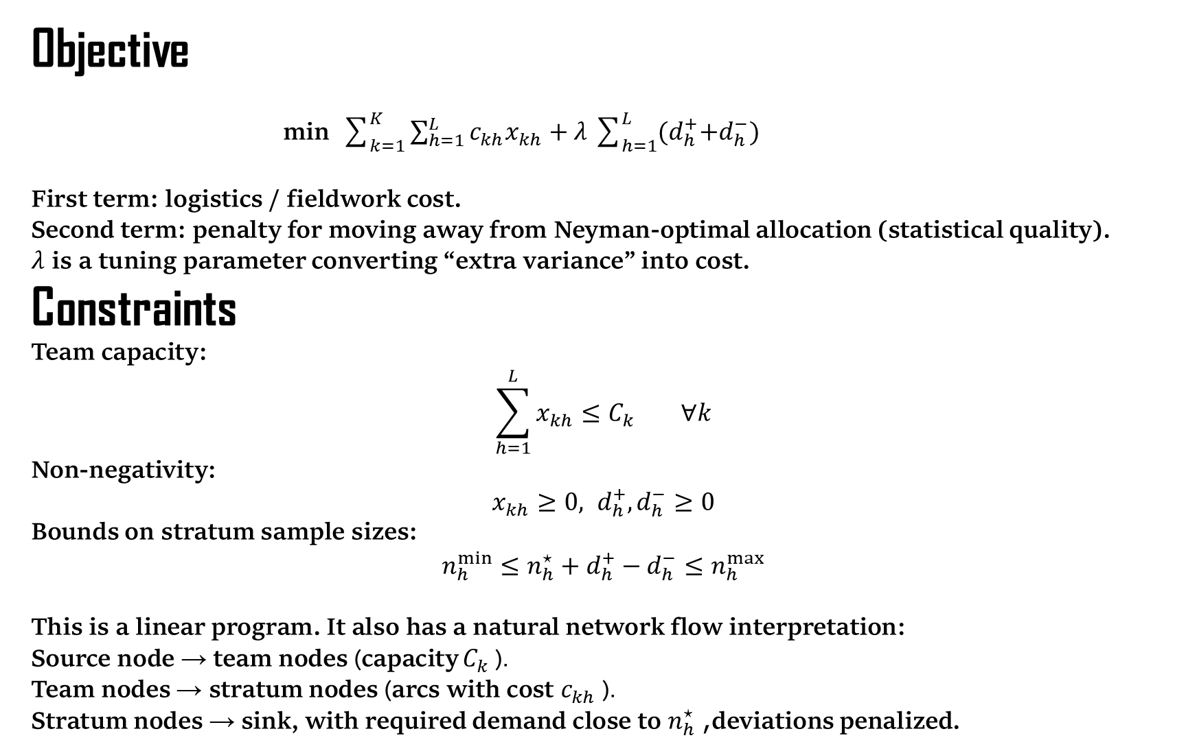
Objective
min $\sum_{k=1}^{K}{\sum_{h=1}^{L}{c_{kh}x_{kh}}}+λ\sum_{h=1}^{L}{{(d}_{h}^{+}+d_{h}^{−}) }$
First term: logistics / fieldwork cost.
Second term: penalty for moving away from Neyman-optimal allocation (statistical quality).
$λ$ is a tuning parameter converting “extra variance” into cost.
Constraints
Team capacity:
$$\sum_{h=1}^{L}{x_{kh}}≤C_{k} ∀k$$
Non-negativity:
$$x_{kh}≥0, d_{h}^{+},d_{h}^{−}≥0$$
Bounds on stratum sample sizes:
$$n_{h}^{min}≤n_{h}^{⋆}+d_{h}^{+}−d_{h}^{−}≤n_{h}^{max}$$
This is a linear program. It also has a natural network flow interpretation:
Source node → team nodes (capacity $C_{k}$ ).
Team nodes → stratum nodes (arcs with cost $c_{kh}$ ).
Stratum nodes → sink, with required demand close to $n_{h}^{⋆}$, deviations penalized.

Slide 8
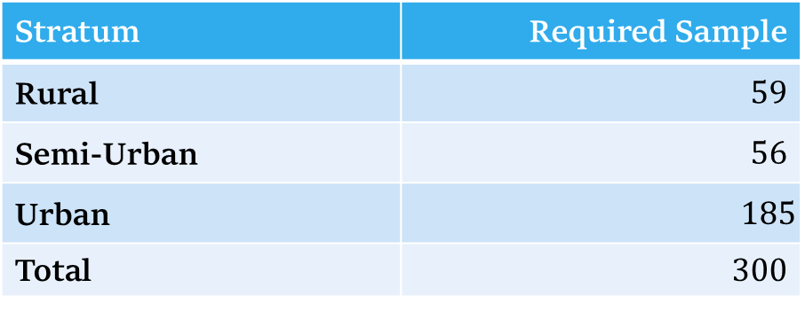
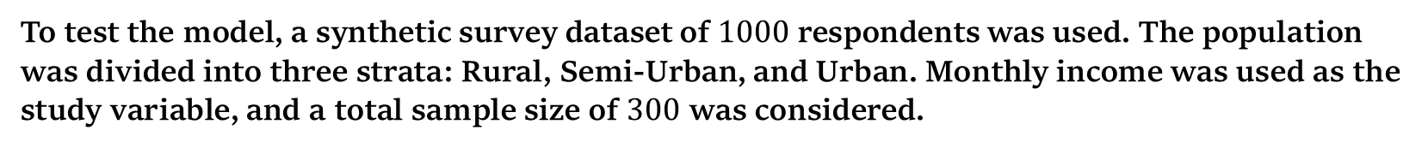

Computational Experiment
To test the model, a synthetic survey dataset of $1000$ respondents was used. The population was divided into three strata: Rural, Semi-Urban, and Urban. Monthly income was used as the study variable, and a total sample size of $300$ was considered.
Using Neyman allocation, the required samples were:
Stratum | Required Sample
Rural | $59$
Semi-Urban | $56$
Urban | $$185$$
Total | $300$
Thus, the Neyman allocation was
$$\left(59,56,185\right)$$

Slide 9

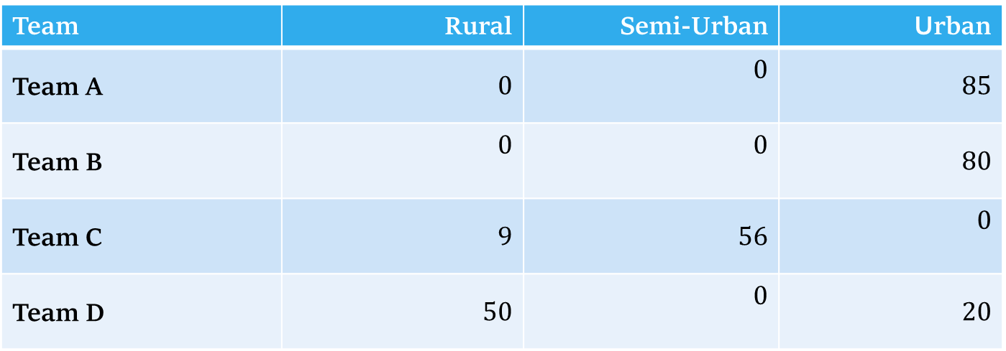
Optimal Fieldwork Allocation
The minimum-cost flow model was solved using PuLP and also implemented using Pyomo for comparison.
The optimal allocation was:
Team | Rural | Semi-Urban | Urban
Team A | $0$ | $0$ | $85$
Team B | $0$ | $0$ | $80$
Team C | $9$ | $56$ | $0$
Team D | $50$ | $0$ | $20$
The total sample requirements are exactly satisfied:
Rural =$59,$ Semi-Urban =$56,$ Urban =$185$.
The minimum fieldwork cost was: $6053.83$

Slide 10
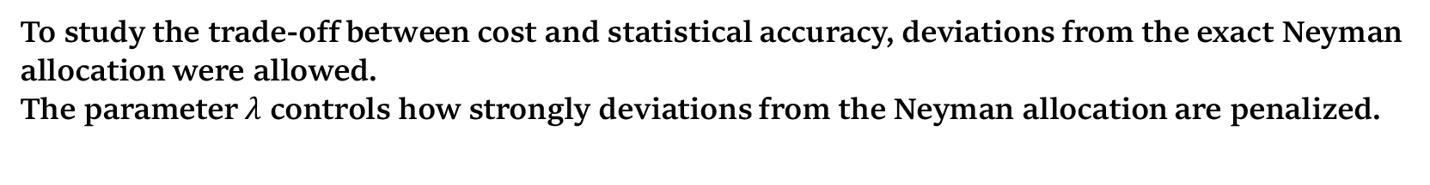
Effect of Team Capacity
A sensitivity analysis was carried out by changing the available interview capacity of the field teams.
The results show that increasing team capacity reduces the minimum fieldwork cost. With more available capacity, the optimization model has greater freedom to assign interviews to lower-cost team-stratum combinations.
Flexible Neyman Allocation
To study the trade-off between cost and statistical accuracy, deviations from the exact Neyman allocation were allowed.
The parameter $λ$ controls how strongly deviations from the Neyman allocation are penalized.

Slide 11
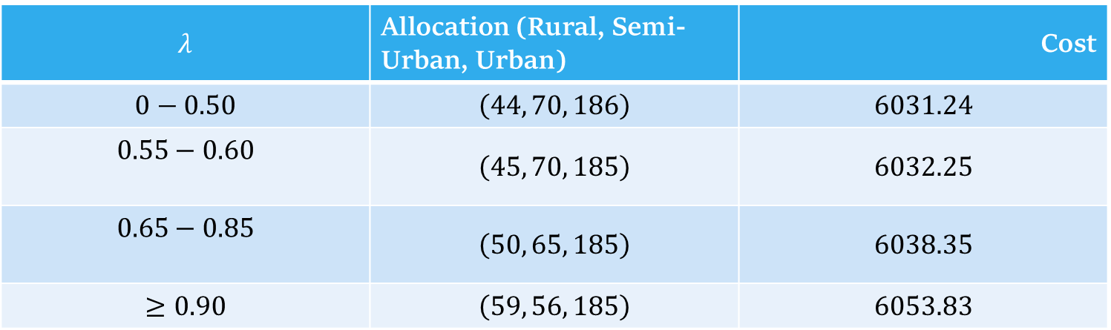
The main results were:
$$λ$$ | Allocation (Rural, Semi-Urban, Urban) | Cost
$$0−0.50$$ | $$\left(44, 70, 186\right)$$ | $$6031.24$$
$$0.55−0.60$$ | $$\left(45, 70, 185\right)$$ | $$6032.25$$
$$0.65−0.85$$ | $$\left(50, 65, 185\right)$$ | $$6038.35$$
$$≥0.90$$ | $$\left(59, 56, 185\right)$$ | $$6053.83$$
As $λ$increases, the solution gradually moves toward the Neyman allocation.
In the tested values, $λ=0.90$ was the smallest value that produced the exact Neyman allocation.

Slide 12
Statistical Precision of the Allocation
The variance of the stratified mean estimator was calculated for each optimized allocation.
For the exact Neyman allocation,
Var(Ȳₛₜ)$=752660.94$
For the cheapest allocation $\left(44, 70, 186\right)$,
Var(Ȳₛₜ)$=783085.85$
which is about $4.04$% higher than the Neyman benchmark.
For the intermediate allocation $\left(50, 65, 185\right)$, the variance increase was only about $1.46$% .
Therefore, reducing fieldwork cost is possible, but it comes with some loss of statistical precision.

Slide 13
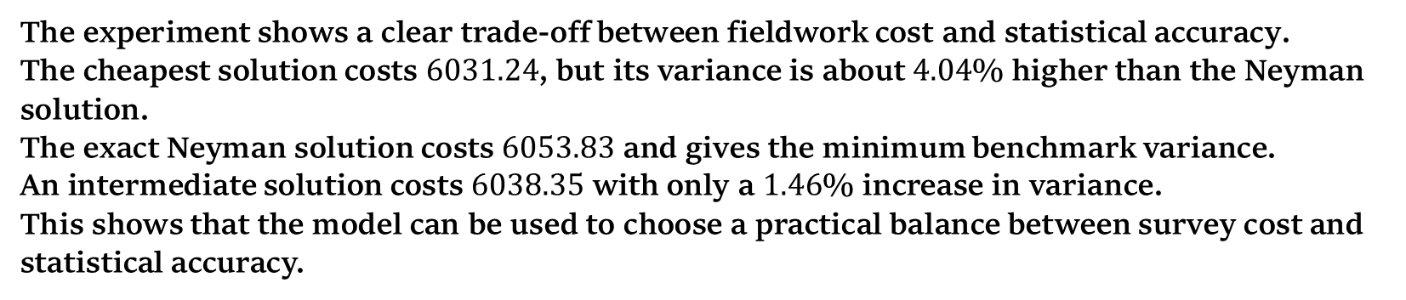
Cost–Precision Trade-off
The experiment shows a clear trade-off between fieldwork cost and statistical accuracy.
The cheapest solution costs $6031.24$, but its variance is about $4.04$% higher than the Neyman solution.
The exact Neyman solution costs $6053.83$ and gives the minimum benchmark variance.
An intermediate solution costs $6038.35$ with only a $1.46$% increase in variance.
This shows that the model can be used to choose a practical balance between survey cost and statistical accuracy.

