Slide 1
DC METRO: IS IT SAFE OUT THERE?
Yuheng Zhang
Pal Doshi
Rahul Bahadur

Slide 2
PROJECT OVERVIEW
Introduction
Finding the factors that affect the crime rate in District of Columbia:
Effect of Temperature
Effect of Nightclubs
Effect of Holidays
Target Audience
All the residents of DC
DC Local government

Slide 3
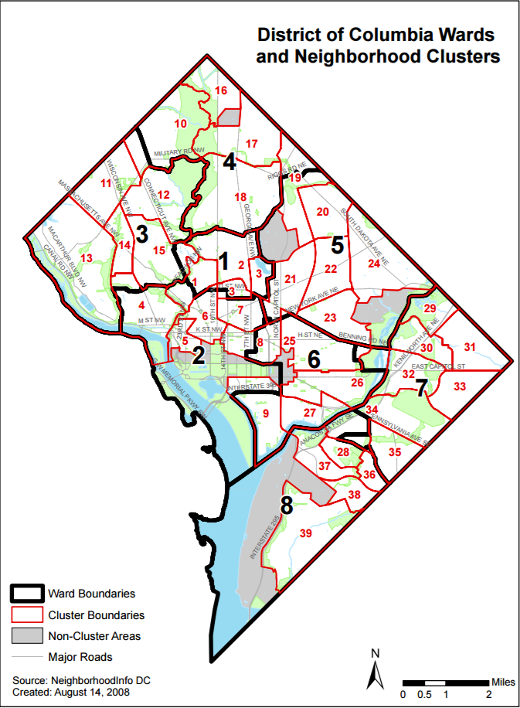
DATA
Source
The DC Metro crime dataset for years 2011-2015 has been extracted from DC.gov website
Description
The dataset includes information like:
Start date of crime
End date of crime
Type of Crime
Neighbourhood Cluster in which the crime occurred
Report date of crime
Weapon/s used

Slide 4
Q1: Does temperature influence the crime rate?

Slide 5
WHY DO WE CARE ABOUT THIS?
It is said that high temperature is one of the factors that leads to agitation in humans
Agitation might lead to crimes
We wanted to check if this statement holds any weight through this question

Slide 6
DATA
Source
The historical weather dataset of D.C area has been extracted from NOAA website
The desired range is from January 1, 2011 to December 31, 2015.
Description
Dataset Includes:
Date (Year, Month, Day)
Temperature (Maximum, Minimum) in ˚F
Precipitation
Evaporation
Soil Temperature in ˚F

Slide 7
DATA CLEANING
For the weather dataset, we only need to pay attention to date and the change of corresponding temperature-related factors. The dataset is quite clean, no missing value.
We dropped the other fields and only kept the date, the Max temperature, the Min temperature.
There are 179400 rows and 7 columns in the final Weather_-Crime dataset

Slide 8
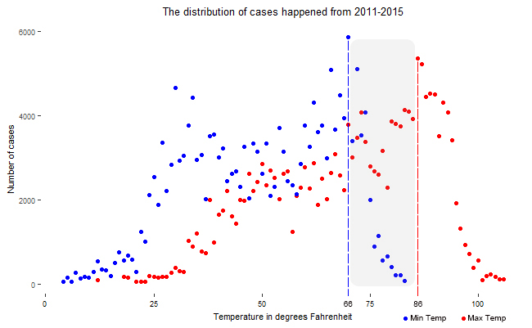
ANALYSIS(I)
We checked the relationship between the frequency of crimes and temperature

Slide 9
ANALYSIS(I) RESULTS
Daily maximum temperature between 85 and 88 degree; number of crime cases would reach the peak.
Daily minimum temperature between 65 and 67 degree; number of crime cases would reach the peak.
The grey area is the area where crime case would most likely happen.
Daily maximum temperature is higher than 87 degree, the number of crimes would reduce significantly.

Slide 10
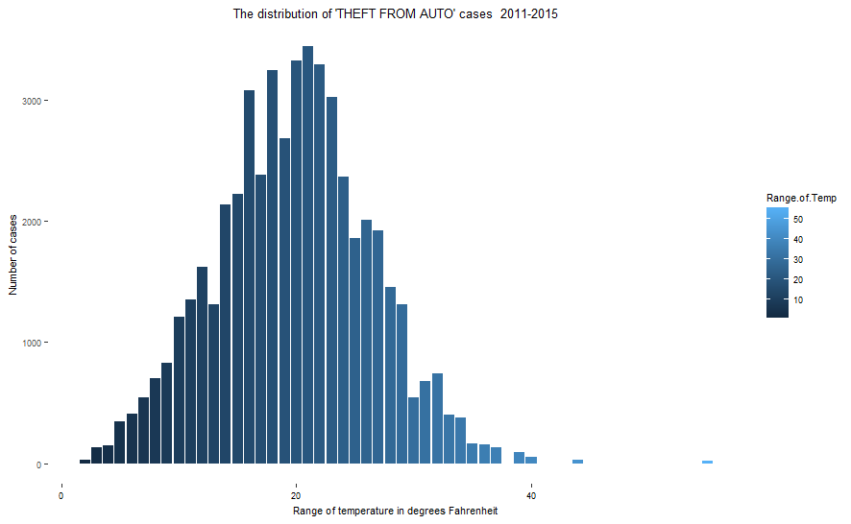
ANALYSIS(II)
Next, we compared the impact of the range of temperature on occurrence rate of crime (all types)

Slide 11
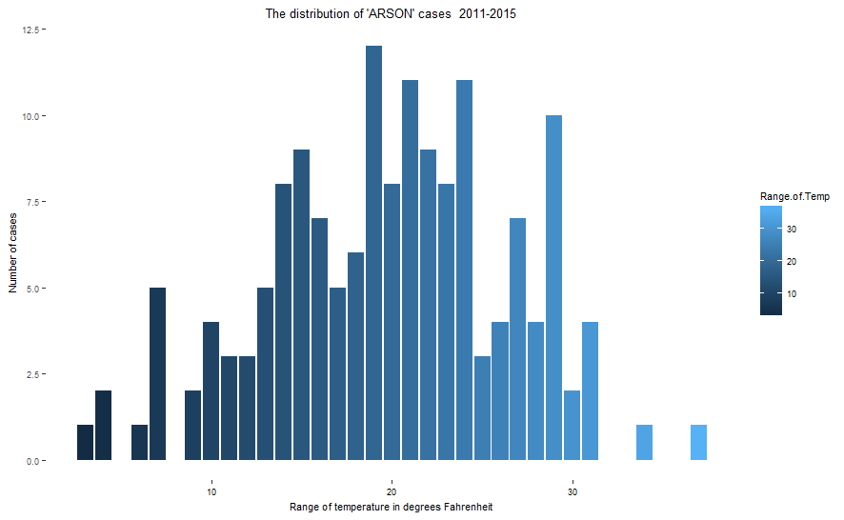


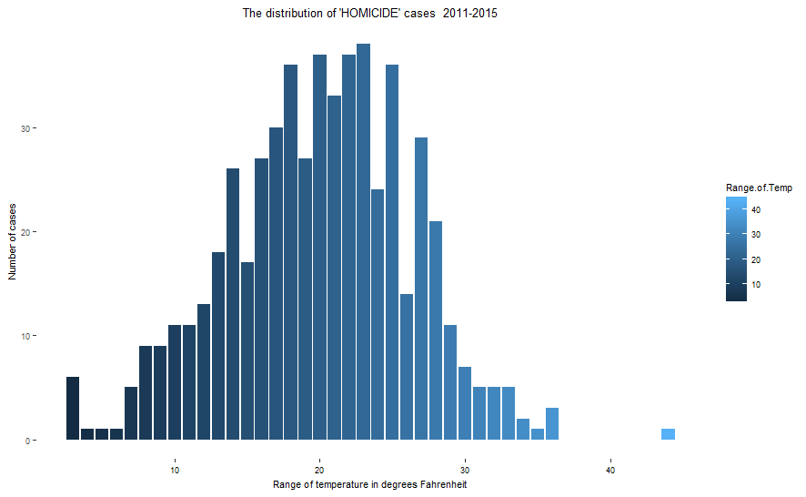


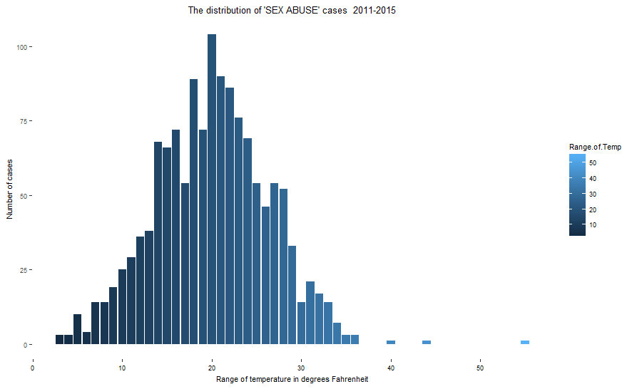


Slide 12
ANALYSIS(II) RESULTS
The range of daily temperature between 16 and 25 degree.
The number of various crime cases would increase.
The period from July to September is the period when most crime cases happen.

Slide 13
ANALYSIS(III) AND RESULTS
Type | Regression coefficient | Effect size | p-value
Arson | 0.020 | 0.054 | 0.085
Assault | 1.754 | 0.211 | 6e-06
Burglary | 2.338 | 0.203 | 9.53e-06
Homicide | 0.100 | 0.213 | 1.9e-05
Motor Vehicle Theft | 2.047 | 0.205 | 8.53e-06
Robbery | 2.517 | 0.187 | 2.26e-05
Sex Abuse | 0.259 | 0.278 | 3.62e-07
Theft From Auto | 6.319 | 0.161 | 9.9e-05
Theft From Other | 9.213 | 0.205 | 8.63e-06
Finally, we determine the impact of maximum temperature on crime-occurrence rate by applying linear regression model

Slide 14
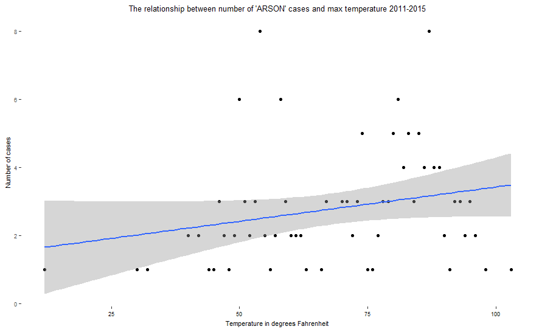
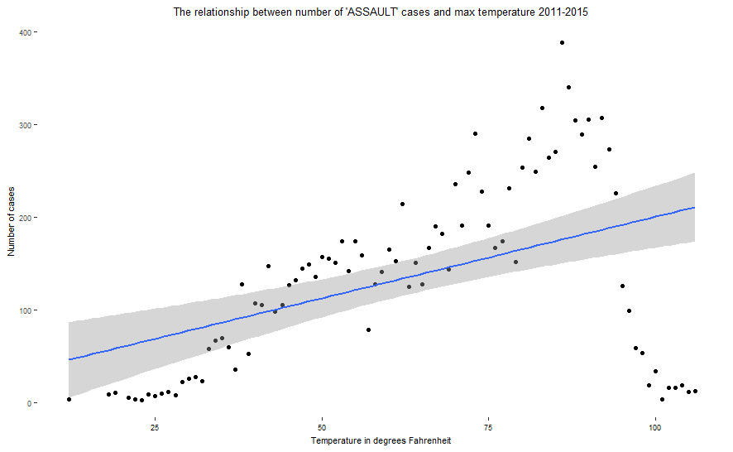
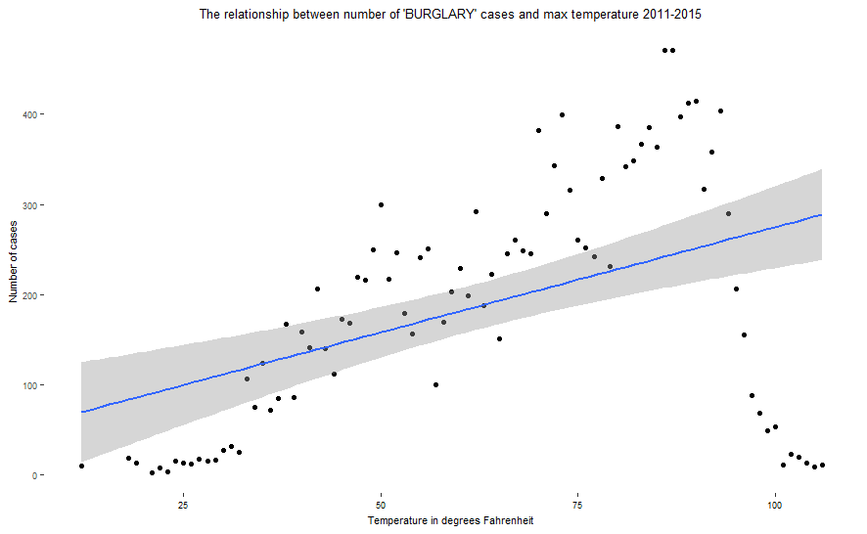
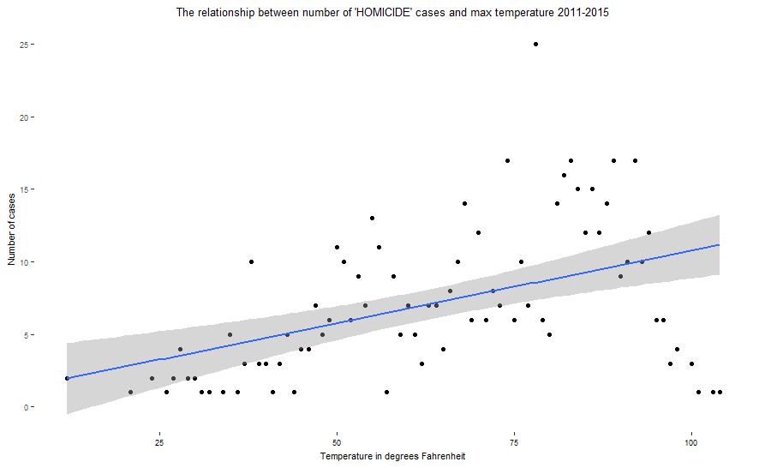
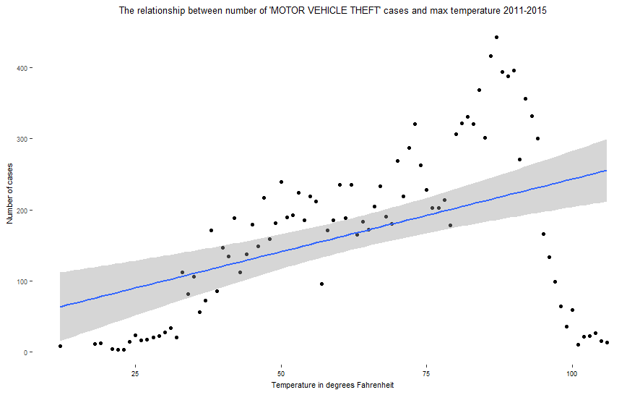
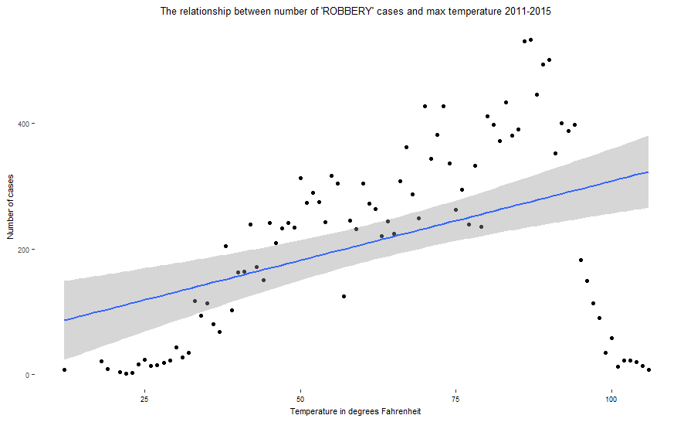
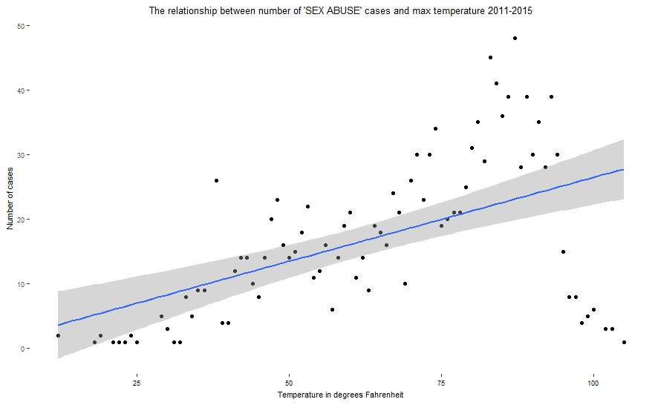
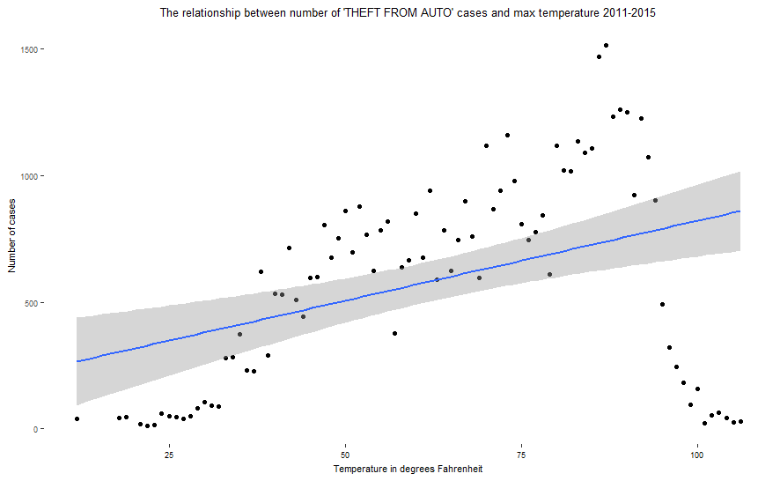
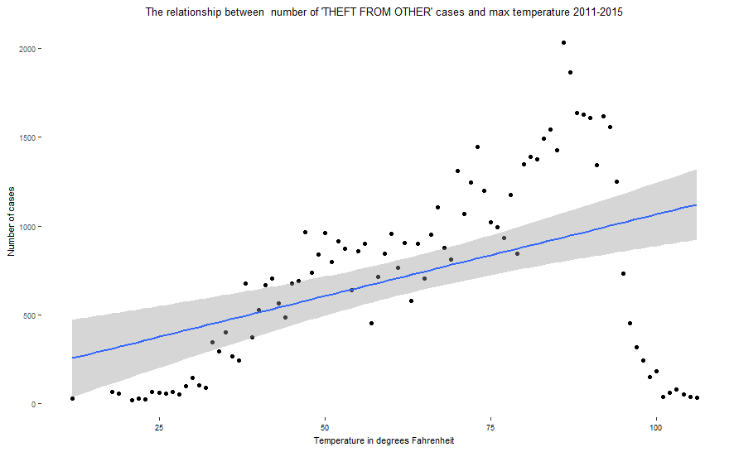

Slide 15
CONCLUSION
Overall, temperature is positively related to the all types of crime cases except the type of “arson” cases.
The number of the type of theft cases is much larger than other kinds of crime cases.
Summer (July to September) is the season which the most crimes happened in a year.
However, except for weather factors, we should also consider other factors, like the social factor.

Slide 16
Q2: Is there a relation between number of nightclubs and crime rate ?

Slide 17
WHY DO WE CARE ABOUT THIS?
A nightclub is defined as "an establishment for night-time entertainment, typically serving drinks and offering music, dancing, etc."
Moreover, there is a common notion that alcohol plays a large role in criminal activities.
Hence, we came up with this research question to study the relation between number of nightclubs and crimes.

Slide 18
DATA
Source
Nightclubs in DC dataset is extracted from DC.gov website (“Night Club,” 2013)
Description
The dataset includes following details:
Name of the club
Address of the club
MAR (Master Address Repository) Address ID

Slide 19
DATA CLEANING
Getting cluster details for nightclubs
We merged the nightclubs dataset with the MAR dataset (which had the mapping of clusters and address ID) using R
Removing irrelevant columns from crime dataset
Next, we deleted the irrelevant columns from our main dataset using Excel VBA-code snippet
Creating cluster-wise data of nightclubs
Our aim was to compare number of crimes to the number of nightclubs in a particular cluster in DC area. For this, we computed the count of nightclubs for each cluster using R

Slide 20
ANALYSIS
TYPE OF CRIME | CORRELATION COEFFICIENT
All | 0.3416
Arson | -0.3207
Assault | -0.0755
Burglary | -0.2488
Homicide | -0.3966
Motor-theft | -0.1612
Robbery | 0.0415
Sex-abuse | 0.1164
Auto-theft | 0.2328
Other-theft | 0.5834
To determine if there is a relationship between the number of nightclubs and occurrence of crimes (cluster-wise), we carried out the correlation test using R

Slide 21
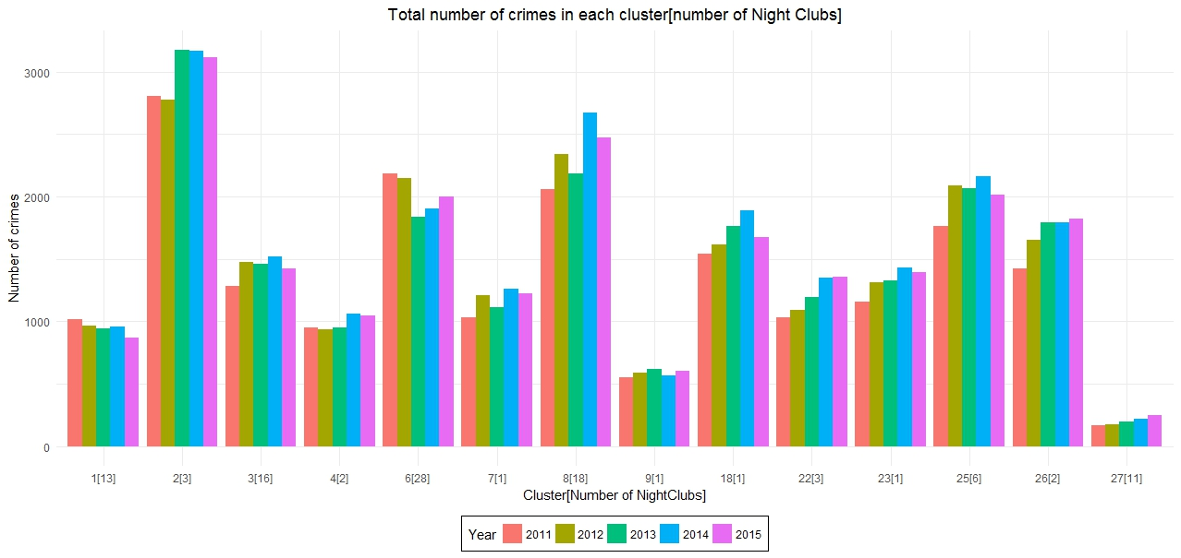
3
18
28
6
1
2
16
1
1
3
13
2
1
11

Slide 22
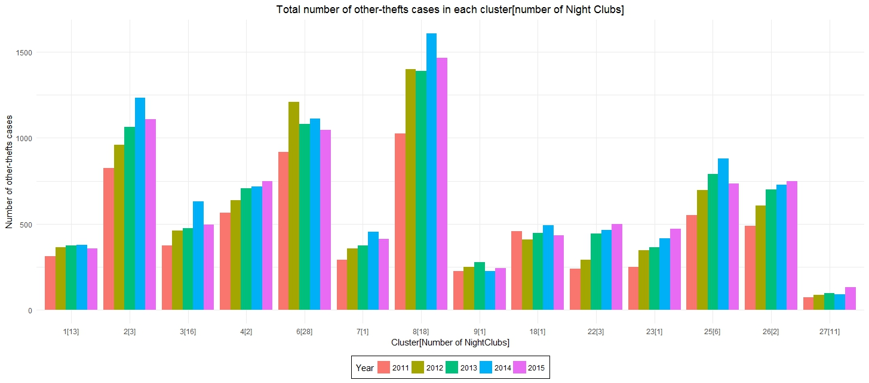
18
3
28
6
2
2
16
1
3
1
1
13
1
11

Slide 23
RESULTS
No relation between the presence of nightclubs and occurrence of crimes
But, we would like to warn the residents that quite a lot of crimes occur in cluster 2; so it is always better to keep your guard on when in that area!
But it should be noted that the nightclubs dataset includes only those places that DC government classified as 'nightclubs'; it does not include details of bars or restaurants serving alcohol.

Slide 24
Q3: How do holidays affect crime rates?

Slide 25
WHY DO WE CARE?
Holidays are the time when everyone goes out to enjoy. Hence, there are lots of people on the streets.
Since, parents are always concerned about their children going out alone we decided to study the effect that the holidays have on crime rates.

Slide 26
DATA
Source
The data regarding the holidays in Washington DC was retrieved from dc.gov page. This data is open to the public and free for modification.
Description
The data had a list of all the official holidays observed in Washington DC and the day on which they are observed, along with a brief description of each.

Slide 27
DATA CLEANING
The DC Crime data set
The data set obtained from dc.gov website had a few outliers. For the purpose of this analysis only those crimes were taken which had a duration of 7 days or less.
Holidays data set
It was mostly clean. However, there were certain days which were mentioned as holidays in one year but not in others.

Slide 28
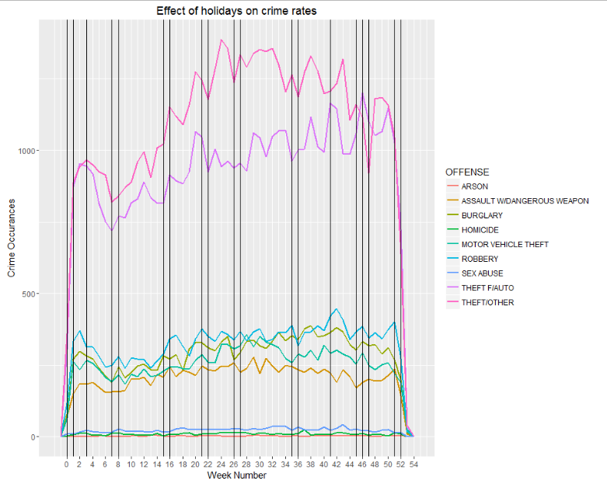
PLOT
Notes:
There was some relation between the crime rates and the holidays. Esp during the beginning and end of the years

Slide 29
FURTHER TESTS
In order to test our claim we decided to conduct a student’s t-test on the data set.
We sub-grouped the crime data set into a holidays and a non-holidays data set. And further sub-divided based on each type of crimes
We also conducted a t-test specifically for the first and the last weeks of the year.

Slide 30
ANALYSIS (I)
Type of crime | p-value | Holidays | Regular days
Arson | 0.3834 | 2.555556 | 2.937500
Assault | 0.3805 | 199.0000 | 210.9143
Burglary | 0.3888 | 278.7368 | 295.80
Homicide | 0.9535 | 9.578947 | 9.514286
Motor Theft | 0.388 | 247.0000 | 261.5143
Robbery | 0.8504 | 329.0526 | 325.2571
Sex Abuse | 0.09747 | 21.42105 | 24.79412
Theft | 0.1698 | 1030.684 | 1128.943
Theft Auto | 0.7416 | 918.6316 | 937.2571
Total Crimes | 0.3995 | 3036.526 | 3195.971

Slide 31
ANALYSIS (II)
Crime rates | p-value | During | Other days
Weeks 0,1,52,53 | 0.06147 | 1535.50 | 3268.22

Slide 32
RESULTS
On an average less crime is committed during holidays. However, nothing conclusive can be said since the p-value is quite high in most of the cases.
For crime rates during beginning and end of the years too nothing conclusive can be said. However, on average, the crime rates are halved during these weeks (0,1,52,53)

Slide 33
FINAL CONCLUSIONS
People should take care while going out during summers
Despite the statistics for DC suggesting no relation between the nightclubs and crimes, it is always better to keep an eye out especially when in cluster 2: Columbia Heights, Park View, Mt. Pleasant, Pleasant Plains
Figures suggest that there are less number of crimes during holidays but being alert at all times is always the best choice

Slide 34
THANK YOU
Any questions?

