Slide 1


Kalasalingam Academy of Research and Education
Department of Electronics and Communication Engineering
Elevium – by Nanochip · ECE221 · III Semester B.E. · 2026–27
SECURE BLE MESH COMMUNICATION SYSTEM
Using STM32 for Industrial Automation
Project Presentation · Team 9 · Embedded Eagles
TEAM MEMBERS
GUIDES AND HEAD OF DEPARTMENT
D. Sandeep
Reg. No. 9925005091
P. Gowtham Kumar Reddy
Reg. No. 9925005104
Mr. Pavan Kumar E — External Guide
Manager – R&D, Elevium – by Nanochip
Prof. Mrs. Loyola Jasmine — Internal Guide
Assistant Professor, Dept. of ECE, KARE
P. Venkata Subbaiah
Reg. No. 9925005120
G. Sanjeeva Kumar
Reg. No. 9925005053
Dr. J. Charles Pravin — Head of the Dept.
Dept. of ECE, KARE
1

Slide 2
1. Introduction
• Industrial automation requires reliable communication between sensors, controllers, and actuators.
• Bluetooth Low Energy (BLE) provides low-power wireless communication.
• BLE Mesh enables many devices to communicate across a wider area using message relaying.
• STM32 microcontrollers can collect sensor data, process events, and control outputs.
• This project presents a secure, scalable wireless monitoring and control concept.
Secure BLE Mesh Communication System Using STM32 | 2

Slide 3
2. Problem Statement & Objectives
Problem Statement
Objectives
• Problem: point-to-point links may not cover large facilities; wired networks can require installation and maintenance; industrial data needs protection.
• Objective: create a multi-node BLE Mesh concept using STM32.
• Read sensor values and transmit status messages.
• Receive commands and operate indicators or a relay.
• Demonstrate secure communication and network scalability.
Secure BLE Mesh Communication System Using STM32 | 3

Slide 4
3. Proposed System Architecture
Sensor Node
STM32 + sensors
BLE Mesh
Network
Gateway / Monitor
Dashboard
Actuator Node
LED / Relay
Sensor data → mesh publication → gateway visualization / command → actuator response
Nodes can relay messages, extending communication beyond one radio link.
Secure BLE Mesh Communication System Using STM32 | 4

Slide 5
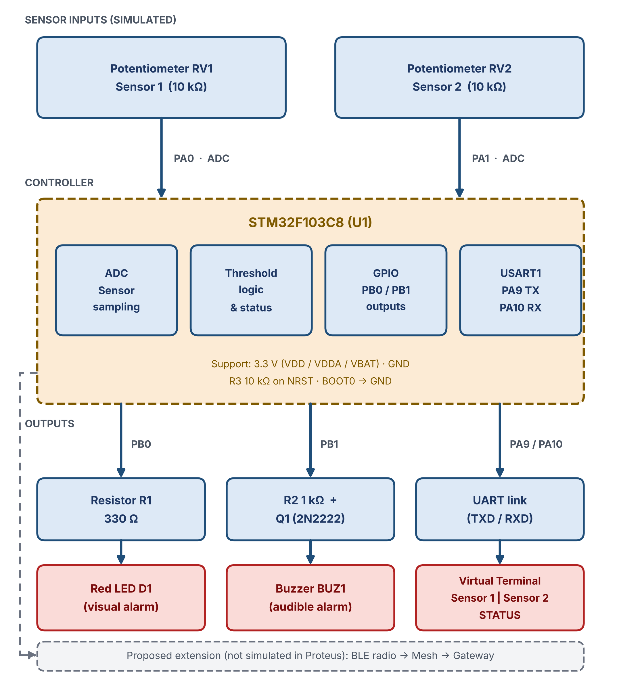
3.1 System Block Diagram
Sensor inputs: Potentiometers RV1 and RV2 simulate two sensors on PA0 and PA1 (ADC).
Controller: STM32F103C8 (U1) samples both channels and applies threshold logic.
Visual alarm: PB0 drives red LED D1 through R1 (330 Ω).
Audible alarm: PB1 drives buzzer BUZ1 through R2 (1 kΩ) and transistor Q1 (2N2222).
Serial monitor: USART1 (PA9 / PA10) sends Sensor 1, Sensor 2 and STATUS to the virtual terminal.
Support circuit: 3.3 V supply, R3 (10 kΩ) on NRST, BOOT0 tied to GND.
Proposed extension: BLE radio and mesh are not simulated in Proteus.
Secure BLE Mesh Communication System Using STM32 | 5

Slide 6
4. Hardware Components
• BLE-capable STM32 board (recommended: STM32WB series for native BLE support).
• Sensor inputs: temperature sensor (LM35 / digital sensor) and vibration sensor or accelerometer.
• Outputs: status LEDs, buzzer, and relay module with driver stage.
• Regulated 3.3 V supply for MCU / BLE circuitry; suitable supply for sensors and relay.
• Optional gateway: PC or phone for display and configuration.
• Supporting parts: resistors, transistor/MOSFET driver, protection diode, wiring, breadboard or PCB.
Secure BLE Mesh Communication System Using STM32 | 6

Slide 7
5. Software & Communication Flow
• Firmware is developed with STM32CubeIDE and STM32CubeMX configuration tools.
• Sensor acquisition: read ADC / digital interfaces and prepare sensor values.
• BLE Mesh model: publish sensor status and subscribe to control messages.
• Security: use provisioned network/application keys and authenticated device onboarding.
• Gateway receives mesh messages and displays live status or sends commands.
• Testing verifies delivery, range, response time, and fault behavior.
Secure BLE Mesh Communication System Using STM32 | 7

Slide 8
6. BLE Mesh Communication
Key Concepts
Typical Message
• Provisioning: securely add a device to the mesh network.
• Publish / Subscribe: send messages to configured destinations.
• Relay: intermediate nodes forward eligible messages.
• Managed flooding supports multi-hop message dissemination.
• Security keys protect network and application messages.
Example: Sensor Node A → mesh message → Gateway / Node B → display and alarm decision.
Secure BLE Mesh Communication System Using STM32 | 8

Slide 9
7. Demonstration & Testing Plan
• Normal operation: sensor node publishes periodic readings; dashboard shows status.
• Threshold event: temperature / vibration exceeds limit; alarm LED or buzzer activates.
• Remote control: gateway sends a command; output node switches LED or relay.
• Network test: observe delivery with direct and relayed paths.
• Security test: confirm unprovisioned nodes cannot participate in protected application traffic.
• Record message success rate, latency, coverage, and power consumption.
Secure BLE Mesh Communication System Using STM32 | 9

Slide 10
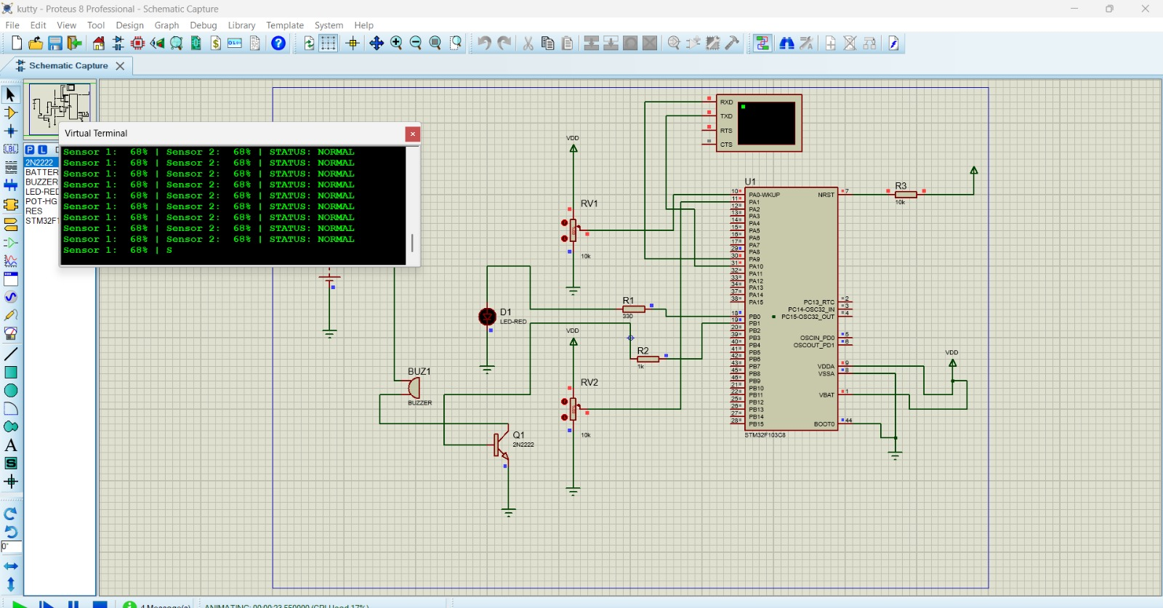
7.1 Proteus Simulation
MCU: STM32F103C8 (U1).
Inputs: Potentiometers RV1 and RV2 simulate two sensor readings.
Outputs: Red LED (D1) and buzzer (BUZ1) driven through a 2N2222 transistor (Q1).
Terminal: Shows Sensor 1, Sensor 2 and STATUS: NORMAL at 68%.
Scope: Demonstrates sensor logic, GPIO and output control; BLE Mesh radio is not simulated.
Secure BLE Mesh Communication System Using STM32 | 10

Slide 11
8. Expected Results, Applications & Limitations
• Expected: wireless sensor status exchange, remote indicator / actuator control, and expandable multi-node architecture.
• Applications: factory monitoring, equipment condition alerts, smart buildings, and warehouses.
• Limitations: range depends on environment; relay traffic and latency rise with network size; hardware and firmware compatibility must be validated.
• Report measured results only after hardware testing; label simulated or proposed results clearly.
Secure BLE Mesh Communication System Using STM32 | 11

Slide 12
9. Conclusion & Future Scope
• STM32-based BLE Mesh can support distributed low-power monitoring and control.
• Mesh relaying can improve coverage compared with a single direct wireless link.
• Security, provisioning, and testing are essential for industrial deployment.
• Future scope: dashboard logging, predictive maintenance, more sensor nodes, and optimized power management.
Secure BLE Mesh Communication System Using STM32 | 12

Slide 13
10. Implementation Note (Important)
• STM32WB55 is BLE-capable and is a more direct choice for BLE Mesh implementation.
• STM32F103C8 does not include an integrated BLE radio. It needs an external BLE module and suitable firmware/interface; it is not by itself a BLE Mesh node.
• Proteus may demonstrate sensor logic, GPIO, and output control, but full BLE Mesh radio behavior may not be simulated.
• Separate Proposed Design, Proteus Simulation, and Verified Hardware Implementation in your report.
Secure BLE Mesh Communication System Using STM32 | 13

