Slide 1
Phylogenetics: General Outline
Basic methods:
  Parsimony optimization
  Maximum likelihood
  Bayesian methods
Matrix structure:
  Parameters affecting character distributions
  Compatibility:
    General theory
    Character correlation
    Inverse modeling for relative rates
Stratigraphic data
  Tree-based methods for assessing sampling
  Testing trees with stratigraphy
Tree-based tests

Slide 2
Important Terms
Phylogeny (= tree): ancestor-descendant relationships over time.
Cladogram: graph depicting general relationships only (no temporal component or designated ancestors).
Clade: descendants of a common ancestor.
Node: inferred common ancestor between taxa (which might or might not match a sampled species); = Hypothetical taxonomic unit (HTU).
Polytomy: node giving rise to 3+ lineages (as opposed to bifurcation).
Outgroup: taxon used to root tree & “polarize” states.
Sister-taxa or sister-groups: taxa derived from a common ancestor (i.e., linked to the same node).

Slide 3
Important Terms (con’t)
Synapomorphy: shared derived states;
  Ideally, homologies are synapomorphies, but homologies cannot be proven.
  In contrast to symplesiomorphy (shared primitive state).
Autapomorphy: character that is invariant save for one taxon.
Homoplasy: “redundancy”.
  Reversals: re-evolving a primitive condition;
  Parallelisms: derived feature appearing 2+ times;
  Like homologies, these cannot be proven.
Branch length: either:
  temporal duration of a branch;
  number of changes along a branch.

Slide 4
Cladogram + Venn Diagram for Metazoans
Snail
Fish
Chimp
Human
Snail not ancestral, or implied to be like common ancestor
Node linking the vertebrate clade.

Slide 5
How to “Write” Cladograms
Nexus Format:
  (Snails,(Fish,(Chimps,Us)));
  (0,(1,(2,3)));
If a new taxon add: (say, clams):
  ((Snails,Clams),(Fish,(Chimps,Us)));
  ((0,4),(1,(2,3)));
Format used by PAUP, MacClade, etc.

Slide 6
How to “Write” Cladograms for Computer
0-4 give taxon #’s (e.g.,., snails,clams, fish, chimps, us);
5-7 are taxon #’s for nodes (i.e., molluscs, vertebrates, apes).

Slide 7
How to “Write” Cladograms for Computer
 | m•[0] | m•[1] | m•[2]
m[0][•] | 2 | 5 | 6
m[1][•] | 2 | 0 | 4
m[2][•] | 2 | 1 | 7
m[3][•] | 2 | 2 | 3
m[x][•] gives clade information for clade x;
m[x][0] gives # of taxa in clade;
m[x][1] & m[x][2] are taxa in clade x.

Slide 8
Polytomy: 3+ lineages attached to node
Multiple possible interpretations
Written as (A, (B,C,D)).

Slide 9
Multiple phylogenetic interpretations for Polytomy
Soft Polytomy
Hard Polytomy A
Hard Polytomy B
Soft Polytomy: reflects uncertainty.
Hard Polytomy A : Ancestor and 2+ descendants sampled.
Hard Polytomy B: Sudden radiation (e.g., species flocking).

Slide 10
Innumerable Phylogenies correspond to any one Cladogram
Both phylogenies have same cladistic topologies but different divergent times among sampled taxa.

Slide 11
Innumerable Phylogenies correspond to any one Cladogram
One phylogeny includes numerous sampled ancestors; other does not. Both fit the same cladistic topology.

Slide 12
Parsimony Optimization: Sankoff Vectors
Each cell gives the number of steps required if state A or state B is the ancestral condition at that node;
E.g., 2 steps need to go from A->B twice in uppermost node.
Lowest number at basal node gives the minimum steps.

Slide 13
Parsimony Optimization: Sankoff Vectors
Re-write cells to give steps need above and below the node;
∴ 2 steps now needed to have state B in remaining node.

Slide 14
Parsimony Optimization: Multistate Characters
Ordered: State X is X steps from state 0.
  State 2 is 2 steps from 0, state 3 is 3 steps from state 0;
  State 2 is 1 step from 1, state 3 is 2 steps from state 1.
Unordered: All states are 1 step from each other.
Binary is essentially a special case of either.

Slide 15
Parsimony Optimization: Sankoff Vectors & Unordered 3-State Character
Because all steps are equidistant, it is simply counting the needed changes.

Slide 16
Parsimony Optimization: Sankoff Vectors & Unordered 3-State Character
In this example, any of the three states can be the two most basal nodes.
Unimportant for cladogram, but important for phylogeny!

Slide 17
Parsimony Optimization: Sankoff Vectors & Ordered 3-State Character
More change now required for some ancestral reconstructions;

Slide 18
Parsimony Optimization: Sankoff Vectors & Ordered 3-State Character
More change now required for some ancestral reconstructions;
∴3 steps needed to make state C ancestral or to make state A the condition of the second node.

Slide 19
Parsimony Optimization: Sankoff Vectors & Ordered 3-State Character
After downwards pass, either A or B might be ancestral;
However, second node now needs to be state B.

Slide 20
Step (= Cost) Matrices
Binary
Unordered
From\To: |  | 0 | 1
0 |  | 0 | 1
1 |  | 1 | 0
From\To: |  | 0 | 1 | 2
0 |  | 0 | 1 | 1
1 |  | 1 | 0 | 1
2 |  | 1 | 1 | 0
Biased Gains
Ordered
From\To: |  | 0 | 1
0 |  | 0 | ≥1
1 |  | ≤1 | 0
From\To: |  | 0 | 1 | 2
0 |  | 0 | 1 | 2
1 |  | 1 | 0 | 1
2 |  | 2 | 1 | 0
Irreversible
Asymmetric
From\To: |  | 0 | 1
0 |  | 0 | ≥1
1 |  | ∞ | 0
From\To: |  | 0 | 1 | 2
0 |  | 0 | 1 | 1
1 |  | 1 | 0 | 1
2 |  | 3 | 2 | 0

Slide 21
Optimization & Inapplicable Characters
Add an “inapplicable” “state” to the step matrices that is distance 0 from all other states.
From\To: 0 1 -
0 0 1 0
1 1 0 0
- 0 0 0
However, condition at node must be set to “-” if the independent character is absent.

Slide 22
Optimization & Inapplicable Characters
State A gives the presence of a complex structure (e.g. a feather) and states (DE) give different conditions for that structure (e.g., feather color). “-” means not possible.
Do not let the computer assume that there is a “primitive” feather color for the whole clade!

Slide 23
Optimization & Inapplicable Characters
Independent character optimized as binary character: B in uppermost node and A at most basal node;
Inapplicable now impossible for uppermost node (optimally state E) but necessary for most basal node.
Sankoff vectors for independent character now altered, too….

Slide 24
Optimization & Inapplicable Characters
Independent character now optimized as A at second most basal node;
Inapplicable now necessary for most that node.
Independent now needs to be 0 for the next two nodes.

Slide 25
Optimization & Inapplicable Characters
Dependent and independent now fully optimized.
NOTE: The dependent character actually makes 0 changes here; all of the change is by the independent character.

Slide 26
Finding the Parsimony Tree(s)
Exhaustive: Examine all trees
  3 x 5 x 7 x … (2n-3) rooted bifurcating trees for n taxa!
  3 x 5 x 7 x … (2n-5) unrooted bifurcating trees for n taxa!
  316 billion rooted trees for 13 taxa alone…..
Branch and Bound
  Begin with nearest-neighbor reconstruction to get maximum estimate of parsimony length (the bound);
  Start with three taxa, then add one (branch) and examine all topologies;
  Repeat; however, once bound is surpassed, give up on these trees;
  Limited by homoplasy: if there is a lot of it, then there will be too many trees shorter than the bound.

Slide 27
Finding the Parsimony Tree(s)
Heuristic: trial and error search.
  Nearest neighbor interchange: link taxa and then swap adjacent branches or whole branches;
  Star decomposition: begin with n-taxon polytomy, and begin linking taxa.
  Above algorithms are “greedy”: if a rearrangment does not work, then they do not revisit it.
  Simulated annealing: accepts new tree if better, and sometimes if the new tree is worse;
    initially more tolerant of worse trees;
    Allows search to wander downhill and then uphill, possibly finding a higher peak.

Slide 28
Common Summaries of Parsimony Trees
Consistency Index (CI) = m / s, where:
  s = # of steps;
  m = minimum possible # of steps;
    = number of derived states unless inapplicable characters are involved;
    If short blue feather and long red feather evolve independently, then 2 changes generate 3 states.
  often calculated without uninformative characters (i.e., invariant or autapomorphic characters).
Retention Index (RI) = (M-s)/(M-m), where:
  M = maximum # of steps;
  m & s as above.

Slide 29
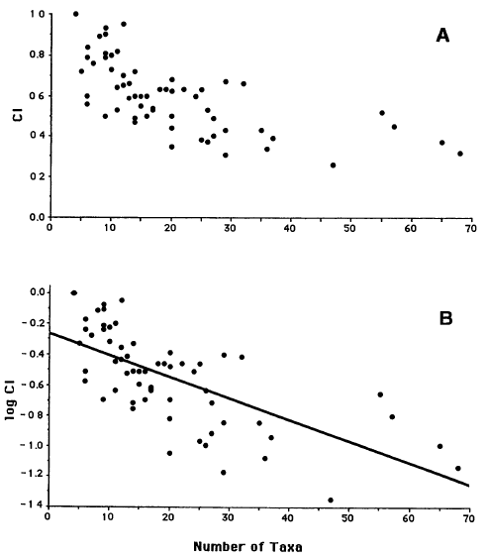
Association between C.I. and Taxon Sampling
Sanderson & Donoghue (1989): C.I. drops as taxon sampling increases for morphological and molecular data.

Slide 30
Association between C.I. and Taxon Sampling
Association strongly pronounced when examining only fossil data.

Slide 31
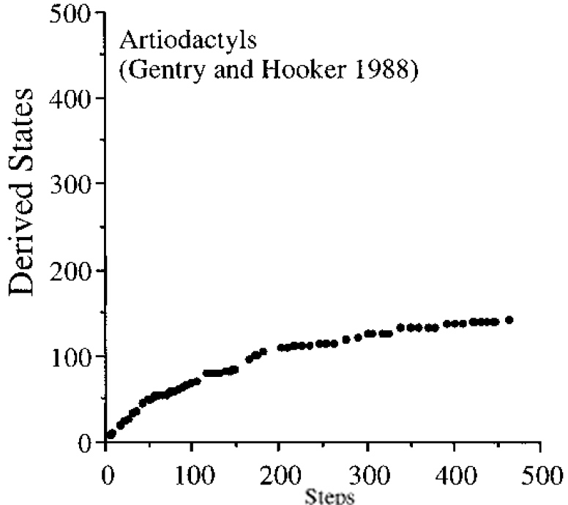
Association between C.I. and Taxon Sampling
Not a methodological artifact, but reflects limitations on recognizable variation.

Slide 32
Parsimony & Probability
Under what circumstances is the character vector [01100] more probable given tree A than given tree B?
I.e., under what circumstances is tree A more likely than tree B given [01100]?

Slide 33
Parsimony & Probability
P[change] is the same on each branch;
  Branch length unimportant:
  No rate shifts on tree;
  Other characters do not affect probability of change;
  P[gain] = P[loss].
Only a single ancestral reconstruction is considered per node.

Slide 34
Parsimony & Probability
Tree A requires only one change.

Slide 35
Parsimony & Probability
The probability of the character vector is:
P[change]^{changes} x (1-P[change])^{static branches}
Log-likelihood of tree is:
changes x ln(P[change] + statics x ln(1-P[change])

Slide 36
Parsimony & Probability
If P[change] = 0.1, then:
P[character | tree] = 0.1¹ x 0.9⁹ = 3.87 x 10⁻²
  ln L[tree | character] = ln(0.1) + (9 x ln[0.9]) = -3.25

Slide 37
Parsimony & Probability
If P[change] = 0.1, then:
P[character | tree] = 0.1² x 0.9⁸ = 4.30 x 10⁻³
  ln L[tree | character] = (2 x ln[0.1]) + (8 x ln[0.9]) = -5.45

Slide 38
Parsimony & Probability
If P[change] = 0.01, then:
P[character | tree] = 0.01¹ x 0.99⁹ = 9.14 x 10⁻³
  ln L[tree | character] = ln(0.01) + (9 x ln[0.99]) = -4.70

Slide 39
Parsimony & Probability
If P[change] = 0.01, then:
P[character | tree] = 0.01² x 0.99⁸ = 9.23 x 10⁻⁵
  ln L[tree | character] = (2 x ln[0.01]) + (8 x ln[0.99]) = -9.29

Slide 40
Parsimony & Probability
If P[change] = 0.001, then:
P[character | tree] = 0.001¹ x 0.999⁹ = 9.91 x 10⁻⁴
  ln L[tree | character] = ln(10⁻³) + (9 x ln[0.999]) = -6.91

Slide 41
Parsimony & Probability
If P[change] = 0.001, then:
P[character | tree] = 0.001² x 0.999⁸ = 9.92 x 10⁻⁷
  ln L[tree | character] = (2 x ln[10⁻³]) + (8 x ln[0.999]) = -13.82

Slide 42
Infinity and beyond…..
P[change] ln L[tree A] ln L[tree B] Difference
10⁻¹ -3.25 -5.45 2.20
10⁻² -4.70 -9.29 4.60
10⁻³ -6.92 -13.82 6.91
10^{-∞} -∞ -2 x ∞ ∞

Slide 43
Shorter tree is more likely while P[change]<0.5
P[change] ln L[tree A] ln L[tree B] Difference
0.2 -3.62 -5.00 1.62
0.4 -5.51 -5.92 0.41
0.5 -6.93 -6.93 0.00
0.6 -8.76 -8.35 -0.41

Slide 44
Shorter tree is more likely while P[change]<0.5
P[change] ln L[tree A] ln L[tree B] Difference
0.5 -6.93 -6.93 0.00
Shift does not occur at P[change] > 0.15 because only a single way of generating one or two changes is considered.

Slide 45
Relaxing assumptions of parsimony
Low vs. high rates of change.
Homogeneous vs. heterogeneous rates.
Unit vs. variable branch lengths.
Certain vs. uncertainty in ancestral reconstructions.
Correlated character change.

Slide 46
Effect of Branch Lengths: Felsenstein 1973
Given a rate π and a branch duration of time b, the expected number of changes is πb.
  Probability of ∆ changes modeled as a Poisson process (i.e., change can occur at any time).
  (πb)∆ x e^{-(πb)}
  P[∆ | πb] = —————
  ∆!

Slide 47
Effect of Branch Lengths: Example
L[τ,π=0.95| char]
= P[0->2|b=0.96] = ([0.95 x 0.96]² x e^{-(0.95 x 0.96)})/2!
x P[0->0|b=0.96] = e^{-(0.95 x 0.96)}
x P[0->0|b=0.14] = e^{-(0.95 x 0.14)}
x P[0->2|b=1.10] = ([0.95 x 1.10]² x e^{-(0.95 x 1.10)})/2!
x P[0->0|b=1.10] = e^{-(0.95 x 1.10)}
= 3.97x10⁻³

Slide 48
Effect of Branch Lengths: Example
ln L[τ,π=0.95| char]
= ln P[0->2|b=0.96] = (2 x ln[0.95 x 0.96]) - (0.95 x 0.96) - ln(2)
+ ln P[0->0|b=0.96] = -(0.95 x 0.96)
+ ln P[0->0|b=0.14] = -(0.95 x 0.14)
+ ln P[0->2|b=1.10] = (2 x ln[0.95 x 1.10] - (0.95 x 1.10) - ln(2)
+ ln P[0->0|b=1.10] = -(0.95 x 1.10)
= -5.53

Slide 49
Effect of Branch Lengths: Example
L[τ,π=0.95| char]
= P[0->2|b=0.96] = ([0.95 x 0.96]² x e^{-(0.95 x 0.96)})/2!
x P[0->0|b=0.96] = e^{-(0.95 x 0.96)}
x P[0->0|b=0.14] = e^{-(0.95 x 0.14)}
x P[0->2|b=1.10] = ([0.95 x 1.10]² x e^{-(0.95 x 1.10)})/2!
x P[0->0|b=1.10] = e^{-(0.95 x 1.10)}
= e^{-(0.95 x 4.26)} x [0.95 x 0.96]² x [0.95 x 1.10]²/(2!x2!)

Slide 50
Tree Likelihood Rephrased
e^{-(0.95 x 4.26)} x [0.95 x 0.96]² x [0.95 x 1.10]² /(2!x2!)
e^{-(rate x ∑ branches durations)}
  x Π [rate x branch durations]^{changes} ÷ Π changes! for all branches showing change in character.
Log-likelihood there is just:
  Rate x ∑static branch durations
  + ∑ changes x ln (rate x branch duration)
  - ln (changes!)
  for all branches showing change in the character.
Can it be this easy???

Slide 51
What is the likelihood of the 2nd nodes states?
L[node 2 = 0| taxa 1, 2] = 0.067
= P[0->2|b=0.96] = ([0.95 x 0.96]² x e^{-(0.95 x 0.96)})/2!
x P[0->0|b=0.96] = e^{-(0.95 x 0.96)}
L[node 2 = 1| taxa 1, 2] = 0.134
= P[1->2|b=0.96] = ([0.95 x 0.96]¹ x e^{-(0.95 x 0.96)})/1!
x P[0->0|b=0.96] = ([0.95 x 0.96]¹ x e^{-(0.95 x 0.96)})/1!
L[node 2 = 2| taxa 1, 2] = 0.067

Slide 52
What is the likelihood of the basal nodes states?
L[node₁ = X| 2, 0, 2, 0]
= P[0| node₁ = X]
x P[2| node₁ = X]
x (P[0| node₁ = X] x P[0 | node₂=0] x P[0 | node₂=0]
+ P[1| node₁ = X] x P[0 | node₂=1] x P[0 | node₂=1]
+ P[2| node₁ = X] x P[0 | node₂=2] x P[0 | node₂=2])

Slide 53
What is the likelihood of the basal nodes states?
L[node₁ = X| 2, 0, 2, 0]
= P[0| node₁ = X]
x P[2| node₁ = X]
x (P[0| node₁ = X] x P[0 | node₂=0] x P[0 | node₂=0]
+ P[1| node₁ = X] x P[0 | node₂=1] x P[0 | node₂=1]
+ P[2| node₁ = X] x P[0 | node₂=2] x P[0 | node₂=2])
Note: final terms are the likelihoods of node 2 states times the conditional probabilities of those states given node 1.

Slide 54
Ancestral Conditions as Conditional Probability:
L[τ,π=0.95| 2, 0, 2, 0]
= ω₀ x L[node₁ = 0| 2, 0, 2, 0]
+ ω₁ x L[node₁ = 1| 2, 0, 2, 0]
+ ω₂ x L[node₁ = 2| 2, 0, 2, 0]
Where ω_{x} is the probability of beginning with state x.
Tree likelihood obviously modified.

Slide 55
Phylogeny Likelihood
Calculate the exact probability of character matrix given a particular phylogeny.
  Branch length affects expectations;
  Relative rates affect expectations.
  characters states branches
L[τ, π | C] = Π ∑ Π P[∆_{ijk} | b_{j}, π]
  i=1 k=0 j=1
  π: rate;
  branch j on tree τ
  C: character matrix
  ∆_{ijk}: number of changes in character i on branch j given ancestral state k.
Different phylogenies matching the same cladogram will have different likelihoods!

Slide 56
Changing Branch Durations Changes Likelihood
Likelihood of upper node as well as P[0], P[1] or P[2] red, yellow and orange branches now altered.
Sum of potentially static lineages AND lineages over which change accrued also differ on the two trees.
Upshot: cladogram does not have likelihood unless you sum over all possible phylogenies!

Slide 57
Changing Rate Changes Likelihood
First tree’s likelihood maximized at π ≅ 0.95;
Second tree’s likelihood maximized at π ≅ 1.20;
Same number of changes favored, but less time:
(t= 4.26 vs. t = 3.30)
Upshot: cladogram does not have likelihood unless you sum over all possible rates!

Slide 58
“Weights” and likelihood
Doubling a character’s weight invokes two step matrices:
From\To: 0 1 From\To: 0 1
0 0 1 0 0 2
1 1 0 1 2 0
This assumes that P[change char. B] = P[change char. A]², not P[change char. B] = 2 x P[change char. A].
From\To: 0 1 From\To: 0 1
0 1-p_{a} p_{a} 0 1-(p_{a})² (p_{a})²
1 p_{a} 1-p_{a} 1 (p_{a})² 1-(p_{a})²
Thus, weights reflect exponents of “base” rate.

Slide 59
“Ordered states” and likelihood
Doubling a character’s weight invokes two step matrices:
From\To: 0 1 2
0 0 1 2
1 1 0 1
2 2 1 0
Instead of implying that 1 must evolve between 0 and 2, it now implies that P[0<->1] = P[0<->2]^{2.}
From\To: 0 1 2
0 1-(p+p²) p p²
1 p 1-2p p
2 p² p 1-(p+p²)
Note: Each row must sum to 1.0.

Slide 60
“Unordered states” and likelihood
Doubling a character’s weight invokes two step matrices:
From\To: 0 1 2
0 0 1 1
1 1 0 1
2 1 1 0
The probability of changing to any one state is simply one divided by the number of options (e.g., 2 if 3 states)..
From\To: 0 1 2
0 1-p p/2 p/2
1 p/2 1-p p/2
2 p/2 p/2 1-p

Slide 61
Continuous vs. Pulsed Change
Equations presented above assume continuous change.
  What if change is pulsed? (speciational, punctuated, etc.);
  If so, then change should have a binomial distribution at each pulse;
  However, pulses themselves might have a Poisson distribution
    e.g., based on speciation rate.
    This gives a Poisson distribution of binomial events!
  anc
P[∆ | t] = ∑P[∆ | i species, π] x P[i species | µ, t],
  i=1
  µ = speciation rate,
  t = time;
  anc = unsampled ancestral species.

Slide 62
Changing Branch Durations Changes Likelihood
Likelihood of upper node as well as P[0], P[1] or P[2] red, yellow and orange branches now altered.
Sum of potentially static lineages AND lineages over which change accrued also differ on the two trees.
Upshot: cladogram does not have likelihood unless you sum over all possible phylogenies!

Slide 63
Bayesian Probability
Bayesian probability: P[hypothesis | data]
  Classical probability is P[≥d | H];
    where d is data & H is hypothesis
    only good for rejecting hypotheses.
  Likelihood: L[H | d] = P [d | H]
    Good for inference (ML)
    Also for hypothesis testing (e.g., ratio tests).
    It is possible for L[H|d] = 1.0 for many hypotheses.
P[H | d] = P[h] x L[H | d] / P[d]
  P[H]: prior probability.
  Only one hypothesis can have P[H | d]>0.5

Slide 64
Bayesian Probability
Given that a bird is black, what is the probability that it belongs to a given species?
  Crow:
    1% of all birds (P[H] = 0.01)
    All of them are black (P[d|H] 1.00)
  New Zealand All Black Cuckoo:
    10⁻⁵% of all birds (P[H] = 10⁻⁷)
    All of them are black (P[d|H] 1.00)
  Pigeon:
    5% of all birds (P[H] = 0.05)
    1% of them are black (P[d|H] 0.01).
  Birds that are black are 4% of birds (P[d] = 0.04)

Slide 65
Bayesian Probability
P[spec.| black] = (P[spec.] x P[black|spec.])/P[black]
P[Crow | black] = (0.01 x 1.00)/0.04
    = 0.25
P[NZ Cuckoo | black] = (10⁻⁷ x 1.00)/0.04
    = 2.5x10⁻⁶
P[Pigeon | black] = (0.05 x 0.01)/0.04
    = 0.0125
NZ All black cuckoo is more likely than pigeon because a greater frequency of cuckoos are black;
Pigeon is more probably because a greater frequency of black birds are pigeons.

Slide 66
Bayesian Probability of General Phylogeny
P[cladogram | data] = ∑ P[tree] x L[tree | data]
P[tree] assumed to be 1/(total trees) for each tree;
  I.e., flat priors.
P[data] assumed to be 1/possible matrices;
Approach basically sums tree likelihoods and divides by the number of trees examined.
Bayesian or conditional likelihood?

