Slide 1
Most Likely Rates given Phylogeny
L[π|001] = ω₀ x (P[τ_{A}] + P[τ_{B}])
  + ω₁ x (P[τ_{C}] + P[τ_{D}])

Slide 2
Most Likely Rates given Phylogeny
If ω₀ = ω₁:
L[π|001] ∝ P[001|π,τ_{A}] + P[001|π,τ_{B}]
+ P[001|π,τ_{C}] + P[001|π,τ_{D}]

Slide 3
Most Likely Rates given Phylogeny
P[001|π,τ_{A}] = (1-π)³ x π¹
P[001|π,τ_{B}] = (1-π)² x π²
P[001|π,τ_{C}] = (1-π)¹ x π³
P[001|π,τ_{D}] = (1-π)² x π²

Slide 4
Most Likely Rates given Phylogeny
If ω₀ = ω₁:
L[π|001] ∝ π-π²

Slide 5
Most Likely Rates given Phylogeny
If ω₀ = ω₁:
L[π|001] ∝ π-π²
dL[π|001] ∝ 1-2π
∴ L[π|001] maximized at 2π = 1.

Slide 6
Allowing uncertain ancestry favors high rates
P[001|π,τ] = π - π²
i.e., probability maximized when character changes half of the time!

Slide 7
Matrices have obvious structure (25 steps over 16 taxa & 20 characters)…..
00000000000000000000
00000110000000010100
00001111000000010100
00001101010000010100
00101101010000010100
01101101111000010100
11101101111000001100
11101101111010000100
11101101111000001100
11101101111010000110
11101101111110000110
11101101111111100110
11101101111111100111
11111001111000001100
11111001111000001100
11111001110000011100

Slide 8
….. or lack thereof (50 steps over 16 taxa & 20 characters)
00000000000000000000
00010000000000001100
00010001000101011100
00000000000001101000
00111011000101011100
00011110101001101001
01011000000101010000
01011000100101011000
01111001000111011000
01111001000001010000
01001010111001101111
01001010111001101111
10001010110000101111
10011010110001101111
11011011110001101101
10001010110000101111

Slide 9
Evaluating Matrix Structure:
Do the distributions of character states tell us anything prior to phylogenetic analysis?
Taxon | Char A | Char B | Char C
Alpha | 0 | 0 | 0
Beta | 1 | 0 | 0
Gamma | 0 | 0 | 1
Delta | 1 | 0 | 1
Epsilon | 1 | 1 | 1
Frack | 1 | 1 | 0
Kappa | 1 | 1 | 0

Slide 10
Character Compatibility
Compatible character pairs: two characters with state combinations that do not necessarily imply homoplasy
Incompatible character pairs: two characters with state combinations that do necessarily imply homoplasy.

Slide 11
Evaluating Matrix Structure:
Taxon | Char A | Char B | Char C
Alpha | 0 | 0 | 0
Beta | 1 | 0 | 0
Gamma | 0 | 0 | 1
Delta | 1 | 0 | 1
Epsilon | 1 | 1 | 1
Frack | 1 | 1 | 0
Kappa | 1 | 1 | 0

Slide 12
Compatibility among binary characters
Compatible: no homoplasy
on some trees
A B
0 0
1 0
1 1
Incompatible: homoplasy
on all trees
A B
0 0
1 0
1 1
0 1

Slide 13
Graphical depiction of (in)compatibility: closing the circuit is “bad”

Slide 14
Compatibility among unordered multistates: break characters down into binaries
D E D E D E D E
0 0 0 0 0 0
1 0 = 1 0 1 0
1 1 1 1 1 1
2 0 2 0 2 0
2 2 2 2 2 0
Compatible: all “pairs” must be compatible AND each pair must have unique combinations.

Slide 15
Compatibility among unordered multistates: only one “pair” need be incompatible
D F D F D F D F
0 0 0 0 0 0
0 2 0 2 0 2
1 0 = 1 0 1 0
1 1 1 1 1 1
2 0 2 0 2 0
2 2 2 2 2 0
Incompatible: states 0 and 2 show all combinations.

Slide 16
Compatibility among unordered multistates: sometimes incompatibility is subtle.
D G D G D G D G
0 0 0 0 0 0
0 1 0 1 0 1
1 0 = 1 0 1 0
1 2 1 2 1 2
2 1 2 1 2 1
2 2 2 2 2 2
Incompatible: all pairs compatible, but you cannot have the third pair and the first two without homoplasy.

Slide 17
Graphical depiction of (in)compatibility: circuit completed

Slide 18
Compatibility among Ordered multistates:
Order of states must not be broken
H I H J
0 0 0 0
1 0 1 0
1 1 1 1
2 1 2 0
2 2 2 2
HI show no gap in distributions (compatible);

Slide 19
Compatibility among Ordered multistates:
Order of states must not be broken
H I H J
0 0 0 0
1 0 1 0
1 1 1 1
2 1 2 0
2 2 2 2
HJ show a gap in distributions (incompatible).

Slide 20
Inferring Phylogeny with Compatibility:
Clique Analysis
Clique: a group of characters that all are compatible;
Take the largest clique and infer phylogeny from those characters
  This can produce a general (usually polytomous) tree with no homoplasy;
Within each section of the phylogeny, find the largest remaining clique;
  Use this to clarify relations among those taxa;
  Rinse & repeat….
Note: “That was them, not us…..” (G. Estabrook, a.k.a., “Mr. Compatibilty”

Slide 21
Testing Matrix Structure with Compatibility: Permutation Tests
Calculate number of compatible pairs in matrix.
Permute matrix, scrambling states within each character;
  Each character retains same number of taxa with each state;
  Estimates P[observed compatibility] given such high rates of change that there is no inheritance.
Calculate compatibility of matrix & characters;
  If observed compatibility is within the range of permuted matrix, then the data likely are cr@p;
  If an individual character’s compatibility is with the range of a permuted character, then it is likely useless.

Slide 22
Testing Matrix Structure with Compatibility: Simple Inverse Models
Calculate number of compatible pairs in matrix.
Evolve a tree and matrix of the same dimensions as the original data;
  Use same number of states as seen for each character;
  Estimates P[observed compatibility] given particular frequencies of change.
Calculate compatibility of matrix & characters;
  Tally P[compatibility | overall changes] for matrix or matrix partitions;
  Tally P[compatibility | # changes, # derived taxa] for each character.

Slide 23
Probability of Compatibility
Given Total Number of Steps
As frequencies of change (and thus homoplasy) increase, the expected matrix compatibility drops.

Slide 24
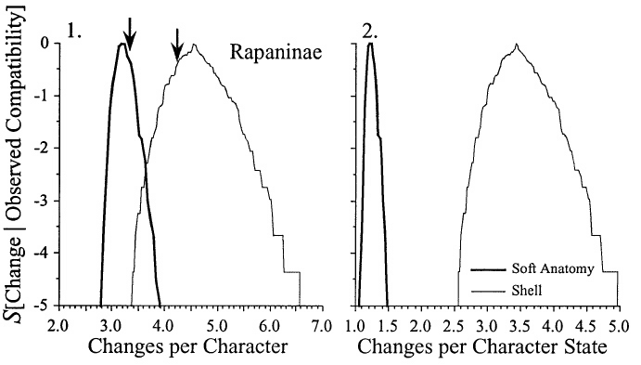
One can test partitions for significant differences in frequencies of change
“Slug” characters are significantly less homoplastic than are shell characters among the Rapaninae.

Slide 25
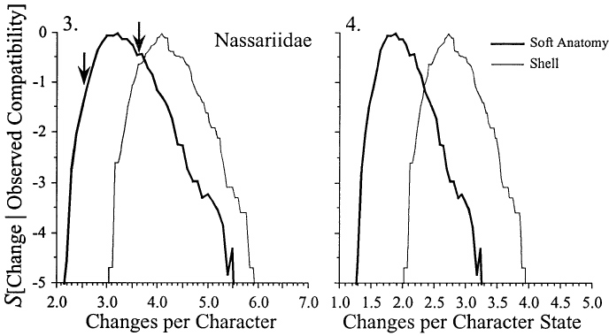
One can test partitions for significant differences in frequencies of change
This is much less true for species in the Nassariidae.

Slide 26
Effect of Change on Compatibility
Simulation of 32 taxa with 100 binary characters and 200 total changes
Infrequently changing characters typically have high compatibilities
frequently changing ones have low compatibilities.

Slide 27
Extreme distributions of taxa with derived states:
End cases automatically compatible
  0 0 0
  0 0 1
  0 0 1
  0 0 1
  0 0 1
  0 0 1
  0 0 1
  0 0 1
  0 1 1
  0 1 1
  0 1 1
  0 1 1
  0 1 1
  0 1 1
  0 1 1
  1 1 1

Slide 28
Effect of Derived Taxa on Compatibility
Simulation of 32 taxa with 100 binary characters and 200 total changes
Characters with 1 or 31 taxa with 0 or 1 (= autapomorphic) are automatically compatible
Characters with 16 0’s and 1’s have lowest compatibility.

Slide 29
Given X steps, compatibility is correlated with the number of derived taxa.
1 Change
3 Changes
2 Changes

Slide 30
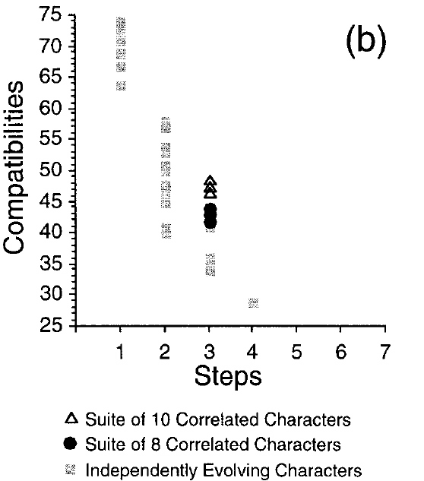
Effect of Correlated Character Change on Compatibility
Simulated case with two suites of characters in which change in one induces a 75% chance of change in others.
Elevates compatibility because distributions are so similar.

Slide 31
Testing for Independent Character Change: Mutual Compatibility
Mutual compatibility: common compatibilities between two characters.
  If character i and j both are compatible with character k, then it is a mutual compatibility.
Character suites that exhibit correlated change should share more mutual compatibilities than independently changing characters.
  Do characters i & j have more mutual compatibilities than expected given compatibility and independent change?

Slide 32
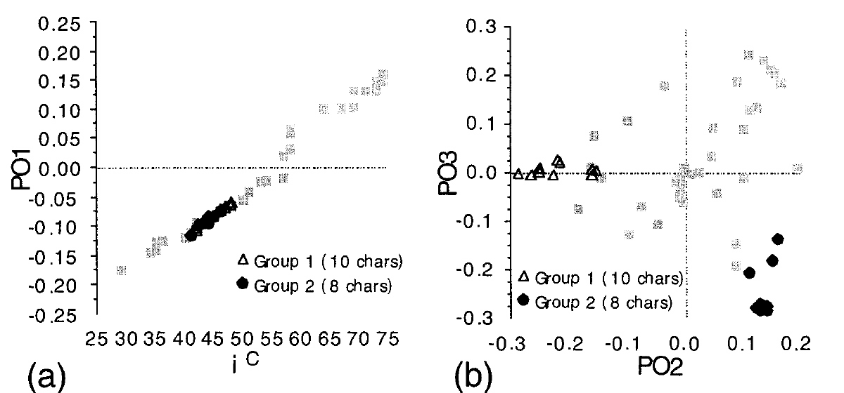
Testing for Independent Character Change: Mutual Compatibility
Multivariate structure among mutual compatibilities clusters correlated suites.
  Similarity between each character pair based on proportion of other characters with which both are compatible.

Slide 33
Testing for Independent Character Change: Mutual Compatibility
Mutual compatibility: common compatibilities between two characters.
  If character i and j both are compatible with character k, then it is a mutual compatibility.
Character suites that exhibit correlated change should share more mutual compatibilities than independently changing characters.
  Do characters i & j have more mutual compatibilities than expected given compatibility and independent change?

Slide 34
Stratigraphic Compatibility
For individual characters: no states with gaps in sampled record
For character pairs: compatible pair in which the appearance of character pairs is also consistent with phylogeny.

Slide 35
Compatible Pair Compatible with Stratigraphy
Ch 1 Ch2 FA LA
0 0 1 8
1 0 2 4
1 1 2 6
2 0 6 8
2 2 7 7
No necessary homoplasy, nor any necessary stratigraphic gaps between morphotypes.

Slide 36
Compatible Pair Incompatible with Stratigraphy
Ch 1 Ch2 FA LA
0 0 5 8
0 1 3 8
1 0 2 6
1 2 1 4
Morphotypes 00 and 01 appear out of order given character necessary to avoid homoplasy.

Slide 37
Compatible Pair Incompatible with Stratigraphy
Ch 1 Ch2 FA LA
0 0 1 8
1 1 2 7
2 1 2 4
2 2 6 8
Morphotypes appear in the right order, but a gap exists between morphotypes 21 & 22.

Slide 38
Compatible Pair Incompatible with Stratigraphy
Ch 1 Ch2 FA LA
0 0 1 8
1 1 2 7
1 1 3 6
Morphotypes appear in the right order, but a gap exists within morphotypes 01.

