Slide 1
Evaluating the Fossil Record with Model Phylogenies
Cladistic relationships can be determined without ideas about stratigraphic completeness; implied gaps might be useful for evaluating stratigraphy.

Slide 2
Evaluating the Fossil Record with Model Phylogenies
Sum of range extensions / ghosts = stratigraphic debt sensu Fisher (1992).

Slide 3
Evaluating the Fossil Record with Model Phylogenies
Many metrics attempting to quantify sampling make naïve assumptions about the minimum possible gaps!

Slide 4
Tree-based evaluations of the fossil record
Phylogeny can be estimated independently of stratigraphic distributions
  Necessarily implies gaps in the record
Two basic types of metrics:
  Consistency: measures general agreement between predicted and observed orders of appearance;
  Gap: measure the sum of gaps implied by a phylogeny.

Slide 5
Tree-based Assessments of Sampling:
Stratigraphic Consistency Index
Consistent node: one in which the sister taxon appears prior to the node;
SCI = Consistent nodes / All nodes

Slide 6
Tree-based Assessments of Sampling:
Relative Completeness Index
RCI = 1 - (∑ Gaps / ∑ Ranges)

Slide 7
Tree-based Assessments of Sampling:
Gap Excess Ratio
GER = (M-g)/(M-m) where:
  M = maximum possible gaps (= ∑first appearances);
  g = implied gaps;
  m = minimum possible gaps.

Slide 8
Tree-based Assessments of Sampling:
Manhattan Stratigraphic Metric
MSM = m/g where:
  g = implied gaps;
  m = minimum possible gaps.
Based on consistency index.

Slide 9
Relationships between Sampling
& Tree-Based Sampling Metrics from Simulations
32 taxa with λ=0.50, μ=0.45 & budding cladogenesis.

Slide 10
Relationships between Sampling
& Tree-Based Sampling Metrics from Simulations
RCI & SCI reflect sampling; GER & (especially) MSM do not.

Slide 11
Properties of the Components to Metrics: Gaps
Sum of gaps increases exponentially as sampling gets worse.

Slide 12
Properties of the Components to Metrics: Minimum Gaps
Sum of minimum gaps also increases exponentially as sampling gets worse.

Slide 13
Properties of the Components to Metrics: Maximum Gaps
Sum of maximum gaps also increases exponentially as sampling gets worse.

Slide 14
Properties of the Components to Metrics: Sum of Ranges
Sum of ranges decreases exponentially, but with minimum determined by the number of taxa.

Slide 15
Problem: People often forget that we do not always have gaps!
If taxa have good fossil records, then many trees will have minimum possible gaps of 0.

Slide 16
Ignoring Ancestors greatly exaggerates implied Range Extensions
Based on 1000 simulations of 32 sampled OTU’s at each R (sampling rate per time unit) with λ = 0.5 & μ = 0.45 per unit

Slide 17
Ignoring Ancestors greatly exaggerates implied Range Extensions
The expectations for wide range of preservation rates become indistinguishable.

Slide 18
Ignoring Ancestors greatly exaggerates implied Range Extensions
Distortion is huge at sampling levels thought to be typical for marine invertebrates and even some land vertebrates.

Slide 19
Ignoring Ancestors greatly exaggerates implied Range Extensions
This is not the case if one accommodates ancestors.

Slide 20
Relationships between Sampling
& Tree-Based Sampling Metrics
Failing to account for ancestors makes things worse…

Slide 21
Using stratigraphic data to assess phylogenies
Stratocladistics: minimize stratigraphic gaps and homoplasies.
Confidence Interval Sieving: rejects trees with gaps exceeding 95% confidence intervals (a la Strauss & Sadler 1989).
Stratolikelihood: determines the probability of stratigraphic distributions given tree and sampling rates.

Slide 22
Stratocladistics
First and last stratigraphic occurrences of each taxon noted.
A gap through an interval treated as evidence against a phylogeny equal to that of an extra morphological change.
“Stratigraphic debt” reduced by ancestor-descendant relationships as well as by altering cladistic topology.
Generates phylogeny, not just a cladogram.

Slide 23
Stratocladistics
Sampled ranges of 6 taxa.

Slide 24
Stratocladistics
6 taxa coded for 7 characters (each row a character).

Slide 25
Stratocladistics
Parsimony tree for 6 taxa given matrix.

Slide 26
Stratocladistics
Phylogeny matching parsimony tree; 8 steps, but gaps (= 3 units of strat. debt) or 11 “steps” overall.

Slide 27
Stratocladistics
Phylogeny matching parsimony tree; B set as ancestor to C because it has no apomorphies.

Slide 28
Stratocladistics
D not considered ancestral because it has an apomorphy; however, that causes 2 gaps.

Slide 29
Stratocladistics
Making D ancestral increases steps to 9 but reduces strat. debt to 1, giving a total score of 10.

Slide 30
Stratocladistics
Making E ancestral saves 1 step and induces 1 gap.

Slide 31
Stratocladistics
No total savings, but making E ancestral reduces unsampled ancestors (another parsimony criterion).

Slide 32
Assumptions of Stratocladistics
Probability of a character changing comparable to probability of a unit of stratigraphic debt.
  (ln P [gap] + ln P[stasis]) ≤ ln P[change]
Probability of all gaps has the same meaning throughout the tree.

Slide 33
Confidence Interval Sieving
Probability of gaps assessed based on confidence intervals;
  Number of sampling opportunities over gap considered.
    If there are no opportunities, then there really is no gap.
  Probability of missing a taxon n times assessed given the number of finds and the number of possible finds within its range;
  Separate “time scales” used for different geographic / environmental units.

Slide 34
Confidence Interval Sieving
If significant gaps exists between a “younger” sister taxon and an “older” species, then apomorphies will be reversed;
  This lengthens the tree and makes it possible for another tree to be shorter;
  The most poorly sampled member of a clade used to formulate CI for that clade;
If significant gaps exist between sister clades, then the tree is simply rejected.
Shortest tree with no significant gaps is taken.

Slide 35
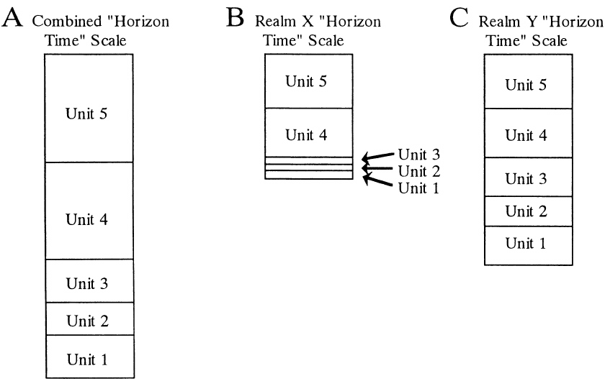
“Horizon Scales” for Different sampling realms
“Height” measures number of sampling opportunities; the “duration” of a time interval can be very different in different sampling realms.

Slide 36
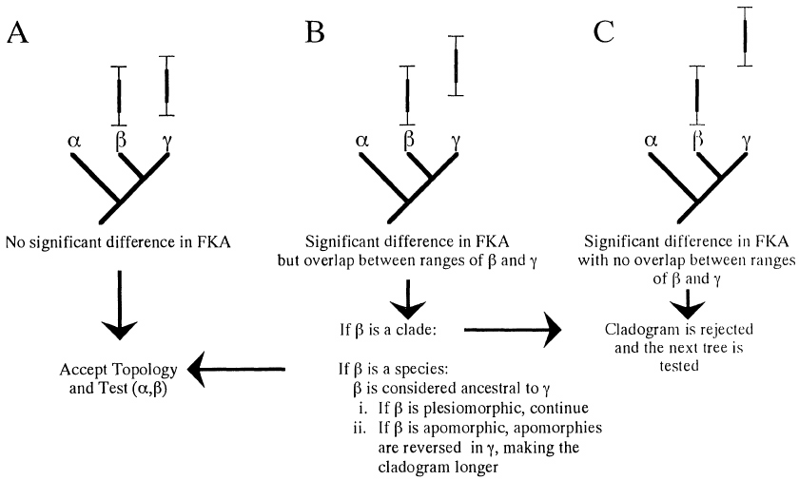
Confidence Interval Sieving
Case simplest for bifurcations…

Slide 37
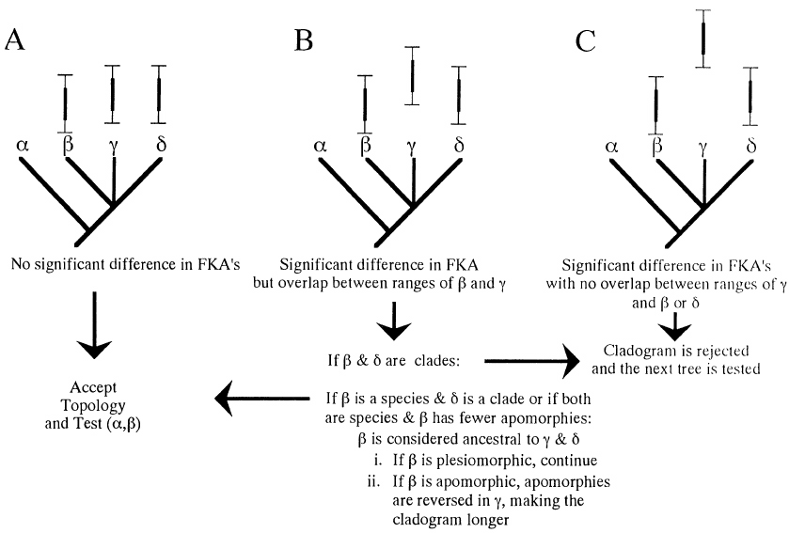
Confidence Interval Sieving
… but not much different for polytomy.

Slide 38
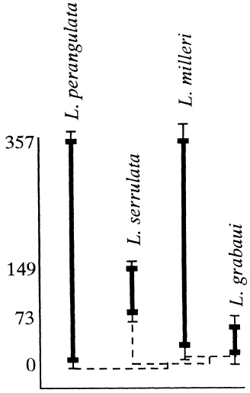
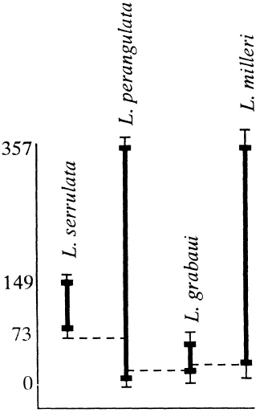
Confidence Interval Sieving
Example of how stratigraphy rejects one phylogeny in favor of another.

Slide 39
Confidence Interval Sieving Assumptions
Strength of characters uniting a clade ignored;
  Gap supported by slowly evolving characters treated no different than a gap supported by highly homoplastic ones;
  Degree of significance no considered.
Method simply rejects hypotheses; it does not show how well they predict data.

Slide 40
Stratolikelihood
Exact probability of gaps calculated given sampling opportunities.
Likelihoods of gaps based on sampling rates within lineages;
  Because sampling rate is unknown, the rate and gap can be maximized;
  Shifts in sampling rates within lineages or within clades taken into account.
L[τ | stratigraphy] x L[τ | morphology] = L[τ | data]

Slide 41
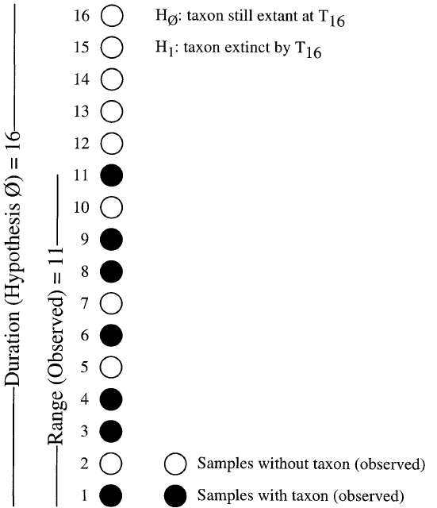
Sampling Rates (θ) of Stratolikelihood
Given that a taxon is found n=7 times in R=11 horizons, the most likely sampling rate is not 7/11, but instead is 5/9…..

Slide 42
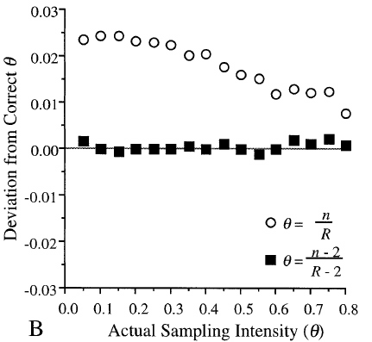
Sampling Rates (θ) of Stratolikelihood
(assessment from simulations)
… as n/R chronically overestimates R. This is because we do not know the true duration over which we made those n finds.

Slide 43
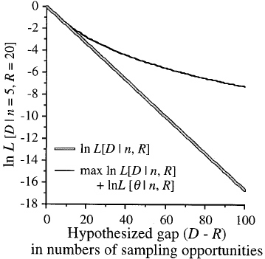
Use sampling rate (θ) maximizing the probability of a sampling gap AND of the observed finds
i.e., use n / D (where D is the number of finds over the hypothesized duration).

Slide 44
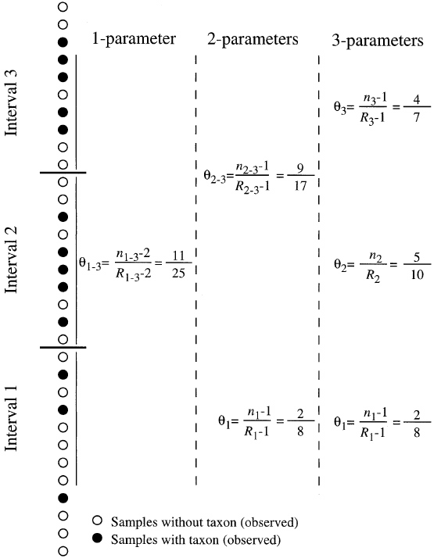
Finding Variable θ in Stratolikelihood
Within lineages, one can test whether θ differs significantly early or late in a stratigraphic range.

Slide 45
Stratolikelihood
Like stratocladistics, tree evaluated “equally” by both morphologic and stratigraphic data.
Like confidence interval sieving, importance of gap depends on the density of sampling and in which sampling realm the gaps should exist.
Unlike either, it allows different characters to present different levels of evidence against phylogeny.

Slide 46
Using Inferred Ancestors to test Hypotheses about Speciation Patterns
Hypotheses about different modes of speciation make different predictions about morphotypes distributions.

Slide 47
If Anagenesis and Bifurcation predominate, then we expect ancestral morphotypes to predate derived morphotypes
Note: Phylogenetic & stratigraphic patterns can only be consistent with anagenesis - imperfect sampling means that we cannot rule out co-existence.

Slide 48
If Budding cladogenesis predominates, then we expect ancestral morphotypes to co-exist with descendant morphotypes.
Note: Within the context of a given cladogram, stratigraphy can reject non-budding relationship between two species!

