Slide 1
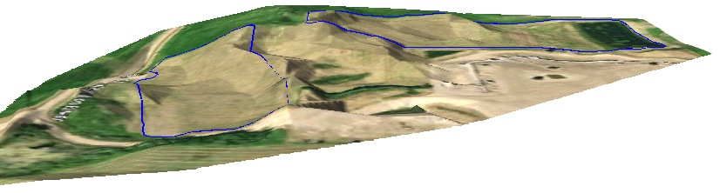
Introduction to GIS Short Course
Day 2 Refresher

Slide 2
What is Geographic Information?
GIS = Geographic Information System(s)
Geographic Information is any information with a location associated with it (so, everything)
Any information you can put on a map
(and want to)

Slide 3
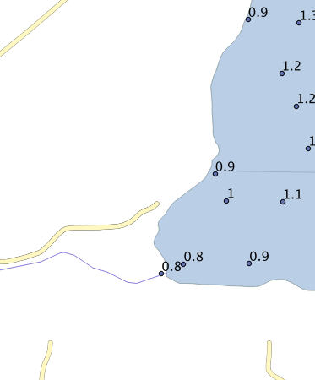
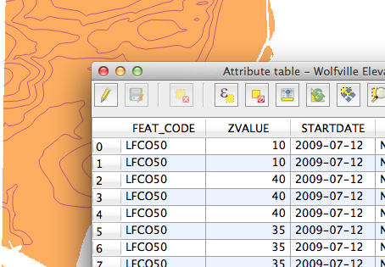
Vector Data
Points
Lines
Polygons
Features, Fields, Attributes

Slide 4
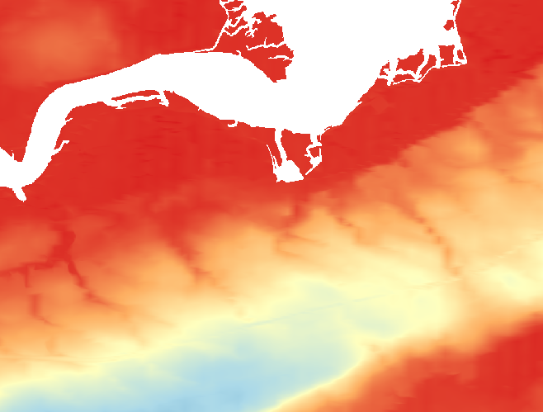
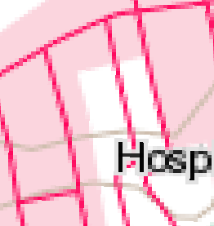
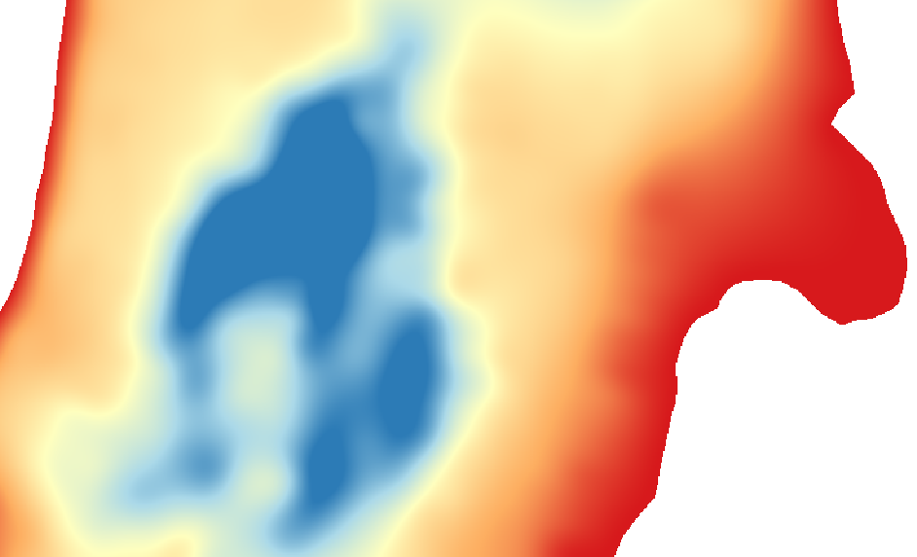

Raster Layers
Can be displayed in a variety of ways – “color ramp” (shown below), grayscale, several discrete colors.
For any point on the map, you can obtain a value from a raster.
Also called a “surface”

Slide 5
Projections
Coordinate Reference Systems
The XY coordinates of a particular dataset
Can be lat/lon (positions on the earth’s surface) or map coordinates (that can be related to lat/lon using a projection)
Earth’s Surface (Latitude, Longitude)
Projection
Map Coordinates (in distance units)

Slide 6
Projections/CRSs
Dataset (layer you add to QGIS)
The map you look at
Layer CRS/Projection
Dataset (layer you add to QGIS)
Project CRS/Projection
Layer CRS/Projection

Slide 7
What Happened in Day 1
Adding data into QGIS
Zoom, pan, navigate around the map
Changing the layer style (raster and vector)
Export your map using the print composer

Slide 8
Making A Map
Prepare your data
Add your data
Make sure your data is in the right place (ensure correct CRS) and pick a Project CRS
Change the style of your layers
Export your map using a print composer (add north arrow and scale bar)

Slide 9
Outline for Day 2
Refresher
Make a map of Study Sites in Nova Scotia
Creating and Editing Vector Layers
Introduction to Raster Processing
Interpolation & contouring
Introduction to Vector Processing
Selecting vector data, manipulating vector data
Your questions/projects!

