Slide 1
Coordinate Reference Systems

Slide 2
Coordinate Reference Systems (CRS)
GIS Data (raster and vector) is represented by coordinates (X and Y).
These X and Y coordinates can mean any number of things!
Latitude, Longitude, UTM Easting, UTM Northing, Arbitrary XY data from a defined grid
Every GIS data file has a CRS, because X and Y coordinates must be represented somehow.

Slide 3
Projections (“Project CRS”)
Earth is a sphere (actually, an ellipsoid), so to represent it on something flat (your screen, a piece of paper) we need a projection.
Projections are never perfect, always distort some combination of shape (angles), scale (distance), and area.
Mathematically, projections convert Latitude/Longitude values (angles) to X/Y values (distances).

Slide 4
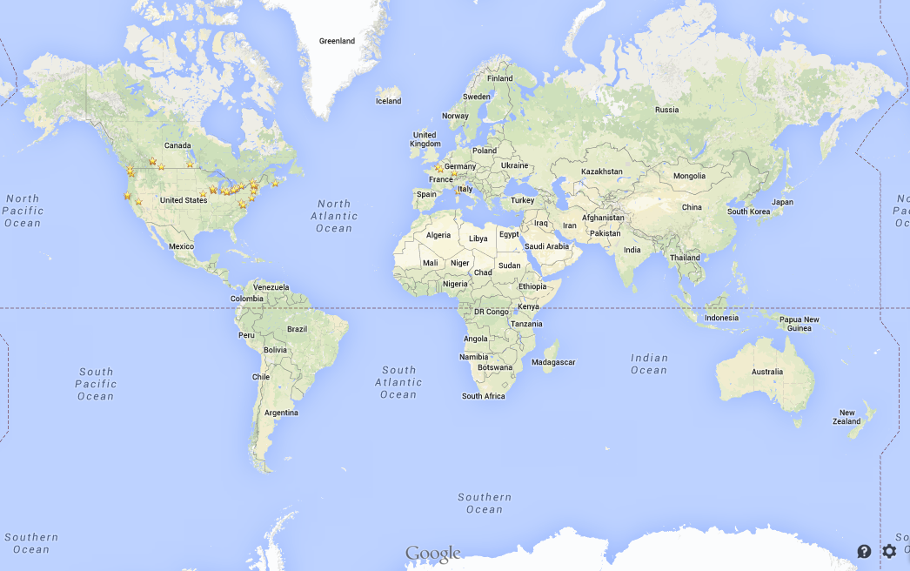
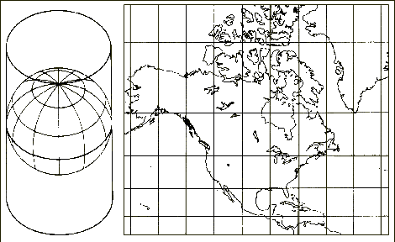
Mercator Projection
Y
X

Slide 5
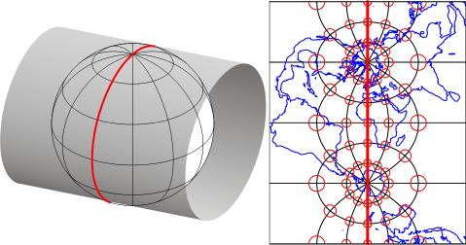
Transverse Mercator Projection
Low distortion for a very specific strip of the world
Used for local data
Y
X

Slide 6
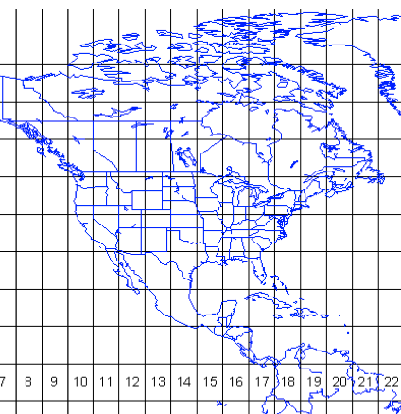
Universal Transverse Mercator Zones

Slide 7
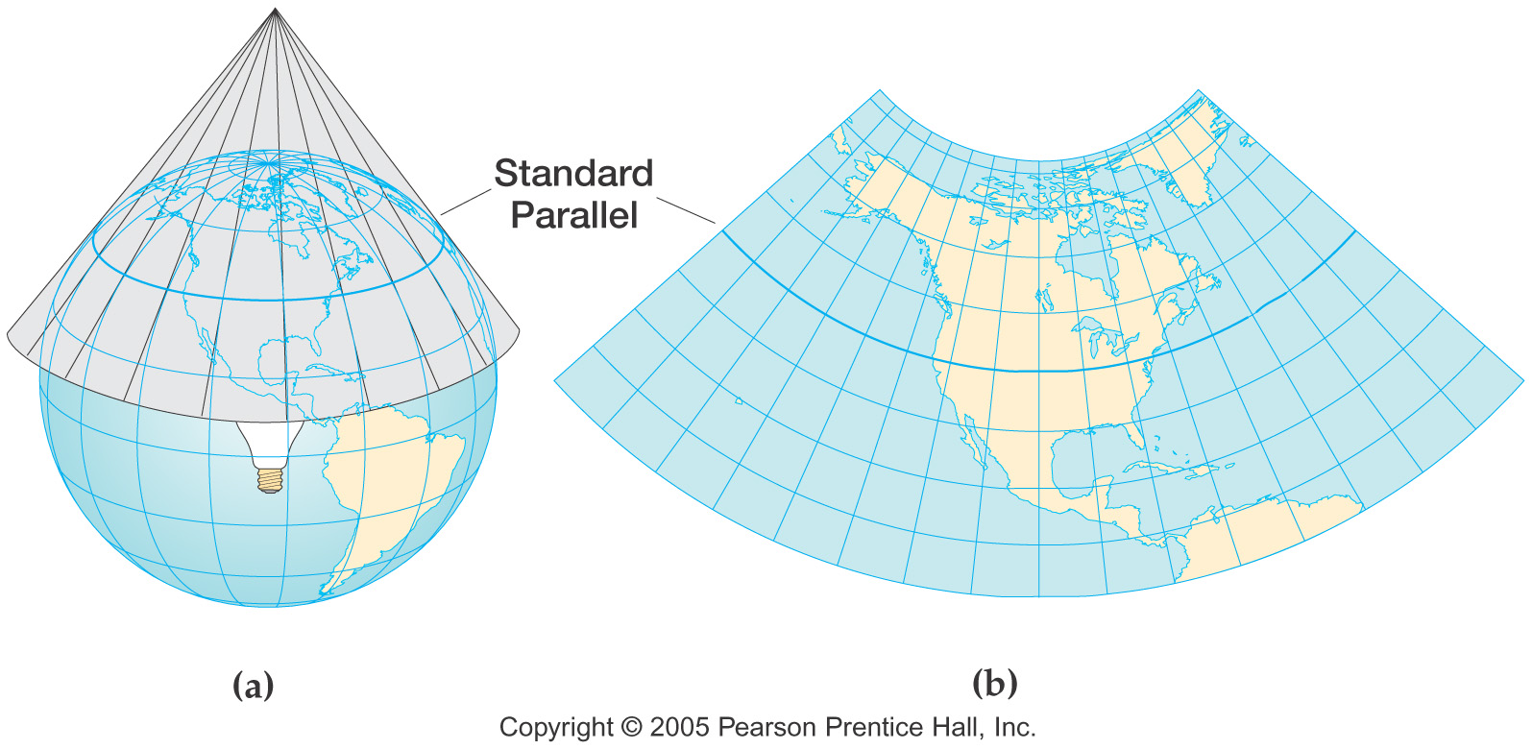
Conic Projection
Y
X

Slide 8
Projections
Coordinate Reference Systems
The XY coordinates of a particular dataset
Can be lat/lon (positions on the earth’s surface) or map coordinates (that can be related to lat/lon using a projection)
Earth’s Surface (Latitude, Longitude)
Projection
Map Coordinates (in distance units)

Slide 9
Projections/CRSs
Dataset (layer you add to QGIS)
The map you look at
Layer CRS/Projection
Dataset (layer you add to QGIS)
Project CRS/Projection
Layer CRS/Projection

Slide 10
Projections/CRSs
The CRS for a dataset can be projected (XY values in distance units) or geographic (latitude/longitude)
The projection in which you view geographic data can be different than the CRS of the dataset (“on-the-fly projection”)
If your data is not plotting in the right place, you have a CRS problem!

Slide 11
Common CRSs
WGS84 = Latitude/Longitude
NAD83 = Latitude/Longitude fixed for North American Plate
Nova Scotia is UTM Zone 20N
For small areas (less than 50-100 km across) use UTM!
For large areas (between UTM zones) use World Mercator or Albers Equal Area Conic
For the arctic, you may need to use other projections

