Slide 1
Data Analysis for
Nature and Conservation
Paleomammals and Geospatial Statistics

Slide 2
Overview
About the R software
About data
Spatial computation
Example: Morpho menelaus

Slide 3
What is the R software?
R is a computer language and computer environment used for:
Statistics
Data Analytics
Machine Learning
Mathematics
Modeling
Benefits of learning R
Many schools expect that you will have some experience with R, python, or MATLAB. It is a huge education and career skill!
Rstudio is an Integrated Development Environment that makes R easy to use.

Slide 4
R is a language
R has a syntax and learning the language is the first part of learning R.
BUT…R is very logical and pretty simple!
It was made for statistics, which sounds dry but remember that statistics is a big part of daily life from sports to finance to science!
We can start slowly and build from there, just like anything on the computer. Think of it as learning a new type of game.
The nice thing about R is, like games, it is very visual. You can check to see what is working and you can make nice graphics.
With not much time and effort, you will feel comfortable typing commands in R, the input, and looking at what it does… the output!

Slide 5



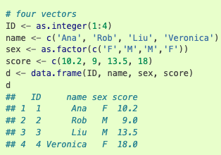
Data
Vector
A piece of data is usually considered a piece of factual information.
It’s often a number, say “53”, but it may be a name or character too, like ”mammal” or “%”
Putting multiple data together gives you a vector. Vectors can be used in matrix math for predicting changes over time.
Vectors can be combined to make lists or dataframes. Dataframes are commonly used in science as rows and columns of many variables over different conditions (ie, Excel sheets).
Functions allow you to manipulate data or create new data!
Matrix
Dataframe
https://rspatial.org/index.html

Slide 6
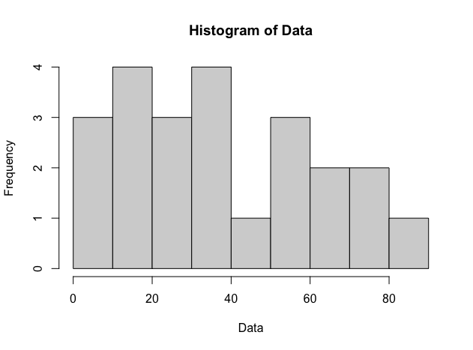
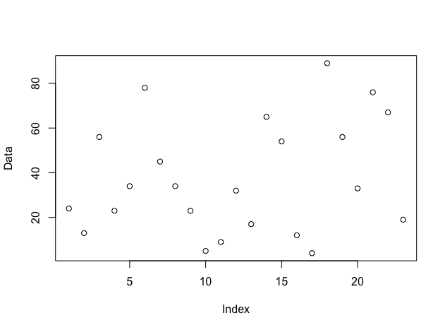
Raw data can be analyzed statistically for useful information!
Example: raw data
Data = c(24,13,56,23,34,78,45,34,23,5,9,32,17,65,54,12,4,89,56,33,76,67,19)
Information about the raw data:
N = 23
Mean(Data) = sum(Data)/N = 37.73913
Median = median(Data) = 33
Mode = mode(Data) = 23, 34, 56
Variance = (Xi-Mean)^2 = 640.6561
SD = sqrt(var) = 25.31119
Data is often a sample from a population.
Using statistics, you can make confident inferences about the population from the small sample that you have!
Notes:
mode(Data) gives you storage mode of the variable
Need to define a function:
Mode <- function(x) {
ux <- unique(x)
ux[which.max(tabulate(match(x, ux)))]
}

Slide 7
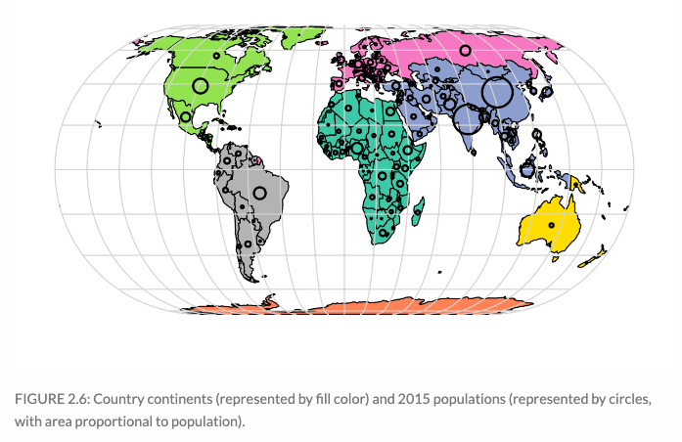
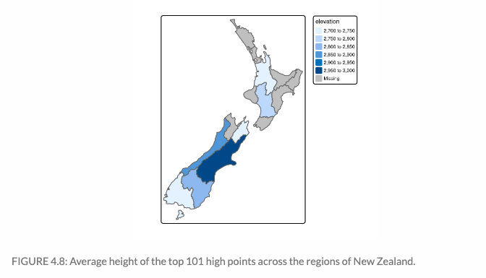
Geocomputation: examining attributes across space (e.g., by latitude and longitude)
Data science, ecology, and geography go hand in hand
Climate change is driving the integration of these fields to solve important problems
Understanding all of this is important not just for science but business and society!
https://r.geocompx.org/

Slide 8
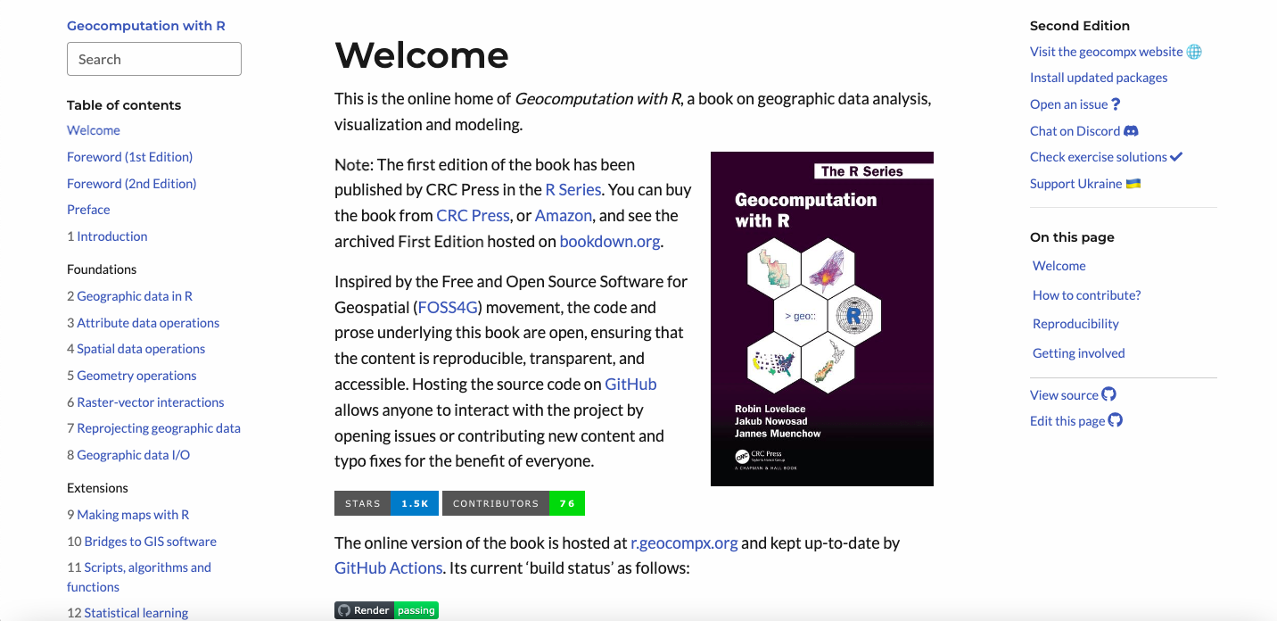
https://r.geocompx.org/

Slide 9
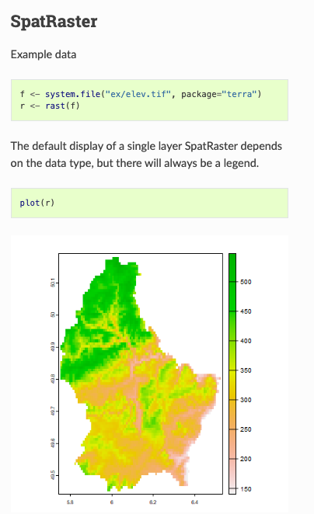
Example: Elevation in Germany
Many thousands of points!
A raster makes small cells, or pixels, of the map and gives the average of each square.
Much less data to work with!

Slide 10
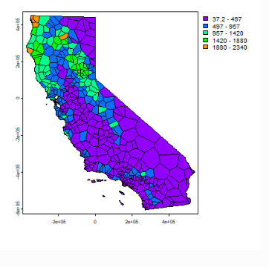
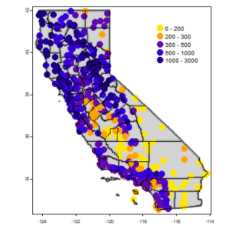
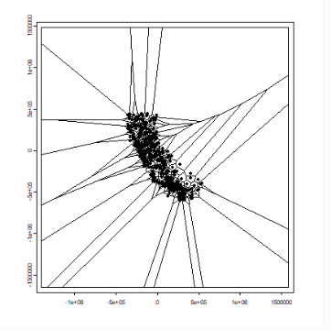
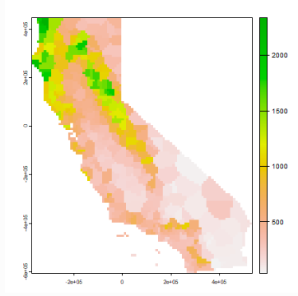
https://rspatial.org/index.html
Interpolate!
Raster
Example: Spatial Data Science –
Plotting California Drecipitation data

Slide 11
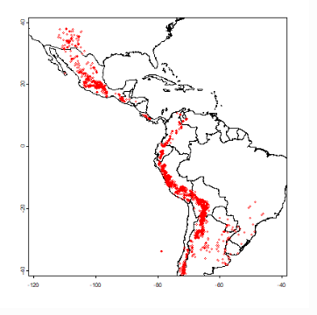
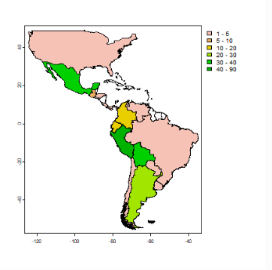
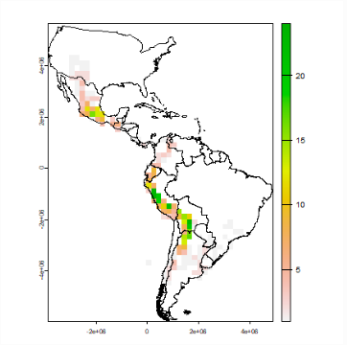
Example: Plot the number of species (species richness) of wild potato across the Americas
A dataframe contains information on wild potatoes with the observation locality and number of species
Wild potatoes!
Species richness by country
Species richness in raster
https://rspatial.org/index.html

Slide 12
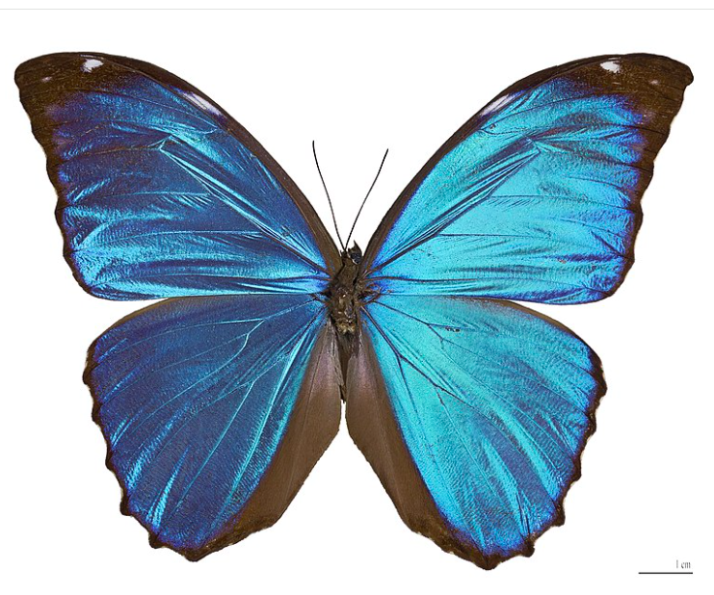
Example: Morpho menelaus – blue morpho butterfly
Range from Mexico to South America
Like old growth forests with canopies
Hydorphobic wings
Not endangered
Highly prized by collectors
If I wanted to see one, where in Central or South America should I go?
I can build a model that describes all the places on earth where habitats/environments/climate are most suitable for this species.
Wikipedia Commons

Slide 13
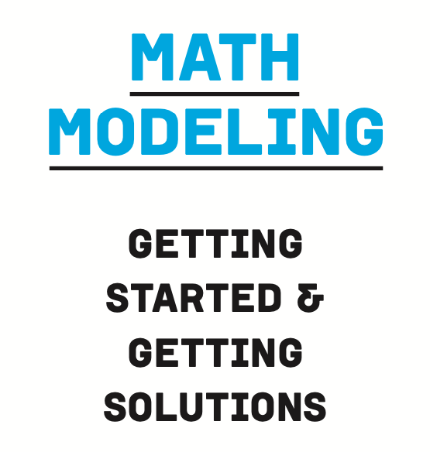
What is modeling?
“A mathematical model is a representation of a system or scenario that is used to gain qualitative and/or quantitative understanding of some real-world problems and to predict future behavior.”
Models are simple abstractions of reality
Models take the core factors of a system and describe their relationships mathematically.
Many models may exist to describe a system, the question is whether it makes sense and is useful

Slide 14
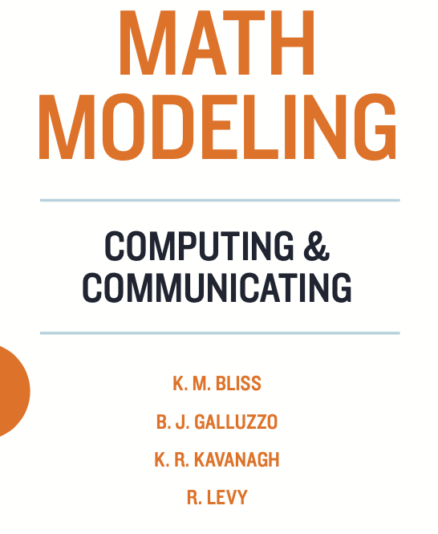
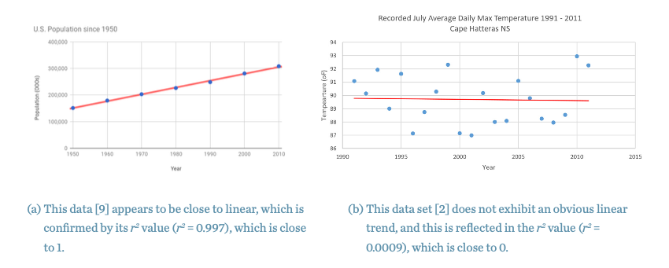
Example: Linear Model
Population
Temperature
As you change x…… how does y respond?
What are x and y in our example?

Slide 15
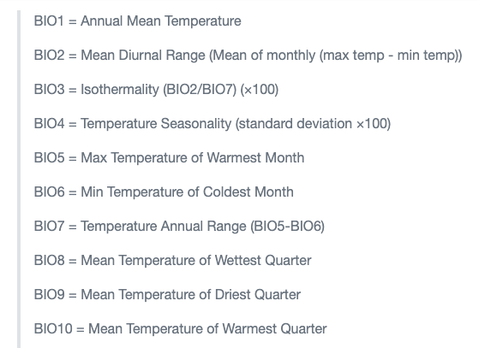
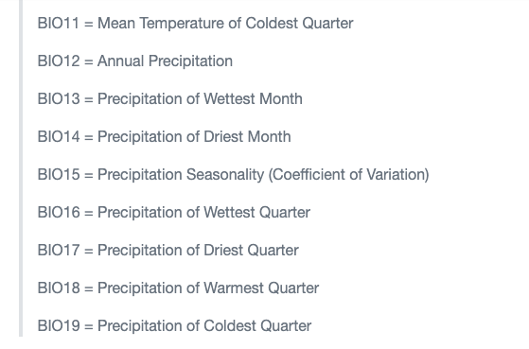
BioClimate data (i.e., the x, independent, or predictor variables)

Slide 16
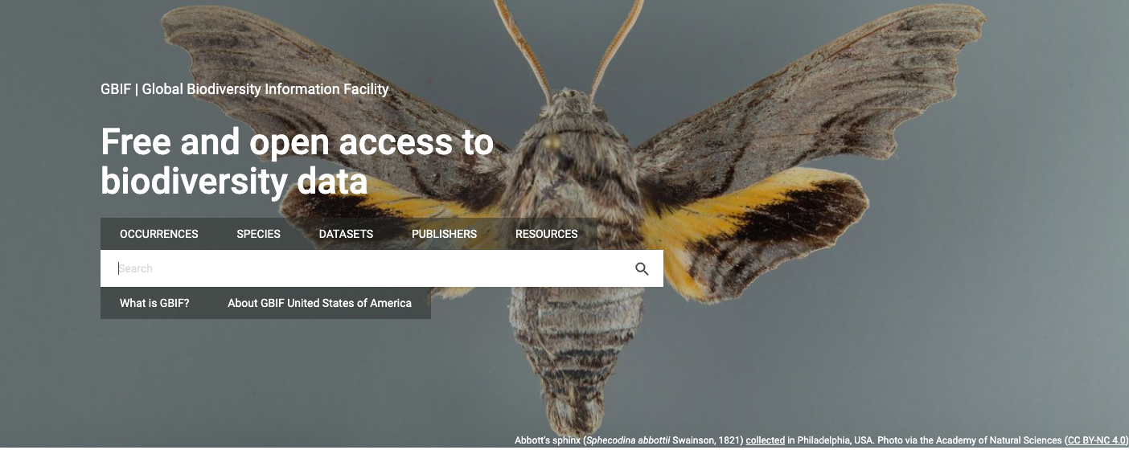
GBIF: Global Biodiversity Information Facility (i.e. the y or dependent variable)

Slide 17
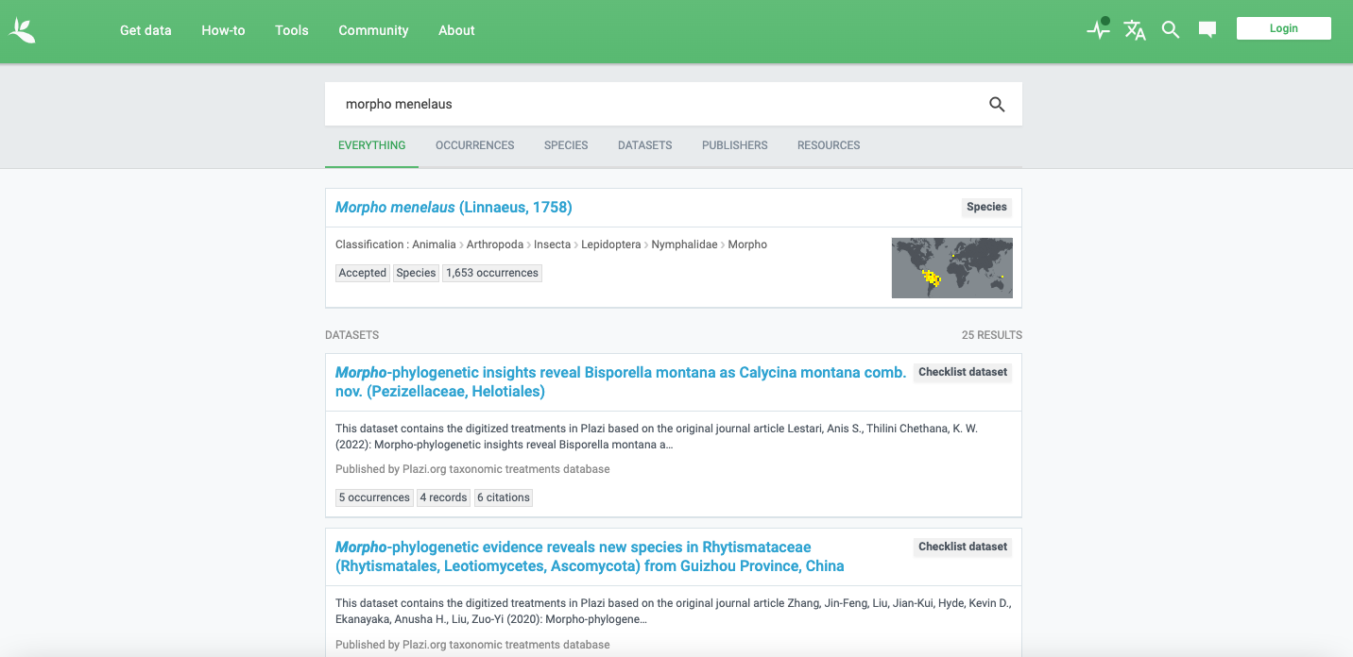
Species Occurrences – Human Observations (i.e. the y or dependent variable)

Slide 18
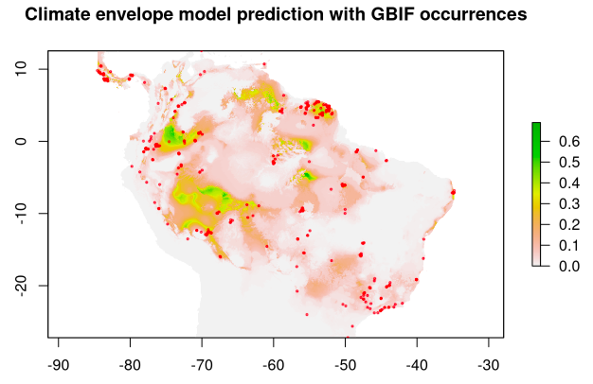
Generalized Linear Model – correlating occurrences with climate
Species location and climate variables – how do they correlate and where?

