Slide 1
O&E Lecture 5 Chapter 53: Population Ecology

Slide 2
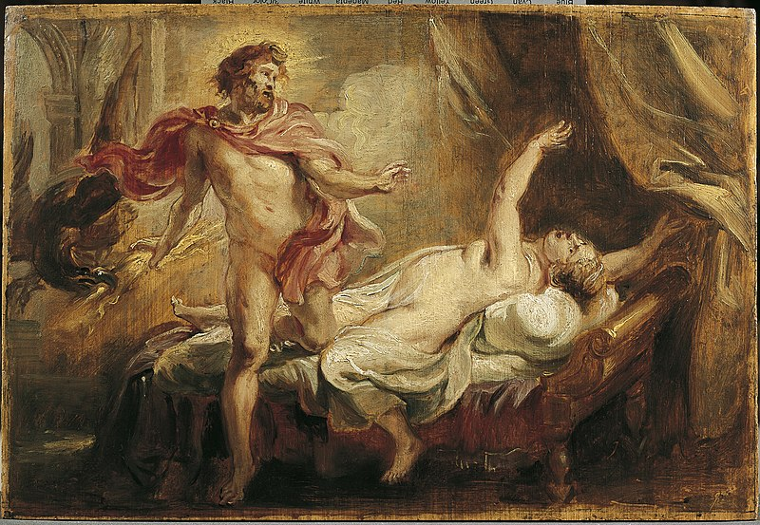
Chapter 53: Population Ecology

Slide 3
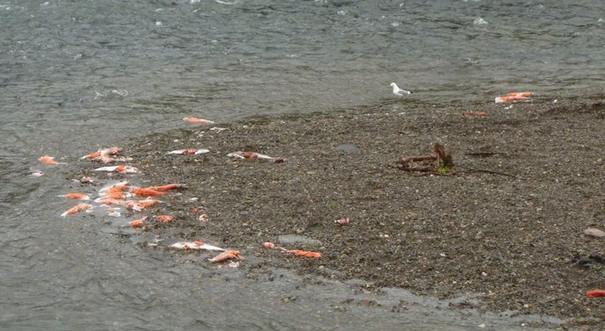
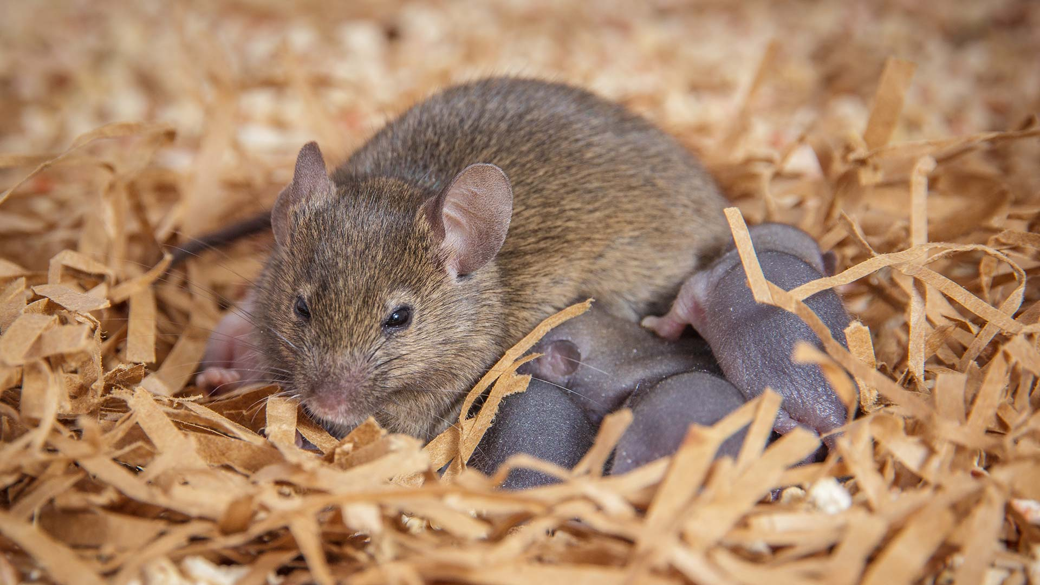
Semelparity & Iteroparity
How to invest in offspring?
Give everything to one clutch (semelparity)
Give some, but hold back for future clutches (iteroparity)
Notes:
https://onlinelibrary.wiley.com/doi/full/10.1002/ece3.4247

Slide 4
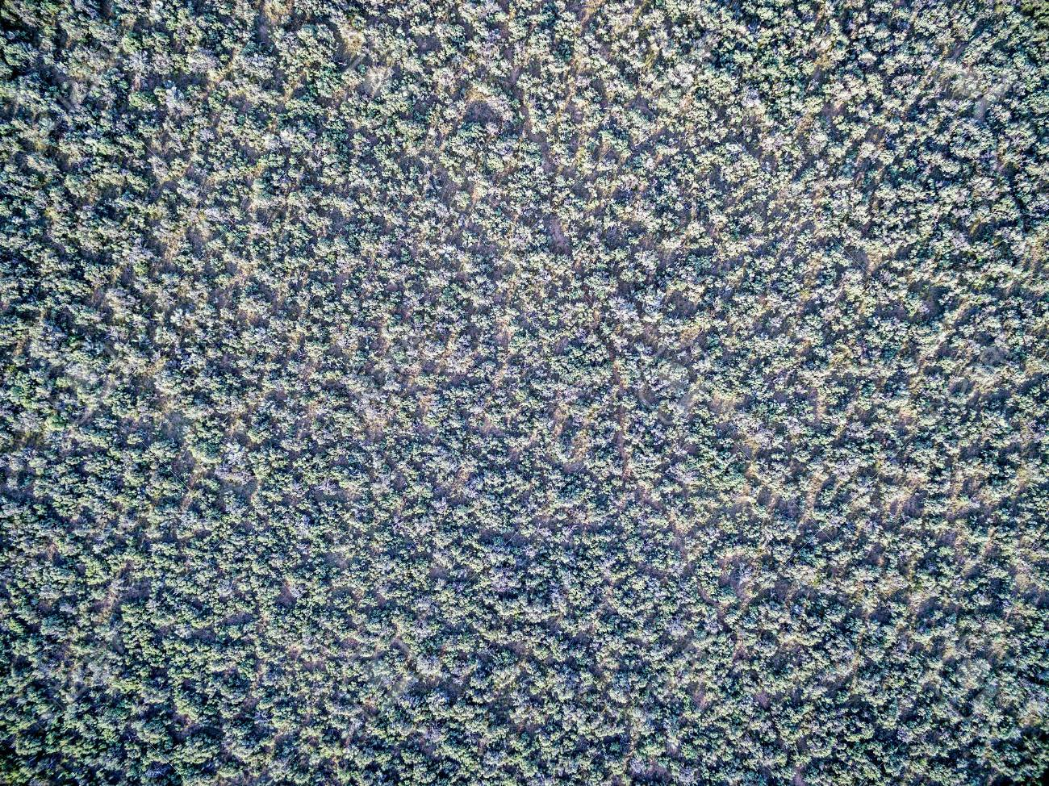

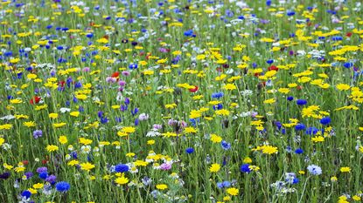
Describing Populations
Density & Dispersion
Uniform: something keeping organisms separate (e.g., organisms repel each other)
Clumped: something keeping organisms together (e.g., organisms grow together)
Random: ¯\_(ツ)_/¯

Slide 5
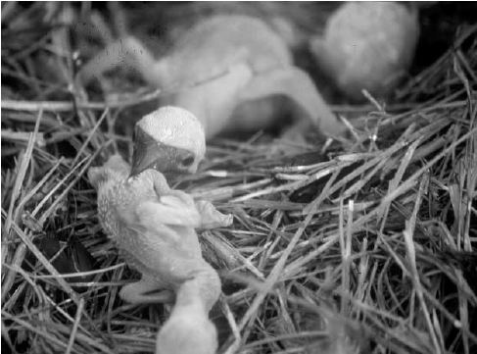
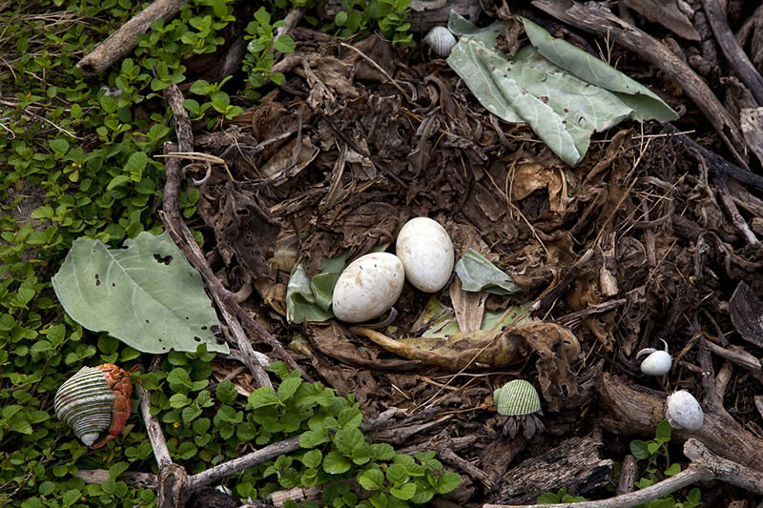
Describing Populations
Density & Dispersion
Birth & Death rates
Notes:
https://www.researchgate.net/publication/225705894_Is_obligate_siblicidal_aggression_food_sensitive

Slide 6
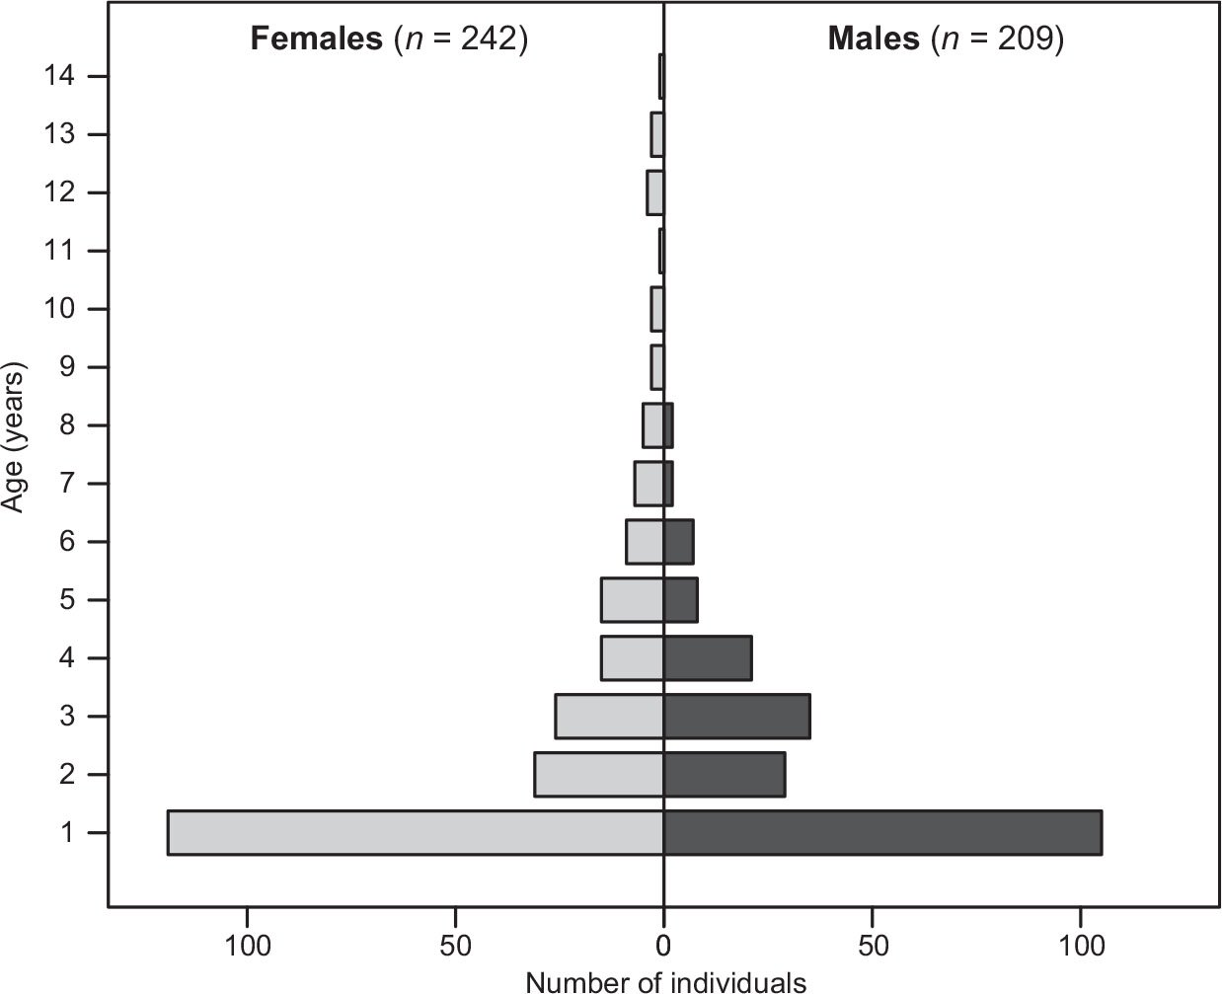
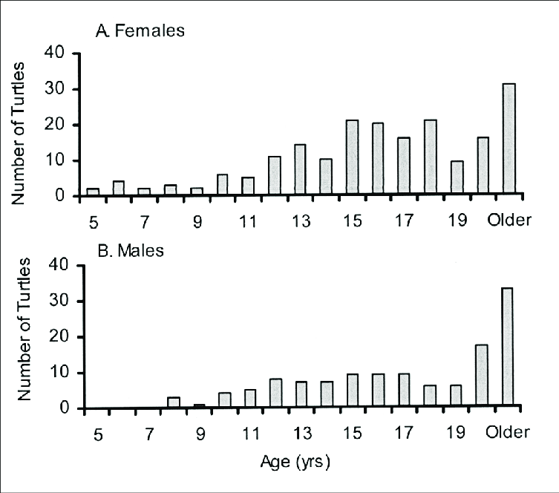
Describing Populations
Density & Dispersion
Birth & Death rates
Survivorship & Age structure
Notes:
https://www.researchgate.net/figure/Age-structure-of-cold-stunned-and-stranded-Green-Turtles-in-south-Texas-estimated-from_fig1_273631876
NC box turtles (left) vs white-tailed deer (right)

Slide 7
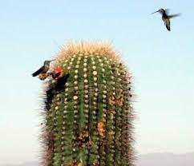
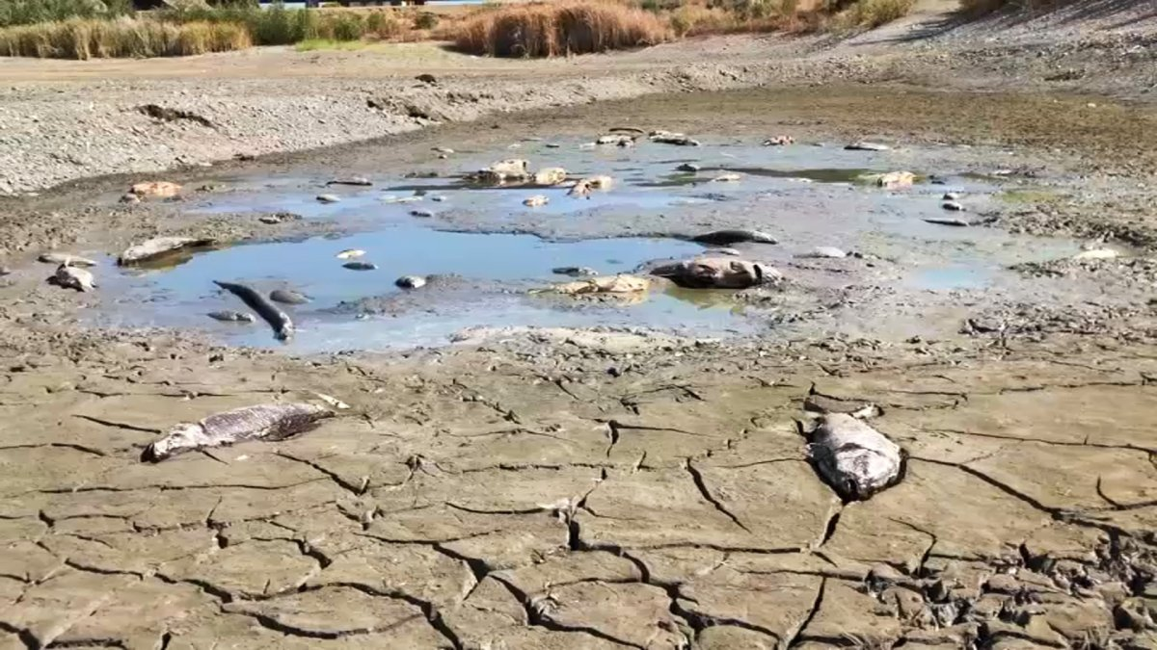
What can change a population?
New individuals being born (birth)
Old individuals dying (death)
Some individuals leaving (emigration)
Some individuals arriving (immigration)
Density dependent and density independent factors

Slide 8
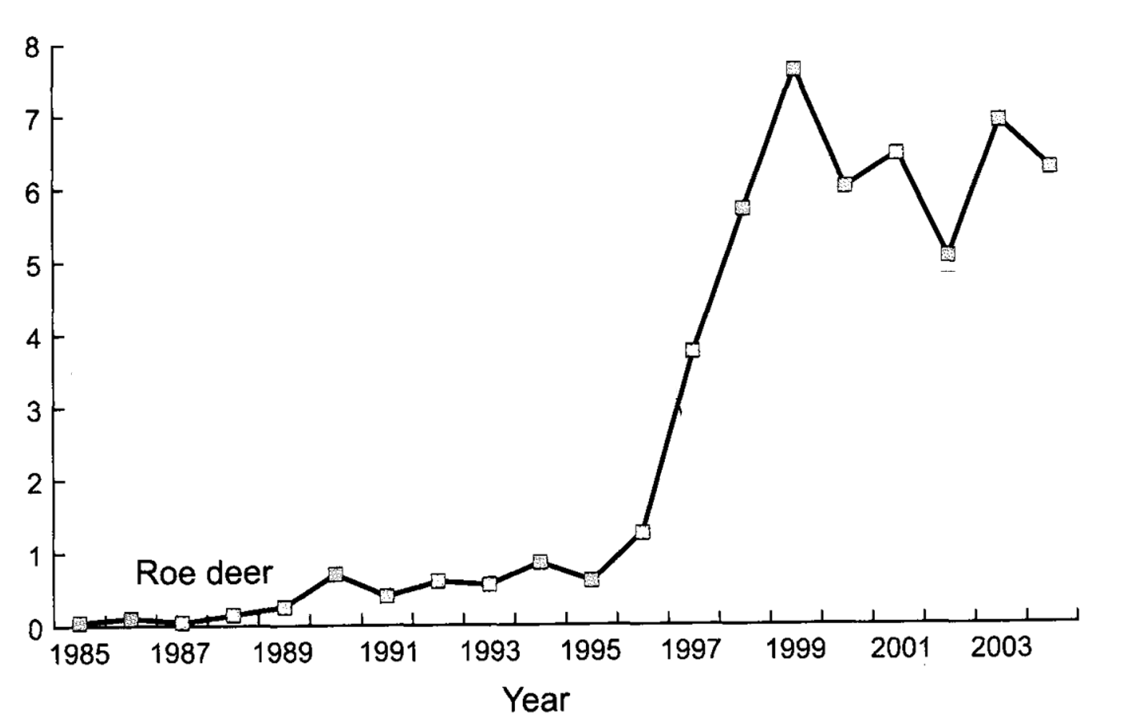
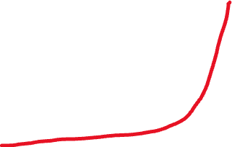
Nature of Population Growth Curves
“J” shape reflects intrinsic rate of growth (r; birth – death)

Slide 9
Nature of Population Growth Curves
“J” shape reflects intrinsic rate of growth (r; birth – death)
”S” shape reflects limits
K = carrying capacity
K

Slide 10

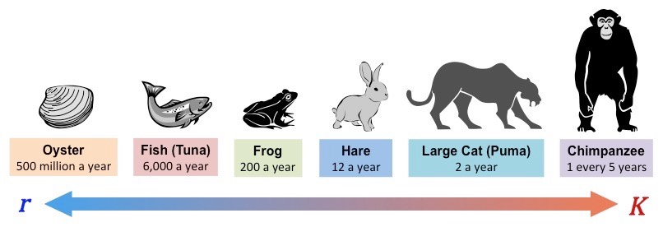
Life History Traits of Individuals
Different types of investments in the young
“r” type strategies: expend resources to make more babies
“K” type strategies: expend resources to make better babies
Fecundity (~offspring born) & Fitness (~offspring that make offspring)

Slide 11
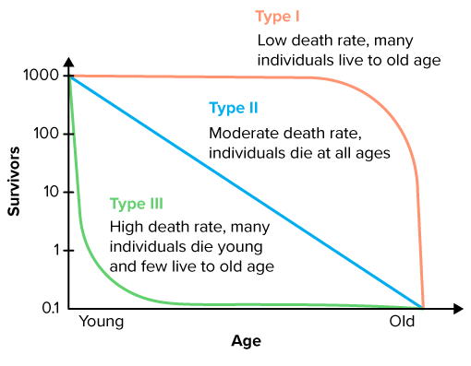
When individuals die varies
Survivorship curves
I: Death increases with age
II: Death rate constant
III: Death decreases with age
These are stereotypes
Curve can change during life

Slide 12

Metapopulations & Dispersal
Metapopulation: groups of populations
Dispersal: movement between populations
Notes:
https://www.mdpi.com/1424-2818/14/7/524

Slide 13
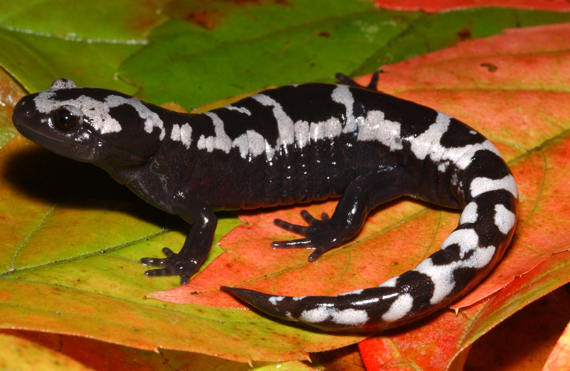
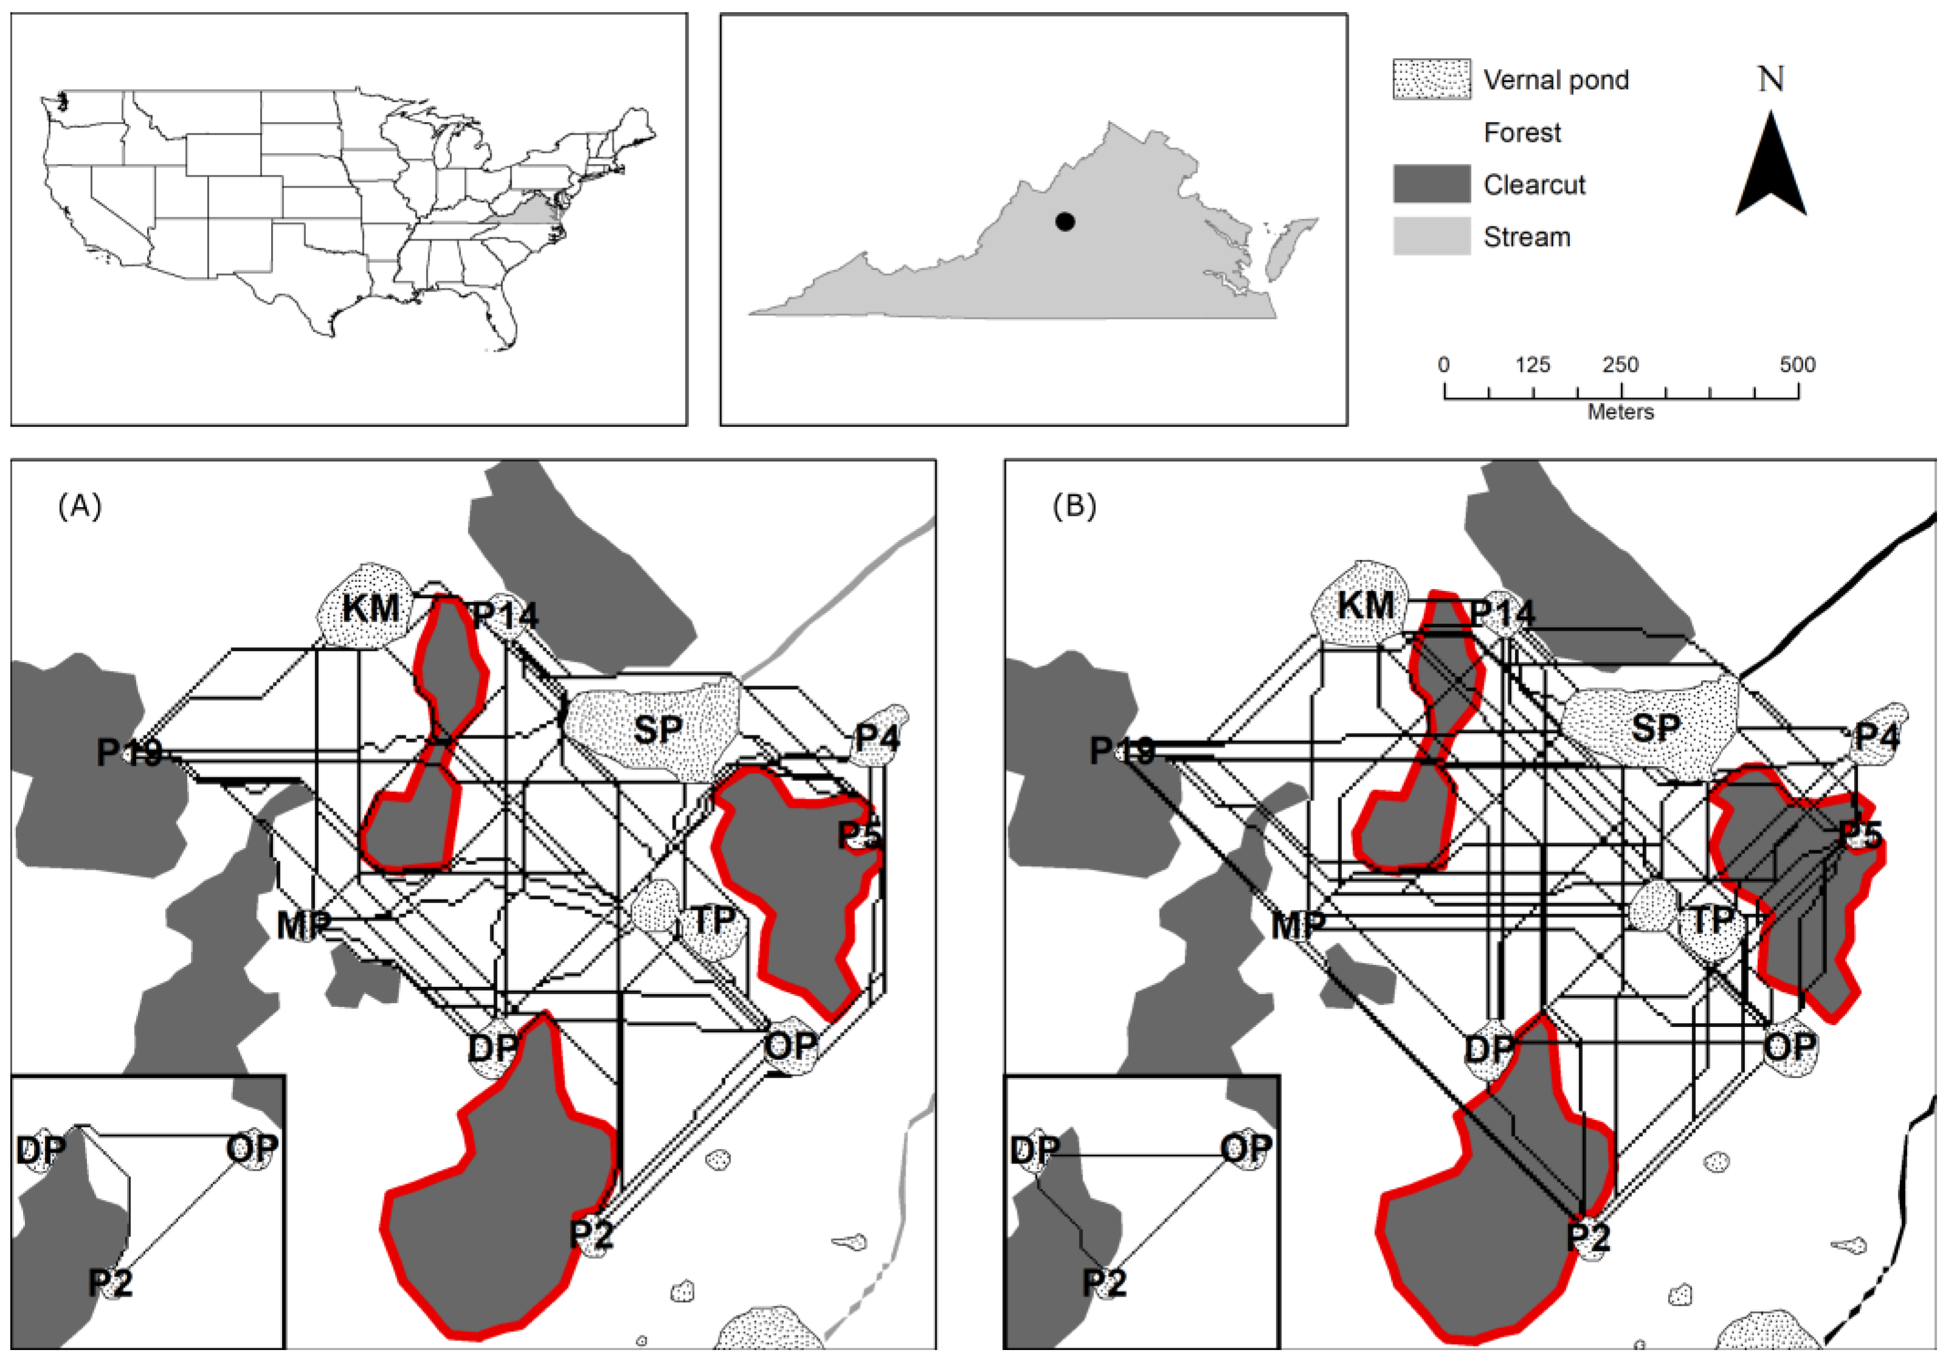
Metapopulations & Dispersal
Metapopulation: groups of populations
Dispersal: movement between populations
Source population
Too many individuals born, some must leave (emigrate out)
Sink population
Too few individuals born, some must arrive from outside (immigrate in) or the population will go extinct
Notes:
https://www.mdpi.com/1424-2818/14/7/524

Slide 14
Review Time!

