Slide 1
Smiles
Wayne Aulner 2
Palep Naren 40
Wei Haung 18
Karthik Vundella 57

Slide 2





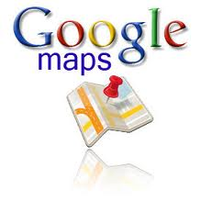

Technology / APIs

Slide 3
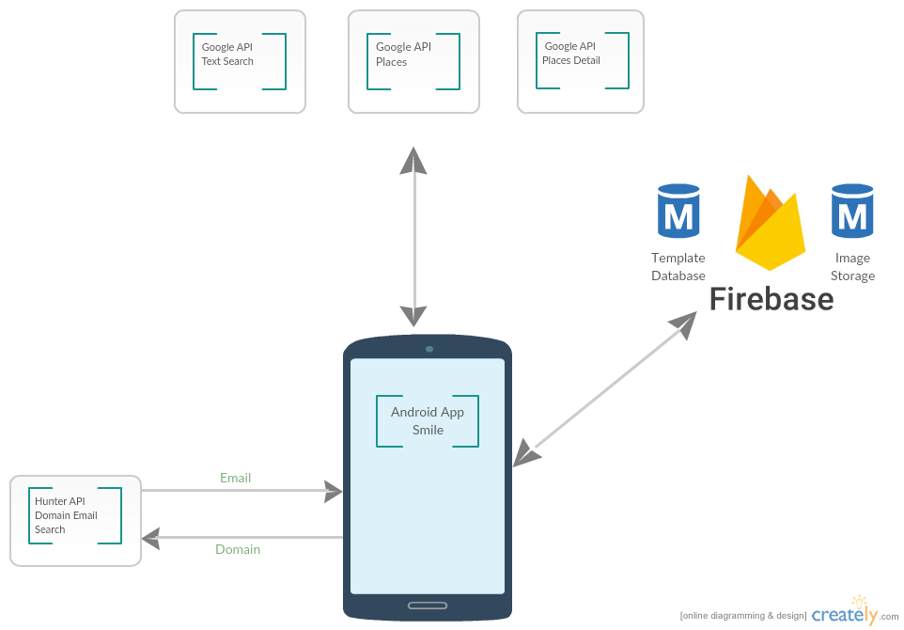
Architecture

Slide 4
Application Features
User Registration
Template consists of demographic information, current and past medical history, and desired treatment.
Pictures are taken of users facial profile and teeth.
Map
Locate an Orthodontist near users current location.
Radius feature based on users current location.
Contact Orthodontist
Tap map marker to see Orthodontists information (Google ratings, address, phone etc.)
Send email to Orthodontist containing all the users template information including pictures.

