Slide 1

TECNOVOLVE

Slide 2
Problem
• Many businesses struggle with outdated IT systems, leading to inefficiencies and security vulnerabilities.
• SMEs often lack in-house expertise to implement and manage modern IT solutions.
• Rapid digital transformation leaves companies unsure of how to adopt new technologies effectively.

Slide 3
Product
• Comprehensive IT Assessment & Strategy Planning
• Infrastructure Design & Implementation
• Cybersecurity Solutions & Risk Management
• Cloud Services (Migration, Management, Optimization)
• IT Support & Training

Slide 4
Target Market
• Small to Medium Enterprises (SMEs)
• Non-profit organizations
• Educational institutions
• Healthcare and Financial sectors looking to upgrade IT infrastructure

Slide 5
Market Size
• Global IT consulting market valued at $57 billion in 2024.
• Expected CAGR of 5.3% through 2030.
• SMEs represent a growing share of digital transformation spending (~$800B globally).

Slide 6
Competitors
• Accenture
• Deloitte
• Capgemini
• Local IT consulting firms

Slide 7
Competitive Advantage
• Personalized service for SMEs and nonprofits.
• Agile and adaptive to latest tech trends.
• Affordable pricing without sacrificing quality.
• Strong focus on education and client empowerment.

Slide 8

Traction & Roadmap
• 10+ clients onboarded in the past 6 months.
• Partnered with major cloud providers.
• Next 12 Months: Expand to 3 new cities, build SaaS tools for IT audits.
• Long-term: Become a leading IT partner for 500+ businesses.

Slide 9
Business/Revenue Model
• Project-based consulting fees
• Recurring revenue from managed services contracts
• Revenue from training sessions and IT audits
• White-label service offerings for partners

Slide 10
Go-to-Market Strategy
• Direct outreach and networking events.
• Partnerships with local business incubators.
• Targeted digital marketing campaigns (LinkedIn, Google Ads).
• Referral incentives for existing clients.

Slide 11
Our Ask
• Seeking R250,000 in funding to scale operations, hire talent, and invest in marketing.
• Use of funds: 40% Talent Acquisition, 30% Marketing, 20% Product Development, 10% Operations.

Slide 12
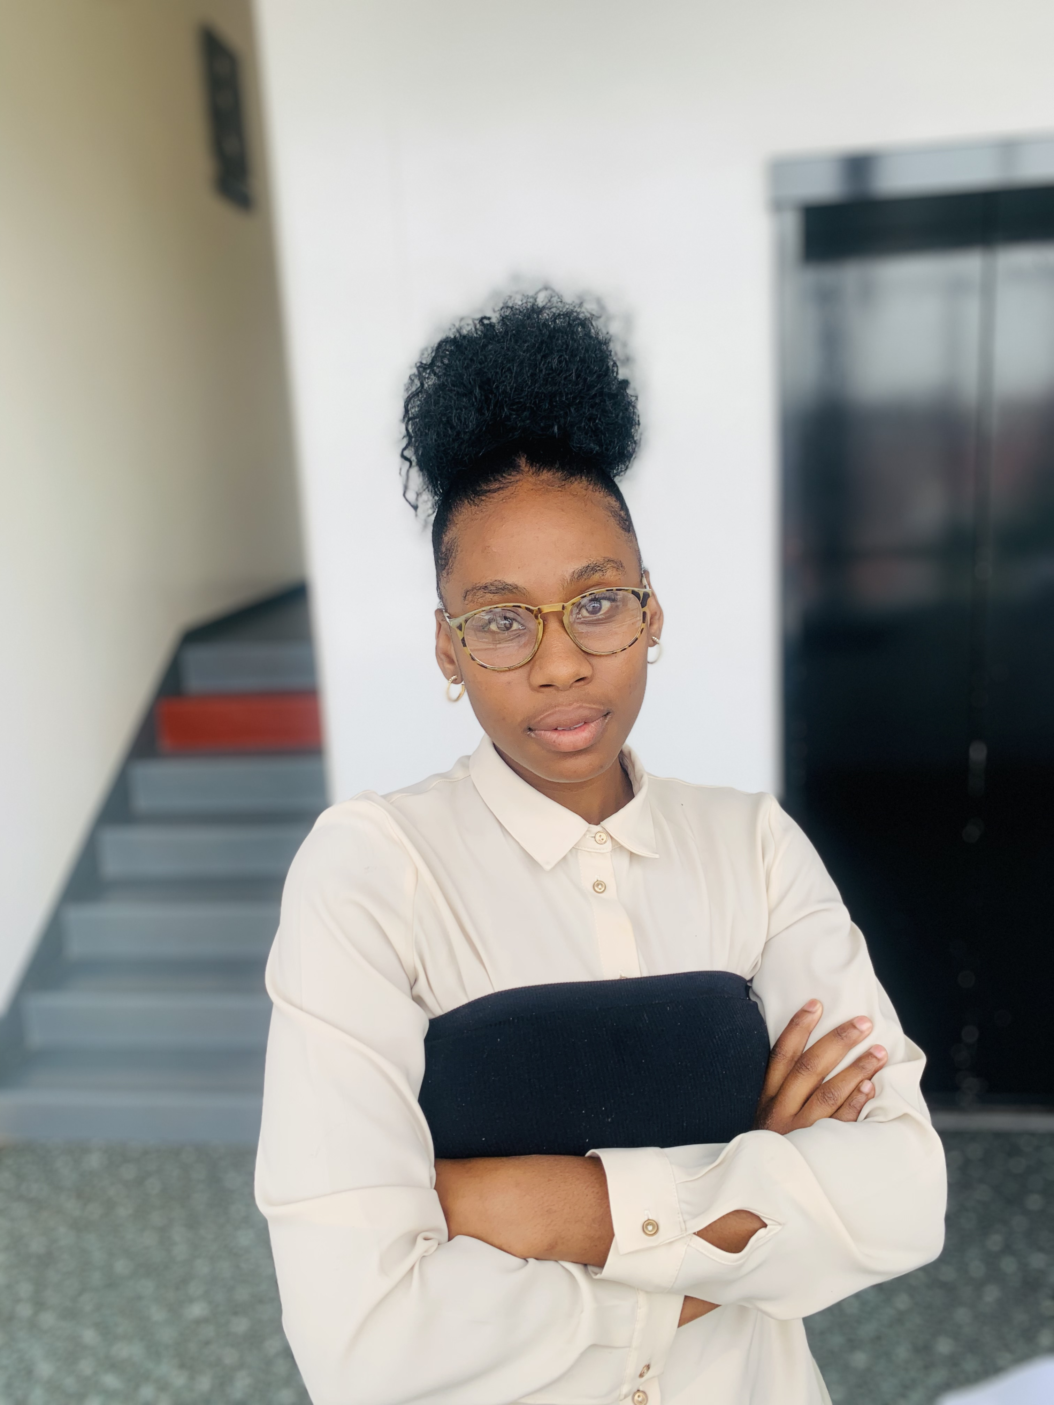
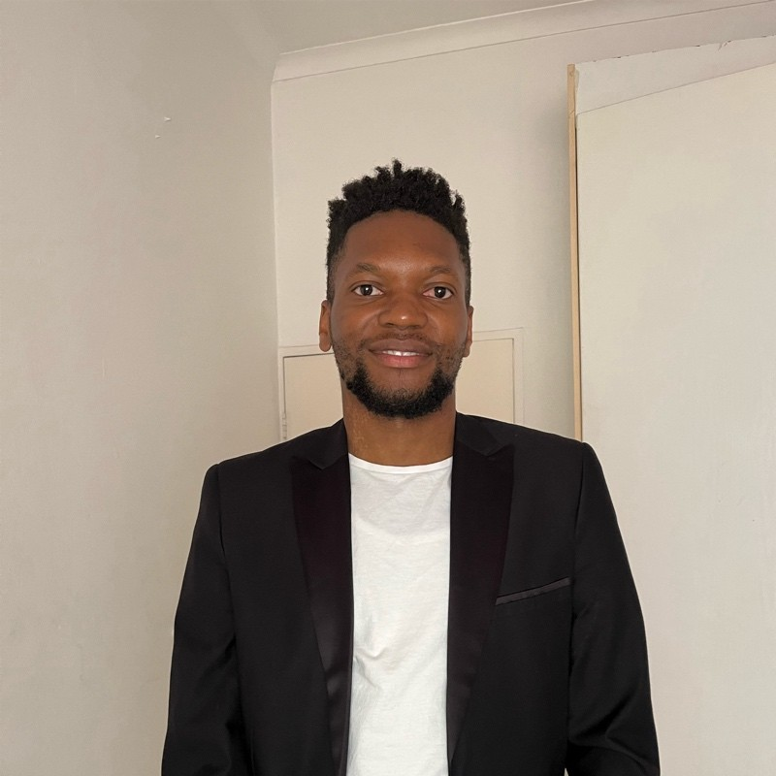
Meet The Team
Jimmy Netshilema-CEO & Founder
Palesa Molefe-Co-Founder

