Slide 1
Student Record Manager
Presented by:
25B11AI241 (D.R.PALGUN)
25B11AI581 (K.BALA ADITYA)
25B11AI361 (G.DILEEP)
25B11AI765 (M.MOHITH NAIK)
Course Instructor:
K.SYAMALA KALYANI,M.TECH
ASSISTANT PROFESSOR,
AIML DEPTARTMENT.

Slide 2
Contents
Abstract
Problem Statement & Objectives
Planned Modules / Functions
Inputs & Expected Outputs
Algorithm
Flowchart
Conclusion

Slide 3
Abstract
This project presents the design and implementation of a Student Record Management System using Object-Oriented Programming (OOP) principles in C++.
The system models real-world academic entities such as Student, Course, and Faculty as classes, applying core OOP concepts including encapsulation , inheritance, polymorphism, and abstraction.
The application supports functionalities such as adding, updating, deleting, searching, and displaying student records, along with grade calculation and result report generation.
This project serves as a practical demonstration of applying theoretical OOP concepts to solve a real-world data management problem.

Slide 4
Issue Description
Data redundancy and inconsistency due to manual entry errors
Difficulty in searching, updating, or retrieving specific student records quickly
Lack of data security, as physical records can be lost, damaged, or accessed by unauthorized persons.
Time-consuming report generation (e.g., calculating grades, attendance summaries)
No structured way to maintain relationships between students, courses, and faculty
Poor scalability — manual systems become unmanageable as the number of students grows

Slide 5
Planed modules/functions
Student (Base data class):
Set Details(), get Details()
Set Roll No(), get Roll No()
Set Name(), get Name()
Set DOB(), get DOB()
Set Contact(), get Contact()
Set Address(), get Address()
Display Student()
To File Format() / from File Format()
Academic Record (inherits or has-a Student):
Add Marks(subject, marks)
Update Marks(subject, marks)
Calculate Total()
Calculate Percentage()
Calculate Grade()
Calculate CGPA()
Display Result()
Attendance Manager:
Mark Attendance(roll No, date, status)
Get Attendance Percentage(roll No)
View Attendance Record(roll No)
Generate Low AttendanceList()
Fee Manager:
Record Fee Payment(roll No, amount, date)
Get Pending Fee(roll No)
Generate Fee Receipt(roll No)
Get Fee History(roll No)

Slide 6
Planed modules/functions
Admin / User:
login(username, password)
logout()
Add New Admin()
Change Password()
Check Access Level()
Menu / UI Controller:
Show Main Menu()
Show Admin Menu()
Show Student Menu()
Handle User Choice()
Exit System()
Report Generator:
Generate Student Report(roll No)
Generate Class Report(class)
Export To File(format) — e.g., CSV/PDF
Print Topper List()

Slide 7
Inputs & outputs
Student:
Academic Record Module:
Attendance Manager Module:
Input:
Roll No: 101
Subject: Maths Marks: 85
Subject: Science Marks: 78
Subject: English Marks: 90
Output:
--- Academic Result ---
Roll No: 101
Name: Ravi Kumar
Maths: 85
Science: 78
English: 90
Total: 253 / 300
Percentage: 84.33%
Grade: A
Input:
Roll No: 101
Name: Ravi Kumar
DOB: 12-05-2005
Contact: 9876543210
Address: Bobbili, AP
Output:
--- Student Added Successfully ---
Roll No: 101
Name: Ravi Kumar
DOB: 12-05-2005
Contact: 9876543210
Address: Bobbili, AP
Input:
Roll No: 101
Date: 26-08-2026
Status: Present
Output:
Attendance marked: Present (26-08-2026)
--- Attendance Summary ---
Roll No: 101 | Total Days: 50 | Present: 46
Attendance %: 92.00%

Slide 8
Inputs & outputs
Fee Manager Module:
Menu:
Report Generator Module:
Input:
Roll No: 101
Amount Paid: 5000
Date: 20-08-2026
Output:
--- Fee Receipt ---
Roll No: 101 | Name: Ravi Kumar
Amount Paid: ₹5000 | Date: 20-08-2026
Pending Balance: ₹2000
Input:
1. Add Student
2. View Student
3. Update Record
4. Delete Record
5. Attendance
6. Fees
7. Reports
8. Exit
Enter choice: 2
Output:
Enter Roll No to view: 101
[Displays student record as shown above]
Returning to Main Menu...
Input:
Generate Report for Class: 10
Output:
--- Class 10 Report ---
Roll No | Name | Percentage | Attendance
101 | Ravi Kumar | 84.33% | 92%
102 | Priya Sharma| 91.20% | 88%
...
Topper: Priya Sharma (91.20%)
Report exported to: class10_report.csv
Admin:
Input:
Username: admin
Password: admin123
Output:
Login successful. Welcome, admin!
Access Level: Full Control

Slide 9
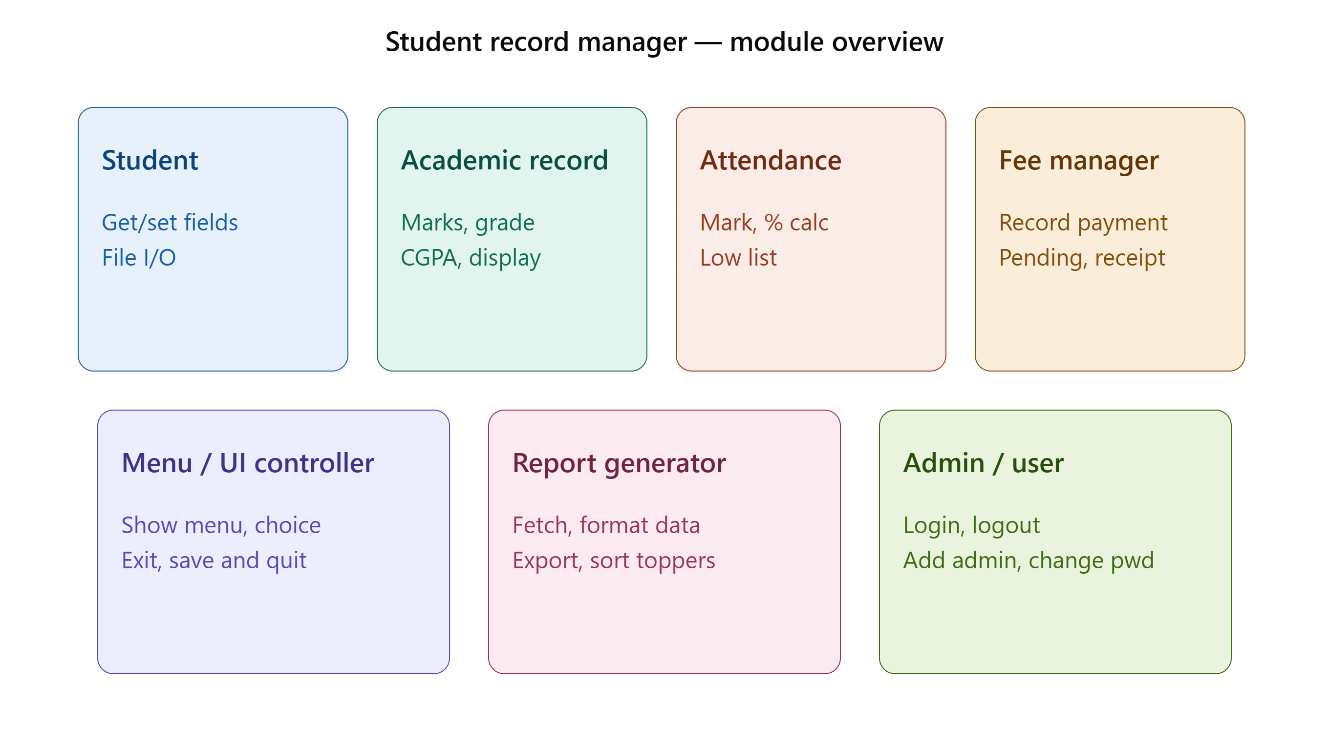
Algorithm

Slide 10
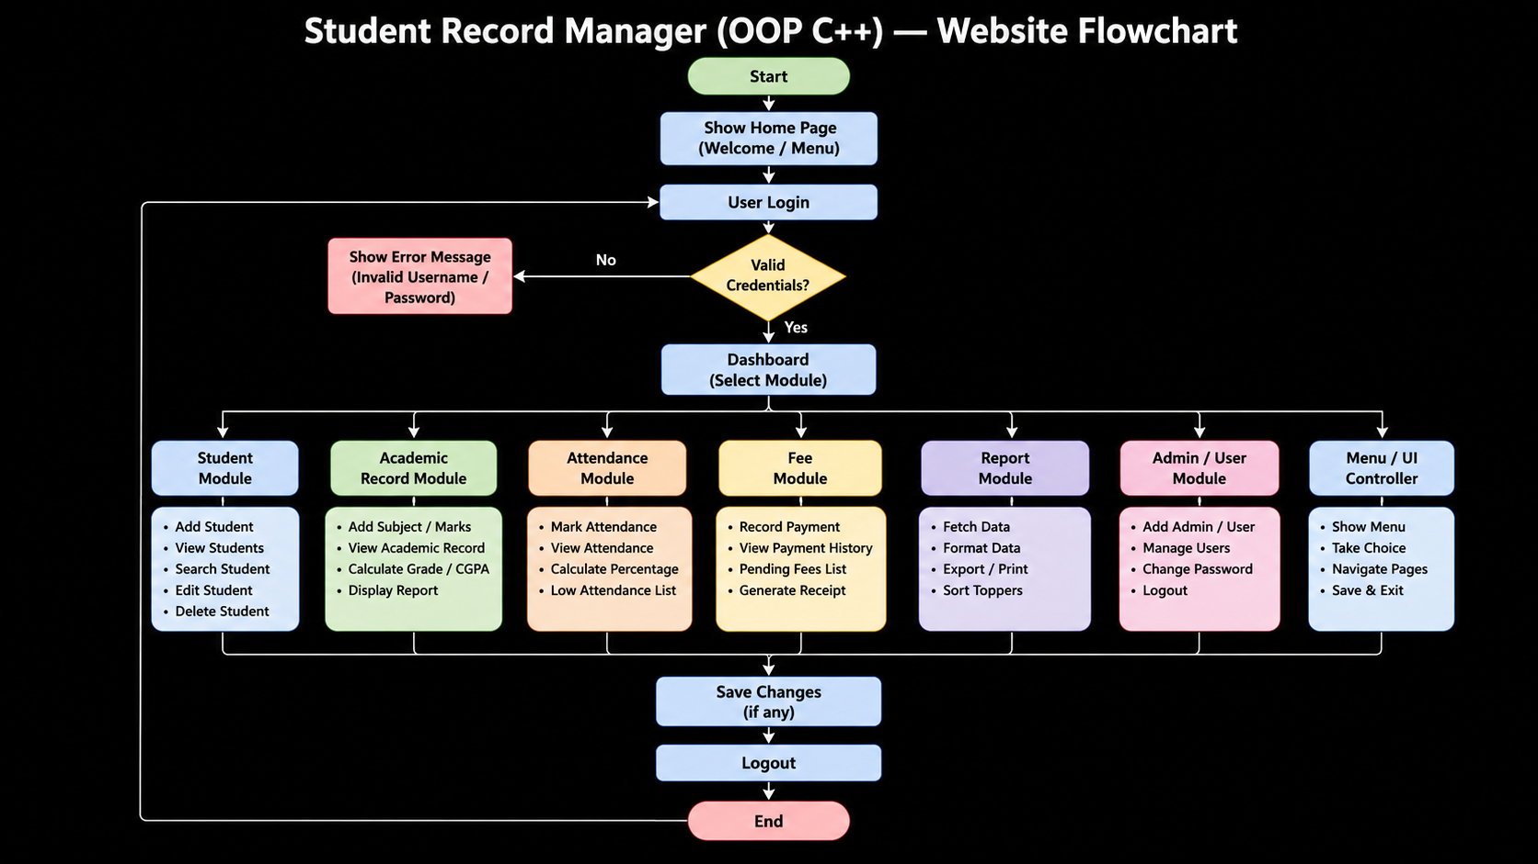
Flow chart

Slide 11
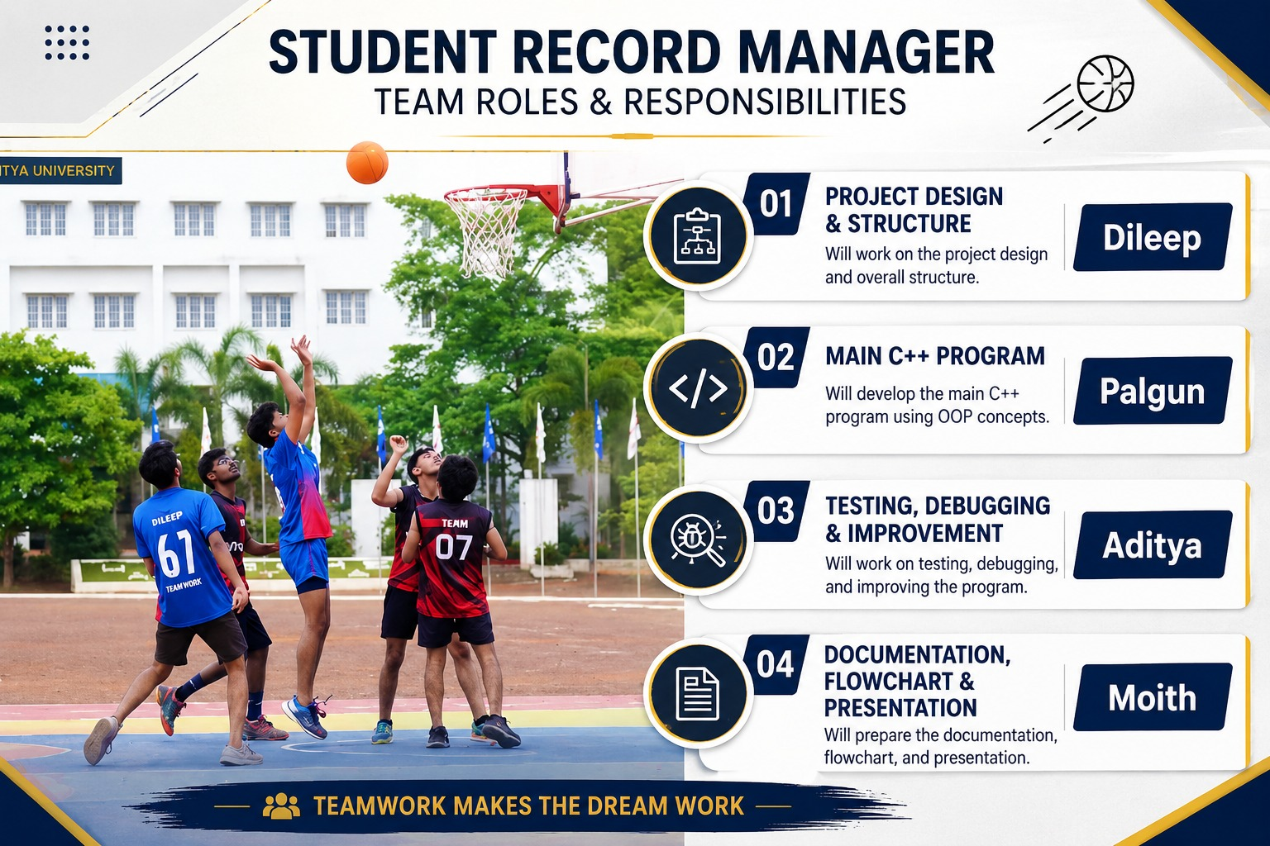
Team contribution

Slide 12
Conclusion
The Student Record Manager provides a systematic and efficient way to manage student information using Object-Oriented Programming in C++. It combines modules such as student records, academic performance, attendance, fee management, reports, and user administration into one system.
The project demonstrates important OOP concepts such as classes, objects, encapsulation, inheritance, and file handling. It reduces manual record management, improves data organization, and makes accessing and updating student information easier.
Overall, the system provides a simple, reliable, and user-friendly solution for managing student records and can be further enhanced with a database, web interface, and additional features in the future.

Slide 13
Thank You

