Slide 1
Otsu’s Thresholding Method
(1979)
Based on a very simple idea: Find the threshold that minimizes the weighted within-class variance.
This turns out to be the same as maximizing the between-class variance.
Operates directly on the gray level histogram [e.g. 256 numbers, P(i)], so it’s fast (once the histogram is computed).

Slide 2
Otsu: Assumptions
Histogram (and the image) are bimodal.
No use of spatial coherence, nor any other notion of object structure.
Assumes stationary statistics, but can be modified to be locally adaptive. (exercises)
Assumes uniform illumination (implicitly), so the bimodal brightness behavior arises from object appearance differences only.

Slide 3
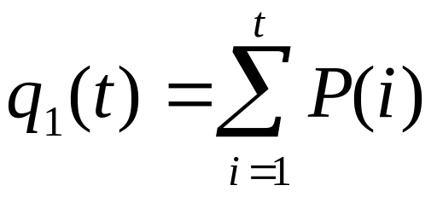
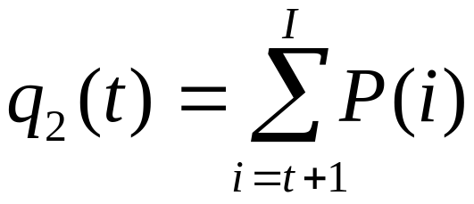
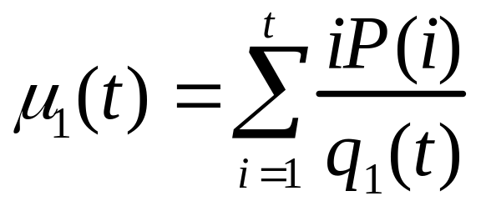
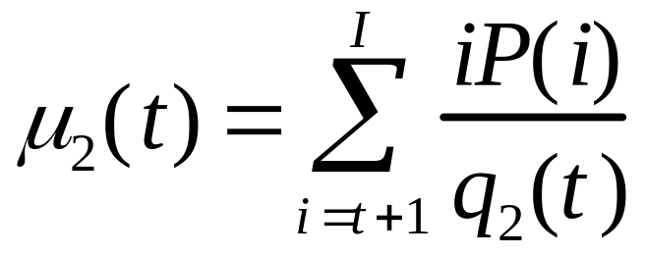
The weighted within-class variance is:
Where the class probabilities are estimated as:
And the class means are given by:

Slide 4
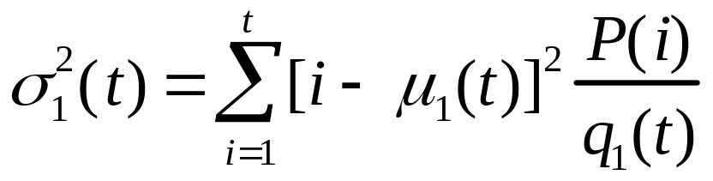
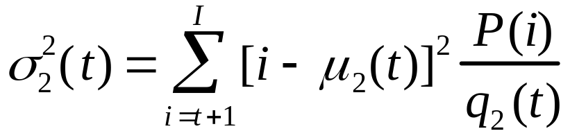

Finally, the individual class variances are:
Now, we could actually stop here. All we need to do is just run through the full range of t values [1,256] and pick the value that minimizes .
But the relationship between the within-class and between-class variances can be exploited to generate a recursion relation that permits a much faster calculation.

Slide 5
Between/Within/Total Variance
The book gives the details, but the basic idea is that the total variance does not depend on threshold (obviously).
For any given threshold, the total variance is the sum of the within-class variances (weighted) and the between class variance, which is the sum of weighted squared distances between the class means and the grand mean.

Slide 6

After some algebra, we can express the total variance as...
Within-class,
from before
Between-class,
Since the total is constant and independent of t, the effect of changing the threshold is merely to move the contributions of the two terms back and forth.
So, minimizing the within-class variance is the same as maximizing the between-class variance.
The nice thing about this is that we can compute the quantities in recursively as we run through the range of t values.

Slide 7
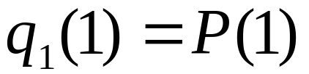
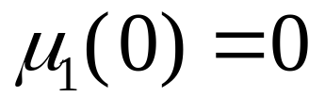
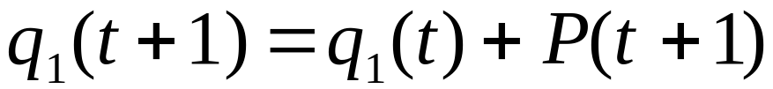
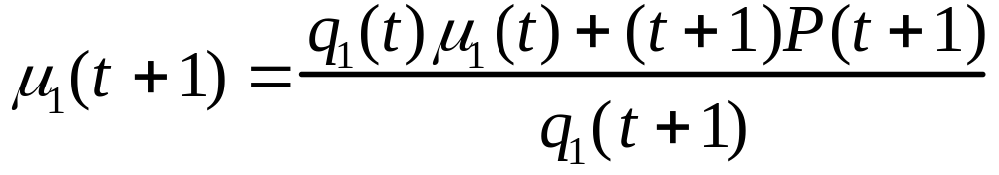
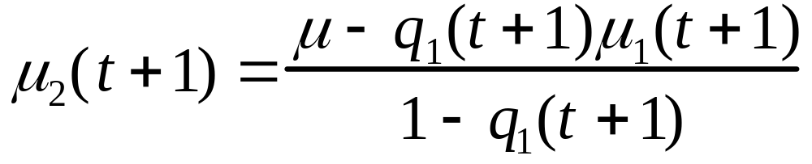
Finally...
Initialization...
;
Recursion...

