Slide 1
POLITY
by- Himanshu Shekhar

Slide 2
Diversity In India
India is a country of many diversities. We speak different languages, have various types of food, celebrate different festivals, practise different religions.
languages, food, music, religions became a mix of the old and the new, and out of this intermixing of cultures, came something new and different.
history of many places shows us how many different cultural influences have helped to shape life and culture there.
Let us try to understand what we mean when we say that historical and geographical factors influence the diversity of a region by looking at life in Kerala and Ladakh.
Ladakh is a desert in the mountains in the eastern part of Jammu and Kashmir
Very little agriculture
People keep Sheep and Goat
Goat in this region produce Pashmina wool
Pashmina Shawl chiefly woven in Kashmir
People eat meat and milk products such as cheese and butter
Ladakh lies in the trade route to Tibet where traders carried Carpets, raw silk, textiles, spices etc.
Buddism reached Tibet via Ladakh. a.k.a Little Tibet.
Islam was introduced 400 years ages in Ladakh.
Kesar Saga ( a local Tibetian national epic which is performed and sung by both Muslims and Buddhists.

Slide 3
Kerala is a south-Indian state which is surrounded by water on one side and mountains on the other.
Spices like Pepper, cloves and cardamons are grown here.
Jewish and Arab traders first came here.
The Apostle of Christ , St. Thomas – credited for bringing Christianity in India nearly 2000 years ago.
Ibn Battuta believed to travelled here nearly 700 years ago and wrote in his travelouge that Muslims community were very much respected.
Vasco da Gama ( a Portugese) discovered a route from Europe to India. He came to Kozikode and docked his ship here.
People practise various religion such as Judaism, Islam, Christianity, Hinduism and Buddhism.
Chinese fishing nets are called cheena-vala. Utensil used for frying fish is called cheenachatti. It is believed that the word cheen has came from China.
People here grow rice. They eat rice, fish and vegetables.
NOTE: Nehru, who coined the phrase, "unity in diversity".

Slide 4
There are eight major religions in the world. Every single one of them is practised in India. We have more than 1600 languages that are people's mother tongues, and there are more than a hundred dance forms.
Prejudice means to judge other people negatively or see them as inferior.
When we fix people into one image we create a stereotype.
Stereotypes stop us from looking at each person as a unique individual with his or her own special qualities and skills that are different from others. They fit large numbers of people into only one pattern or type.
Discrimination happens when people act on their prejudices or stereotypes.

Slide 5
What is a Government?
It is an institution or an individual who is responsible for decision such as:
Making roads, railways, hospitals, schools etc.
Running various public services if they deemed it right
Protecting boundaries of the country and maintaining peace in the country.
Ensuring enough food for its citizen
Providing justice to the needed
Types of Governments:
Monarchy
Democracy
Fascism
Dictatorship
Communism
Oligarchy
Republicanism
Totalitarianism

Slide 6
Democratic Governments
People have the power to elect their leaders.
Democracy is the rule by the people.
India is a representative democracy which mean people do not participate directly instead they elect a representative through an election. These representatives meet together and make decision for the entrie population.
A government cannot call itself a democratic unless it allows their citizen a Universal Adult Franchise.(All adults have the right to vote in an election.)
In earliest forms governments allowed only men who owned property and were educated, to vote. This meant that women, the poor, the property-less and the uneducated were not allowed to vote.
American women gotAmerican women got the right to vote in 1920 while women in the UK got to vote on the same terms as men some years later, in 1928.

Slide 7
the Cauvery water dispute between Karnataka and Tamil Nadu. The water stored in Krishna Raja Sagara dam in Karnataka is used for irrigating a number of districts and for meeting the needs of the city of Bengaluru. The water stored in Mettur dam in Tamil Nadu is used for crops grown in the delta region of that state. A conflict arises because both dams are on the same river. The downstream dam in Tamil Nadu can only be filled up if water is released from the upstream one located in Karnataka. Therefore, both states can't get as much water as they need for people in their states. This leads to conflict. The central government has to step in and see that a fair distribution is worked out for both states.

Slide 8
Panchayati Raj
Gram Sabha is a meeting of all adults who live in the area covered by a Panchayat.
Anyone who is 18 years old or more and who has the right to vote is a member of the Gram Sabha.
Sarpanch = Panchayat President
Panch = member of the panchayat
Village Panchayat is divided into Wards(small areas) and each ward elects representative who is called Ward Member(Panch).
Gram Panchayat = Ward Panchs + Sarpanch
Gram Panchayat is elected for 5 years.
Gram Panchayat has a secretary who is also called Secretary of Gram Sabha who is responsible for calling the meeting of the Gram Sabha and Gram Panchayat and keeping a record of the proceedings.
Gram Sabha is a key factor in making the Gram Panchayat play its role and be responsible.
Gram Panchayat are placed before the people.
Gram Sabha prevents the Panchayat from doing wrong things like misusing money or favouring certain people.
Gram Panchayat meets regularly and one of its main tasks is to implement development programmes for all villages that come under it.
the work of the Gram Panchayat has to be approved by the Gram Sabha.

Slide 9
The work of a Gram Panchayat includes
The construction and maintenance of water sources, roads, drainage, school buildings and other common property resources.
Levying and collecting local taxes
Executing government schemes related to generating employment in the village.

Slide 10
Sources of funds for the Panchayat
Collection of taxes on houses, market places etc.
Government scheme funds received through various departments of the government – through the Janpad and Zila Panchayats.
Donations for community works etc.

Slide 11
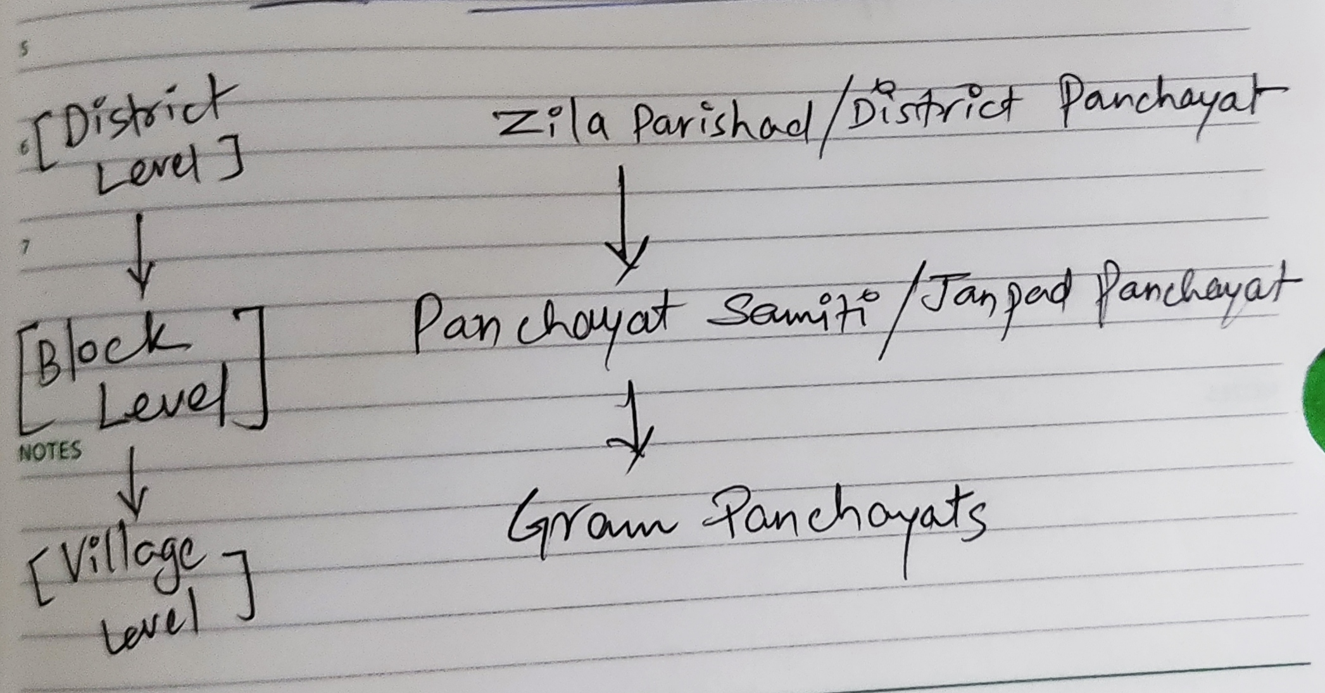
3-Levels of Panchayats

Slide 12
Panchayati Raj System is a process through which people participate in their own government.
The Panchayati Raj system is the first tier or level of democratic government.
The Panchs and the Gram Panchayat are answerable to the Gram Sabha because it is the members of the Gram Sabha who elected them.

