Slide 1
CH9. Host Controller Interface and commands ch10. Logical Link and adaptation protocol(l2cap)
RTLAB
YuJin Park

Slide 2
CH9. Host Controller Interface and commands

Slide 3
Host Controller Interface and Commands
Standard method of communication between the upper and lower layers
LE reuses the specification of the HCI layer for BR/EDR and extends it.
HCI Packet Types(LE)
HCI Command Packets
HCI Event Packet(LE Meta Event = 0x3E)
HCI ACL Data Packet
GATT Based Profiles
Generic Access Profile
Upper Layer
Generic Attribute Profile(GATT)
Attribute Protocol(ATT)
Security Manager (SM)
Event
Code
L2CAP
Parameter Total Length
Event Parameter
0
Event Parameter
1
Event Parameter
…
Format of BR/EDR Event Packet Types
Host Controller Interface (HCI)
Lower Layer
Link Layer
Event
Code
(0x3E)
Parameter Total Length
Sub Event Code
Sub Event Parameter
0
Event Parameter
…
Physical Layer
Format of LE Meta Event Packet Types

Slide 4
HCI Commands and Events
LE Command : HCI_LE prefix.
HCI Commands and Events
Device Setup
Controller Flow control
Host flow control
Controller Information
Remote Configuration
Device Discovery
Connection Setup
Connection State
Physical Links
Link Information
Authentication and Encryption
Testing

Slide 5
Device Setup & Flow control
Device Setup
HCI_Reset : reset the controller(physical layer) and Link layer.
Controller Flow Control
HCI_Read_Buffer_Size, HCI_LE_Read_Buffer_Size
Number_Of_Completed_Packets_Event
Host Flow Control
Host_Buffer_Size_Command
Host_Number_Of_Completed_Packets_Command
Data_Buffer_Overflow_Event
White_List
HCI_LE_Read_White_List_Size
HCI_LE_Clear_White_List
HCI_LE_Add_Device_To_White_List
HCI_LE_Remove_Deivce_From_White_List
Host
Controller
Separate Buffers
HCI LE Read Buffer Size
HCI Read Buffer Size
LE ACL Buffer Size, Number of LE Buffers
Shared Buffers
Initialize count of buffers to Number of buffers
If count > 0
HCI ACL Data Packet
Decrement count by number of packets sent to the controller
Packets Transmitted on LE-U logical link
Number of Completed Packet Event
Increment count by number of packets reported as processed by the controller

Slide 6
Controller & Remote Information
Controller Information
HCI_Read_Local_Version_Information
HCI_Read_Local_Supported_Command
HCI_Read_Support_Features_Command
HCI_LE_Read_Support_Features_Command
HCI_LE_Read_Supported_States
Remote Information
HCI_LE_Read_Remote_Used_Features(Encryption Only)
LE_Read_Remote_Used_Feature_Complete

Slide 7
Controller configuration
Controller Configuration Commands
HCI_LE_Set_Advertise_Enable
HCI_LE_Set_Advertising_Data
HCI_LE_Set_Advertising_Parameters
HCI_LE_Set_Random_Address
HCI_LE_Set_Scan_Response_Data
HCI_Read_LE_Host_Support
HCI_Write_LE_Host_Support

Slide 8
Device Discovery and Connection
Device Discovery
HCI_LE_Set_Scan_Enable
HCI_LE_Set_Scan_Parameters
HCI_LE_Advertising_Report_Event
Connection Setup
HCI_LE_Create_Connection
LE_Connection_Complete_Event
HCI_Disconnet
Disconnetion_Complete_Event
Connection State
HCI_LE_Connection_Update
LE_Connection_Update_Complete_Event

Slide 9
Physical Link & Link Information
Physical Link
HCI_LE_Set_Host_Chnnel_Classification(Channel map)
Link Information
HCI_Read_Transmit_Power_Level
HCI_Read_RSSI
HCI_LE_Read_Advertising_Channel_Tx_Power
HCI_LE_Read_Channel_Map

Slide 10
Authentication and Encryption
HCI_LE_Encrypt
HCI_LE_Long_Term_Key_Requested_Event
HCI_LE_Long_Term_Key_Request_Reply
HCI_LE_Long_Term_Key_Request_Negative_Reply
HCI_LE_Rand
HCI_LE_start_Encryption
Ecryption_Change_Event
Encryption_Key_Refresh_Complete_Event

Slide 11
Testing
HCI_LE_Receiver_Test
HCI_LE_Transmitter_Test
HCI_LE_Test_End

Slide 12
Usage of White Lists
HCI_LE_Set_Advertising_Parameters
HCI_LE_Set_Scan_Parameters
HCI_LE_Create_Connction

Slide 13
Practical Sequence Diagrams
Typical sequence for passive scanning
Typical sequence for active scanning
Host
Host
Controller
Controller
Host
Host
Controller
Controller
Set Scan
Parameters
HCI_LE_Set_Scan_
Parameters
= passive scanning
Set Scan
Parameters
HCI_LE_Set_Scan_
Parameters
= active scanning
Set Advertising Parameters
HCI_LE_Set_Advertising_
Parameters
= Connectable_Undirected
Set Advertising Parameters
HCI_LE_Set_Advertising_
Parameters
= Connectable_Undirected
Enable_Scanning
LE_Set_Scan_Enable
Enable_Scanning
LE_Set_Scan_Enable
Set Advertising Data
HCI_LE_Set_Advertising_
Data
Set Advertising Data
HCI_LE_Set_Advertising_
Data
Link Layer State : Scanning
Link Layer State : Scanning
Enable Advertising
HCI_LE_Set_Advertise_Enable = 1
Enable Advertising
HCI_LE_Set_Advertise_Enable = 1
LL State : Advertising
LL State : Advertising
ADV_IND
ADV_IND
Advertising Report
LE_Advertising_Report_Event
SCAN_REQ
ADV_IND
ADV_IND
SCAN_RSP
Advertising Report
LE_Advertising_Report_Event

Slide 14
ch10. Logical Link and adaptation Protocol(l2cap)

Slide 15
Logical Link control and Adaptation Protocol
Interface between the higher Layer protocols and the lower layers(Link/Physical Layer)
LE reuses the L2CAP functionality of BR/EDR
GATT Based Profiles
Generic Access Profile
Upper Layer
Generic Attribute Profile(GATT)
Attribute Protocol(ATT)
Security Manager (SM)
L2CAP
Host Controller Interface (HCI)
Lower Layer
Link Layer
Physical Layer

Slide 16
PDU and SDU
Protocol Data Unit
Service Data Unit
Maximum Transmission Unit(MTU)
Maximum size of SDU
LE minimum MTU : 23 octets
Attribute Protocol
Attribute Protocol
SDU
SDU
L2CAP
L2CAP PDU
L2CAP
Maximum size depends on MTU

Slide 17
Basic Assumptions
The Packet delivered in the correct sequence.
Only one LE-U logical link exists between the two devices.
The controllers provide a degree of reliability by including error detection, and retransmission mechanisms.
The controller provide flow control mechanisms for data going over the air as well as data going over the HCI transport layer

Slide 18
L2CAP Features
Fixed Channel Identifiers
Attribute Protocol (CID : 0x0004)
LE L2CAP Signaling Channel (CID : 0x0005)
Security Manager Protocol (CID : 0x0006)
Fragmentation and Deflagmentation of data
Multiplexing and Demultiplexing of various channels over a shared logical link(LE-U)

Slide 19
Data Packets & L2CAP Parameters
MTU : 23 octets
Flush Timeout : 0xFFFF (Infinite)
Quality of Service : Best Effort
Mode : Basic mode
Length
(2 octets)
Channel ID
(2 octets)
Information Payload
LE L2CAP Data Packet Format

Slide 20
L2CAP Signaling
Command Reject (code : 0x01)
Connection Parameter Update Request (code : 0x12)
Interval Min
Interval Max
Slave Latency
Timeout Multiplier
(Connection Supervision Timeout = Timeout Multipler * 10 ms)
Connection Parameter Update Response (code : 0x13)

Slide 21
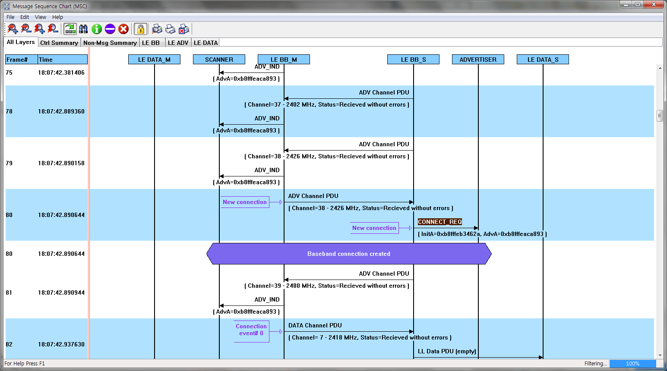
HCI Connection Sequence

Slide 22
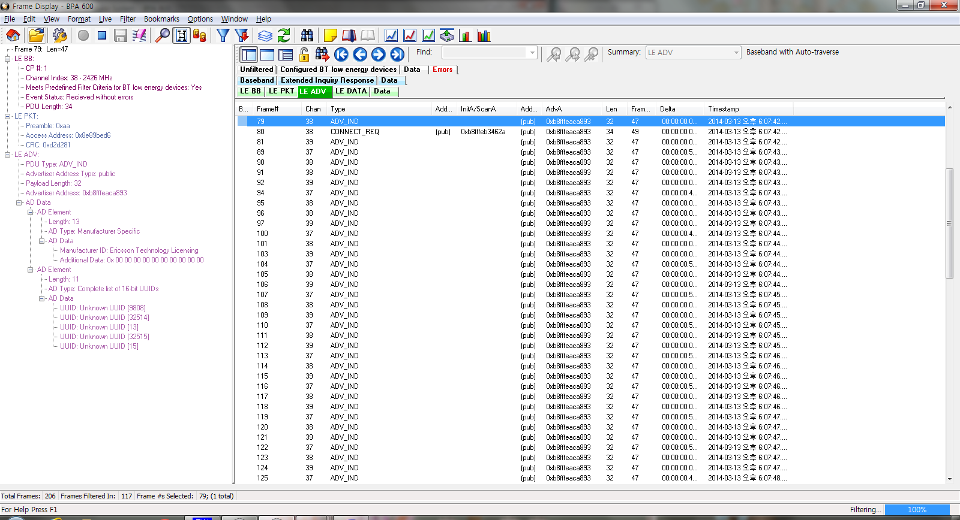
HCI Connection Sequence

Slide 23
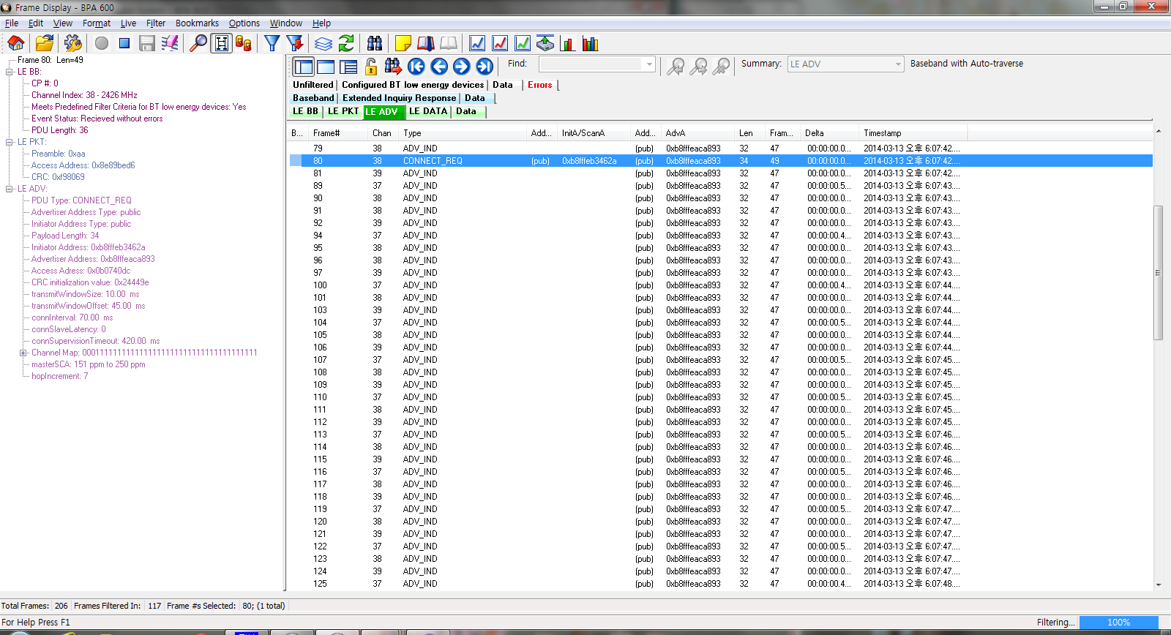
HCI Connection Sequence

Slide 24
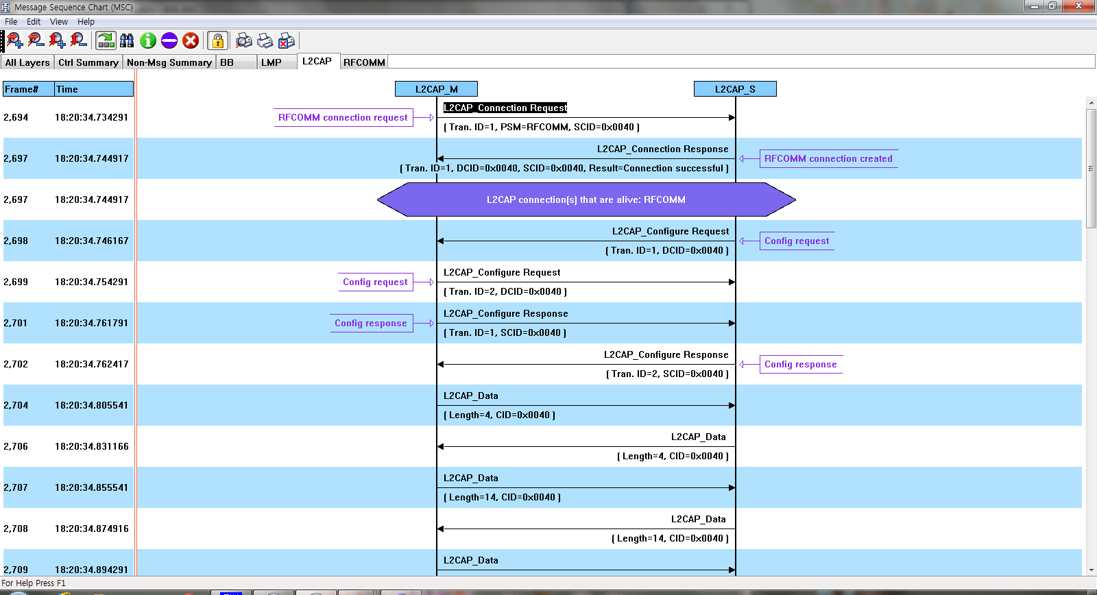
L2CAP Connection Sequence(Classic)

Slide 25
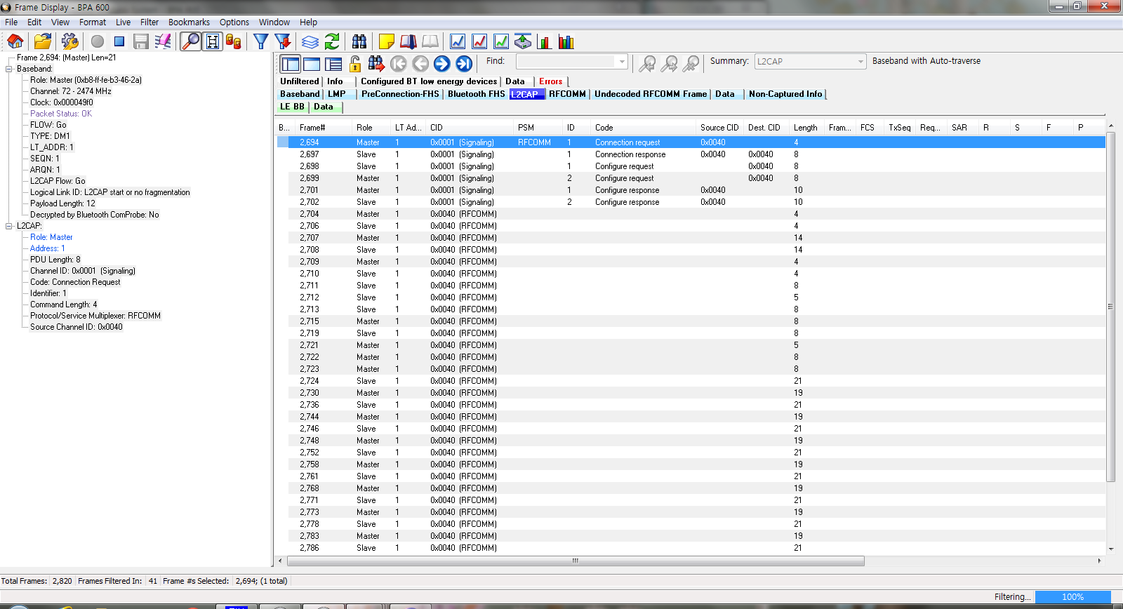
L2CAP Connection Sequence(Classic)

Slide 26
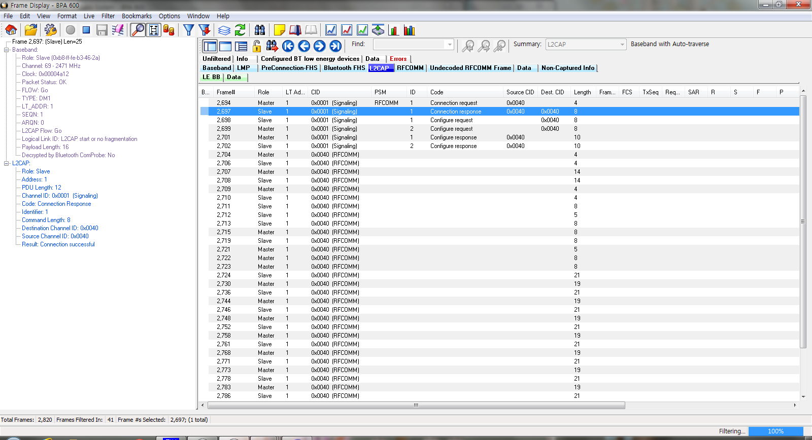
L2CAP Connection Sequence(Classic)

Slide 27
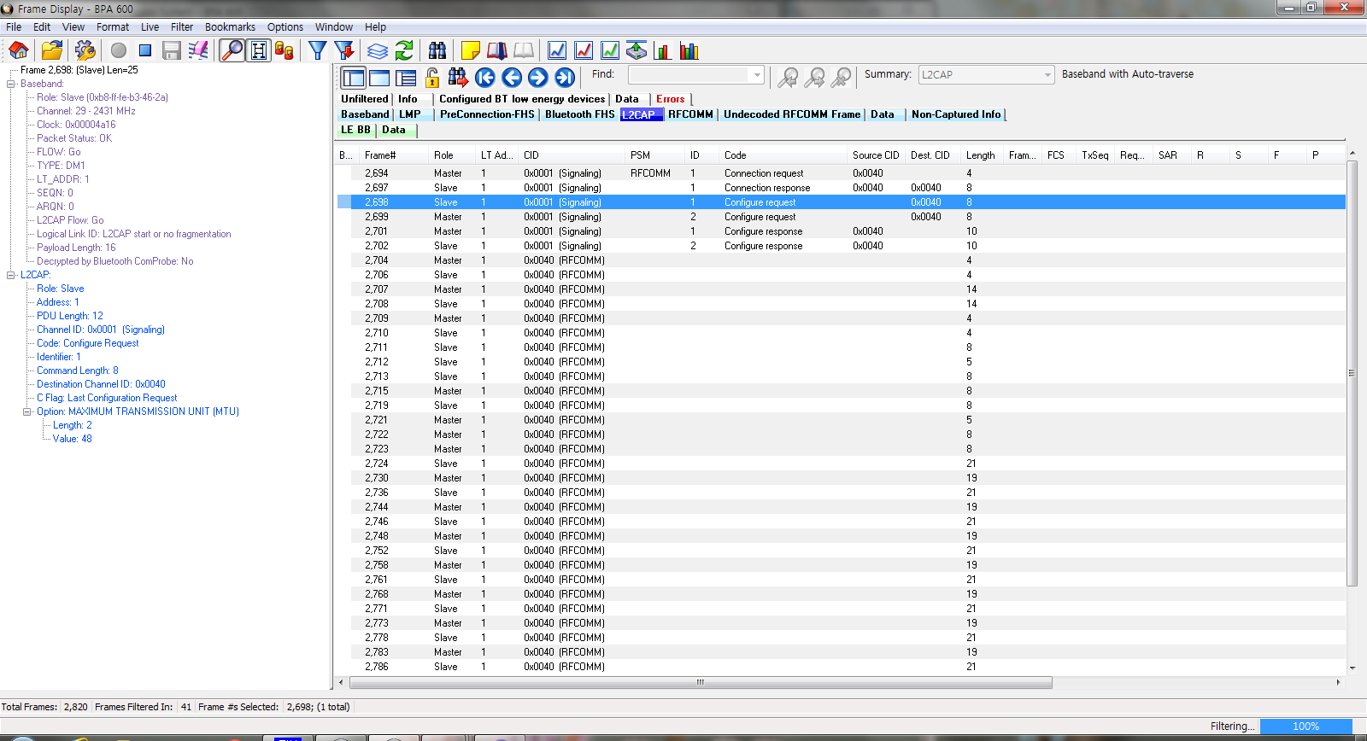
L2CAP Connection Sequence(Classic)

Slide 28
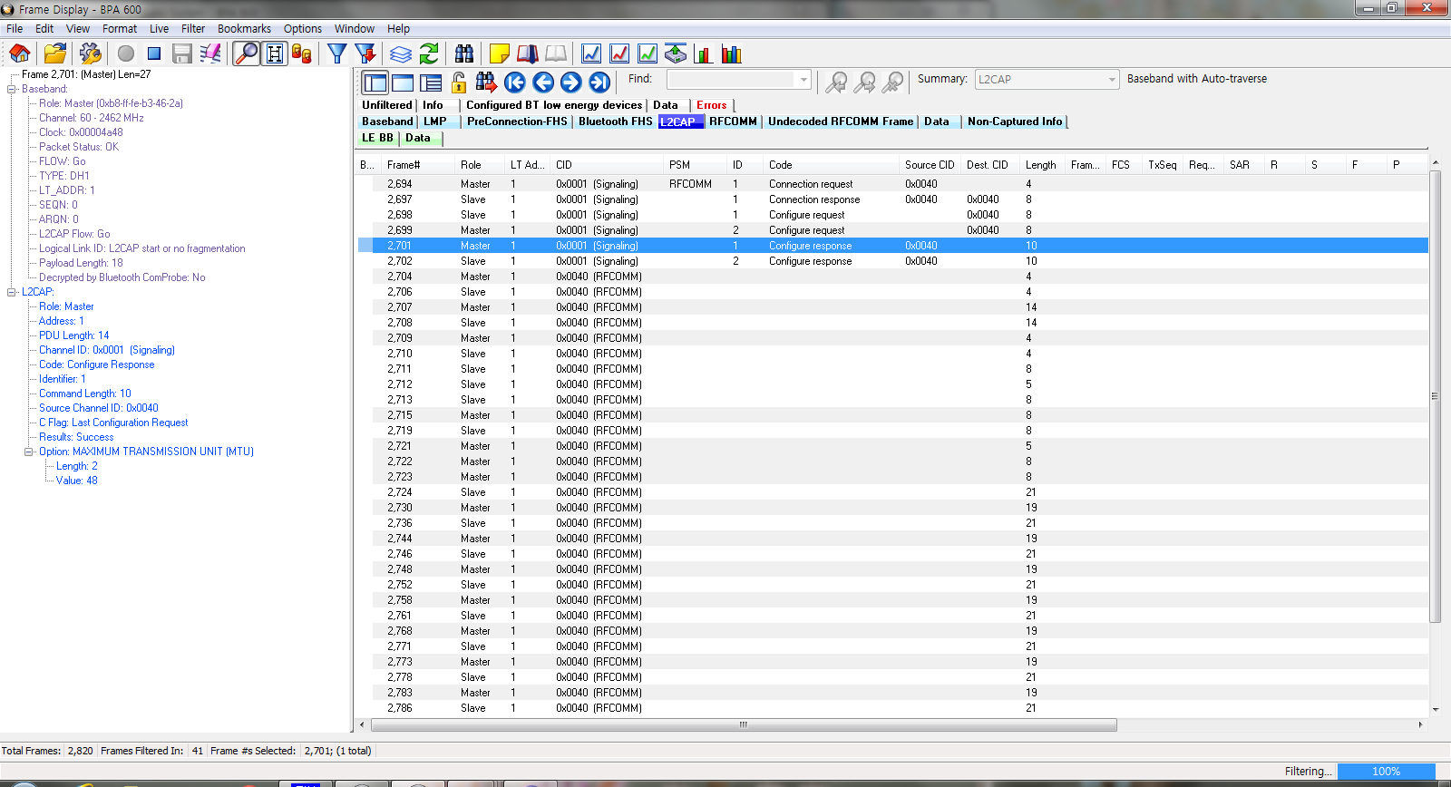
L2CAP Connection Sequence(Classic)

Slide 29
END.

