Slide 1
Problem Statement
Machine learning plays an increasingly significant role in the building of Network Intrusion Detection Systems. However, machine learning models trained with imbalanced cybersecurity data cannot recognize minority data effectively.
Some reasons causing imbalanced data
In data flow majority class tends to be benign classes, thus making dataset imbalance
The malicious attack approaches changes over time and very few
samples can be seen or labeled

Slide 2
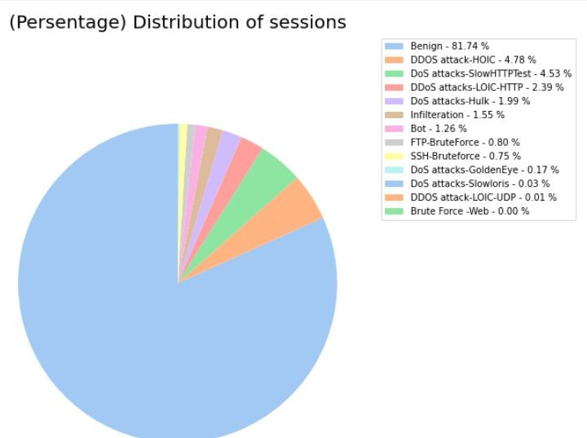
Problem Statement
The imbalance problem is prevalent in Cybersecurity which can significantly deteriorate the performance of Machine Learning models.
New types of attacks are constantly developed which could be absent from training dataset and can be misclassified as “benign”.
Proposed Solution:
Undersampling or Oversampling.
Merging minority classes into larger groups using unsupervised ML approaches.

Slide 3

Outline
Getting Data (EDA)
Data Preprocessing
Clustering
Smote Over-Under Sampling
Cross Validation
Model evaluation
Results
Future Work
References

Slide 4
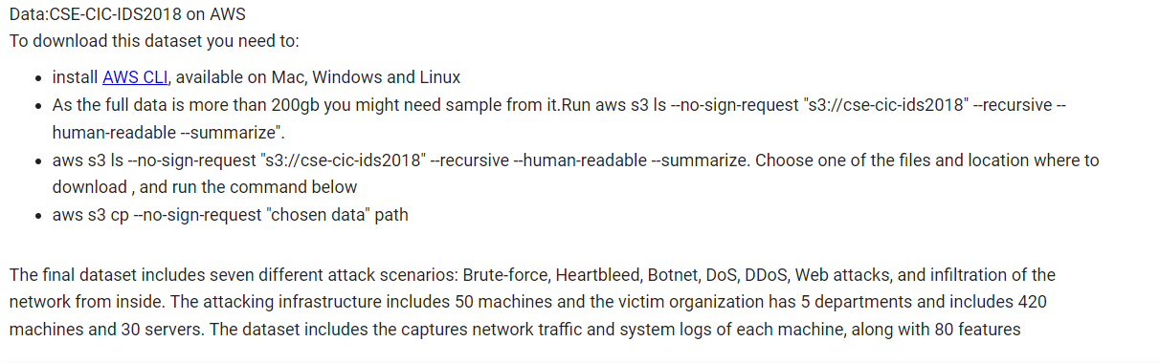
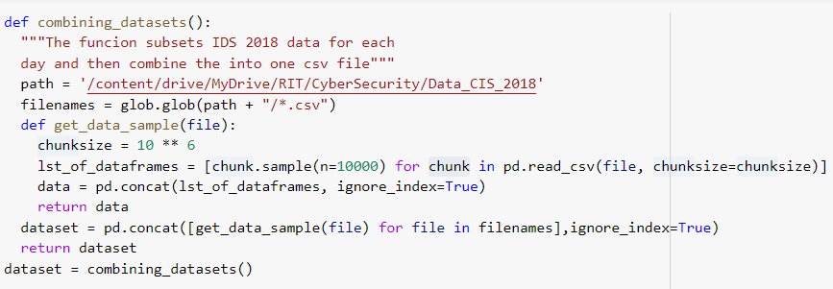
Getting Data IDS 2018

Slide 5
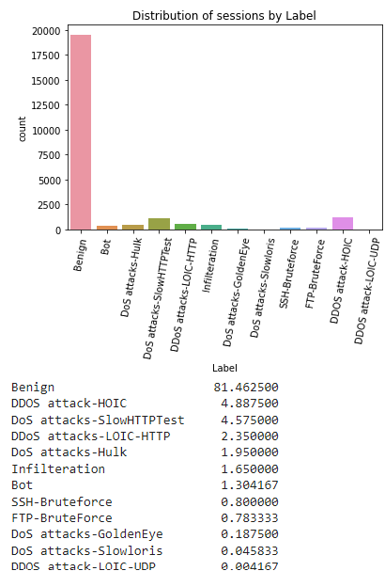
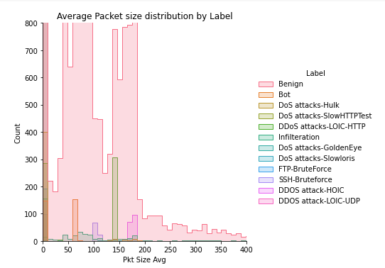
Exploratory data analysis

Slide 6
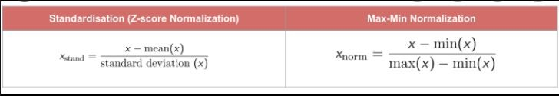
Data Preprocessing
Normalizing & Standardizing
Winsorizing for Outliers
PCA for numeric variables
KNN for missing values

Slide 7
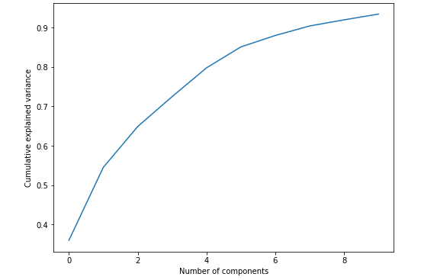
Why to use PCA
Principal component analysis (PCA) is the process of computing the principal components and using them to perform a change of basis on the data. Sometimes using only the first few principal components and ignoring the rest. It is used for data reduction, in our project we need it because out clustering methods worked better and faster on principal components rather than original data
We can state that 10 principal components explains more than 90% variation of the data with 80 features.

Slide 8
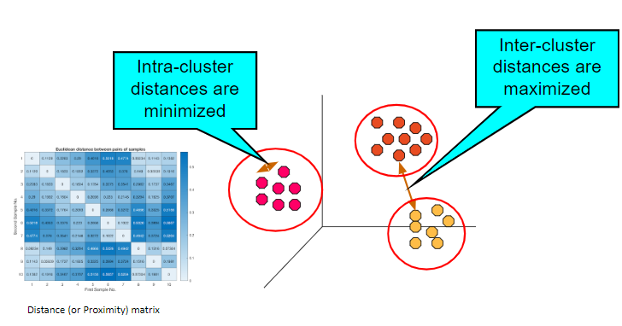
Unsupervised Learning : Clustering
Finding groups of malicious attacks such that the objects in a group will be similar (or related) to one another and different the attacks in other groups.
The purpose of Clustering is to merge malicious attacks.
Agglomerative Clustering
K-Means
DBSCAN

Slide 9
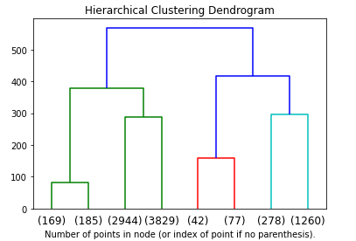
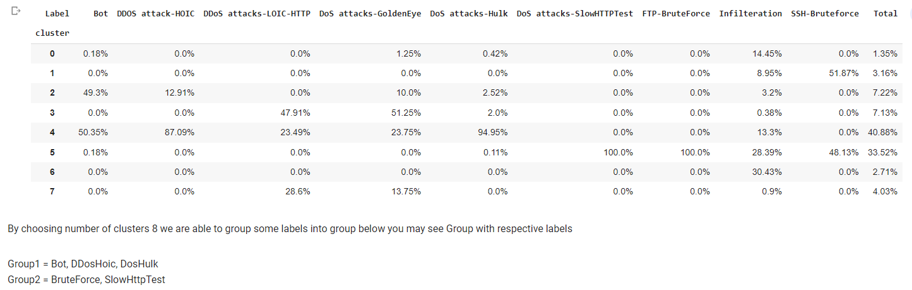
Agglomerative Clustering

Slide 10
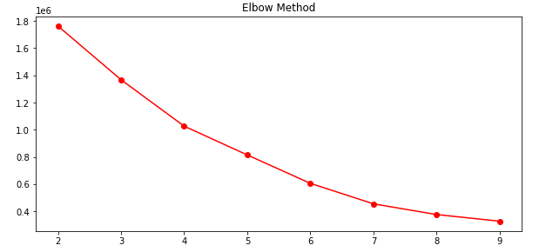
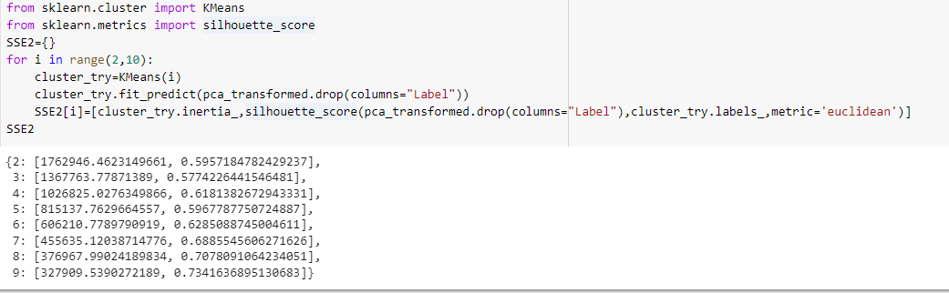
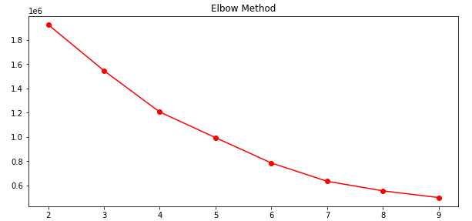
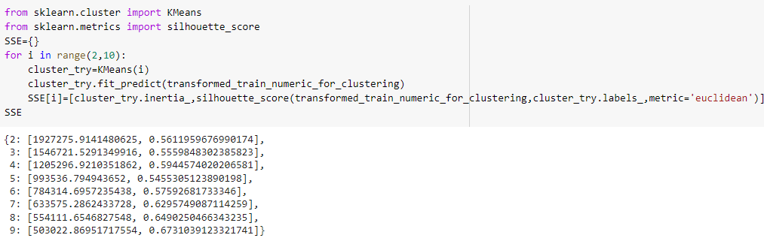
K-Means
K-Means on PCA
K-Means on Original Data

Slide 11
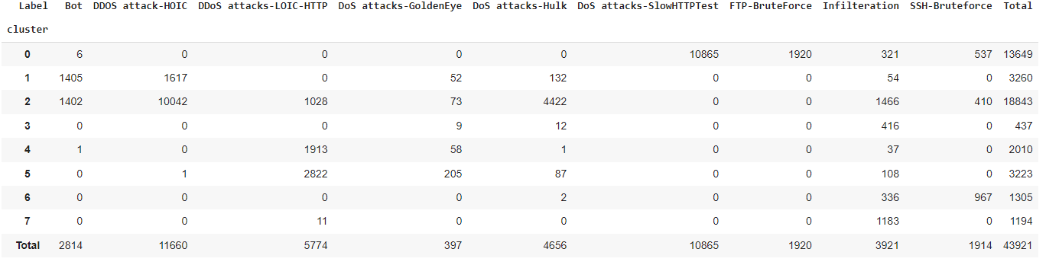

K-Means Results
The results are pretty much the same with Agglomerative Clustering so its reasonable to merge those clusters
Note : DBSCAN was not useful as its produces 169 clusters

Slide 12
Smote
Core idea: Convert the (imbalanced) training data set into a more balanced training dataset before training a classifier
Undersampling: Frequency of benign class is reduced to match frequency of minority class
Fewer samples : higher variance, may impact decision boundary poorer classifier
Oversampling: Synthetic samples of minority class are created (e.g. via duplication) to make them equal/close in proportion to majority class
Ensure enough samples to justify creation of decision boundary Analogous to assigning a higher weight to samples during training
Model Evaluation: Oversampling/Undersampling will be done with several different ratios. The best ratio will be chosen based F-1 Score.

Slide 13
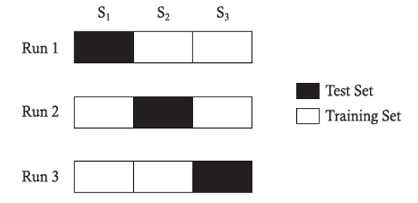
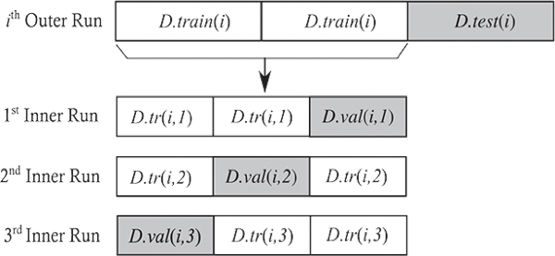
Cross Validation
K-fold Cross validation
Makes effective use of all available samples for both training and testing
Partition data into k disjoint subsets
k-fold: train on k-1 partitions, test on the remaining one
Test error (generalization error) is estimated as average error across folds
Choosing k – tradefoff between effective training and reliable evaluation
k between 5 and 10 (80 – 90% samples used for training) works in most cases
GridSearch Cross-Validation can be used to estimate generalization error

Slide 14
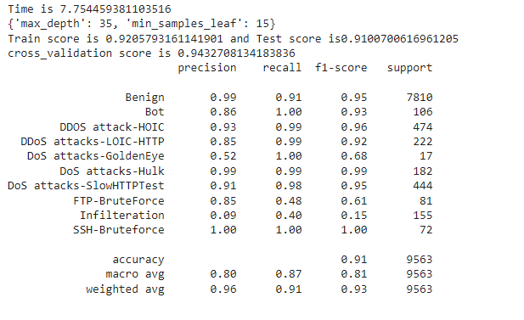
Base Line Model

Slide 15
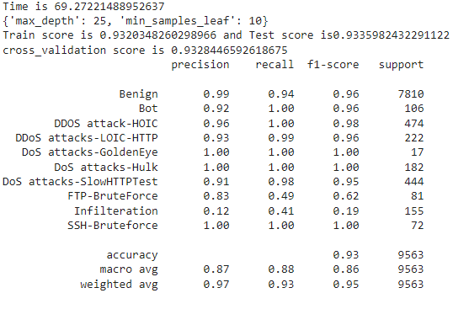
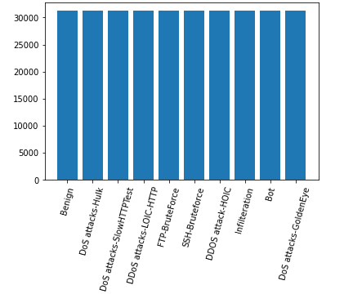
Winner Models: Equal Distributions
Group 1 = FTP-BruteForce, SlowHttpTest Group2 = Bot, DDosHoic, DosHulk

Slide 16
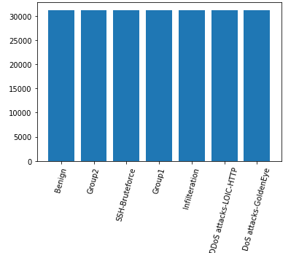
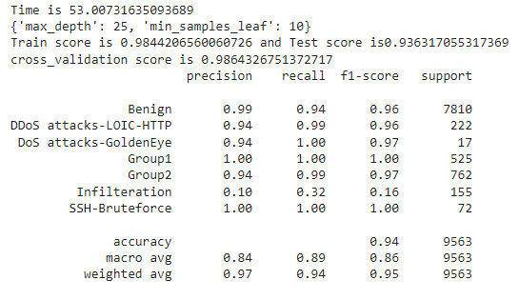
Winner Models: Equal Distributions and Grouping Method
Group 1 = FTP-BruteForce, SlowHttpTest Group2 = Bot, DDosHoic, DosHulk

Slide 17
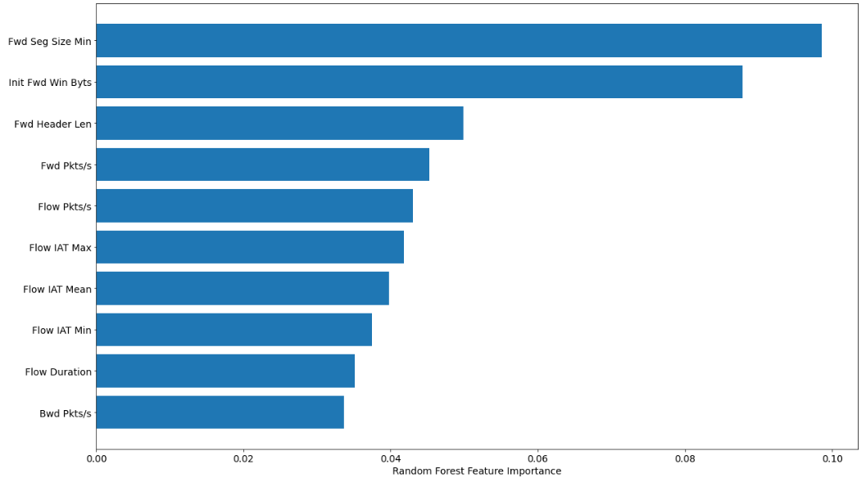
Feature Importance

Slide 18
Conclusion
Oversampling helps for detecting minority classes in Malicious Attacks problem
Grouping SlowHTTPTest with FTP-BruteForce in one group and Bot, Ddos Hoic and Dos Hulk into another decrease chance of them to be misclassified as Benign
In case of Data Dimensionality issue Clustering performs better and faster on PCA data
GitHub Repo

Slide 19
Thank You Questions?

