Slide 1
CS683: Advanced Computer Architecture-2024
L1-Performance, Performance, and Performance
https://www.cse.iitb.ac.in/~biswa/courses.html

Slide 2

Phones (smart/non-smart) on silence plz, Thanks

Slide 3

Join Piazza if you are part of CS683

Slide 4

Programmer’s view

Slide 5

Let’s start with programming for Performance
(know your architecture)

Slide 6

Performance
100,000x speedup since the first processor ☺
[1971:
92500 instructions per second, 640B RAM
2024:
10s of billion instructions per second, TB of RAM]
Automobile industry: really slow ☹ Imagine tata motors providing 2X speedup every 18 months ☺
Game of trade-offs btw. What is the price per performance?

Slide 7
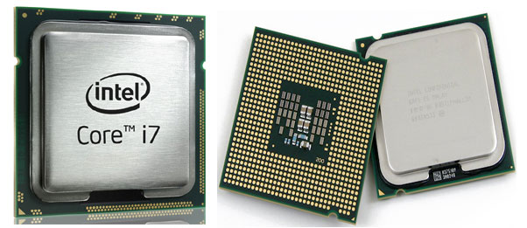
void CS683(int *arr, int size) {
for (int i = 0; i < size-1; ++i)
arr[i] = arr[i+1];
}

Slide 8

Performance
CPU
Execution time: CPU time + IO waiting
CPU time: User time + System (OS) time
CPU
CPU time: Time spent running a program

Slide 9
Example
#define N 32
#define T 1024 * 1024 double A[N][N];
#define | N | 32
#define | T | 1024 | * | 1024
#define | N | 128
#define | T | 1024 | * | 1024
#define | N | 256
#define | T | 1024 | * | 1024
#define | N | 4096
#define | T | 1024 | * | 1024
235 ms
240 ms
for (it = 0; it | < | T; it++)
for (j = 0; j | < | N; j++)
for (i = 0; | i | < N; i++)
420 ms
A[i][j] += 1;
750 ms

Slide 10
Which one is better? Why?
for (int i = 0; i < n; i++) { z[i] = x[i] – y[i];
}
for (int i = 0; i < n; i++) { z[i] = z[i] * z[i];
}
for (int i = 0; i < n; i++) { z[i] = x[i] – y[i];
z[i] = z[i] * z[i];
}
Which version is more efficient if we have large arrays?

Slide 11
Spell it out
Instructions
Cycles
Time
=
X
X
Program
Instruction
Cycle
(code size)
(CPI)
(cycle time)

Slide 12
Cycles per Instruction
Instructions: I mean the DYANMIC (ADD, MUL, JUMP, LOAD/STORE) ones
void CS683(int *arr, int size) {
for (int i = 0; i < size-1; ++i)
arr[i] = arr[i+1];
}
CPU
All instructions are not the SAME
So, cycles per instruction is not a constant

Slide 13

From Theory to Practice: Performance-101

Slide 14
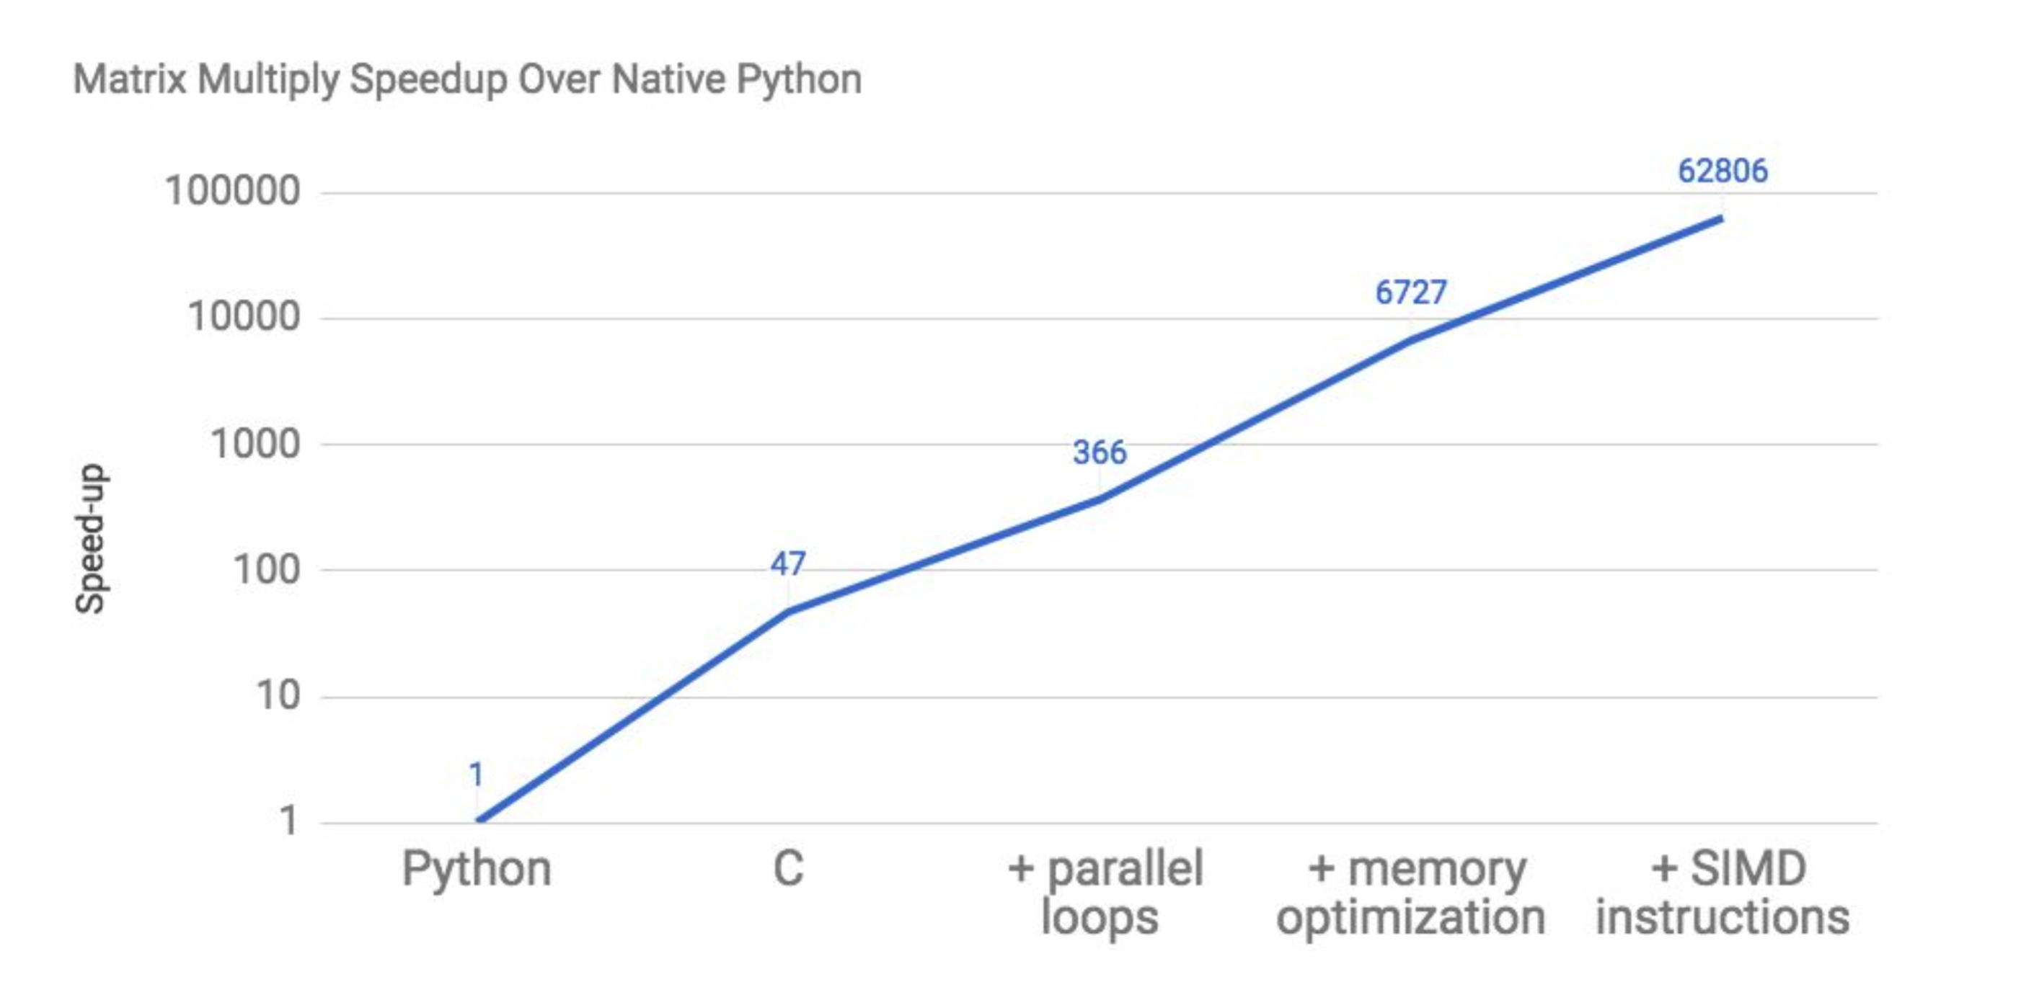
Language: No Big Deal!! AI/ML && Python

Slide 15
OK. So??

Slide 16
Seriously??

Slide 17
That’s It!! You can’t do better ☹

Slide 18
What the hell? This is insane !!

Slide 19
62,806X

Slide 20


Welcome to CS683, again !!

Slide 21

Let’s Jump into Memory Hierarchy, why?

Slide 22

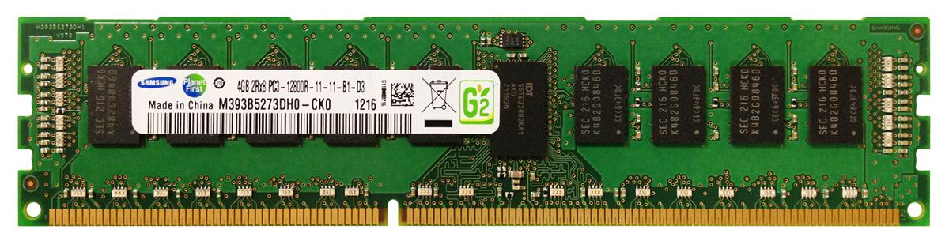
From where does these zeros come from?
Core
L1
L2
L3
DRAM Contr.
2 Cycles
12 Cycles
30 Cycles
200 Cycles
Memory stores CODE and DATA
Processor accesses through LOADs (reads) and STOREs(writes)
Memory Wall
CPU

Slide 23

The game of latency and bandwidth starts

Slide 24


Hang on!! I got the Mantra!!
Reduction in DRAM accesses ~
Reduction in CPI (cycles per instruction)
WRONG!
First Law of Performance:
Make the common case fast
Second Law of Performance:
Make the fast case common
Amdahl’s law
What if your program is not memory intensive

Slide 25

Do not ignore the uncommon too
Give me an example for a credit point

Slide 26

Let’s Pause and understand: The game of “common” and “uncommon”

Slide 27
Do not
Over-engineer
Over-think
Over …………………..

Slide 28

10,000 Feet View on Caches
$$: Cache
Speculation technique
Speculation works because of locality

Slide 29
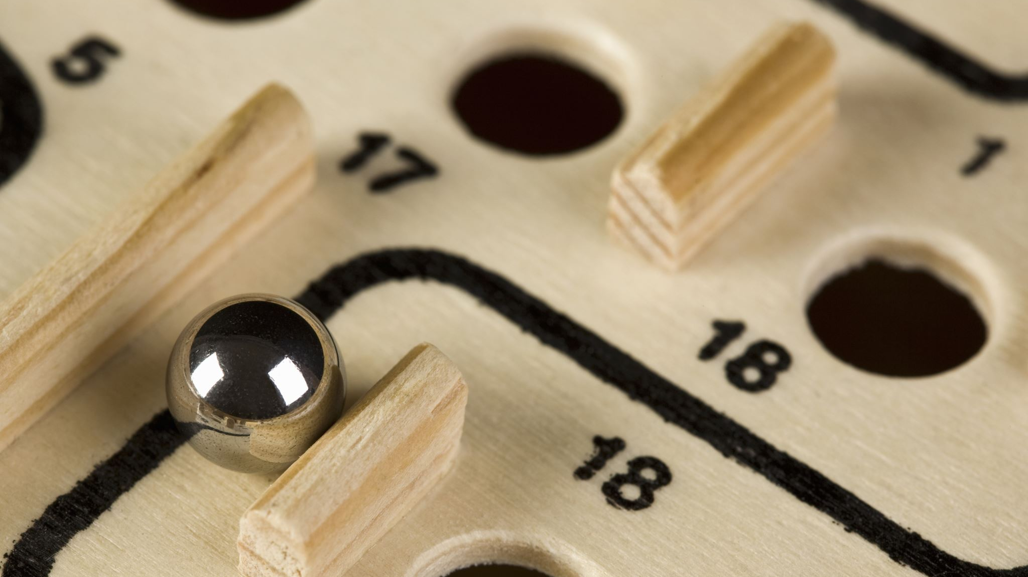
Caches
Hardware hash tables ☺
Catch the cache

Slide 30
Summary
IPC/CPI
Latency/Bandwidth
Common case

