Slide 1
CS773-2025-Spring: Computer Architecture for Performance and Security
Lecture 9: Spectre Variant-II and Meltdown

Slide 2

Phones on silence, please Thank You

Slide 3




The threat model [Transient execution attacks]
I₁
I₂
I₃
I₄
I₅
LOAD
I₆
I₅
I₄
I₃
I₂
But, microarchitectural traces remain
BRANCH
SUB
Squashed(Transient instrs.)
ADD
Speculative instrs.
MUL
Head of ROB
CACHE
Branch misprediction
A4F7 | D33A
F44A | F12A
10A3 | 345B
1234 | AB12
Instructions Sequence
ROB
Core
Core
SECRET DEPENDENT
Same thread
I can read the cache state change !!
SMT

Slide 4
Spectre: More details
Variant –I: The attacker tries to affect the prediction of branch outcome. However, the branch predictor is indexed by PC. In reality, some bits of PC. For example, a 1024-entry branch predictor, then a 64-bit PC is hashed into a 10-bit index for the branch predictor.
Spectre (variant-I) can happen between two threads of the same core.
So it works even on a single core. Can happen at L1 cache/L2 cache/L3 cache
It is also possible to attack a core that is not using SMT. How? Context switch: The attacker comes, mis-trains, and a context switch happens, and the victim comes and starts accessing illegitimate addresses.
Variant-II: It uses Branch Target Buffer and not branch predictor. Attacker writes an instruction that puts target into an address that is not accessible. This is also known as branch target injection. Variant-I was bound check bypass. Indirect JMP instructions consult the indirect branch predictor to direct speculative execution to the most likely target of the branch.

Slide 5
Variant-II continues
An attacker can jump to a spectre gadget code by mistraining the BTB so that a victim will jump to that code snippet and start executing it speculatively.

Slide 6
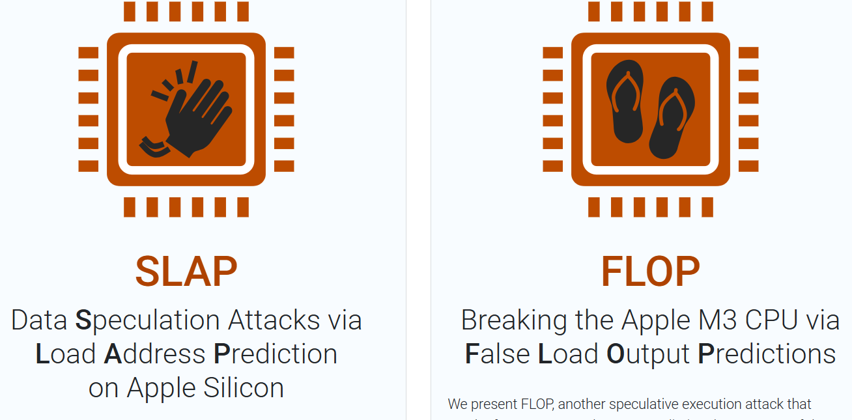
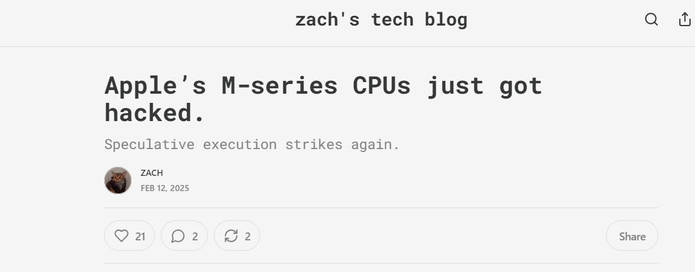
Last 7 years: Spectre continues to ….

Slide 7
Summary of Spectre Attack: As an attacker
"Two paths diverged in a branch, and I— I took the one less traveled by, And that has made all the difference.“ ☺
-Frobert Rost, The Path/Road Not Taken
"Two paths diverged in a branch, and I— I took the one more traveled by, And that has made all the difference.“ ☺
-Frobert Rost, The Path Taken

Slide 8
Please read the paper (only one Section)
Spectre-Variant (I and II)

Slide 9

Meltdown: The O3 Curse!!
raise_exception();
// line below is never reached
secret=KernelArray[data*4096];
Kernel Trap
Out-of-order (O3) as
it has no dependency
secret=KernelArray[data*4096];
2. raise_exception();
What about page-fault?
https://meltdownattack.com/meltdown.pdf

Slide 10
How does it work? Same way as Spectre
Based on secret value, you access a particular cache set. The beauty of a meltdown attack is that you can dump the entire kernel into the cache ☹
Mitigation: Let’s understand the problem first. Before the Meltdown attack, the CR3 register that stores the base address of the page table remained the same, even if the user switched to kernel mode.
What next: All addresses of the kernel is mapped to all processes too ☺
Why? Switching time overhead is high if it wont be mapped
Solution: KPTI (kernel page table isolation). A new CR3 register only for the kernel page table. So a user cannot access kernel addresses in user mode even speculatively ☺ Applied successfully on several Intel processors on various OSes (Linux-2.6.32 to 4.13.0), Windows 10, Docker, LXC, and OpenVZ.

Slide 11
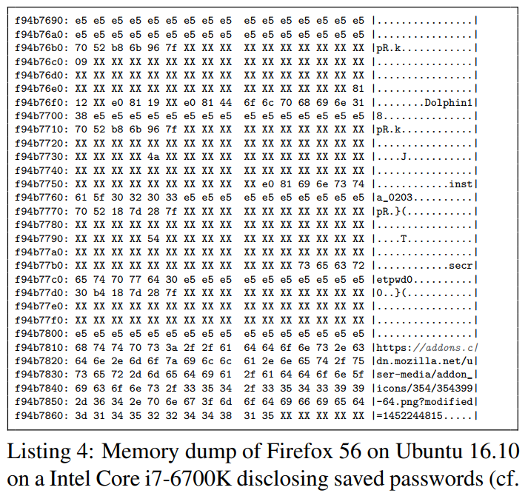
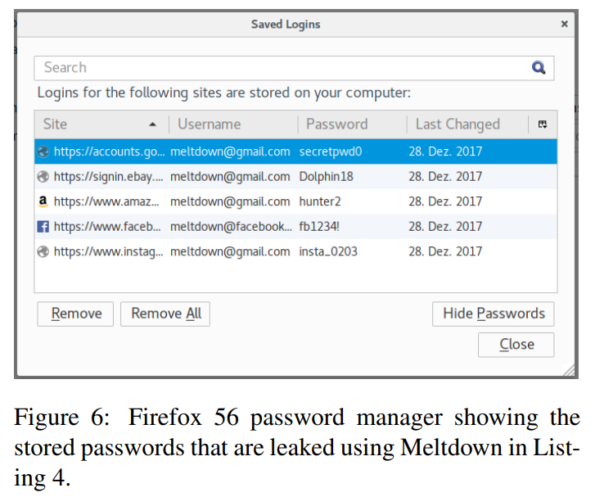
Real World Real Melt and Down

Slide 12
Readings
Spectre and Meltdown: https://meltdownattack.com/
For meltdown, make sure KASLR is disabled if you want to attack now.
ASLR (Address space layout randomization) randomizes the location of binaries in memory.
Also make sure, you disable meltdown mitigation patch

