Slide 1
CS683: Advanced Computer Architecture-2025
Lecture-1: Every Cycle Matters
https://www.cse.iitb.ac.in/~biswa/courses.html

Slide 2

Phones (smart/non-smart) on silence plz, Thanks

Slide 3
LH-102 is the place to be
CS683 at LH-102 from next week

Slide 4

Let’s start with programming for Performance
(know your architecture)

Slide 5
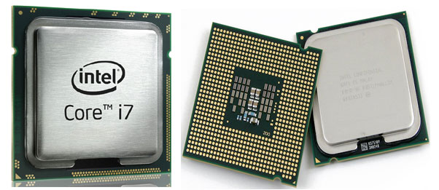
void CS683(int *arr, int size) {
for (int i = 0; i < size-1; ++i)
arr[i] = arr[i+1];
}

Slide 6
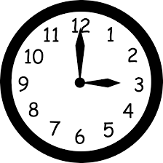
Performance
CPU
Execution time: CPU time + IO waiting
CPU time: User time + System (OS) time
CPU
CPU time: Time spent running a program

Slide 7
Spell it out (Programming language matters too)
Instructions
Cycles
Time
=
X
X
Program
Instruction
Cycle
(code size)
(CPI)
(cycle time)

Slide 8
Micro mantra-I: ISA vs Microarchitecture
Same program compiled for different ISAs with or without the same/similar microarchitecture may lead to different runtimes.

Slide 9

We are almost ready: The game of latency and bandwidth

Slide 10

Let’s Jump into Memory Hierarchy

Slide 11

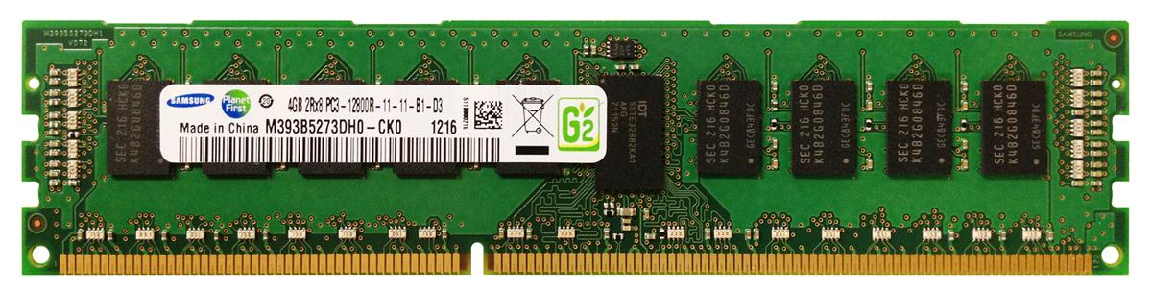
From where do these latency numbers come from?
Core
L1
L2
L3
DRAM Contr.
2 Cycles
12 Cycles
30 Cycles
200 Cycles
Memory stores CODE and DATA
Processor accesses through LOADs (reads) and STOREs(writes)
Memory Wall
CPU

Slide 12


Hang on!! I got the Mantra!!
Reduction in DRAM accesses ~
Reduction in CPI (cycles per instruction)
WRONG!
First Law of Performance:
Make the common case fast
Second Law of Performance:
Make the fast case common
Amdahl’s law
What if your program is not memory intensive

Slide 13

Do not ignore the uncommon too
Give me an example

Slide 14

Let’s Pause and understand: The game of “common” and “uncommon”

Slide 15
Do not
Over-engineer
Over-think
Over …………………..

Slide 16

10,000 Feet View on Caches
$$: Cache
Speculation technique
Speculation works because of locality

Slide 17

Caches
Hardware hash tables ☺

Slide 18
Locality (why does it exist?)
Temporal locality:
Recently referenced items are likely to be referenced again
Spatial locality:
Items with nearby addresses tend to be referenced again

Slide 19
Locality: Example
sum = 0;
for (i = 0; i < n; i++)
sum += a[i];
return sum;
Spatial/Temporal
Locality?
Data references
Reference array elements in succession (stride-1 reference pattern).
Reference variable sum each iteration.
spatial
temporal

Slide 20
Wake-up Test: Improve Spatial Locality
int sum_array_3d(int a[M][N][N])
{
int i, j, k, sum = 0;
for (i = 0; i < N; i++)
for (j = 0; j < N; j++)
for (k = 0; k < M; k++)
sum += a[k][i][j];
return sum;
}

Slide 21
Cache and DRAM
Block b is in cache: Hit!
Request: 14
Block b is not
in cache:Miss!
Request: 12
Cache
8
9
14
3
8
14
4
9
14
10
3
8
9
14
3
12
4
Request: 12
10
12
Block b is fetched from
Memory (replacement)
DRAM
0
1
2
3
0
1
2
3
0
1
2
3
4
4
5
6
7
4
5
6
7
4
5
6
7
8
9
10
8
9
10
11
10
11
8
9
10
11
12
13
14
15
12
13
14
15
12
12
13
14
15

