Slide 1
CS683: Advanced Computer Architecture-2025
L11: More the better?: Multicore Systems
https://www.cse.iitb.ac.in/~biswa/courses.html

Slide 2

Phones (smart/non-smart) on silence plz, Thanks

Slide 3
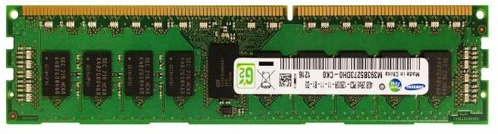
Welcome to Multicore Systems
L1 TLB
Core 0 L1 $ L2 $
Core 1 L1 $ L2 $
Core 2 L1 $ L2 $
Core 3 L1 $ L2 $
Interconnect
L3
L2 TLB
Page table walker (PTW)

Slide 4
Oh hang on!! One more time, last time
Do caches cache page table entries?
Yes, there is no other way to go to memory
So, the path for page table walk is: L1 TLB, L2 TLB, MMU caches, L1 cache, L2 cache, L3 cache, and then DRAM
So the worst case of five memory accesses for one translation can be five L1 hits too ☺

Slide 5
Summary
L1I
L1D
L2, LLC
DTLB, STLB, L1, L2, LLC
TLBs, MMU caches, Caches
PTWs, TLBs, MMU caches, Caches
VIPT, PIPT

Slide 6




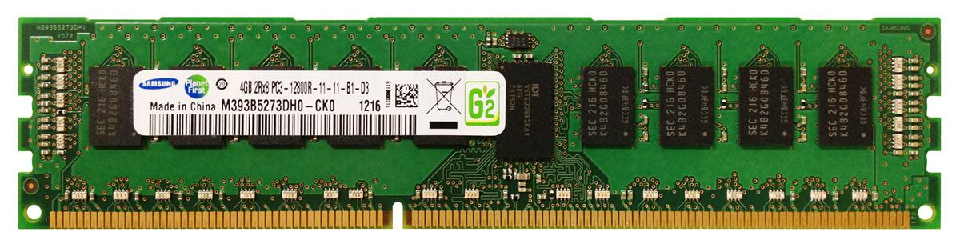
Multicore
Core 0
Core 1
Core 2
Core 3
L1
L1
L1
L1
L2
L2
L2
L2
Interconnect
L3

Slide 7



















Caches: Private/Shared
Core 0
Core 1 Core 2 Core 3
Core N-1
…
Interconnect
Cache (Private/Shared)

Slide 8








Application behavior
Core 0
Core 1
Core-Cache Fitting
LLC Fitting/thrashing
L1/L2
L1/L2
Interconnect
LLC
LLC

Slide 9






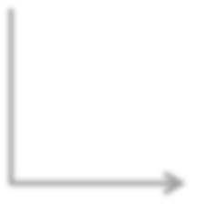














Sliced/Banked LLC: NUCA (Non-uniform(local/remote) Cache)
Core 0 L1 L2
Core 1 L1 L2
Core 2 L1 L2
Core 3
L1
L2
All caches are
Pipelined/banked
In commercial
machines
Ring(s)
S0
S1
S2
S3

Slide 10

Shared Resources
LLC
Space contention
Bandwidth contention (off-chip)
Revisit replacement policies, prefetching etc

Slide 11
More Problems once we jump into DRAMs

Slide 12
Let’s Pause and Reflect on all (Exam time)
Keywords: Latency, bandwidth, multi-level caches, TLBs, inclusive, exclusive, non-inclusive, inclusive, banking, pipelined, victim cache, stream buffers, prefetchers: software and hardware, stride, stream, next-line, SIMD, virtual memory, VIPT, PIPT, page table walkers, MMU caches, private cache, shared cache, sliced caches, streaming, thrashing, fitting, friendly, replacement policies: SRRIP/DRRIP, dead-block predictor, Miss rate, MPKI, MLP, MSHRs, fill buffers,NUCA, NUMA, remote cache, local cache, Huhhhhhhhhhhhhhhhhhhhhhhhhhhhhhhhhhhhhh

Slide 13
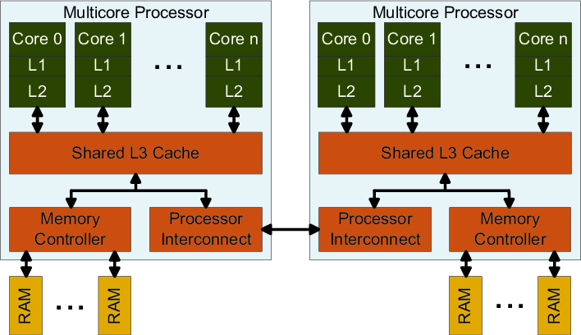
For Vedant : (just assume the socket is a chip)

Slide 14
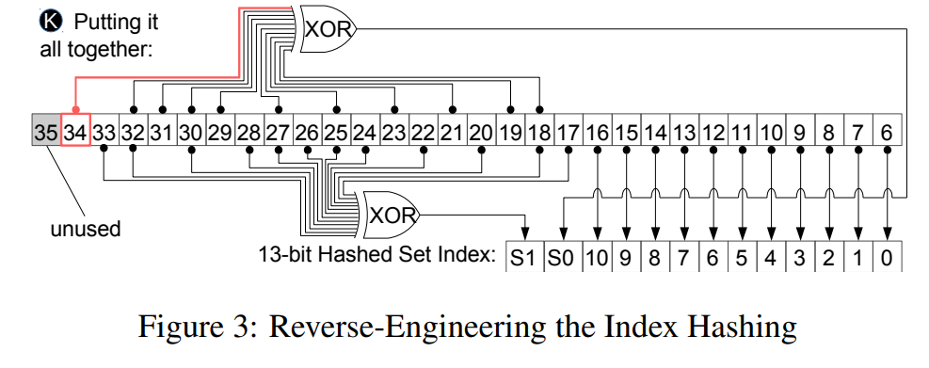
Intel Hash function for slicing (S1S0 are two bits for slicing), DAC’

