Slide 1
CS683: Advanced Computer Architecture-2025
L13: Cache Coherence
https://www.cse.iitb.ac.in/~biswa/courses.html

Slide 2

Phones (smart/non-smart) on silence plz, Thanks

Slide 3
Coherence vs Consistency
Shared memory systems:
Have multiple private caches for performance reasons
Need to provide the illusion of a single shared memory
Intuition: A read should return the most recently written value
What is “most recent”?
Formally:
Coherence: What values can a read return?
Concerns reads/writes to a single memory location
Consistency: When do writes become visible to reads?
Concerns reads/writes to multiple memory locations

Slide 4
Cache Coherence
P1
P2
P3
Cache
Bus
LLC/DRAM
sum=0

Slide 5
Cache Coherence
P1
P2
P3
rd &sum
sum =0
V
DRAM
sum=0
Advanced Computer Architecture

Slide 6
Cache Coherence
P1
P2
P3
rd &sum
sum=0
V
sum=0
V
DRAM
sum=0

Slide 7
Cache Coherence
wr sum
(sum = 3)
P1
P2
P3
sum=0
sum=0
V
3
V
D
DRAM
sum=0

Slide 8
Cache Coherence
P1
wr &sum
(sum = 7)
P2
P3
sum=3
D
sum=0
7
V
D
DRAM
sum=0

Slide 9
The Problem
Err!
Voila
P1
P2
P3
rd &sum
print sum=3
print sum=7
sum=3
D
sum=7
D
DRAM
sum=0

Slide 10
The Problem
If multiple cores cache the same block, how do they ensure they all see a consistent state?
Solution:
1. Write Propagation: All writes eventually become visible to other cores.
2. Write Serialization: All cores see write to a cache line in same order.
Need a protocol to ensure (1) and (2) called cache coherence protocol

Slide 11

Invalidate/Update
Invalidate –
Write to a cache line, and simultaneously broadcast invalidation of address to all others
Other cores clear/invalidate their cache lines
Update –
Write to a cache line, and simultaneously broadcast written data to all others
Other cores update their caches if data was present

Slide 12
A Simple MSI protocol
Extend single valid bit per line to three states:
M(odified): only one cache, memory not updated.
S(hared): one or more caches, and memory copy is up-to-date
I(nvalid): not present
These bits will be at the tag store as before
Read - Read request on bus, transitions to S
Write - ReadEx request, transitions to M state

Slide 13
State-transitions: Processor side (Master core)
PrRd/ –
PrWr/ –
PrRd/ –
PrWr/BusRdX
M
S
PrWr/BusRdX
PrRd/BusRd
I

Slide 14
Bus-side (Rest of the cores)
BusRd/ –
M
BusRd/Flush
S
BusRdX/Flush
BusRdX/ –
I
BusRd/ –
BusRdX/ –

Slide 15
MSI Protocol
P1
P2
P3
Cache
Snooper
Snooper
Snooper
Bus
DRAM
X=1

Slide 16
P1
P2
P3
rd &X
BusRd
Snooper
Snooper
Snooper
DRAM
X=1

Slide 17
P1
P2
P3
X=1
S
Snooper
Snooper
Snooper
DRAM
X=1

Slide 18
P1
P2
P3
wr &X
(X=2)
X=1
2
S
M
Snooper
Snooper
Snooper
DRAM
X=1

Slide 19
P1
P2
P3
rd &X
X=2
M
Snooper
Snooper
Snooper
BusRd
DRAM
X=1

Slide 20
P1
P2
P3
X=2
M
S
X=2
S
Snooper
Snooper
Snooper
Flush
DRAM
X=1
2

Slide 21
LLC/DRAM as the coherence point
P1
P2
P3
wr &X
X=3
X=2
S
I
X=2
3
S
M
Snooper
Snooper
Snooper
BusRdX
LLC
X=2

Slide 22
P1
P2
P3
rd &X
X=2
3
I
S
X=3
M
S
Snooper
Snooper
Snooper
BusRd
Flush
DRAM
Update DRAM as well
X=2
3

Slide 23
P1
P2
P3
rd &X
X=3
S
X=3
S
Snooper
Snooper
Snooper
DRAM
X=3

Slide 24
Summary
Proc Action | State P1 | State P2 | State P3 | Bus Action | Data From
R1 | - | - | - | BusRd | Mem
W1 | - | - | - | BusRdX | Mem
R3 | - | - | - | BusRd | P1 cache
W3 | - | - | - | BusRdX | Mem
R1 | - | - | - | BusRd | P3 cache
R3 | - | - | - | - | -
R2 | - | - | - | BusRd | Mem

Slide 25
Summary
Proc Action | State P1 | State P2 | State P3 | Bus Action | Data From
R1 | S | - | - | BusRd | Mem
W1 | M | - | - | BusRdX | Mem
R3 | S | - | S | BusRd | P1 cache
W3 | I | - | M | BusRdX | Mem
R1 | S | - | S | BusRd | P3 cache
R3 | S | - | S | - | -
R2 | S | S | S | BusRd | Mem

Slide 26
Cache Coherence Performance
Coherence misses: misses due to accesses to blocks that were invalidated due to coherence events
True sharing: misses that occur when multiple threads share the same data item (byte/word)
False sharing: misses that occur when multiple threads share different data items located in a single cache block

Slide 27
Cache Coherence Performance
Parameters | True Sharing Misses | False Sharing Misses
Larger cache size | increased | increased
Larger block/line size | decreased | increased
Larger associativity | unclear | unclear

Slide 28
Multicore to Manycore (Think about coherence performance)

Slide 29
Too much traffic: Cache Coherence Directory is the solution
Snoopy Protocols (Goodman 1983)
Directory Protocols
P
P
P
P
P
P
P
P
$ $ $ $
Interconnect Network
$
$
$
$
Bus
Mem/LLC.
Dir.
Mem/LLC.
Snoopy schemes
broadcast
Directory schemes send
requests over memory bus
messages to only those caches
that might have the line
Difficult to scale to large numbers of processors
Requires additional bandwidth to cache tags for snoop requests
Can scale to large numbers of processors
Requires extra directory storage to track possible sharers

Slide 30



MSI Directory Protocol
Main Memory/LLC
…
Tag
State
Data
Core 0
Core N
Cache states: Modified (M) / Shared (S) / Invalid (I)
Directory states:
Uncached (Un): No sharers
Shared (Sh): One or more sharers with read permission (S)
Exclusive (Ex): A single sharer with read & write permissions (M)
Transient states not drawn for clarity; for now, assume no racing requests

Slide 31
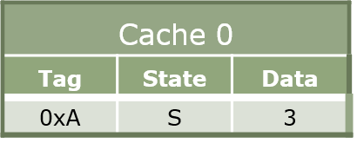
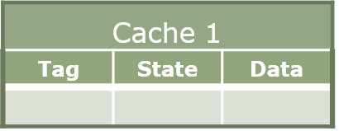
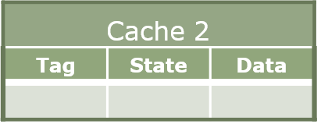
Example
Main Memory/LLC
3
Mem[0xA] = 3
Directory
Tag
State
Sharers
Tag
State
Sharers
0xA
Sh
{0}
2
ShReq 0xA
4
ShResp 0xA, data=3
Tag
State
Data
Tag
State
Data
0xA
I->S
Core 0
Core 1
Core 2
1
LD 0xA

Slide 32
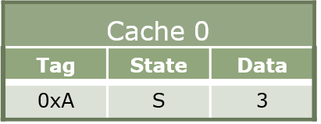
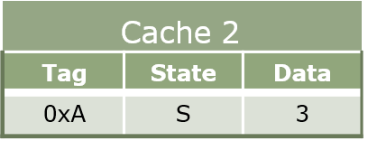
Example-Contd
Main Memory/LLC
3
Mem[0xA] = 3
Directory
Tag
State
Sharers
Tag
State
Sharers
0xA
Sh
{0,2}
0xA
Sh
{0}
4
ShResp 0xA, data=3
2
ShReq 0xA
Tag
Tag
State
State
Data
Data
0xA
I->S
Core 0
Core 1
Core 2
1
LD 0xA

Slide 33
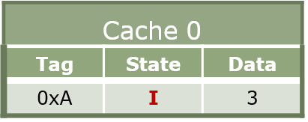
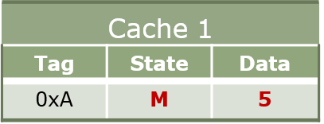
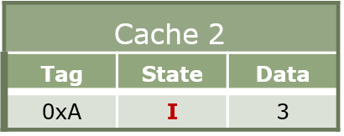
Example-Contd.
Main Memory/LLC
5 Mem[0xA] = 3
Directory
Tag
State
Sharers
Tag
State
Sharers
0xA
Ex
{1}
0xA
Sh
{0,2}
3 InvReq 0xA
₆ ExResp 0xA
2 ExReq 0xA
3 InvReq 0xA
data = 3
4 InvResp 0xA
4 InvResp 0xA
Tag
Tag
State
State
Data
Tag
State
Data
Data
Tag
State
Data
0xA
S
3
0xA
I->M
0xA
S
3
Core 0
Core 1
Core 2
1 ST 0xA

Slide 34
Directory Organization
Requirement: Directory needs to keep track of all the cores that are sharing a cache block
Challenge: For each block, the space needed to hold the list of sharers grows with number of possible sharers…

Slide 35
Flat Directory
Dedicate a few bits of main memory to store the state and sharers of every line
Encode sharers using a bit-vector
Main Memory
State Sharer Set
Sh | 0 | 1 | 0 | 0 | 1 | 1 | 0 | 0
64 bytes
Simple
10 bits
✗ Slow
✗ Very inefficient with many processors (~P bits/line)

Slide 36
Sparse Directory
Not every line in the system needs to be tracked – only those in private caches!
Idea: Organize directory as a cache
Way 1 Way 2 Way 3 Way 4
Directory Entry Format
Line Address State Sharer Set
0xF00 | Sh | 0 | 1 | 0 | 0 | 1 | 1 | 0 | 0
Low latency, energy-efficient
✗ Bit-vectors grow with # cores → Area scales poorly

Slide 37
Coherence Directory in 2024
Common multicore memory hierarchy:
Main Memory
1+ levels of private caches
A shared last-level cache
Need to enforce coherence among private caches
Idea: Embed the directory information in shared cache tags
– Shared cache must be inclusive (life is easy)
Shared cache
Private cache
Private cache
…
Private cache
Core 0
Core 1
Core N
– Need extended directory if non-inclusive (Intel Skylake-X/SP)

Slide 38




Multi-socket Coherence
Can use the same or different protocols to keep coherence across multiple levels
Key invariant: Ensure sufficient permissions in all intermediate levels
Example: 8-socket Xeon E7 (8 cores/socket)
Main Memory
Main Memory
MESIF protocol Snooping (QPI)
Interconnect
L3
L3
MESI protocol
L3 in-cache directory
L2
L2
L2
L2
…
…
…
Core 0
Core 7
Core 0
Core 7
Chip 0
Chip 7

Slide 39
Remember Inclusive Cache ☺
Inclusion traffic on top of coherence traffic as back-invalidations will go to each core’s private caches.
Non-inclusive caches with extended directory is a win-win tradeoff with additional design complexity.

