Slide 1
CS683: Advanced Computer Architecture
Lecture 15: It is the Memory Stupid! ☺
https://www.cse.iitb.ac.in/~biswa/courses/

Slide 2
Memory Consistency
The memory consistency model of a shared-memory system determines the order in which memory operations will appear to execute to the programmer.
– Core 1 writes to some memory location…
– Core 2 reads from that location…
– Do we get the result we expect?

Slide 3
Coherence vs Consistency
Formally:
– Coherence: What values can a read return?
• Concerns reads/writes to a single memory location
– Consistency: When do writes become visible to reads?
• Concerns reads/writes to multiple memory locations

Slide 4
Why it matters?
Initial memory contents
a: 0 // memory location a storing zero
flag: 0 // memory location flag storing zero
Processor 1 Processor 2
Store (a), 10; | L: | Load r1, (flag);
Store (flag), 1; |  | if r₁ == 0 goto L; Load r2, (a);
What value does r2 hold after both processors
finish running this code?

Slide 5
Why it matters?
Initial memory contents
a: 0 // memory location a storing zero
flag: 0 // memory location flag storing zero
Processor 1 Processor 2
Store (a), 10; | L: | Load r1, (flag);
Store (flag), 1; |  | if r₁ == 0 goto L; Load r2, (a);
What value does r2 hold after both processors
finish running this code?
It depends on the order in which processor 2
observes processor 1’s stores!
10 if Store (flag) > Store (a); 0 or 10 otherwise

Slide 6
The definition, An important one
memory consistency model, or, more simply, a memory model, is a specification of the allowed behavior of multithreaded programs executing with shared memory. For a multithreaded program executing with specific input data, it specifies what values dynamic loads may return. Unlike a single-threaded execution, multiple correct behaviors are usually allowed.

Slide 7

The definition
“A system is sequentially consistent if the result of any execution is the same as if the operations of all the processors were executed in some sequential order, and the operations of each individual processor appear in the order specified by the program”
Leslie Lamport, Turing award winner
Sequential Consistency =
arbitrary order-preserving interleaving
of memory references of sequential programs

Slide 8
Let’s continue
Processor 1
Store (a), 10;
Store (flag), 1;
Processor 2
L: Load r1, (flag); if r₁ == 0 goto L; Load r2, (a);
In-order instruction execution
Atomic loads and stores
SC is easy to understand, but architects and compiler writers want to violate it for performance

Slide 9
Trend so far ☹
Architectural optimizations that are correct for uniprocessors often violate sequential consistency and result in a new memory model for multiprocessors

Slide 10

Memory Consistency Models
Sequential Consistency
All reads and writes in order
Relaxed Consistency (one or more of the following)
Loads may be reordered after loads
e.g., PA-RISC, Power, Alpha
Loads may be reordered after stores
e.g., PA-RISC, Power, Alpha
Stores may be reordered after stores
e.g., PA-RISC, Power, Alpha, PSO
Stores may be reordered after loads
e.g., PA-RISC, Power, Alpha, PSO, TSO, x86
Other more esoteric characteristics
e.g., Alpha

Slide 11
X86 uses TSO (Total Store Order)
We will come back in two weeks time. Once we understand how the processor looks at stores.
So far we have seen how caches see stores ☺

Slide 12
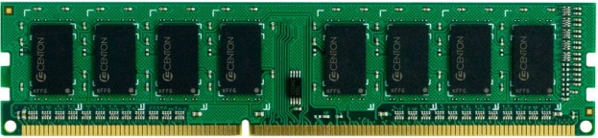
DRAM Organization
Channel
Rank 1 with 8 chips
DIMM
Rank
Rank 0 with 8 chips
Chip
Bank
Row
Column

Slide 13
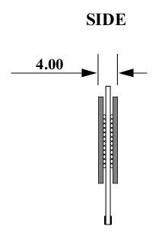
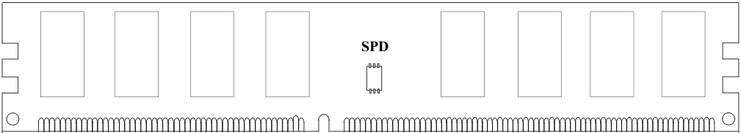
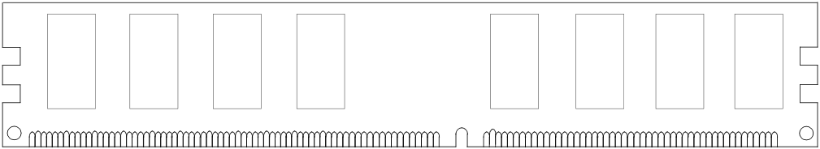
Rank
DIMM (Dual in-line memory module)
Side view
Front of DIMM
Back of DIMM
Rank 0: collection of 8 chips
Rank 1

Slide 14
Ranks, Banks, Rows, Columns
Rank 0
Rank 1
Bank 0
Bank 1
DIMM
Bank 2
Bank 3
Multiple Chips

Slide 15
Ranks, Banks, Rows, Columns
Rank 0
Chip
Bank 0
Bank 1
16
64 bits
16
Bank
16
Bank 2
Bank 3
16
Row
X16 device (DRAM width, # output pins)
Column
16-bit interface: 16 bits from each chip in one go

Slide 16
Row Decoder and Row buffer
2KB
Each bank has a row buffer
Row Decoder
Stores the last used row
Row Buffer
Column mux

Slide 17
An Example
2Gb * 8 DRAM Chips (one side of the rank)
Total 16 chips + 2 chips for ECC (for both the ranks)
64 bit + 8 bit ECC interface (72 bit wide DIMM)
Transferring a 64B cache line will take 8 transfers of 8B each
8B will come from 8 chips (8 bits from one chip)
1 bit from each DRAM array assuming 8 DRAM arrays per bank

Slide 18
DRAM to LLC interaction
Physical memory space
Chip 0
Chip 1
Rank 0
Chip 7
0xFFFF…F
. . .
...
<0:7>
<8:15>
<56:63>
0x40
64B
cache block
Data <0:63>
0x00

Slide 19
DRAM to LLC interaction
Physical memory space
Chip 0
Chip 1
Rank 0
Chip 7
0xFFFF…F
. . .
Row 0
Col 0
...
<0:7>
<8:15>
<56:63>
0x40
64B
cache block
Data <0:63>
0x00

Slide 20
DRAM to LLC interaction
Physical memory space
Chip 0
Chip 1
Rank 0
Chip 7
0xFFFF…F
. . .
Row 0
Col 0
...
<0:7>
<8:15>
<56:63>
0x40
64B
cache block
Data <0:63>
8B
0x00
8B

Slide 21
DRAM to LLC
Physical memory space
Chip 0
Chip 1
Rank 0
Chip 7
0xFFFF…F
. . .
Row 0
Col 1
...
<0:7>
<8:15>
<56:63>
0x40
8B
64B
cache block
Data <0:63>
8B
0x00
8 cycles (DRAM IO): 1 cycle transfers 8 bytes from a column

Slide 22
DRAM Address Mapping (One Channel)
2GB DRAM, 8 Banks, 16K rows, 2K Columns per bank
Cache Interleaving: Consecutive cache blocks in consecutive banks
Row (14 bits)
High Column
Bank (3 bits)
Low Col.
Byte in bus (3 bits)
8 bits
3 bits
Row Interleaving: Consecutive rows in consecutive banks
Row (14 bits)
Bank (3 bits)
Column (11 bits)
Byte in bus (3 bits)

Slide 23
Row Access
A “DRAM row” is also called a “DRAM page”
Each address is a <row,column> pair
Access to a “closed row”
Activate command opens row (placed into row buffer)
Read/write command reads/writes column in the row buffer
Precharge command closes the row and prepares the bank for next access
Access to an “open row”
No need for activate command

Slide 24
Row Buffer hit/miss/conflict
Access Address:
(Row 0, Column 0)
Columns
(Row 0, Column 1)
(Row 0, Column 85)
(Row 1, Column 0)
Row address 0
Row address 1
Row decoder
Rows
Row Buffer
CONFLICT !
HIT
Row 1
HIT
Row 0
Empty
Column address 0
Column mux
Column address 0
Column address 1
Column address 85
Data

Slide 25
DRAM Timing Constraints
tRAS: Row address strobe latency
tRP: Precharge latency
tCAS: Column address strobe latency
tRC: Row cycle time: tRAS+tRP

Slide 26
Row (Page) Policies
Open Page (do not get confused with an OS page)
After an access: Keep the page in the row-buffer
Consecutive accesses to the same page : Row-buffer Hit
On an access to different page: Close the row and open the new one
Closed page:
After an access: Close the page if there are no accesses to the same row in the request queue.
Consecutive accesses to different page : Low latency
On an access to different page: No need to close the row

Slide 27
10K view on the latency
Page Empty: ACT + CAS
Page Hit: CAS
Page Miss: PRE+ACT+CAS

Slide 28
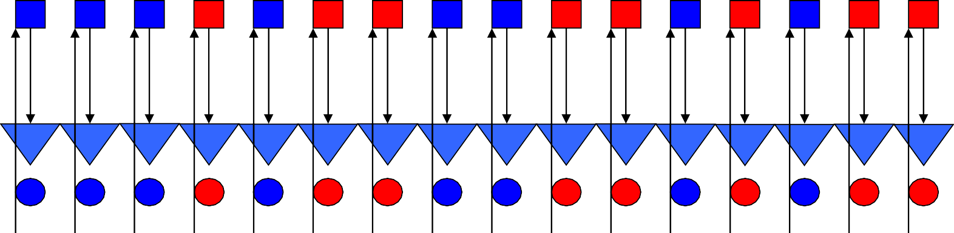
DRAM Refresh
DRAM cells
Row Buffer
DRAM cells lose contents after a while,
Refresh command refreshes all rows at different granularity
How to implement a refresh? What is the latency? How frequent?
DRAM cells are refreshed every 64 ms at normal temperature (< 85◦C).

Slide 29

PAUSE

Slide 30
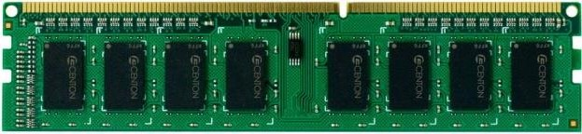
DRAM Controller
LLC
DRAM
Controller
Addr. Mapper
RQ WQ
CQ
CQ
CQ
CQ
Command Scheduler
Command and Address bus
Frequency 800MHz
1066MHz
1333MHz
Double Data Rate (DDR)
Data bus (burst length= eight beats each of 64-bits)
Frequency 1600MHz
2133MHz
2666MHz
Advanced Computer Architecture

Slide 31
DRAM Bandwidth
Names | Memory clock | I/O bus clock | Transfer rate | Theoretical bandwidth
DDR-200, PC-1600 | 100 MHz | 100 MHz | 200 MT/s | 1.6 GB/s
DDR-400, PC-3200 | 200 MHz | 200 MHz | 400 MT/s | 3.2 GB/s
DDR2-800, PC2-6400 | 200 MHz | 400 MHz | 800 MT/s | 6.4 GB/s
DDR3-1600, PC3-12800 | 200 MHz | 800 MHz | 1600 MT/s | 12.8 GB/s
DDR4-2400, PC4-19200 | 300 MHz | 1200 MHz | 2400 MT/s | 19.2 GB/s
DDR4-3200, PC4-25600 | 400 MHz | 1600 MHz | 3200 MT/s | 25.6 GB/s
DDR5-4800, PC5-38400 | 300 MHz | 2400 MHz | 4800 MT/s | 38.4 GB/s
DDR5-6400, PC5-51200 | 400 MHz | 3200 MHz | 6400 MT/s | 51.2 GB/s
Advanced Computer Architecture

