Slide 1
CS683: Advanced Computer Architecture
Lecture 16: Bye Bye Monsoon;Time for front-end mysteries ☺
https://www.cse.iitb.ac.in/~biswa/courses/

Slide 2
Instruction Level Parallelism (ILP)
Scalar pipeline (baseline)
Instruction overlap parallelism = D
Peak IPC = 1.0
D
D different instructions overlapped
Successive
Instructions
1
2
3
4
5
6
7
8
9
10
11
12
Time in cycles

Slide 3
Superscalar Processor
Superscalar (pipelined) Execution
Instruction parallelism = D x N
Peak IPC = N per cycle
D x N different instructions overlapped
N
Successive
Instructions
1
2
3
4
5
6
7
8
9
10
11
12
Time in cycles

Slide 4
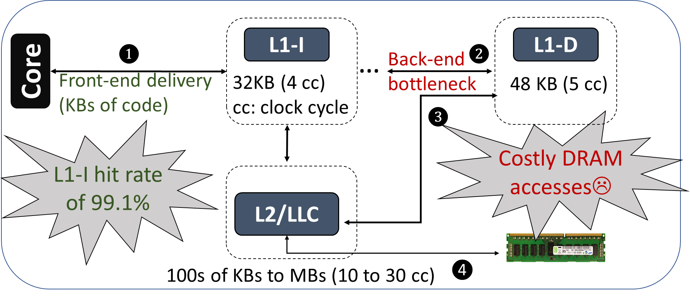
Most of the Computer Architecture Courses

Slide 5
Modern Processors: In-order fetch
1. LOAD
2. SUB
3. LOAD
4. LOAD
5. MUL
In-order Instruction Fetch
(Multiple fetch in one cycle)
Advanced Computer Architecture

Slide 6
Modern Processors: Out-of-order Execute
1. LOAD
2. LOAD
2. SUB
1. SUB
3. LOAD
3. LOAD
4. LOAD
5. LOAD
5. MUL
4. MUL
In-order Instruction Fetch
(Multiple fetch in one cycle)
Out of order execute
Advanced Computer Architecture

Slide 7
Modern Processors: In-order Commit
1. LOAD
1. LOAD ☹
2. LOAD
2. SUB
2. SUB ☹
1. SUB
3. LOAD
3. LOAD ☹
3. LOAD
4. LOAD
4. LOAD ☹
5. LOAD
5. MUL
5. MUL☹
4. MUL
In-order Instruction Fetch
(Multiple fetch in one cycle)
In-order Completion (commit)
Out of order execute
Advanced Computer Architecture

Slide 8
Modern Processors: In-order Commit
Reorder buffer (ROB)
3
2
1. LOAD
1. LOAD ☹
1
2. LOAD
2. SUB
2. SUB ☹
1. SUB
3. LOAD
3. LOAD ☹
ROB head
3. LOAD
4. LOAD
4. LOAD ☹
5. LOAD
5. MUL
5. MUL☹
4. MUL
In-order Instruction Fetch
(Multiple fetch in one cycle)
In-order Completion (commit)
Out of order execute
Advanced Computer Architecture

Slide 9
Modern Processors: Speculative Execution
4
Branch Predictor: TRUE
3
1. BE
2
2. SUB
1
Speculative (wrong path)
instructions
3. LOAD
BE reaches ROB head and
then processor realized it is a mistake
4. LOAD
5. ADD
In-order Instruction Fetch
(Multiple fetch in one cycle)
Recent Intel processors have 750-entry ROBs
Advanced Computer Architecture

Slide 10
Modern Processors: Speculative Execution
4
Branch Predictor: TRUE
3
Instructions 2, 3, and 4
Got squashed
1. BE
2
2. SUB
1
Speculative (wrong path)
instructions
3. LOAD
BE reaches ROB head and
then processor realized it is a mistake
4. LOAD
5. ADD
In-order Instruction Fetch
(Multiple fetch in one cycle)
Same happens in the case of a page fault, exception etc…
Advanced Computer Architecture

Slide 11
Three Great tastes that tastes great together
CPI < 1 : Go for Superscalar
Superscalar increases data hazards: Go for out-of-order
Branch instructions are the problem: Speculative execution
Advanced Computer Architecture

Slide 12
Front-end Bottleneck (Servers, mobile workloads)
Direction
Direct Branch Predictor
Always Taken
Branches
Conditional
Direct Jump
Direct Call
Indirect Call
Indirect Jump
Return
Branch Target
Branch Target Buffer
Indirect Branch Predictor
Return Address Stack
Advanced Computer Architecture

Slide 13
Branch instructions
int func(int num) {
int temp = 0;
if(num > 0)
{
temp = temp + 1;
goto loc;
}
switch(temp)
{
case 0: break;
case 1: break;
case 2: break;
case 3: break;
case 4: break;
}
temp--;
loc: return temp;
}
int main() {
func(5);
int (*temp)(int) = &func;
temp(5);
}
func(int):
….
cmp DWORD PTR [rbp-20], 0
jle .L2
add DWORD PTR [rbp-4], 1
jmp .L3
.L2:
cmp DWORD PTR [rbp-4], 4
ja .L4
mov eax, DWORD PTR [rbp-4]
mov rax, QWORD PTR .L6[0+rax*8]
jmp rax
….
ret
main: ….
call func(int)
mov QWORD PTR [rbp-8], OFFSET FLAT:func(int)
mov rax, QWORD PTR [rbp-8]
mov edi, 5
call rax
ret
Conditional
Direct Jump
Indirect Jump
Return
Direct Call
Indirect Call
C++ Code
(b) Assembly Code
Advanced Computer Architecture

Slide 14
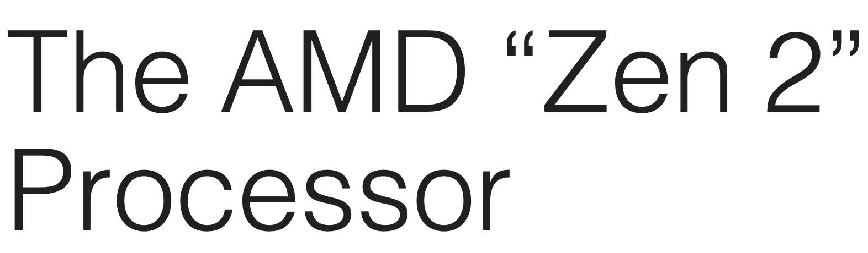

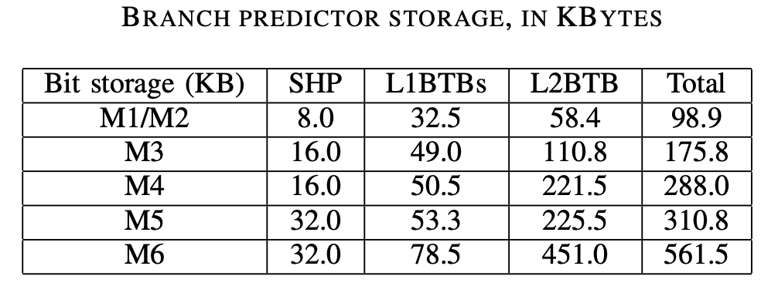
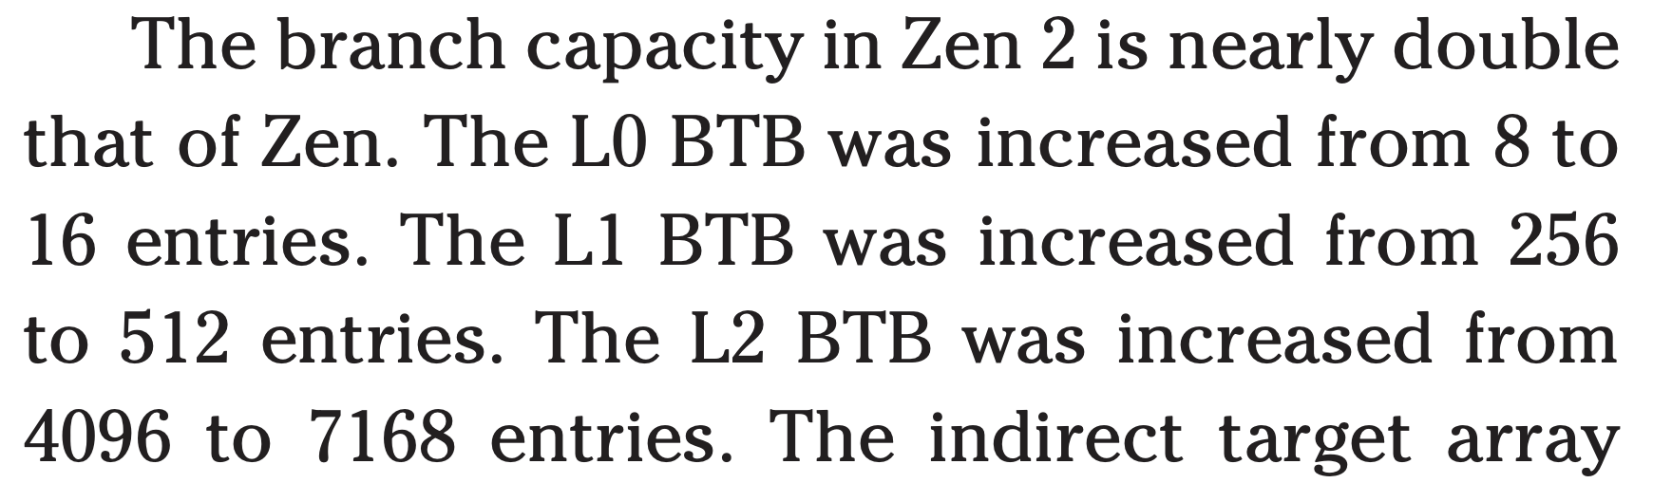
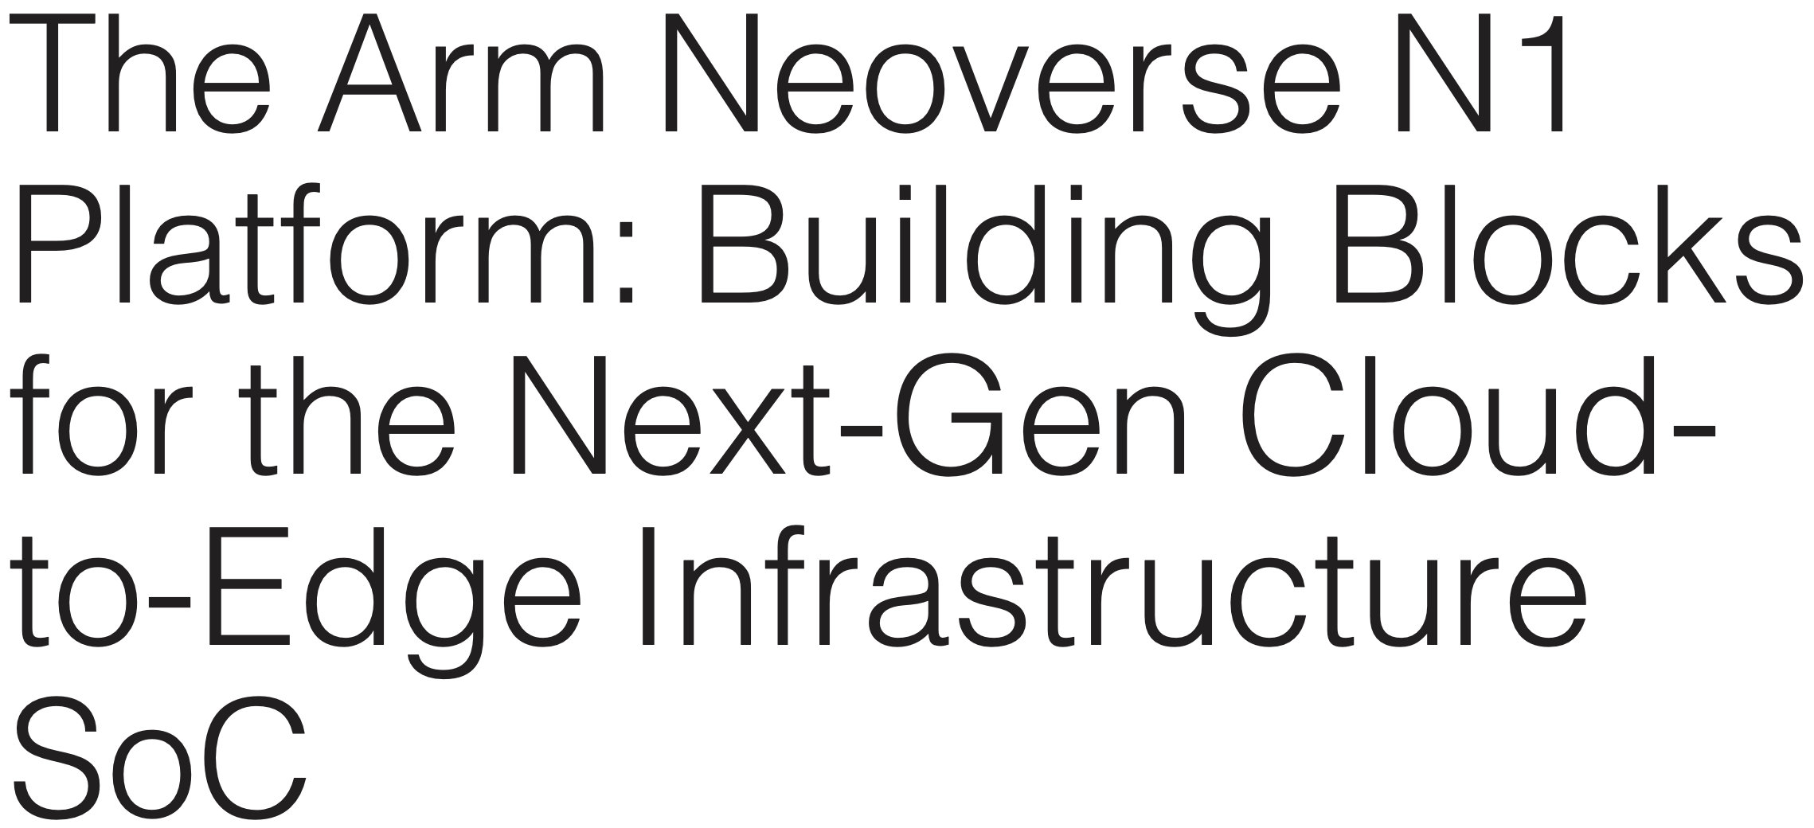
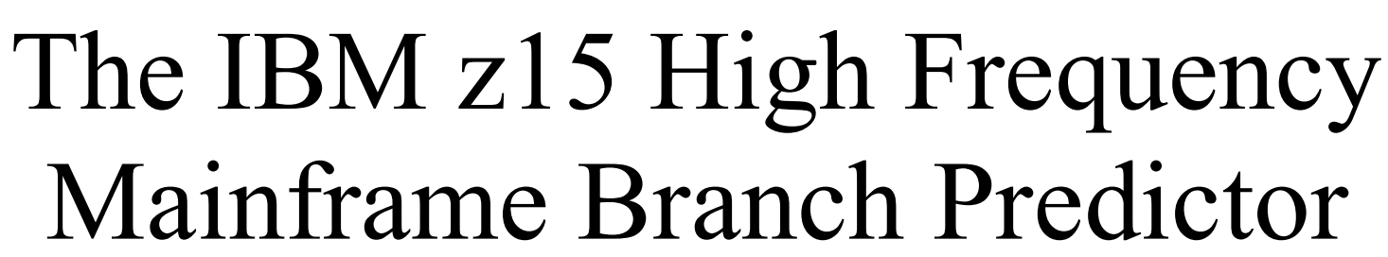
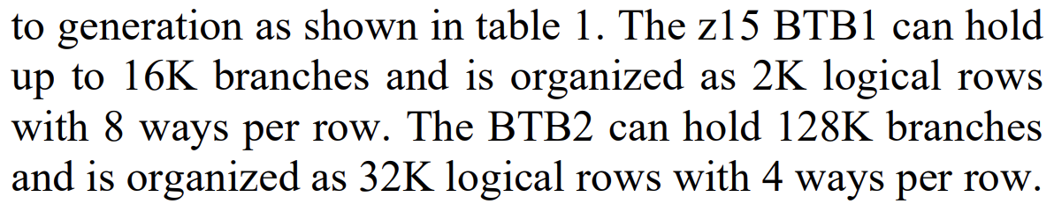
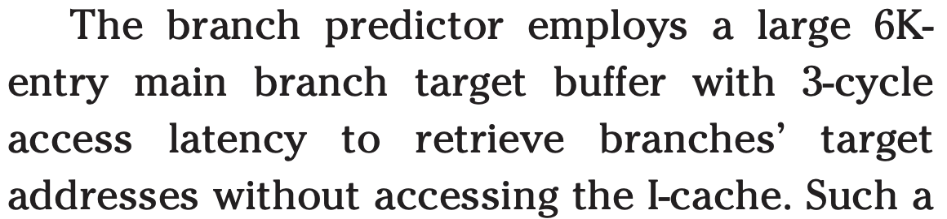
BTB/L1I Capacity/latency Problem
Advanced Computer Architecture

Slide 15
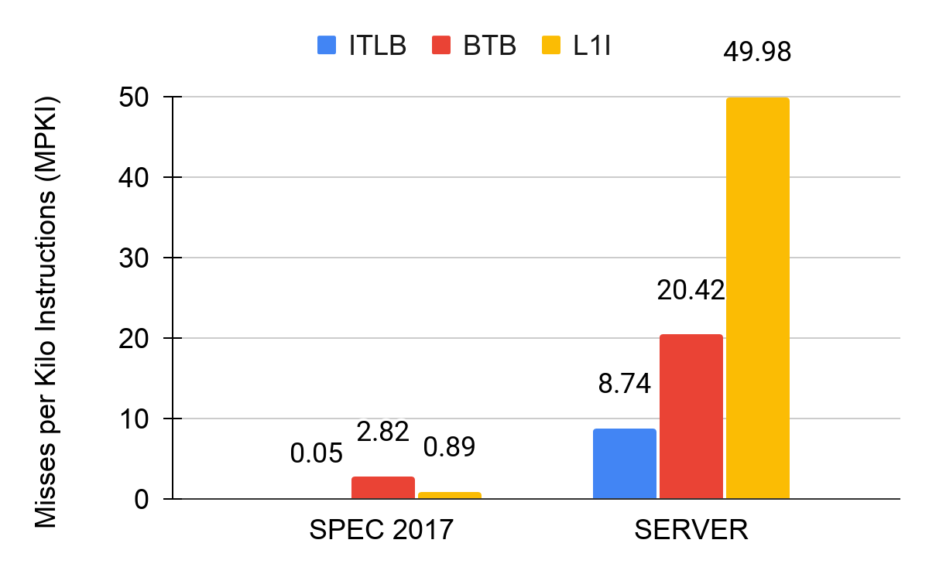
An Example
High MPKI in front-end structures due to increase in codebase.
Advanced Computer Architecture

Slide 16
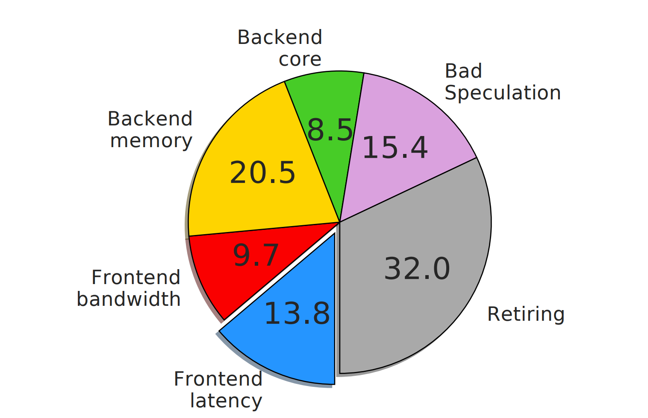
Ideal front-end: Google Web search
Ideal BTB :- All misses converted to hits.
Ideal L1I :- Misses converted to hits.
Ideal front-end does not provide significant performance improvement on top of ideal BTB (it has ideal ITLB too).
Advanced Computer Architecture

Slide 17
Decoupled Frontend: Welcome to the Mystery
Next Instruction Pointer
Fetch Target Queue
Branch Predictor
i
i
Instruction Fetch
Instruction Decode
Prefetch Request
L1I
Fetch Directed Instruction Prefetching (FDIP)
Decoupling allows to run way ahead of demand fetch which helps to reduce the impact of long latency L1I misses
Thanks to Vedant for this slide

Slide 18
Decoupled Front-end
5
Insert Branch Target in to BTB
Direct Jump
Direct Call
Conditional
Indirect Jump
Indirect Call
Return
ITLB
L1I Cache
Direct Branch Predictor
Indirect Branch Predictor
1
2
3
5
5
Instruction
Return Address Stack
Branch Target Buffer
Decode
Execute
Fetch Target Queue
4
5
Branch Target
Branch predictor looks ahead even if L1I misses
Advanced Computer Architecture

Slide 19
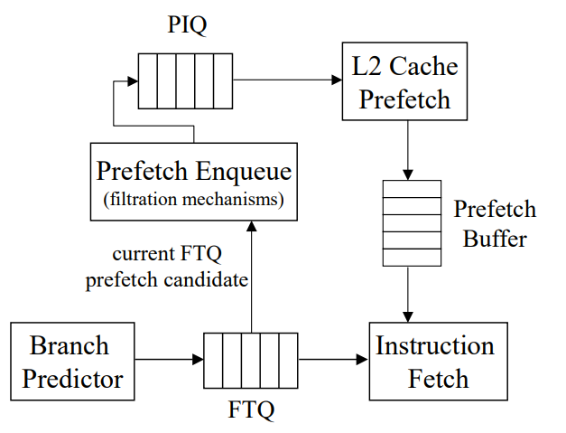
FDIP paper (Fetch Directed Instruction Prefetching)
https://cseweb.ucsd.edu/~calder/papers/MICRO-99-FDP.pdf
PIQ: Prefetch Instruction Queue
FTQ: Fetch Target Queue
One entry in FTQ stores 8 instructions

Slide 20
Benefits
Branch predictor can move ahead and L1I misses can be amortized ☺
Instruction prefetching?
Hides latency of multi-level branch predictor and BTB
Demands a larger BTB though ☹
BTB prefetching?
Tradeoffs: BTB capacity vs L1I capacity and latency
What else?
Advanced Computer Architecture

Slide 21
L1I misses can cause Decode Starvation
FETCH Queue
DECODE Queue
Issue Queue
 | IF
 | ID
 | EX
I1
I2
I3
I4
I5
Empty
L1 I
L2
Decode stage stalls, waiting for the instructions to arrive from the outer levels of memory
LLC
DRAM

Slide 22
Decode Latency will be there, anyways ☹
x86 uses variable-length instructions
Size of the decoder cannot be fixed like ARM ISA.
Also, x86 is RISCY ISA ☺ CISC for programmers, RISC for the execution units
One CISC instruction -> many RISC micro-operations
Here is the deal: There is a macro-op queue containing CISC instructions that a pre-decoder logic converts into micro-ops. It can take up to six cycles in the worst case.
Then there will a decode. In general, decoding takes a considerable amount of power and latency.
What can be done? Well, use a cache, called micro-op cache. A hit in the micro-op cache can bypass decode latency.
BTW, which stage in the pipeline, the micro-op cache will be accessed?

Slide 23
Think about latency and bandwidth again
Front-end latency and bandwidth
Bad speculation (branch predictor, micro-op cache too ☺)

Slide 24

Students@CS683 after Front-end mysteries

