Slide 1
CS683: Advanced Computer Architecture
Lecture 17: Humid October ☹
Front-end Mysteries, hmmm, re/de-mystified
https://www.cse.iitb.ac.in/~biswa/courses/

Slide 2
Decoupled Front-end
5
Insert Branch Target in to BTB
Direct Jump
Direct Call
Conditional
Indirect Jump
Indirect Call
Return
ITLB
L1I Cache
Direct Branch Predictor
Indirect Branch Predictor
1
2
3
5
5
Instruction
Return Address Stack
Branch Target Buffer
Decode
Execute
Fetch Target Queue
4
5
Branch Target
Branch predictor looks ahead even if L1I misses
Advanced Computer Architecture

Slide 3
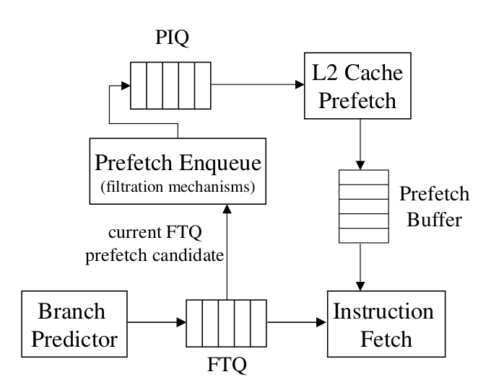
FDIP(Fetch Directed Instruction Prefetching)
PIQ: Prefetch Instruction Queue
FTQ: Fetch Target Queue
@Image adapted from FDIP, MICRO'1999

Slide 4
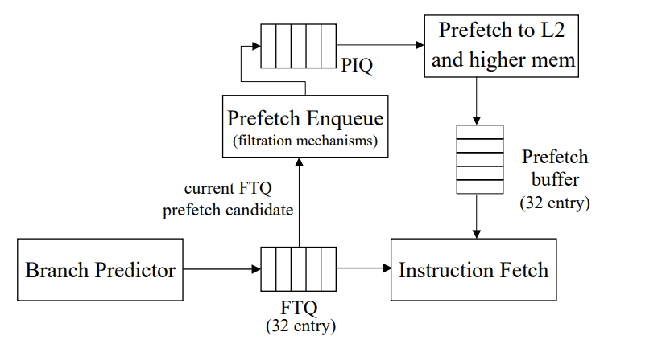
FTQ directed code prefetching (FDIP)
FTQ is of 24 to 32 entries, one entry in FTQ stores 8 instructions
Advanced Computer Architecture

Slide 5
Benefits
Branch predictor can move ahead and L1I misses can be amortized ☺
Instruction prefetching?
Hides latency of multi-level branch predictor and BTB
Demands a larger BTB though ☹
BTB prefetching?
Tradeoffs: BTB capacity vs L1I capacity and latency
What else?
Advanced Computer Architecture

Slide 6
L1I misses can cause Decode Starvation
FETCH Queue
DECODE Queue
Issue Queue
 | IF
 | ID
 | EX
I1
I2
I3
I4
I5
Empty
L1 I
L2
Decode stage stalls, waiting for the instructions to arrive from the outer levels of memory
LLC
DRAM

Slide 7
Decode Latency will be there, anyways ☹
x86 uses variable-length instructions
Size of the decoder cannot be fixed like ARM ISA.
Also, x86 is RISCY ISA ☺ CISC for programmers, RISC for the execution units
One CISC instruction -> many RISC micro-operations
Here is the deal: There is a macro-op queue containing CISC instructions that a pre-decoder logic converts into micro-ops. It can take up to six cycles in the worst case.
Then there will a decode. In general, decoding takes a considerable amount of power and latency.
What can be done? Well, use a cache, called micro-op cache. A hit in the micro-op cache can bypass decode latency.
BTW, which stage in the pipeline, the micro-op cache will be accessed?

Slide 8
Think about latency and bandwidth again
Front-end latency and bandwidth
Bad speculation (branch predictor, micro-op cache too ☺)

Slide 9

Students@CS683 after Front-end mysteries

Slide 10
We are together: The Bigger Picture (latency and bandwidth)
ROB
Back
End
IFETCH Buffer
Front End
DECODE Buffer
Issue
Queue
Micro-op cache
IF
ID
EX
MA
WB
Commit
IF
L1 I
L2
L1 D
LLC
L2
DRAM
LLC
DRAM

Slide 11
Some fun questions?
How many Indian students know front-end mysteries bit by bit, cycle by cycle?
1
10
100
1000
10000
100000

Slide 12


Here are the front-end Ninjas

Slide 13
O3 (out-of-order) processor
Pipelining: Tries to achieve CPI =1
Hardware scheduling so far: In order execution Instructions after stall must wait even if independent.
Dynamic scheduling: Out of order execution
Hardware lookahead of blocked instructions
Inorder, O3
Inorder fetch, O3 execute, Inorder completion

Slide 14
Issue Stage??
To enable O3 execution,
We split Decode stage into
Dispatch: Decode instructions, check for structural hazards
Issue: Read operands after all the data hazards are taken care of and issue the instructions to next stage

Slide 15
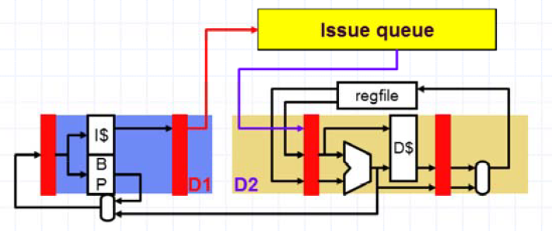
Issue Q (instructions enter in-order, leave out-of-order)
Issued
Dispatched

Slide 16
Why Issue Q or Operation Q?
In-order pipeline: younger ones cannot pass/cross the older instructions
Issue Q: Structure that can hold multiple instructions in-flight, actually not a Q
Register renaming also happens at this stage. More later ☺

Slide 17
The Complete Picture First: IBM 360
From Mem FP Op
FP Registers
Queue Load Buffers
Load1 Load2 Load3 Load4 Load5 Load6
Store Buffers
Add1 Add2 Add3
Mult1 Mult2
Reservation
Stations
To Mem
Register renaming through reservation stations
FP adders
FP multipliers

Slide 18
What is the deal?
Control & buffers distributed with Function Units (FU);
FU buffers called “reservation stations”; have pending operands
Registers in instructions replaced by values or pointers to reservation stations(RS); called register renaming ;
avoids WAR, WAW hazards
More reservation stations than registers, so can do optimizations compilers can’t
Results to FU from RS, not through registers, over Common Data Bus that broadcasts results to all FUs
Load and Stores treated as FUs with RSs as wells

Slide 19
Reservation Station
Op: Operation to perform in the unit (e.g., + or –)
Vj, Vk: Value of Source operands
Store buffers has V field, result to be stored
Qj, Qk: Reservation stations producing source registers (value to be written)
Qj,Qk=0 => ready
Store buffers only have Qi for RS producing result
Busy: Indicates reservation station or FU is busy
Register result status—Indicates which functional unit will write each register, if one
exists. Blank when no pending instructions that will write that register.

Slide 20
Pipeline Stages++
Dispatch and Issue—get instruction from Op Queue
If reservation station free (no structural hazard),
control issues instr & sends operands (renames registers).
To make it simple for the rest of the lecture, let’s assume only issue
Execution—operate on operands (EX) When both operands ready then execute;if not ready, watch Common Data Bus for result
Write result—finish execution (WB)
Write on Common Data Bus to all awaiting units; mark reservation station available
Normal data bus: data + destination (“go to” bus)
Common data bus: data + source (“come from” bus)
64 bits of data + 4 bits of Functional Unit source address
Write if matches expected Functional Unit (produces result)
Does the broadcast

Slide 21
Example: Ready Steady Go!
Instruction status:
Exec Write Comp Result
Load: 2 cycle FP add: 2 cycles
FP multiply: 10 cycles FP divide: 40 cycles
Instruction LD
LD MULTD SUBD DIVD ADDD
j k
F6 34+ R2
F2 45+ R3
F0 F2 F4
F8 F6 F2
F10 F0 F6
F6 F8 F2
Issue
Busy Address
Load1 Load2 Load3
No
No No
Reservation Stations:
Time Name Busy Op
S1
Vj
S2 RS RS
Vk Qj Qk
Add1 Add2 Add3 Mult1 Mult2
No
No No No No
Register result status:
Clock
F0 F2 F4 F6 F8
F10 F12 ... F30
0
FU

Slide 22
Cycle-1
Instruction status:
Exec
Write
Load: 2 cycle FP add: 2 cycles
FP multiply: 10 cycles FP divide: 40 cycles
Instruction | j | k | Issue | Comp Result |  |  |  | Busy | Address
LD | F6 34+ | R2 | 1 |  | Load1 |  |  | Yes | 34+R2
LD | F2 45+ | R3 |  |  | Load2 |  |  | No
MULTD | F0 F2 | F4 |  |  | Load3 |  |  | No
SUBD | F8 F6 | F2
DIVD | F10 F0 | F6
ADDD | F6 F8 | F2
Reservation Stations:
Time Name Busy Op
S1
Vj
S2
Vk
RS RS
Qj Qk
Add1 Add2 Add3 Mult1 Mult2
No
No No No No
Register result status:
Clock
F0 F2 F4 F6 F8
Load1
F10 F12 ... F30
1
FU

Slide 23
Cycle-2
Instruction status:
Exec
Write
Instruction | j | k | Issue | Comp Result |  |  |  | Busy | Address
LD | F6 34+ | R2 | 1 |  | Load1 |  |  | Yes | 34+R2
LD | F2 45+ | R3 | 2 |  | Load2 |  |  | Yes | 45+R3
MULTD | F0 F2 | F4 |  |  | Load3 |  |  | No
SUBD | F8 F6 | F2
DIVD | F10 F0 | F6
ADDD | F6 F8 | F2
Reservation Stations:
Time Name Busy Op
S1
Vj
S2
Vk
RS RS
Qj Qk
Add1 Add2 Add3 Mult1 Mult2
No
No No No No
Register result status:
Clock |  | F0 | F2 | F4 | F6 | F8 | F10 | F12 ... F30
2 | FU |  | Load2 |  | Load1

Slide 24
Cycle-3
Instruction status:
Instruction | j | k | Issue | Comp Result |  | Busy | Address
LD | F6 34+ | R2 | 1 | 3 | Load1 | Yes | 34+R2
LD | F2 45+ | R3 | 2 |  | Load2 | Yes | 45+R3
MULTD | F0 F2 | F4 | 3 |  | Load3 | No
SUBD | F8 F6 | F2
DIVD | F10 F0 | F6
ADDD | F6 F8 | F2
Reservation Stations:
S1
Vj
S2
Vk
RS RS
Qj Qk
Time Name Busy Op
Add1 No
Add2 No
Add3 No
Mult1 Yes MULTD Mult2 No
R(F4)
Load2
Register result status:
Clock |  | F0 | F2 | F4 | F6 | F8 | F10 | F12 ... F30
3 | FU | Mult1 | Load2 |  | Load1

Slide 25
Cycle-4
Instruction status:
Exec Write
j k Issue Comp Result
F6 34+ R2 1 3 4
F2 45+ R3 2 4 F0 F2 F4 3
F8 F6 F2 4 F10 F0 F6
F6 F8 F2
Instruction LD
LD MULTD SUBD DIVD ADDD
Busy
Address
Load1 Load2 Load3
No
Yes 45+R3
No
Reservation Stations:
Time Name Busy Op
S1
Vj
S2
Vk
RS RS
Qj Qk
Add1 Yes
Add2 No
Add3 No Mult1 Mult2
SUBD M(A1)
Load2
Yes MULTD R(F4) Load2
No
Register result status:
Clock |  | F0 | F2 | F4 | F6 | F8 | F10 | F12 ... F30
4 | FU | Mult1 | Load2 |  | M(A1) | Add1

Slide 26
Cycle-5
Instruction status:
Exec Write
j k Issue Comp Result
F6 34+ R2
F2 45+ R3
F0 F2 F4
F8 F6 F2
F10 F0 F6
F6 F8 F2
Instruction LD
LD MULTD SUBD DIVD ADDD
Busy Address
1
2
3
4
5
3
4
4
5
Load1 Load2 Load3
No
No No
Reservation Stations:
Time Name Busy Op
S1
Vj
S2
Vk
RS RS
Qj Qk
2 Add1 Add2 Add3
10 Mult1
Mult2
Yes SUBD M(A1) M(A2)
No No
Yes MULTD M(A2) R(F4)
Yes DIVD M(A1) Mult1
Register result status:
Clock |  | F0 | F2 | F4 | F6 | F8 | F10 | F12 ... F30
5 | FU | Mult1 | M(A2) |  | M(A1) | Add1 | Mult2

Slide 27
Cycle-6
Instruction status:
Exec Write
j k Issue Comp Result
F6 34+ R2
F2 45+ R3
F0 F2 F4
F8 F6 F2
F10 F0 F6
F6 F8 F2
Instruction LD
LD MULTD SUBD DIVD ADDD
Busy Address
1
2
3
4
5
6
3
4
4
5
Load1 Load2 Load3
No
No No
Reservation Stations:
Time Name Busy Op
S1
Vj
S2
Vk
RS RS
Qj Qk
1 Add1 Add2 Add3
9 Mult1 Mult2
Yes SUBD M(A1) M(A2)
Yes ADDD M(A2) Add1
No
Yes MULTD M(A2)
R(F4)
M(A1) Mult1
Yes DIVD
Register result status:
Clock |  | F0 | F2 | F4 | F6 | F8 | F10 | F12 ... F30
6 | FU | Mult1 | M(A2) |  | Add2 | Add1 | Mult2

Slide 28
Cycle-7
Instruction status:
Exec Write
j k Issue Comp Result
F6 34+ R2
F2 45+ R3
F0 F2 F4
F8 F6 F2
F10 F0 F6
F6 F8 F2
Instruction LD
LD MULTD SUBD DIVD ADDD
Busy Address
1
2
3
4
5
6
3
4
4
5
Load1 Load2 Load3
No
No No
7
Reservation Stations:
Time Name Busy Op
S1
Vj
S2
Vk
RS RS
Qj Qk
0 Add1 Add2 Add3
8 Mult1 Mult2
Yes SUBD M(A1) M(A2)
Yes ADDD M(A2) Add1
No
Yes MULTD M(A2)
R(F4)
M(A1) Mult1
Yes DIVD
Register result status:
Clock |  | F0 | F2 | F4 | F6 | F8 | F10 | F12 ... F30
7 | FU | Mult1 | M(A2) |  | Add2 | Add1 | Mult2

Slide 29
Cycle-8
Instruction status:
Exec Write
j k Issue Comp Result
F6 34+ R2
F2 45+ R3
F0 F2 F4
F8 F6 F2
F10 F0 F6
F6 F8 F2
Instruction LD
LD MULTD SUBD DIVD ADDD
Busy Address
1
2
3
4
5
6
3
4
4
5
Load1 Load2 Load3
No
No No
7
8
Reservation Stations:
Time Name Busy Op
S1
Vj
S2
Vk
RS RS
Qj Qk
Add1 2 Add2 Add3
7 Mult1 Mult2
No
Yes ADDD (M-M) M(A2)
No
Yes MULTD M(A2) R(F4)
Yes DIVD M(A1) Mult1
Register result status:
Clock |  | F0 | F2 | F4 | F6 | F8 | F10 | F12 ... F30
8 | FU | Mult1 | M(A2) |  | Add2 | (M-M) | Mult2

Slide 30
Cycle-9
Instruction status:
Exec Write
j k Issue Comp Result
F6 34+ R2
F2 45+ R3
F0 F2 F4
F8 F6 F2
F10 F0 F6
F6 F8 F2
Instruction LD
LD MULTD SUBD DIVD ADDD
Busy Address
1
2
3
4
5
6
3
4
4
5
Load1 Load2 Load3
No
No No
7
8
Reservation Stations:
Time Name Busy Op
S1
Vj
S2 RS RS
Vk Qj Qk
Add1 1 Add2 Add3
6 Mult1 Mult2
No
Yes ADDD (M-M) M(A2)
No
Yes MULTD M(A2) R(F4)
Yes DIVD M(A1) Mult1
Register result status:
Clock |  | F0 | F2 | F4 | F6 | F8 | F10 | F12 ... F30
9 | FU | Mult1 | M(A2) |  | Add2 | (M-M) | Mult2

Slide 31
Cycle-10
Instruction status:
Exec Write
j k Issue Comp Result
F6 34+ R2
F2 45+ R3
F0 F2 F4
F8 F6 F2
F10 F0 F6
F6 F8 F2
Instruction LD
LD MULTD SUBD DIVD ADDD
Busy Address
1
2
3
4
5
6
3
4
4
5
Load1 Load2 Load3
No
No No
7
8
10
Reservation Stations:
Time Name Busy Op
S1
Vj
S2
Vk
RS RS
Qj Qk
Add1 0 Add2 Add3
5 Mult1 Mult2
No
Yes ADDD (M-M) M(A2)
No
Yes MULTD M(A2) R(F4)
Yes DIVD M(A1) Mult1
Register result status:
Clock |  | F0 | F2 | F4 | F6 | F8 | F10 | F12 ... F30
10 | FU | Mult1 | M(A2) |  | Add2 | (M-M) | Mult2

Slide 32
Cycle-11
Instruction status:
Exec Write
j k Issue Comp Result
F6 34+ R2
F2 45+ R3
F0 F2 F4
F8 F6 F2
F10 F0 F6
F6 F8 F2
Instruction LD
LD MULTD SUBD DIVD ADDD
Busy Address
1
2
3
4
5
6
3
4
4
5
Load1 Load2 Load3
No
No No
7
8
10
11
Reservation Stations:
Time Name Busy Op
S1
Vj
S2
Vk
RS RS
Qj Qk
Add1 Add2 Add3
4 Mult1 Mult2
No
No No
Yes MULTD M(A2) R(F4)
Yes DIVD M(A1) Mult1
Register result status:
Clock | F0 |  | F2 | F4 | F6 | F8 | F10 | F12 ... F30
11 | FU | Mult1 | M(A2) | (M-M+M(M-M) |  |  | Mult2

Slide 33
Cycle-12
Instruction status:
Exec Write
j k Issue Comp Result
F6 34+ R2
F2 45+ R3
F0 F2 F4
F8 F6 F2
F10 F0 F6
F6 F8 F2
Instruction LD
LD MULTD SUBD DIVD ADDD
Busy Address
1
2
3
4
5
6
3
4
4
5
Load1 Load2 Load3
No
No No
7
8
10
11
Reservation Stations:
Time Name Busy Op
S1
Vj
S2
Vk
RS RS
Qj Qk
Add1 Add2 Add3
3 Mult1 Mult2
No
No No
Yes MULTD M(A2) R(F4)
Yes DIVD M(A1) Mult1
Register result status:
Clock | F0 |  | F2 | F4 | F6 | F8 | F10 | F12 ... F30
12 | FU | Mult1 | M(A2) | (M-M+M(M-M) |  |  | Mult2

Slide 34
Cycle-13
Instruction status:
Exec Write
j k Issue Comp Result
F6 34+ R2
F2 45+ R3
F0 F2 F4
F8 F6 F2
F10 F0 F6
F6 F8 F2
Instruction LD
LD MULTD SUBD DIVD ADDD
Busy Address
1
2
3
4
5
6
3
4
4
5
Load1 Load2 Load3
No
No No
7
8
10
11
Reservation Stations:
Time Name Busy Op
S1
Vj
S2
Vk
RS RS
Qj Qk
Add1 Add2 Add3
2 Mult1 Mult2
No
No No
Yes MULTD M(A2) R(F4)
Yes DIVD M(A1) Mult1
Register result status:
Clock | F0 |  | F2 | F4 | F6 | F8 | F10 | F12 ... F30
13 | FU | Mult1 | M(A2) | (M-M+M(M-M) |  |  | Mult2

Slide 35
Cycle-14
Instruction status:
Exec Write
j k Issue Comp Result
F6 34+ R2
F2 45+ R3
F0 F2 F4
F8 F6 F2
F10 F0 F6
F6 F8 F2
Instruction LD
LD MULTD SUBD DIVD ADDD
Busy Address
1
2
3
4
5
6
3
4
4
5
Load1 Load2 Load3
No
No No
7
8
10
11
Reservation Stations:
Time Name Busy Op
S1
Vj
S2
Vk
RS RS
Qj Qk
Add1 Add2 Add3
1 Mult1 Mult2
No
No No
Yes MULTD M(A2) R(F4)
Yes DIVD M(A1) Mult1
Register result status:
Clock | F0 |  | F2 | F4 | F6 | F8 | F10 | F12 ... F30
14 | FU | Mult1 | M(A2) | (M-M+M(M-M) |  |  | Mult2

Slide 36
Cycle-15
Instruction status:
Exec Write
j k Issue Comp Result
F6 34+ R2
F2 45+ R3
F0 F2 F4
F8 F6 F2
F10 F0 F6
F6 F8 F2
Instruction LD
LD MULTD SUBD DIVD ADDD
Busy Address
1
2
3
4
5
6
3
4
15
7
4
5
8
Load1 Load2 Load3
No
No No
10
11
Reservation Stations:
Time Name Busy Op
S1
Vj
S2
Vk
RS RS
Qj Qk
Add1 Add2 Add3
0 Mult1 Mult2
No
No No
Yes MULTD M(A2) R(F4)
Yes DIVD M(A1) Mult1
Register result status:
Clock | F0 |  | F2 | F4 | F6 | F8 | F10 | F12 ... F30
15 | FU | Mult1 | M(A2) | (M-M+M(M-M) |  |  | Mult2

Slide 37
Cycle-16
Instruction status:
Exec Write
j k Issue Comp Result
F6 34+ R2
F2 45+ R3
F0 F2 F4
F8 F6 F2
F10 F0 F6
F6 F8 F2
Instruction LD
LD MULTD SUBD DIVD ADDD
Busy Address
1
2
3
4
5
6
3
4
15
7
4
5
16
8
Load1 Load2 Load3
No
No No
10
11
Reservation Stations:
Time Name Busy Op
S1
Vj
S2
Vk
RS RS
Qj Qk
Add1 Add2 Add3 Mult1
40 Mult2
No
No No No
Yes DIVD M*F4 M(A1)
Register result status:
Clock | F0 |  | F2 | F4 | F6 | F8 | F10 | F12 ... F30
16 | FU | M*F4 | M(A2) | (M-M+M(M-M) |  |  | Mult2

Slide 38
Cycle-55
Instruction status:
Exec Write
j k Issue Comp Result
F6 34+ R2
F2 45+ R3
F0 F2 F4
F8 F6 F2
F10 F0 F6
F6 F8 F2
Instruction LD
LD MULTD SUBD DIVD ADDD
Busy Address
1
2
3
4
5
6
3
4
15
7
4
5
16
8
Load1 Load2 Load3
No
No No
10
11
Reservation Stations:
Time Name Busy Op
S1
Vj
S2
Vk
RS RS
Qj Qk
Add1 Add2 Add3 Mult1
1 Mult2
No
No No No
Yes DIVD M*F4 M(A1)
Register result status:
Clock | F0 |  | F2 | F4 | F6 | F8 | F10 | F12 ... F30
55 | FU | M*F4 | M(A2) | (M-M+M(M-M) |  |  | Mult2

Slide 39
Cycle-56
Instruction status:
Exec Write
j k Issue Comp Result
F6 34+ R2
F2 45+ R3
F0 F2 F4
F8 F6 F2
F10 F0 F6
F6 F8 F2
Instruction LD
LD MULTD SUBD DIVD ADDD
Busy Address
1
2
3
4
5
6
3
4
15
7
56
10
4
5
16
8
Load1 Load2 Load3
No
No No
11
Reservation Stations:
Time Name Busy Op
S1
Vj
S2
Vk
RS RS
Qj Qk
Add1 Add2 Add3 Mult1
0 Mult2
No
No No No
Yes DIVD M*F4 M(A1)
Register result status:
Clock | F0 |  | F2 | F4 | F6 | F8 | F10 | F12 ... F30
56 | FU | M*F4 | M(A2) | (M-M+M(M-M) |  |  | Mult2

Slide 40
Explicit Register Renaming
Make use of a physical register file that is larger than number of registers specified by ISA
Keep a translation table:
ISA register => physical register mapping
Physical register becomes free when not being used by any instructions in progress.
Fetch
Decode/ Rename
Execute
Rename
Table

Slide 41
Explicit Register Renaming
Rapid access to a table of translations
A physical register file that has more registers than specified by the ISA
Many modern architectures use explicit register renaming + Tomasulo-like reservation stations to control execution.

Slide 42
Summary
WAR and WAW hazards are primarily eliminated by explicit register renaming. It cannot mitigate RAW hazards. However, it will still rename it so that the processor moves further. Once it runs out of all the registers, it will stall.
Implicit register renaming through reservation stations also mitigates WAR and WAW hazards. For RAW hazards, the processor will wait and stall.

