Slide 1
CS683: Advanced Computer Architecture
Lecture 18: out-of-order, re-order, rename, all demystified ☺
https://www.cse.iitb.ac.in/~biswa/courses/

Slide 2
Exceptions and all
Tomasulo (Last week’s out of order with reservation station, out of order completion/commit):
In-order issue, out-of-order execution, out-of-order completion
Recall: An interrupt or exception is precise if there is a single instruction for which:
All instructions before that have committed their state
No following instructions (including the interrupting instruction) have modified any state.
Need way to resynchronize execution with instruction stream (I.e. with issue- order)

Slide 3
Re-order Buffer (ROB)
Out-of-order commit: What about precise exceptions ?
It would be great to have in-order commit with O3 execute.
The process of an instruction leaving the ROB will now be called as commit.
To preserve precise exceptions, a result is written into the register file only when the instruction commits.
Until then, the result is saved in a temporary register in the ROB.

Slide 4
Speculative Tomasulo with ROB
Dispatch and Issue—get instruction from Op Queue
If reservation station and reorder buffer slot free, issue instr & send operands & reorder buffer no. for destination (“Issue”), renaming
Execution—operate on operands (EX)
When both operands ready then execute; if not ready, watch CDB for result; when both
in reservation station, execute; checks RAW (sometimes called “issue”)
Write result—finish execution (WB)
Write on Common Data Bus to all awaiting FUs
& reorder buffer; mark reservation station available.
Commit—update register with reorder result
When instr. at head of reorder buffer & result present, update register with result (or store to memory) and remove instr from reorder buffer. Mispredicted branch flushes reorder buffer (sometimes called “graduation” or “retire”)

Slide 5
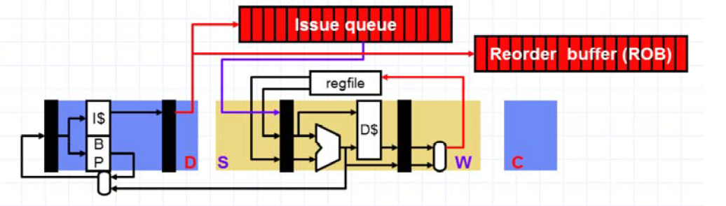
Issue Q + ROB

Slide 6
Recovery phase
In-order Out-of-order In-order
Fetch
Commit
Decode
Reorder Buffer
Kill
Kill
Kill
Execute
Inject handler PC
Mis-speculation?
Instructions fetched and decoded into instruction reorder buffer in-order
Execution is out-of-order ( ⇒ out-of-order completion)
Commit (write-back to architectural state, i.e., regfile & memory) is in-order
Temporary storage needed to hold results before commit (shadow registers and store buffers)

Slide 7
The complete pipeline
Update predictors
kill
kill
Branch Resolution
kill
Branch Prediction
kill
Out-of-Order
In-Order
Decode & Rename
PC Fetch
Reorder Buffer
Commit
In-Order
Physical Reg. File
Dispatch in-order
and Issue O3
Branch
ALU
MEM
Store
D$
Unit
Buffer
Execute

Slide 8
Transient instruction
A speculative instruction that does not commit is a transient instruction

Slide 9
Speculative Execution-II
1. Proceed ahead despite unresolved dependencies using a prediction for an architectural or micro-architectural value
2. Maintain both old and new values on updates to architectural (and often micro-architectural) state
After speculation check
3. After sure that there was no mis-speculation and there will be no more uses of the old values, discard old values and just use new values
3. In event of mis- speculation, dispose of all new values, restore old values, and re-execute from point before mis- speculation
OR

Slide 10
ROB
Valid
Program Counter
Compar network | Reorder Buffer
 | FP Regs
Exceptions?
FP
Op
Queue
Dest Reg
Result
Reorder Table
Res Stations
Res Stations
FP Adder
FP Adder
Please note that ROB stores the results too ☺ , When commit/retire, it updates registers and memory

Slide 11
Done?
FP Op
Queue
ROB7
ROB6
ROB5
ROB4
ROB3
ROB2
ROB1
Newest
Reorder Buffer
Oldest
F0
LD F0,10(R2)
N
Registers
To
Memory
Dest
Dest
from
Memory
Dest
Reservation
Stations
1 10+R2
FP adders
FP multipliers

Slide 12
Done?
FP Op
Queue
ROB7
ROB6
ROB5
ROB4
ROB3
ROB2
ROB1
Newest
Reorder Buffer
F10
ADDD F10,F4,F0
N
Oldest
F0
LD F0,10(R2)
N
Registers
To
Memory
Dest
Dest
from
Memory
2 ADDD R(F4),ROB1
Dest
Reservation
Stations
1 10+R2
FP adders
FP multipliers

Slide 13
Done?
FP Op
Queue
ROB7
ROB6
ROB5
ROB4
ROB3
ROB2
ROB1
Newest
Reorder Buffer
F2
DIVD F2,F10,F6
N
If the predicted taken path is wrong,
flush out all instructions from the ROB
and reissue in the correct order
F10
ADDD F1,F4,F0
N
Oldest
F0
LD F0,10(R2)
N
Registers
To
Memory
Dest
Dest
from
Memory
2 ADDD R(F4),ROB1
3 DIVD ROB2,R(F6)
Dest
Remember exception/page
fault handling gets resolved
when the instruction
reaches the head of the ROB
Reservation
Stations
1 10+R2
FP adders
FP multipliers

Slide 14
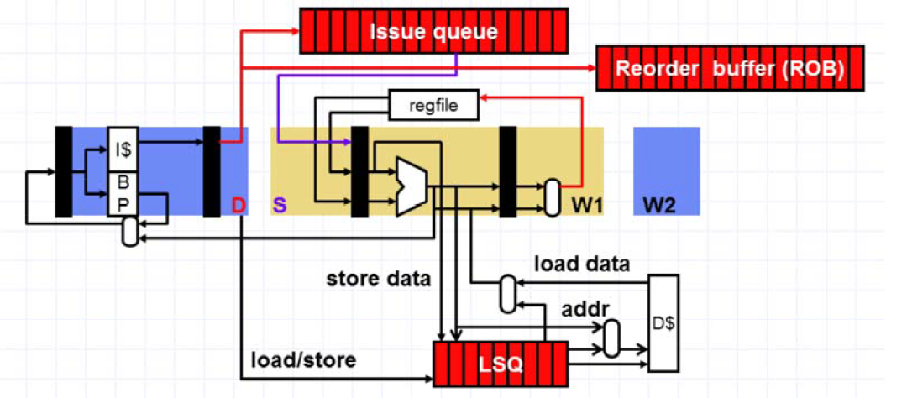
LSQ (Load Store Q): For out-of-order requests into memory hierarchy

Slide 15
Why LSQ?
ROB makes sure register writes are in order. What about stores or memory writes?
LSQ:
Stores write to LSQ, in an O3. That is why writes are not in critical path ☺
When store retires, head of LSQ written to L1D
When load executes, access LSQ and L1D in parallel.
Loads are O3. Else there is no point ☺

Slide 16
Why LSQ?
For non-memory operations, dependency is checked in the issue stage
But but but, memory addresses are known after execute stage. So when and where to check dependency.
LSQ tracks memory dependences (L-S, S-L, L-L, S-S).

Slide 17
Continues…. LQ and SQ, On a load request
Select the youngest store older than the load
If hit in the SQ, forward data from SQ
If miss, send it to TLB and L1D.

Slide 18
The tricky situation
sd x1, (x2)
ld x3, (x4)
When can we execute the load?

Slide 19
Approaches
In-order: ☹ Then what is the point of out-of-order ☹ ☹
Can execute load before store, if addresses known and x4 != x2
Each load address compared with addresses of all previous uncommitted stores, do not LOAD if STORE address is not known

Slide 20
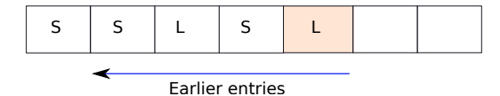
Dependency violation continues
LOAD executed before STORE ☹ Fix it ☹
How?
Select the oldest load that is younger than the store
Use store position, Processor flushes and restarts.

Slide 21
Address Speculation
sd x1, (x2)
ld x3, (x4)
Guess that x4 != x2
Execute load before store address known
Need to hold all completed but uncommitted load/store addresses in program order
If subsequently find x4==x2, squash load and all following instructions => Large penalty for inaccurate address speculation

Slide 22
Better Approach? Predict, Load-store dependency predictor
Predict, which loads or load store pairs will cause violations.
Loads must execute in-order with respect to older stores.
Load execution requires knowledge of all older store addresses. If some older store address is not available yet, wait ☹
There is a store buffer (along with store Q) that deals with the committed store instructions and pushing data into cache hierarchy.

Slide 23
More subtle
Store queue deals with in-flight instructions.
Once a store instruction retires from the pipeline and is no longer speculative, its data and address are transferred from the store queue to the store buffer.

Slide 24
Do not Forget the Bigger Picture
Issue Q
ROB
RS
LQ
SQ
Store buffer

Slide 25
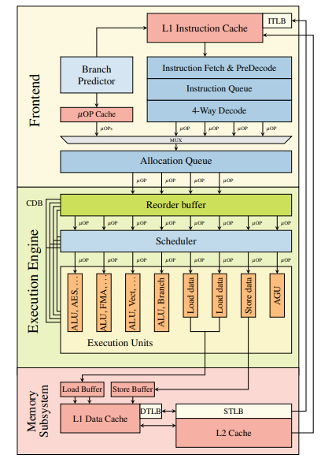
Is this relevant in 2023? Intel Skylake for you☺
Intel latest processor

Slide 26
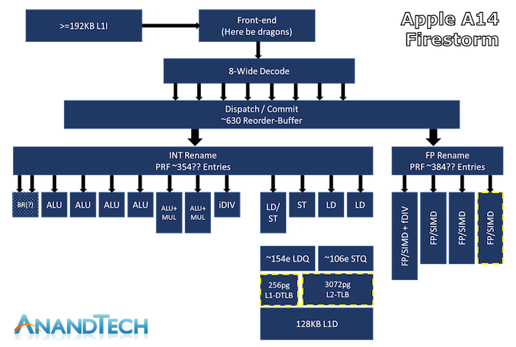
Apple hai Kya?
Apple latest processor

Slide 27
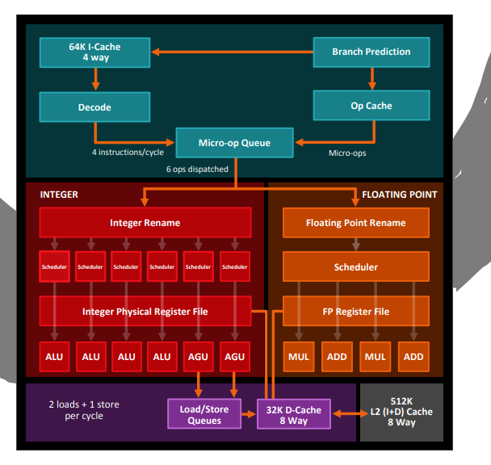
What about AMD?
AMD latest processor

Slide 28

Devil is in the details

Slide 29
Connect All now
Memory systems, caches, TLBs, MSHRs, LSQs, O3 execution, ROB, …..
Can you guess: An L3 cache miss may not cause performance degradation, why? When? ☺
What next: Energy/Power of a modern processor

Slide 30
SMT processors: ILP to TLP (Thread-level)

Slide 31



Single-thread to SMT (Yes IBM, no Apple)
What is a thread in hardware? It is a PC, Thread level parallelism
Time (processor cycle)
Simultaneous
Multithreading
Superscalar
Fine-Grained Coarse-Grained
Multiprocessing
Thread 1
Thread 2
Thread 3
Thread 4
Thread 5 Idle slot
Advanced Computer Architecture

Slide 32

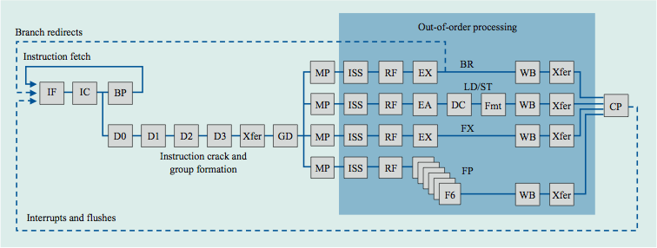

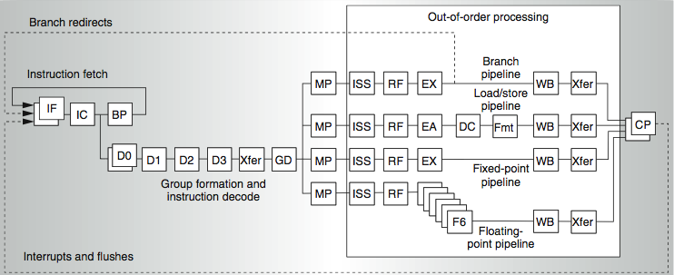


IBM Power Series
Power 4
2 commits (architected register sets)
Power 5
2 fetch (PC),
2 initial decodes
Advanced Computer Architecture

