Slide 1
CS683: Advanced Computer Architecture-2025
Lecture-2: Microarchitecture Conscious Programming
https://www.cse.iitb.ac.in/~biswa/courses.html

Slide 2
How to Access Contents of a Cache?
One byte
Core

Slide 3
From Bytes to Blocks (Lines)
One byte
One line
Core
Typical line size: 64 to 128 Bytes

Slide 4
A Bit Deeper: Cache with 1024 lines each of 32B
4 GB DRAM
One byte
Line 0
Address (32-bit)
One line
Core
Line 1023

Slide 5
A Bit Deeper: Cache with 1024 lines each of 32B
4 GB DRAM
One byte
Line 0
Address (32-bit)
One line
Core
Line 1023
Line number (index): 10 bits
Byte offset (offset): 5 bits

Slide 6
Directed Mapped Cache
Tag
Index
Offset
Line 0
Line 512
byte
.
.
.
Line 1023

Slide 7
Direct Mapped in Action
31
14
4
0
Cache Tag
Cache Index
Byte Select
Ex: 0x50
Ex: 0x01
Ex: 0x00
Valid Bit
Cache Tag
Cache Data
Byte 31
:
Byte 1
Byte 0
0
0x50
Byte 63
:
Byte 33
Byte 32
1
2
3
:
:
:
Byte 1023
:
Byte 992
1023

Slide 8
What if We Provide Multiple Ways?
Tag
Index
Offset
One byte
Tag
Line 0
Set 0
Tag
Tag
Set 511
byte
Tag
Line 1023

Slide 9
2-Way Associative Cache in Action
31
14
5
0
Cache Tag
Cache Index
Byte Select
Valid
Cache Tag
Cache Data
Cache Data
Cache Tag
Valid
Cache Block 0
Cache Block 0
:
:
:
:
:
:
Compare
Sel1
1
Mux
0
Sel0
Compare
OR
Hit
Cache Block

Slide 10
4-way : Just a Better Picture
Tag
Index
V
Tag
Data
V
Tag
Data
V
Tag
Data
V
Tag
Data
0
1
2
.
.
.
255
0
1
2
.
.
.
255
0
1
2
.
.
.
255
0
1
2
.
.
.
255
4x1 select
Hit
Data

Slide 11
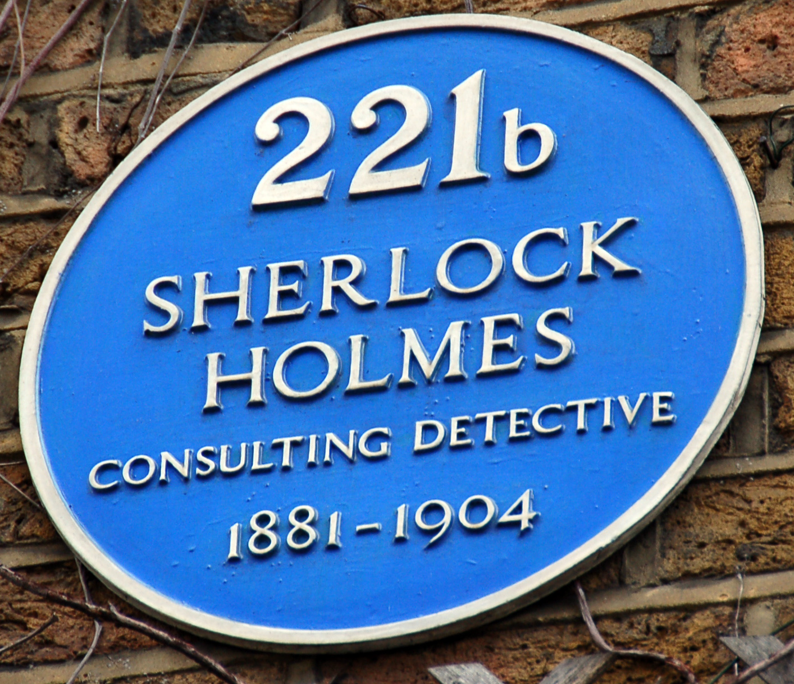
A Bit Different Way
Baker Street: Cache Index ☺
221b: Tag bits ☺
Sherlock Holmes: Byte offset ☺ ☺

Slide 12
The Extreme: One Cache is One Set (Fully-assoc.)
Tag
Offset
One byte
Tag
Line 0
Tag
byte
Tag
Tag
Line 1023

Slide 13
Wake-up test again: #ints inside a block?
18 bits
10 bits
4 bits
Address:
31
0
Tag
Set index
Block offset
 | # of int in block
A. | 0
B. | 1
C. | 2
D. | 4
E. | Unknown: We need more info

Slide 14
Wake-up test again:
If N = 16, how many bytes does the loop access of a?
int CS683(int* a, int N)
{
int i;
int sum = 0;
for(i = 0; i < N; i++)
{
sum += a[i];
}
return sum;
}
 | Accessed Bytes
A | 4
B | 16
C | 64
D | 256

Slide 15
The 3Cs
Cold (compulsory) miss
Cold misses occur because the cache starts empty and this is the first reference
Capacity miss
Occurs when the set of active cache blocks (working set) is larger than the cache.
Conflict miss ☺ conflicting addresses into one set

Slide 16
Matrix Multiplication
Description:
Multiply N x N matrices
Matrix elements are doubles (8 bytes)
O(N³) total operations
/* ijk */
for (i=0; i<n; i++) {
for (j=0; j<n; j++) {
sum = 0.0;
for (k=0; k<n; k++)
sum += a[i][k] * b[k][j];
c[i][j] = sum;
}
}

Slide 17

Why Matrix Multiplication?
AI/ML
Image Processing
Scientific Computing
Graph traversals
Many more …

Slide 18
Miss Rate Analysis
Assume:
Block size = 32B (big enough for four doubles)
Matrix dimension (N) is very large
Approximate 1/N as 0.0
Cache is not even big enough to hold multiple rows
Analysis Method:
Look at access pattern of inner loop
j
k
j
=
x
i
i
k
C
A
B

Slide 19
Cache Layout
C arrays allocated in row-major order
each row in contiguous memory locations
Stepping through columns in one row:
for (i = 0; i < N; i++)
sum += a[0][i];
accesses successive elements
if block size (B) > sizeof(a_{ij}) bytes, exploit spatial locality
miss rate = sizeof(a_{ij}) / B
Stepping through rows in one column:
for (i = 0; i < N; i++)
sum += a[i][0];
accesses distant elements
no spatial locality!
miss rate = 1 (i.e. 100%)

Slide 20
Effect of loops (ijk)
Inner loop:
/* ijk */
for (i=0; i<n; i++) {
for (j=0; j<n; j++) {
sum = 0.0;
for (k=0; k<n; k++)
sum += a[i][k] * b[k][j];
c[i][j] = sum;
}
}
(*,j)
(i,j)
(i,*)
A
B
C
Row-wise
Column-
wise
Fixed
Block size = 32B (four doubles), your laptop will have 64B blocks
Miss rate for inner loop iterations:
A B C
0.25 1.0 0.0

Slide 21
Effect of loops (kij)
/* kij */
for (k=0; k<n; k++) {
for (i=0; i<n; i++) {
r = a[i][k];
for (j=0; j<n; j++)
c[i][j] += r * b[k][j];
}
}
Inner loop:
(i,k)
(k,*)
(i,*)
A
B
C
Fixed
Row-wise
Row-wise

Slide 22
Effect of loops (jki)
/* jki */
for (j=0; j<n; j++) {
for (k=0; k<n; k++) {
r = b[k][j];
for (i=0; i<n; i++)
c[i][j] += a[i][k] * r;
}
}
Inner loop:
(*,k)
(*,j)
(k,j)
A
B
C
Column-
wise
Fixed
Column-
wise

Slide 23
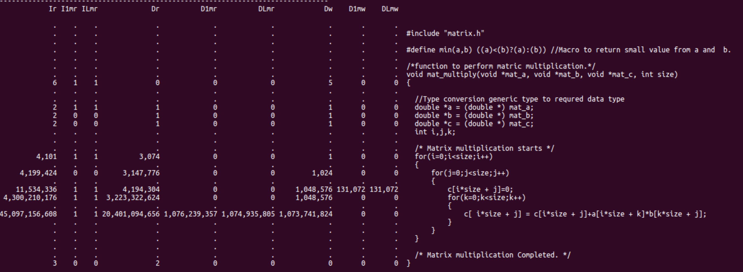
Let’s Dig Deep: Where are the Cache misses? Cache grind

Slide 24
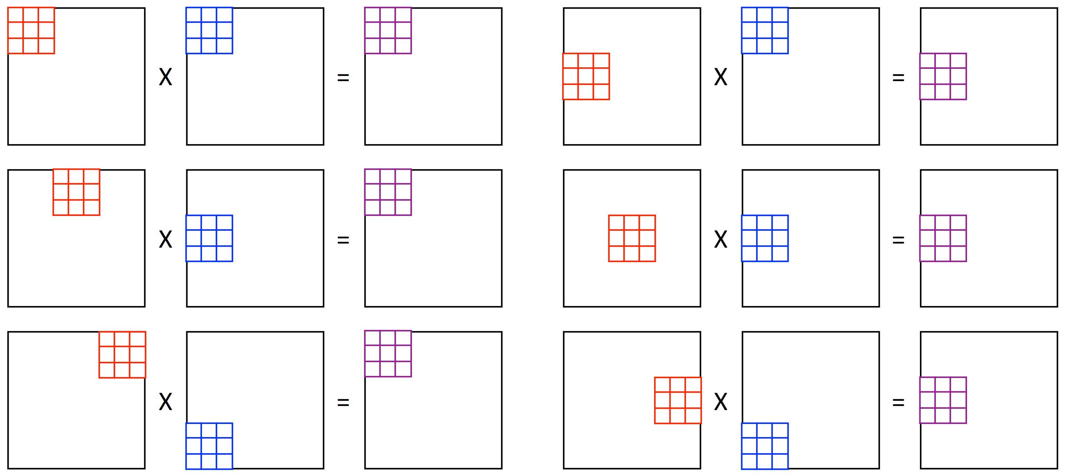
Matrix Multiplication with Tiling/Blocking: 101 ☺

Slide 25
Here it is (Naïve MM)
9/8 (n³) memory accesses
How: One miss in eight accesses (64B cache block) for the first array (n/8)
Second array: 8/8 misses, total: 9n/8 misses per iteration
For n² iterations = 9/8 (n³) ☺

Slide 26
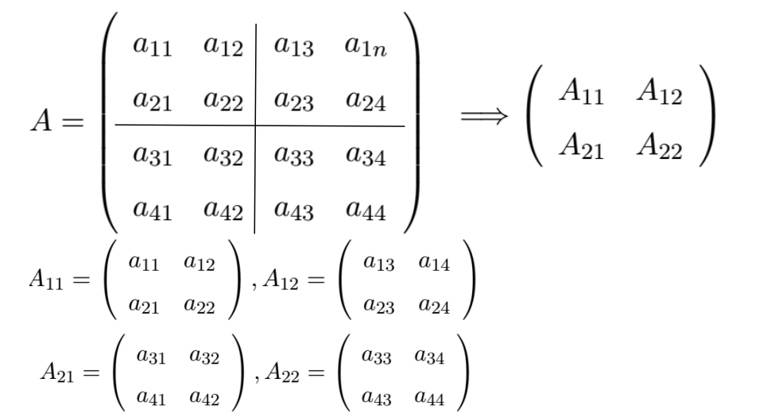
Tiled/Blocked

Slide 27
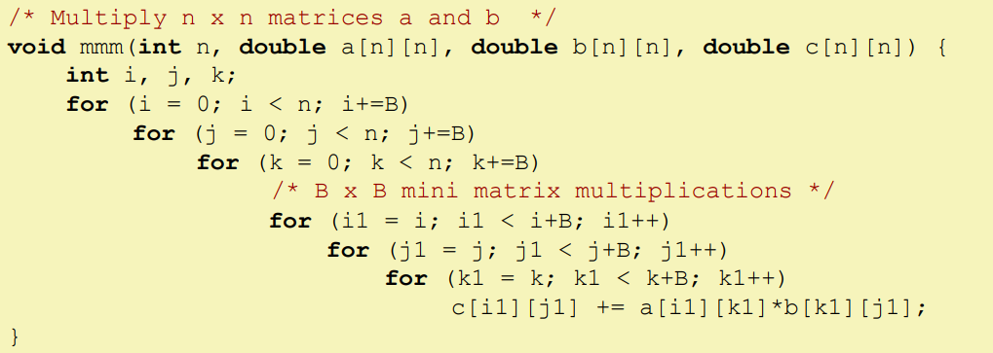
The Code

Slide 28
Blocked or Tiled MM
Number of tiles per row or per column= n/B, For two arrays = 2n/B
Tile size = B X B
Three tiles are in the C, 3B² are in the cache
For each tile: B²/8 misses,
Two arrays = 2n/B X B²/8 = nB/4 for each block/tile iteration
Total number of misses for (n/B)² iterations = n³/4B

Slide 29
The X factor
Matrix multiplication has inherent temporal locality:
Input data: 3n²
computation 2n³
Every array element is used O(n) times!

Slide 30
Speedup
A: Non-tiled: 9/8 (n³)
B: Tiled: n³/4B
Speedup =

Slide 31
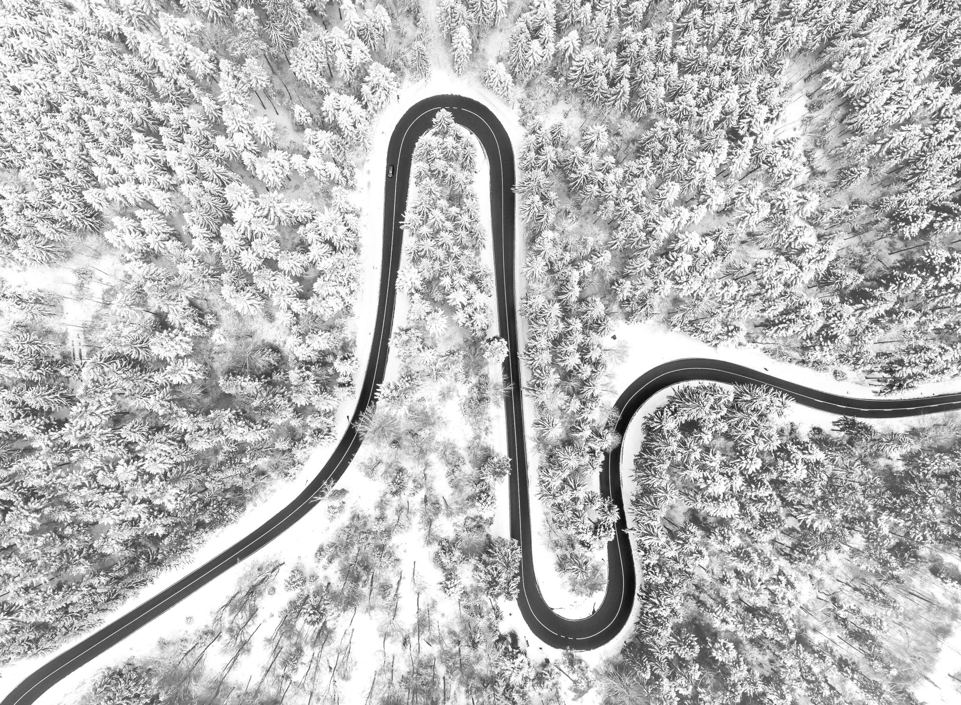
Speedup
If B = 16, 72X speedup ☺ ☺
Why 16?

