Slide 1
CS683: Advanced Computer Architecture
The last lecture: 10K feet view on architecture security

Slide 2
Information leakage
CIA: Confidentiality, Integrity, Availability

Slide 3
Information leakage
CIA: Confidentiality, Integrity, Availability
Confidentiality: was data being computed upon not revealed to an un-permitted party?
Integrity: was the computation performed
correctly, returning the correct result?
Availability: did the computational resource carry out the task at all?

Slide 4

Channels of Interest
Physical channels
Power, EM,
sound, etc.
Timing channels
Response time
Microarchitectural channels
Microarch events (e.g., timing, perf. counters, mem interleavings)
Processor
Victim
Processor
Victim
Processor
Victim
Attacker
Attacker requires measurement equipment → physical access
Attacker may be remote (e.g., over an internet connection)
Attacker may be remote, or be co-located

Slide 5
Side/Covert Channel
A side channel is an unintended communication between two or more parties
A covert channel is an intended communication between two or more parties
(you upload a video on YouTube to communicate some information to your friends, if Gmail, whatsapp, call is not allowed)
In both cases:
Communication should not be possible, following computing systems semantics
The physical channel used for the communication can be the same
Side channels → unintended → need de-noising Covert channels can show “best case” leakage

Slide 6
Scope of these channels
Inter-process(application) communication that can violate privilege boundaries
Infer information from application’s data-dependent HW resource usage
Side/covert channels not in any interface specification (e.g. ISA).
Therefore stealthy
Sophisticated mechanisms needed to detect channel
No permanent indication one has been exploited

Slide 7
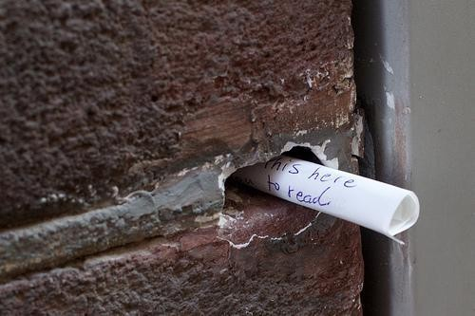
Let’s try to send a bit
Two processes can agree on “dead drops”
Cache:
# ways
# sets

Slide 8
Let’s try to send a bit
Two processes can agree on “dead drops”
Cache:
# ways
Process 1 (Sender)
Process 2 (Receiver)
# sets

Slide 9

Let’s try to send a bit
Two processes can agree on “dead drops”
Cache:
# ways
Process 1 (Sender)
Process 2 (Receiver)
# sets
if (send ‘1’) repeat N: fill set i else
idle
t1 = rdtsc() repeat N: fill set i t2 = rdtsc()
If (t2 – t1 > THRESH) read ‘1’ Else read ‘0’

Slide 10

How is it different from legitimate communication
send(msg)
recv()
Channel
Normal communication
Covert Channel communication
include <socket.h>
void send(bit msg) {
socket.send(msg);
}
bit recv() {
return socket.recv(msg);
}
void send(bit msg) {
// pressure on cache
}
bit recv() { st = time();
// pressure on cache
return time() – st > THRESH;
}

Slide 11
From Covert to Side Channel
Victim
Attacker
Hardware resource
if (send ‘1’) Use resource else
idle
Covert channel:
t1 = rdtsc() Use resource t2 = rdtsc()
if (secret)
Use resource
else
idle
if (t2 – t1 > THRESH) read ‘1’ else read ‘0’
Side channel:

Slide 12
From Covert to Side Channel
Victim
Attacker
Hardware resource
if (send ‘1’) Use resource else
idle
Covert channel:
t1 = rdtsc() Use resource t2 = rdtsc()
if (secret)
Use resource
else
idle
if (t2 – t1 > THRESH) read ‘1’ else read ‘0’
Side channel:

Slide 13

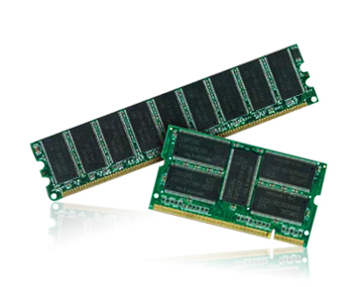

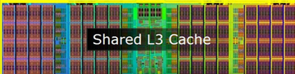
Side/Covert Channel: Summary
Spy
Victim
Side-channel attacks
Let’s play
Oh Yes!!
Covert-channel attacks

Slide 14
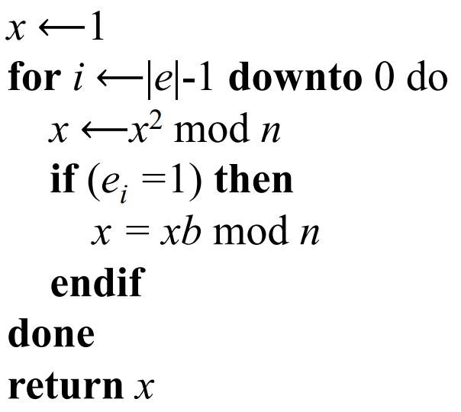
Information leakage in the real world
Modular exponentiation, b^{e} mod n
Exponent e is used for decryption
square
reduce
multiply
Attacker tries to get the e

Slide 15
Information leakage
Modular exponentiation, b^{e} mod n
Exponent e is used for decryption
square
reduce
e_{i} = 0, Square Reduce (SR)
e_{i} = 1, SRMR
multiply
Attacker tries to get the e

Slide 16
Clflush instruction
Invalidates from every level of the cache hierarchy in the cache coherence domain the cache line that contains the linear address specified with the memory operand. If that cache line contains modified data at any level of the cache hierarchy, that data is written back to memory. The source operand is a byte memory location.

Slide 17


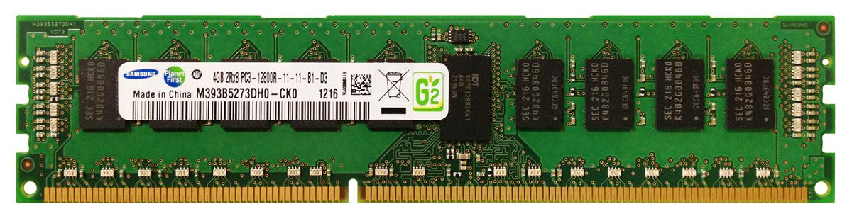
Flush attack
Step 0:Spy maps the shared library, shared in the cache
Step 1:Spy flushes the cache block
Hit, Voila
Step 2: Victim reloads the cache block
LLC
Step 3: Spy reloads the cache block (hit/miss)
17

Slide 18


Spectre and Meltdown

Slide 19

Spectre in Action: Fasten Your Seat Belts
int CS773Array = [100, 200, 300];
int attacker = 4;
if (attacker < sizeof(CS773Array))
x = CS773Array[attacker]
y=MyArray[CS773Array[attacker]*512]
DRAM LOAD (make sure you
thrash all from cache)
DRAM LOAD (make sure you thrash all from
cache)
X is the secret that is not accessible to the attacker

Slide 20

Branch Predictor and Speculative Execution
int CS773Array = [100, 200, 300];
int attacker = 4;
if (attacker < sizeof(CS773Array))
y = MyArray[CS773Array[attacker]*512]
Branch predictor returns TRUE ☹

Slide 21
Branch Predictor and Speculative Execution
int CS773Array = [100, 200, 300];
int attacker = 4;
if (attacker < sizeof(CS773Array))
y = MyArray[CS773Array[attacker]*512]
Branch predictor returns TRUE ☹
T T T T T T T T T T T
Attacker has mis-trained it ☹ ☹
How? By using values less than 3 always ☹ ☹

Slide 22
Branch Predictor and Speculative Execution
int CS773Array = [100, 200, 300];
int attacker = 4;
if (attacker < sizeof(CS773Array))
y = MyArray[CS773Array[attacker]*512]
Branch predictor returns TRUE ☹
Attacker has mis-trained it ☹ ☹
Processor is on the wrong-path ☹ ☹ ☹

Slide 23
Branch Predictor and Speculative Execution
int CS773Array = [100, 200, 300];
int attacker = 4;
if (attacker < sizeof(CS773Array))
y = MyArray[CS773Array[attacker]*512]
Branch predictor returns TRUE ☹
Attacker has mis-trained it ☹ ☹
Processor is on the wrong-path ☹ ☹ ☹
Branch resolution latency 200 cycles ☹ ☹ ☹ ☹

Slide 24
Within these 200 cycles ☺
int CS773Array = [100, 200, 300];
int attacker = 4;
if (attacker < sizeof(CS773Array))
y = MyArray[CS773Array[attacker]*512]
CS773Array[4] is in L1/L2/L3 ☹
The address is in the cache ☹ ☹
Yes, you guessed it right: F+R, P+P cache attacks ☹ ☹ ☹

Slide 25
After say 200 cycles
Processor realized it was a mistake and
squashed all wrong path instructions
But cache has the data ☹
y = MyArray[CS773Array[attacker]*512]
LOAD MyArray[0] 60 ns
LOAD MyArray[512] 60 ns
LOAD MyArray[1024] 5 ns Bingo !! CS773Array[attacker] = 2

Slide 26
What if myarray is not shared with the attacker?
Still it is possible to do Spectre attack ☺
How?
CS773Array[attacker] = 0, you access set 0
CS773Array[attacker] = 1, you access set 1
CS773Array[attacker] = k, you access set k
So, in summary, the attacker can do prime and probe on sets and check which sets show latency difference

Slide 27
Summary of Spectre Attack: As an attacker
"Two paths diverged in a branch, and I— I took the one less traveled by, And that has made all the difference.“ ☺
-Frobert Rost, The Path/Road Not Taken
"Two paths diverged in a branch, and I— I took the one more traveled by, And that has made all the difference.“ ☺
-Frobert Rost, The Path Taken

Slide 28
Meltdown: The O3 Curse!!
raise_exception();
// line below is never reached
secret=KernelArray[data*4096];
Kernel Trap
Out-of-order (O3) as
it has no dependency
secret=KernelArray[data*4096];
2. raise_exception();
What about page-fault?
https://meltdownattack.com/meltdown.pdf

Slide 29

Rowhammer
Row of Cells
Wordline
Row
Victim Row
Row
Aggressor Row
V_{LOW}
Closed
V_{HIGH}
Opened
Row
Victim Row
Row
Repeatedly opening and closing a row induces disturbance errors in adjacent rows

Slide 30
Rowhammer (Reliability issue)
Row of Cells
Wordline
Row
Victim Row
Row
Aggressor Row
V_{LOW}
Closed
V_{HIGH}
Opened
Row
Victim Row
Row
“It’s like breaking into an apartment by repeatedly slamming a neighbor’s door until the vibrations open the door you were after” – Motherboard Vice

Slide 31
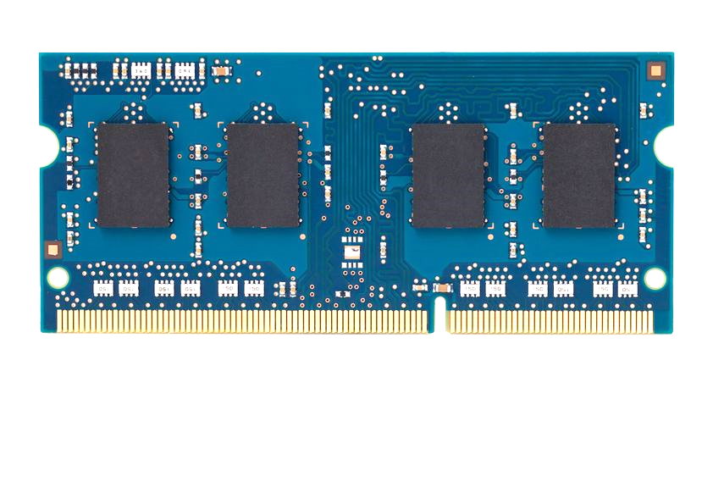
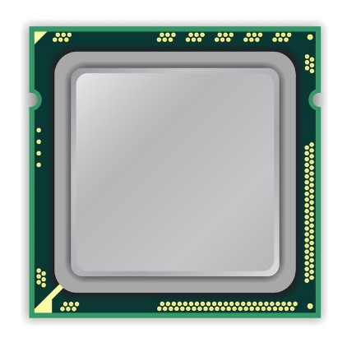
The Code Please
x86 CPU
DRAM Module
DDR3
Avoid cache hits
Flush X from cache
Avoid row hits to X
Read Y in another row
111111111
X
111111111
111111111
111111111
Y
111111111
111111111

Slide 32
The code please
loop:
mov (X), %eax
mov (Y), %ebx
clflush (X)
clflush (Y)
mfence
jmp loop
001110111
111111111
X
111111111
1111
111111111
101111101
110001011
111111111
Y
1111
111111111
011011110
111111111

Slide 33
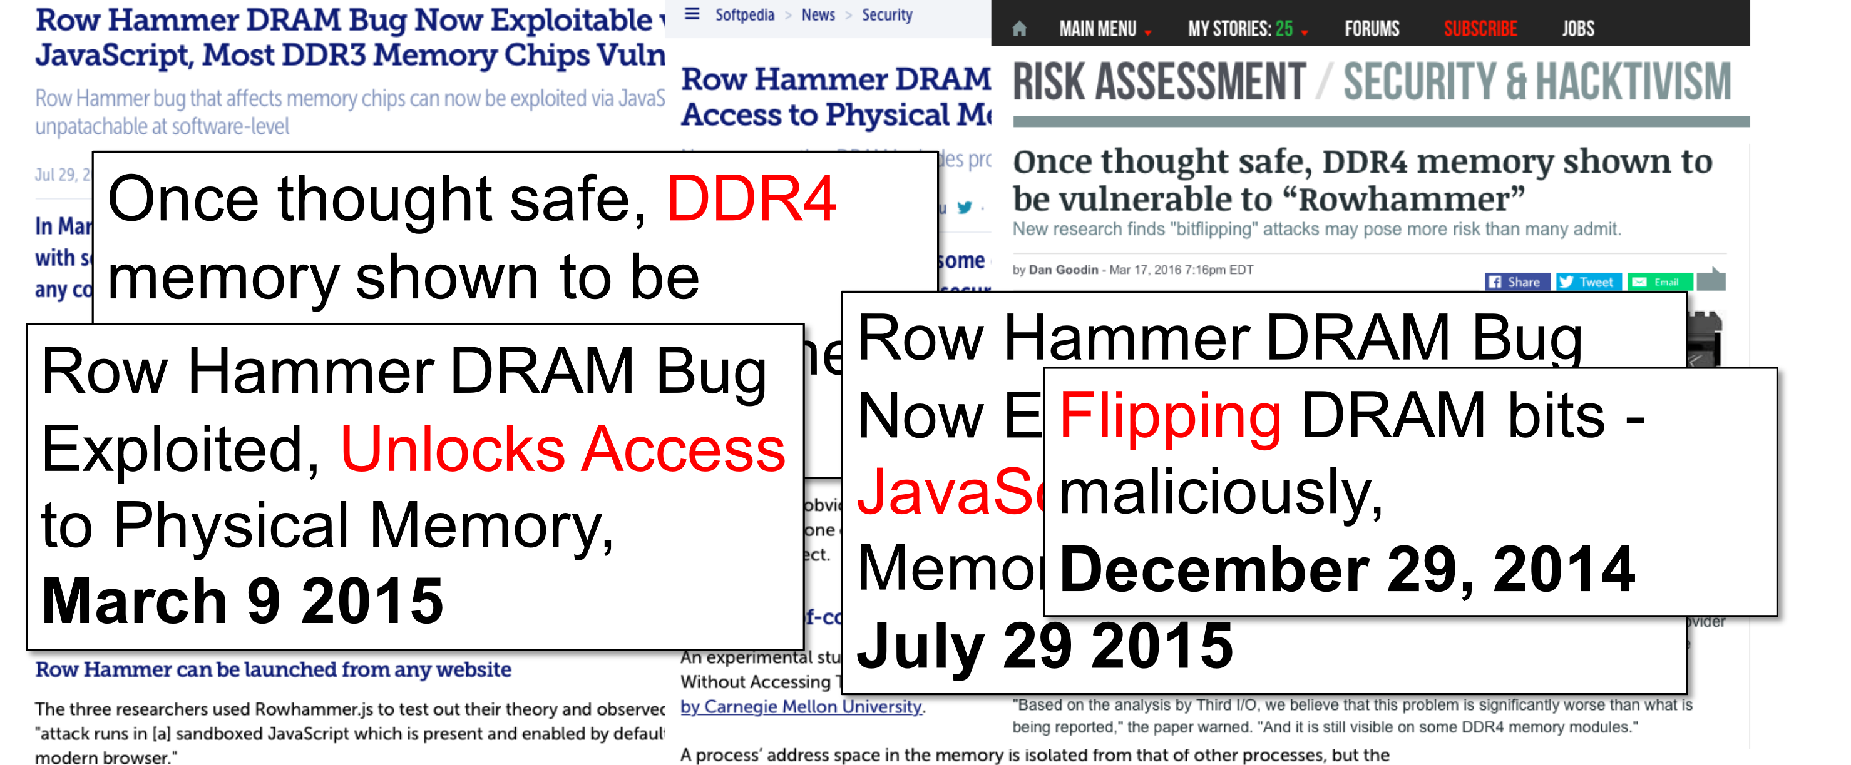
Why? Electromagnetic Coupling
Toggling the wordline voltage briefly increases the voltage of adjacent wordlines
Slightly opens adjacent rows → Charge leakage

Slide 34
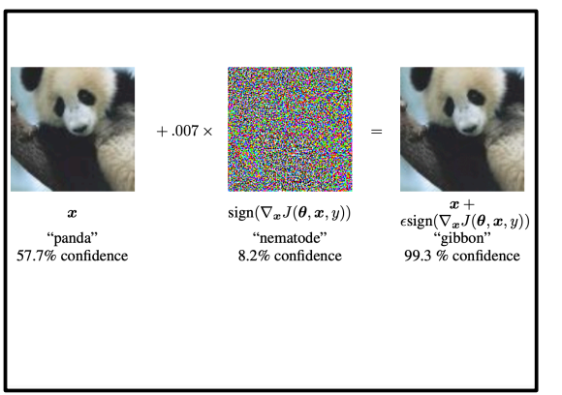
Nah Actually a Security issue
PTHammer (hammering into the page table)
Kernel Privilege Escalation
Think about ML/DL models

