Slide 1
CS683: Advanced Computer Architecture-2025
Lecture-3: RIP The conscious programmers, Microarchitects in town
https://www.cse.iitb.ac.in/~biswa/courses.html

Slide 2
Let’s add software/compiler prefetch instructions (built-ins)
for( j=0; j< 100; j++) {
prefetch(b[j+7][0])
prefetch(a[0][j+7])
a[0][j] = b[j][0] * b[j+1][0]
}
Software prefetching hides latency by fetching data for future iterations while the demand accesses are accessing data relevant to the current iteration.
It is a load like instruction, but programmer/compiler has to manually insert it based on the need.

Slide 3
What else? SIMD programming
SIMD: Single instruction multiple data
Usage of 128 bit, 256 bit, 512 bit registers
You can do multiple operations in one cycle
More when you make your hands dirty for assignment-I

Slide 4

Programming Assignment-1 Heads-up (coming on 11th August)

Slide 5
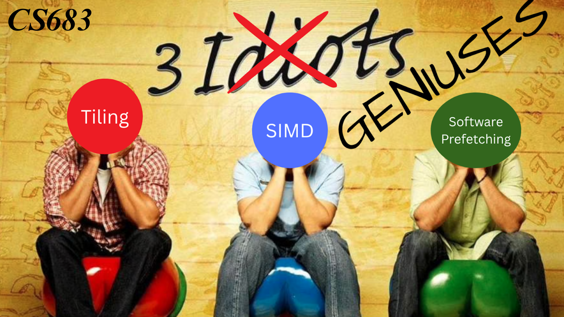
All is Well: It is coming

Slide 6

Form a team (only 30 out of 160 submitted)

Slide 7
Programmer to Microarchitecture view
From now on, no programmer optimizations
Assume, the code written is the best code written
Now what can be done to improve cache performance

Slide 8
Ends of a CPU
Front-end: Dealing with instructions, fetch and decode stage
Back-end: From execute to writeback stage
Modern processors are superscalar fetching k instructions per cycle. K is typically around 6 to 8.

Slide 9
Let’s understand some terms keeping Memory stage in mind
Hit, Miss, Miss penalty
Sequence of events in a typical cache hierarchy
Goal is to improve latency and bandwidth but how.

