Slide 1
CS683: Advanced Computer Architecture-2025
L7: Time to Shift the Gears
(Hardware Prefetching)
https://www.cse.iitb.ac.in/~biswa/courses.html

Slide 2

Phones (smart/non-smart) on silence plz, Thanks

Slide 3
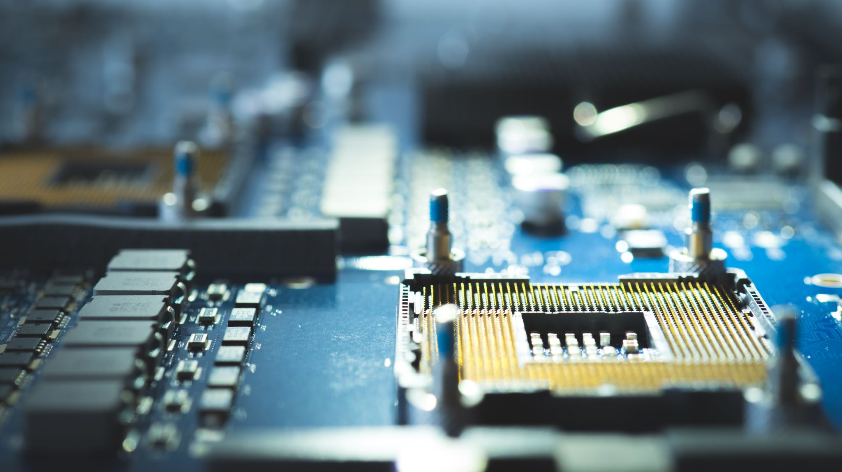
Reducing Miss rate, Nah, Miss Latency
Hardware Prefetching

Slide 4
Hardware Prefetching
What?
Latency-hiding technique - Fetches data before the core demands.
Why?
Off-chip DRAM latency has grown up to 400 to 800 cycles.
How?
By observing/predicting the demand access (LOAD/STORE) patterns.

Slide 5

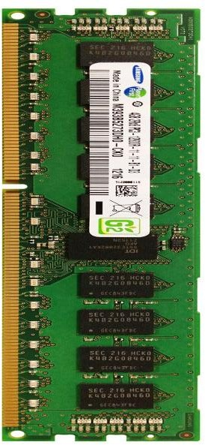

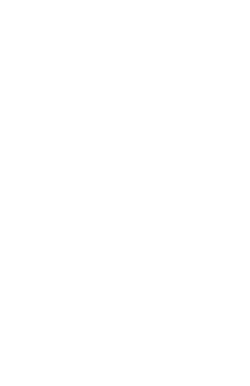
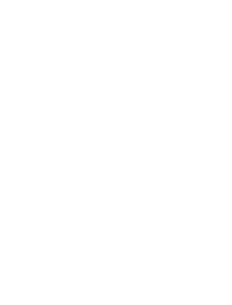

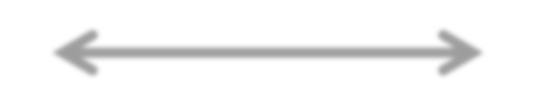
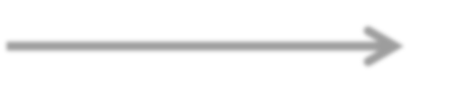
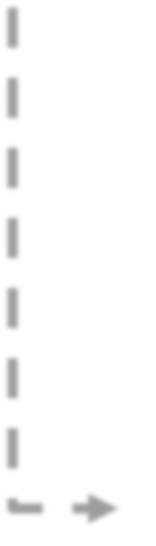
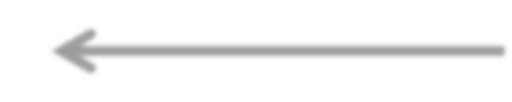
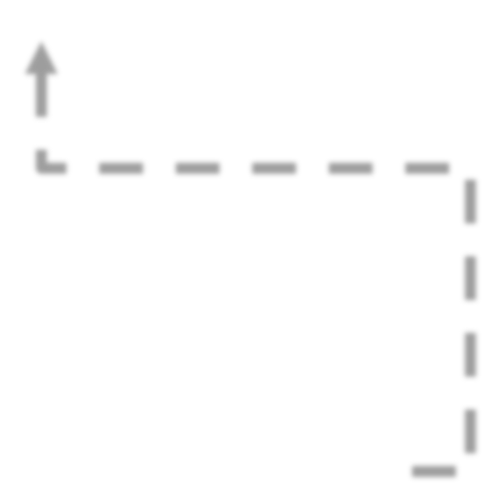

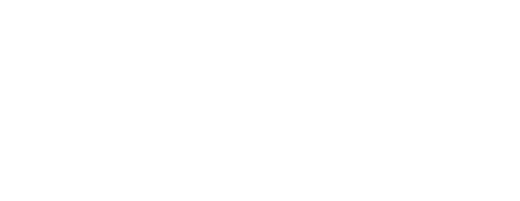
An example
HIT
❺
X+3
Core
❸
L2
X+2 X+1 X
❹
X+3
❷
❶
Prefetcher

Slide 6
Prefetch Degree
Prefetch Degree: Number of prefetch requests to issue at a given time. Think about MSHR size now. It should go up to accommodate prefetching.
Demand Access
L2
X
Prefetcher
L3/DRAM
X+1
X+1 | X+2
X+1 | X+2 | X+3 | X+4

Slide 7
Prefetch Distance
Prefetch Distance: How far ahead of the demand access stream are the prefetch requests issued?
demand
access
prefetch
 |  | X |  |  | Y
Prefetch-distance Y = X + 4
Y = X + 8 Y = X + 16

Slide 8
The Simplest one
Next Line: Miss to cache block X , prefetch X+1. Degree=1, Distance=1
Works well for L1 Icache and L1 Dcache.
Next N Line: Miss to cache block X , prefetch X+1, X+2, ….. X+N, Degree=N, Distance= min. 1 and max. N

Slide 9
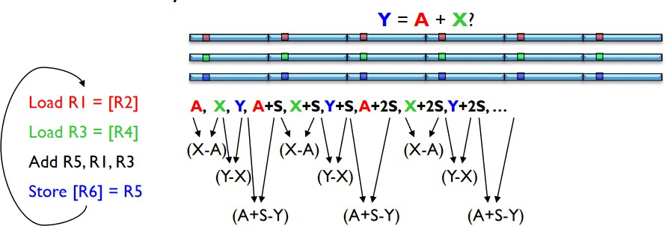
What about this?

Slide 10
for (i = 0; i < N; i=i+16)
sum +=c[i];
IP_{X}: PC: LOAD
Cache line size of 64B
L0
L1
L2
L3
L4
L5
L6
...
Page
c[0]
c[16]
c[32]
c[48]
2
2
2
Stride=difference in cache line accesses
*Loops over arrays/structures

Slide 11
IP-stride prefetching [Intel, AMD, ARM, IBM]
PC
effective address
-
instruction tag
previous address
stride
state
+
prefetch address

Slide 12
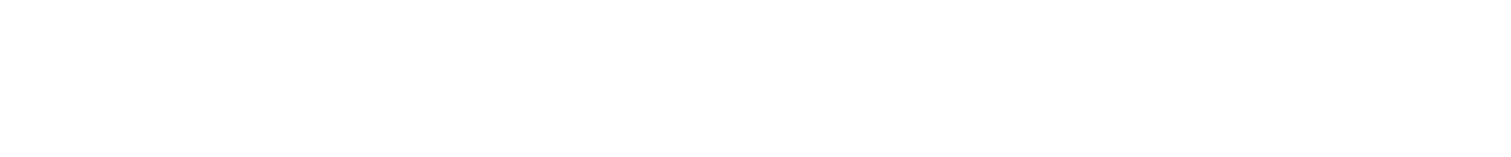
Stream prefetcher [Intel, IBM, ARM, AMD]
miss sequence
100 | 102 | 104 | 503 | 504 | 501 | 499
Tr
ained
Trained!
100 102 104 504 501 499 !
₁st ₂nd ₃rd ₁st ₂nd ₃rd
503
504
501
Fail!
miss miss miss miss miss miss
Training: Consecutive misses in the same direction.
Prefetching: Next k lines in the stream direction.

Slide 13

Stream prefetcher (Region based) in action
Stream direction
memory access
start addr end addr
 |  |  | Monitored region
original addr
prefetch distance
prefetch degree

Slide 14
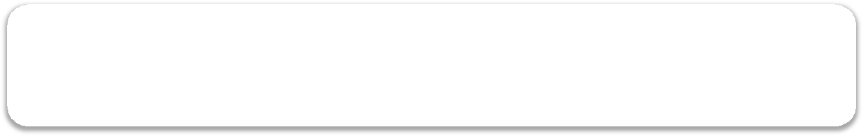
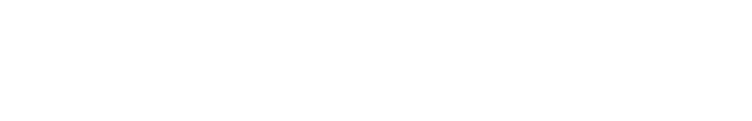
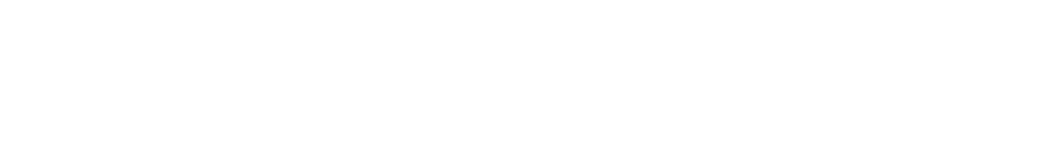
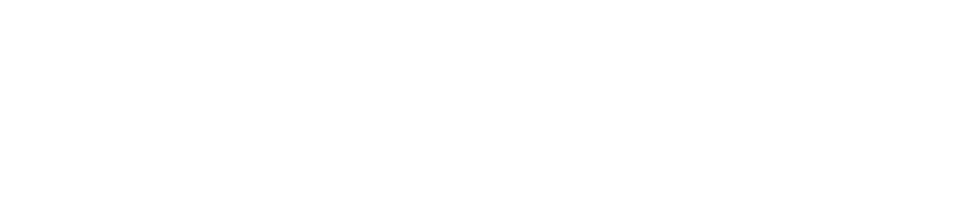

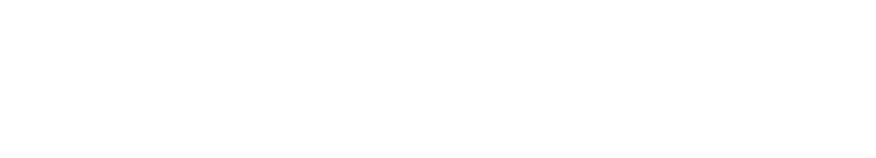
Quantifying prefetchers
PrefetchAccuracy(i) = ^{Prefetchhits(i)}
Prefetchissued(i)
Prefetched Block in the Cache.
_{Lateness(i) =} Prefetchlate(i)
Prefetchhits (i)
Prefetched Block Still on its way
Prefetched Block evicted a demand block that will be reused
Pollution(i) = ^{LLC Poll(i)}
Demandmisses(i)
_{Coverage(i) =} Prefetch Hits(i) Prefetch Hits (i) + Demandmisses(i)
Fraction of misses avoided

