Slide 1
TITLE: Task Manager with Progress Tracker
Presented By:
Vinod Palingi
MVGR College of Engineering
CSE(AIML)

Slide 2
OUTLINE
Problem Statement
System Development Approach (Technology Used)
Algorithm & Deployment (Step-by-Step Procedure)
Result
Conclusion
Future Scope(Optional)
References

Slide 3
Problem Statement
Many individuals struggle with managing daily tasks and tracking productivity. Existing solutions are often:
Overly complex with unnecessary features
Lack visual progress indicators
Not intuitive for daily use
Don't provide immediate feedback on productivity

Slide 4
System Approach
Frontend Technologies:
HTML5 - Semantic structure and accessibility
CSS3 - Modern styling with Flexbox/Grid, gradients, and animations
JavaScript (ES6+) - Dynamic functionality and local storage management
Design Approach:
Mobile-first responsive design
Material Design principles for intuitive UI/UX
Component-based architecture for maintainability
Progressive Web App capabilities

Slide 5
Algorithm & Deployment
Application Architecture Design
User Interface Layer (HTML/CSS)
↓
Business Logic Layer (JavaScript)
↓
Data Persistence Layer (localStorage)
Core Algorithm Implementation
// Task Management Algorithm
1. Initialize the application and load existing tasks
2. Handle user input for new tasks
3. Validate and sanitize input data
4. Create a task object with a unique ID and a timestamp
5. Update task list and persist to localStorage
6. Re-render UI with updated task list
7. Calculate and display progress metrics
// Progress Tracking Algorithm
1. Count total tasks and completed tasks
2. Calculate completion percentage: (completed/total) × 100
3. Update progress bar width and percentage display
4. Refresh statistics counters in real-time
Production Deployment
Host on GitHub Pages or Netlify
Configure custom domain (optional)
Implement a service worker for offline functionality

Slide 6
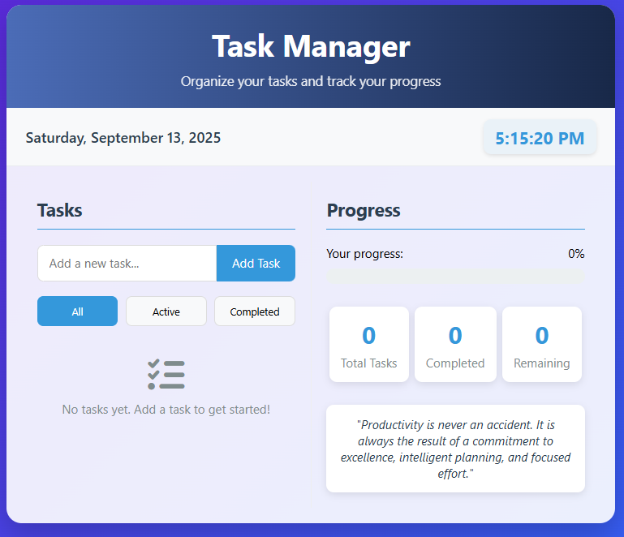
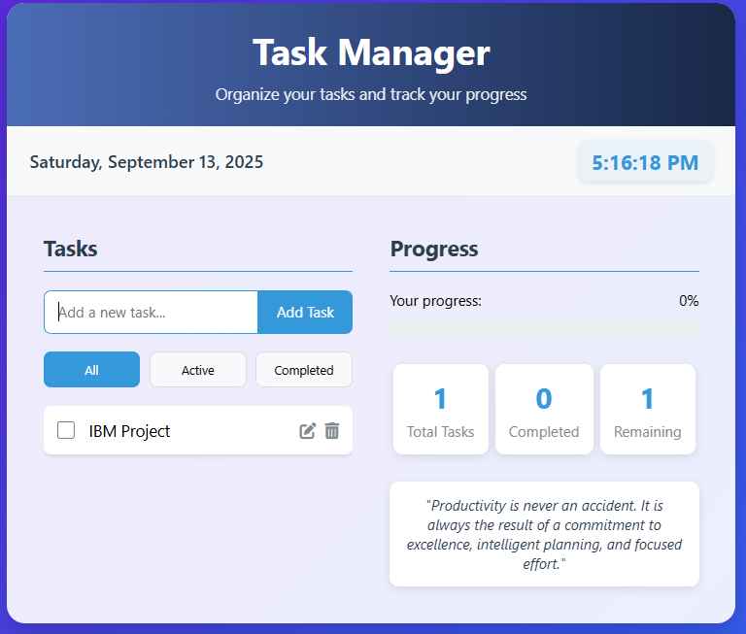
Result
https://github.com/palingivinod/IBM_SKILL_BUILD-INTERMSHIP

Slide 7
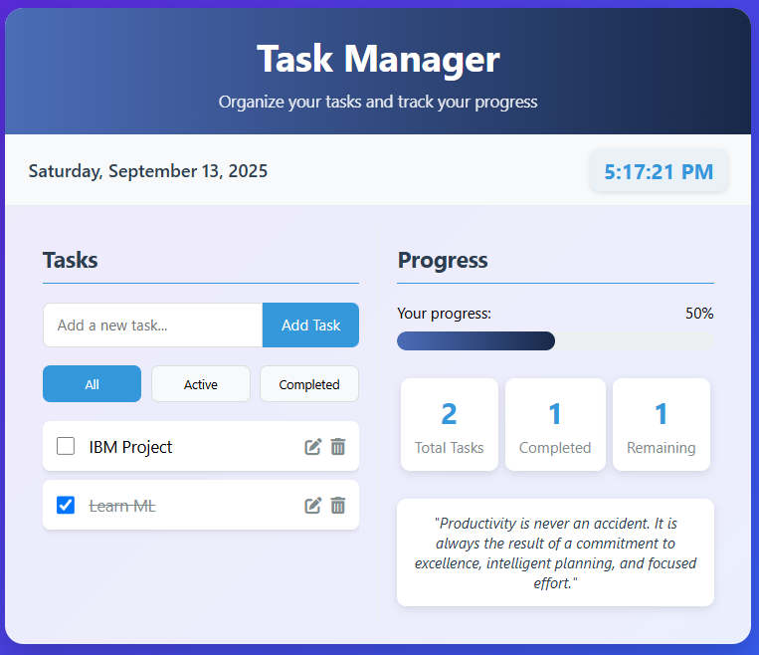
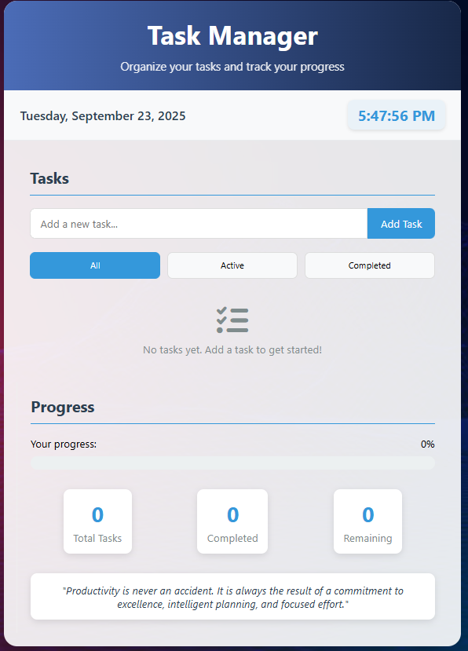
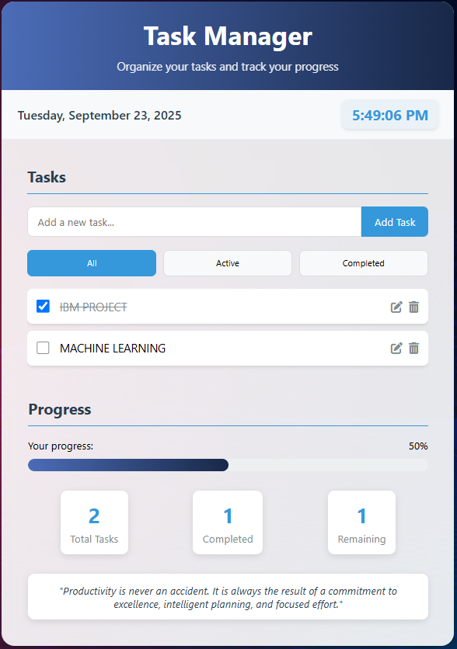
Result
https://github.com/palingivinod/IBM_SKILL_BUILD-INTERMSHIP

Slide 8
Conclusion
The Task Manager with Progress Tracker successfully addresses the productivity management needs by providing:
Cost-effective solution with zero subscription fees
Reduced complexity compared to enterprise task managers
Enhanced user engagement through visual progress indicators
Immediate productivity feedback for better time management
This application demonstrates that simple, focused tools can effectively solve common productivity challenges without the overhead of complex systems.

Slide 9
Future scope
Task categories and tags for better organization
Due dates and reminders with browser notifications.
Task categories and tags for better organization
Due dates and reminders with browser notifications.
Task categories and tags for better organization
Due dates and reminders with browser notifications

Slide 10
References
MDN Web Docs - JavaScript Documentation
W3Schools - HTML5 & CSS3 Tutorials
Google Material Design Guidelines
ECMAScript 6 Specification

Slide 11
THANK YOU

