Slide 1
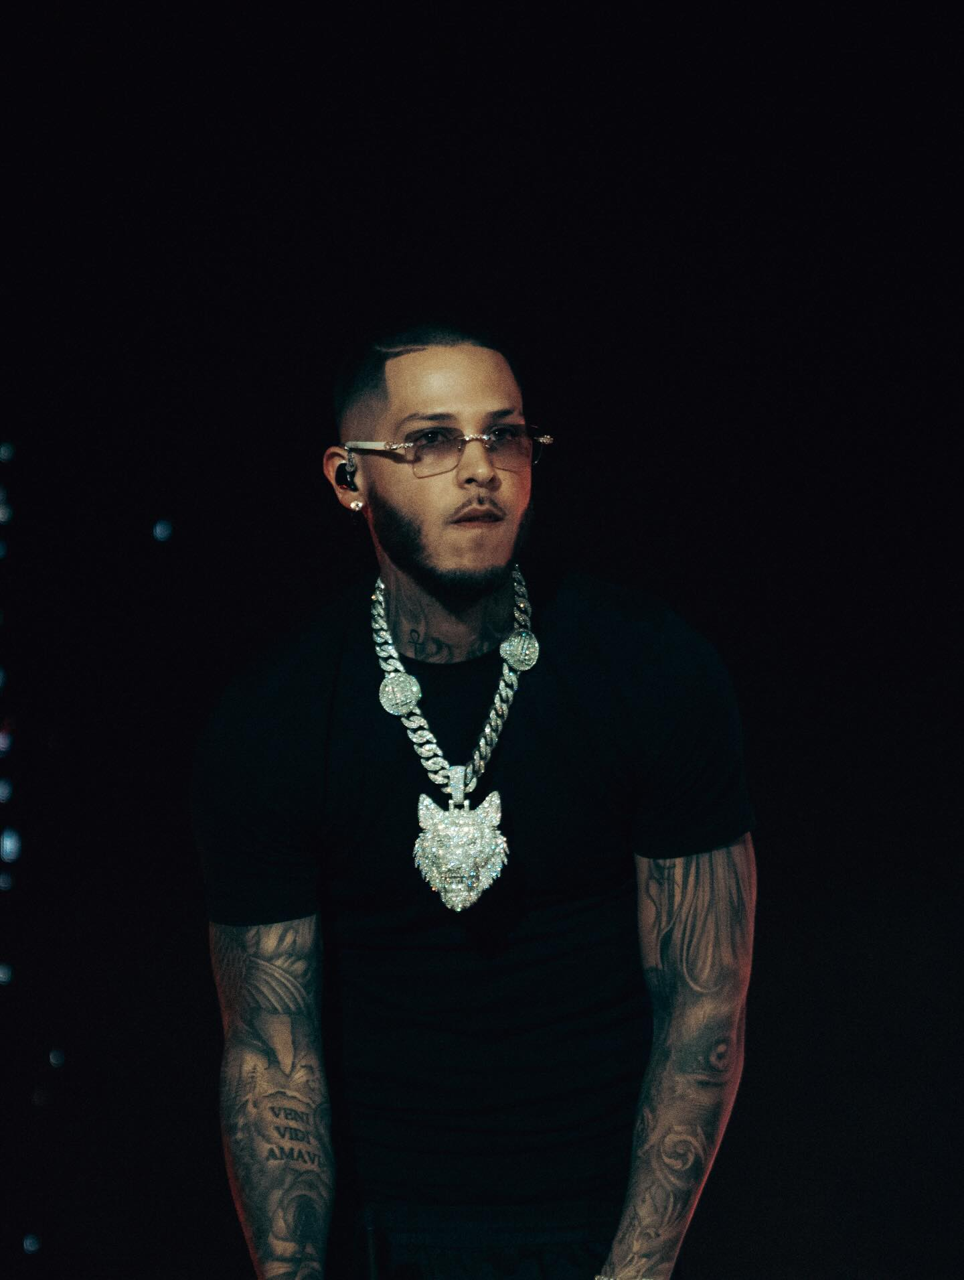

ADS PLAYBOOK · 2026
ROA
US TOUR
2026
Pre-release · Pre-sale · On-sale · Sustain
21
20
~47K
8W
PRESENTED BY
SHOWS
METROS
CAPACITY
WINDOW
AUG 6 — SEP 26, 2026

Slide 2
01 · TOUR OVERVIEW
21 shows. 8 weeks. Four regional clusters.
# | CITY | DATE | VENUE | CAP | T
1 | New York, NY | Thu, Aug 6 | The Palladium | 2,198 | A
2 | Philadelphia, PA | Fri, Aug 7 | Franklin Music Hall | 3,000 | A
3 | Reading, PA | Sat, Aug 8 | Santander PAC | 1,774 | C
4 | Washington, DC | Thu, Aug 13 | The Anthem | 2,000 | B
5 | Boston, MA | Fri, Aug 14 | Lynn Auditorium | 2,072 | B
6 | Providence, RI | Sat, Aug 15 | The Strand | 1,000 | C
7 | Chicago, IL | Fri, Aug 21 | Copernicus Center | 1,853 | B
8 | Columbus, OH | Sat, Aug 22 | La Boom | 2,000 | C
9 | Charlotte, NC | Fri, Aug 28 | Ovens Auditorium | 2,447 | B
10 | Atlanta, GA | Sat, Aug 29 | Atlanta Coliseum | 3,000 | A
11 | Los Angeles, CA | Thu, Sep 3 | The Novo | 2,387 | A
# | CITY | DATE | VENUE | CAP | T
12 | Fresno, CA | Fri, Sep 4 | Rainbow Ballroom | 1,500 | C
13 | San Jose, CA | Sat, Sep 5 | San Jose Event Center | 2,000 | B
14 | Miami, FL | Thu, Sep 10 | Miami Bandshell | 1,300 | A
15 | Orlando, FL | Fri, Sep 11 | HRL Live | 2,913 | A
16 | Tampa, FL | Sat, Sep 12 | Jannus Live / Ritz Ybor | ~1,600 | B
17 | Routing TBD | Thu, Sep 17 | TBD | TBD | —
18 | Dallas, TX | Fri, Sep 18 | Escapade 2001 | 3,000 | A
19 | Houston, TX | Sat, Sep 19 | White Oak Music Hall | 3,000 | A
20 | Denver, CO | Fri, Sep 25 | The Stampede | 2,287 | B
21 | Minneapolis, MN | Sat, Sep 26 | The Myth Live (Maplewood) | 2,200 | B
TIER KEY
A Priority metro
B Secondary
C Regional / build
ROA · US TOUR 2026
02 / 18

Slide 3
02 · MARKET TIERS
Budget and creative effort follow tier.
TIER A
TIER B
TIER C
Priority Metros
Secondary
Regional / Build
8 shows · ~55% of budget
8 shows · ~30% of budget
4 shows · ~15% of budget
New York
Philadelphia
Atlanta
Los Angeles
Miami
Orlando
Dallas
Houston
Washington DC
Boston
Chicago
Charlotte
San Jose
Tampa
Denver
Minneapolis
Reading
Providence
Columbus
Fresno
Strong PR/Latino DMAs, proven ticket velocity. Full-funnel from 8 weeks out.
Solid demand, lighter cold spend. Lean on lookalikes of Tier A buyers.
Feeder markets to nearby Tier A/B. Drive-in targeting from 75mi radius.
ROA · US TOUR 2026
03 / 18

Slide 4
03 · CAMPAIGN FRAMEWORK
Four phases, one funnel, repeated per city.
01
TEASE & ANNOUNCE
GOAL
OBJECTIVE
Build warm audience. Collect emails.
Engagement / Lead
T-10 → T-7 weeks
02
PRE-SALE
GOAL
OBJECTIVE
Convert warm audience with code.
Conversions (Purchase)
T-7 → T-5 weeks
03
ON-SALE
GOAL
OBJECTIVE
Scale cold + retarget.
Conversions (Purchase)
T-5 → T-2 weeks
04
SUSTAIN / FILL
GOAL
OBJECTIVE
Close remaining inventory.
Conversions + Reach
T-2 → show day
ROA · US TOUR 2026
04 / 18

Slide 5
04 · PHASE 1
Tease & Announce — T-10 to T-7 weeks
WHAT WE'RE DOING
AUDIENCES
Announce the tour, build warm audience, collect pre-sale email list.
Geo per city (25mi + 75mi feeder radius)
Interests: Reggaeton, Latin Urban, ROA peers
Lookalike of prior Zamora Live ticket buyers (1-3%)
Video viewers of teaser (seed for Phase 2)
Teaser video drop across Reels + TikTok (organic)
Announcement post on IG + FB the same day as ads go live
Engagement campaign (video views, 3s) — cheap reach in Tier A
Lead form ads (email) in Tier A + Tier B metros
Landing page with email capture + "Notify Me" by city
CREATIVE + BUDGET
Post + Story split (4:5 feed + 9:16 story/reels)
2 hooks × ES / EN subtitles × 2 placements = 8 creatives
Budget share of city total: ~20%
Target CPL (email): ≤ $1.50 Tier A · ≤ $2.00 Tier B/C
ROA · US TOUR 2026
05 / 18

Slide 6
05 · PHASE 2
Pre-sale — T-7 to T-5 weeks
WHAT WE'RE DOING
FUNNEL
Convert the warm list with an exclusive pre-sale code, 48h window.
Lead
Email +
SMS
LP /
Code
Checkout
Purchase
>
>
>
>
Email blast to list (code + countdown)
Retargeting ads to video viewers + LP visitors
SMS if list has numbers (Zamora Live list)
No cold spend — pre-sale targets only warm audience
Goal: 15-25% of Phase 1 email list converts in pre-sale window.
TARGETS
Purchase ROAS ≥ 4.0x (warm retargeting)
CPA (ticket) ≤ $8 Tier A · ≤ $12 Tier B/C
Pre-sale sell-through: 20-35% of capacity
Budget share of city total: ~15%
ROA · US TOUR 2026
06 / 18

Slide 7
06 · PHASE 3
On-sale — T-5 to T-2 weeks
WHAT WE'RE DOING
AUDIENCES
Open to public. Scale cold with highest-ROAS creatives from pre-sale.
Cold: Lookalike 1% + 3% of pre-sale buyers
Warm: IG/FB engagers + video 25%+ viewers
Hot: LP visitors 30d + initiate checkout
Exclude: past ticket buyers (last 12 months)
Launch public on-sale across all ticketing URLs
Scale winning creative · pause the bottom 30%
Layer retargeting: engagers → video viewers → landing page → checkout starters
First inventory report 72h after on-sale
TARGETS
Purchase ROAS ≥ 2.5x blended · ≥ 5x retargeting
CPA (ticket) ≤ $12 Tier A · ≤ $18 Tier B/C
Reach ≥ 35% of target metro 18-44 Latino
Budget share of city total: ~50%
ROA · US TOUR 2026
07 / 18

Slide 8
07 · PHASE 4
Sustain / Fill — T-2 to show day
WHAT WE'RE DOING
IF UNDER 70% SOLD
Close remaining inventory with urgency creative + day-of-show reach.
Double daily budget on best-performing campaign
Add a discount-code ad to the email list
Cross-promote from adjacent cities (50-150mi)
Local radio / influencer boost coordinated w/ Zamora Live
Urgency hooks: "Last tickets", "Sold out in X"
Venue-day-of Reach campaign (radius 10mi)
UGC + tour footage from prior shows
Retarget checkout-abandoners aggressively
Pause creative with CTR < 0.8% or CPA > 2x target
TARGETS
Sell-through at show day ≥ 90%
Day-of-show reach in venue radius ≥ 60%
CPA can rise 50% — fill is the priority
Budget share of city total: ~15%
ROA · US TOUR 2026
08 / 18

Slide 9
08 · AUDIENCES
Cold, warm, hot — seeded from Phase 1 forward.
LAYER | AUDIENCE | SIZE PER CITY | USED IN
COLD | Lookalikes of Zamora Live past ticket buyers | 400-800k | Phase 3
COLD | Lookalikes of pre-sale buyers | 800k-1.5M | Phase 3-4
COLD | Reggaetón / Latin urban interest | 1-3M | Phase 1-3
COLD | Spanish-speaking 18-44 in market | 500k-1M | Phase 1, 4
WARM | Video viewers of the tour teaser | seed 10k+ | Phase 2-4
WARM | IG / FB page engagers (90 days) | seed 20k+ | Phase 2-4
WARM | Landing page visitors (30 days) | seed 15k+ | Phase 2-3
HOT | Checkout started — no purchase (14 days) | seed 2k+ | Phase 3-4
HOT | Pre-sale email list | 2-10k | Phase 2
EXC | Zamora Live cross-artist ticket buyers (365d) | — | Exclude in cold
COLD = acquire · WARM = nurture · HOT = close · EXC = exclude. The 365-day exclusion runs against the Zamora Live cross-artist ticket-buyer list (ROA has no prior US buyers).
ROA · US TOUR 2026
09 / 18

Slide 10
09 · CREATIVE
Post + Story always split. ES first, EN as subtitle.
POST · FEED
STORY · REELS
4:5 · 1080×1350
9:16 · 1080×1920
HERO
ROA
CITY DATE
VENUE
[CTA]
Hook = artist face + date + city in first 1s
Clear CTA: 'GET TICKETS' / 'PRE-SALE AHORA'
Ticketmaster / Zamora Live logo bottom right
4 variants per phase per city
ROA
▲
CITY
DATE
[SWIPE]
Vertical motion — hook ends with date + CTA
Keep safe area: avoid top/bottom 250px
Native IG font subtitles · captions on
Dedicated vertical cut, not a crop of the feed version
ES primary copy · EN subtitle overlay · Always split Post + Story · 4 variants per phase per city
ROA · US TOUR 2026
10 / 18

Slide 11
10 · BUDGET
Split by tier and by phase.
BY MARKET TIER · PER CITY
BY PHASE (% OF CITY TOTAL)
TIER | # SHOWS | % BUDGET | BUDGET / CITY
A | 8 | 55% / $13.7K | ~$275 / day
B | 8 | 30% / $6.3K | ~$140 / day
C | 4 | 15% / $3.0K | ~$75 / day
Tease & Announce
20%
Pre-sale
15%
On-sale
50%
Sustain / Fill
15%
MEDIA BUDGET · ROLLING PER-CITY MODEL
Tier A · ~50 days active · $275/day ≈ $13,750 / city · 8 cities = $110,000 Tier B · ~45 days · $140/day ≈ $6,300 / city · 8 cities = $50,400 Tier C · ~40 days · $75/day ≈ $3,000 / city · 4 cities = $12,000
Total working media ≈ $172,400 · Phase mix: 20 / 15 / 50 / 15 · Active-day window varies by rolling launch date. Budget flows between cities weekly based on blended ROAS and sell-through pacing.
ROA · US TOUR 2026
11 / 18

Slide 12
11 · KPIs & REPORTING
What we measure, how often.
2.5x+
$12 / $18
$1.50 / $2.00
≥ 90%
BLENDED ROAS · ≥5x retargeting
CPA CEILING · TIER A / B-C
EMAIL CPL · TIER A / B-C
SELL-THROUGH · SHOW DAY
REPORTING CADENCE · Every metric below is pixel + CAPI deduplicated, UTM-tagged, and reconciled against Ticketmaster / Zamora Live settlement data.
DAILY
WEEKLY
PER SHOW
Per-city check — spend, click-through, cost per ticket, ROAS, tickets sold vs pacing.
Per-city summary vs goals. Creative refresh cadence. Top/bottom performers. Budget reallocation proposal for the next 7 days.
T-72h, T-48h, T-24h, post-show. Sell-through %, final ROAS, cost per ticket, total tickets by source. Post-mortem 48h after the show.
ROA · US TOUR 2026
12 / 18

Slide 13
12 · TIMELINE
Phases stacked on show date. Rolling launch per city.
T-10
T-9
T-8
T-7
T-6
T-5
T-4
T-3
T-2
T-1
SHOW
Tease & Announce
Pre-sale
On-sale
Sustain / Fill
KEY MILESTONES
T-10 Creative brief signed · Ticketing URLs live · Tracking ready
T-7 Pre-sale code + landing page email capture live
T-5 Public on-sale + Zamora Live cross-promo activated
T-2 Urgency creative + day-of-show radius reach
+48h Post-show report + creative + audience learnings passed to next city
ROA · US TOUR 2026
13 / 18

Slide 14
APPENDIX · A
ROA — artist dossier
IDENTITY
13.8M
~2.0M
742K
Gilberto Figueroa
Naranjito, Puerto Rico · Universal Music Latino
SPOTIFY MONTHLY
LISTENERS
INSTAGRAM
@ROAPR__
FAN PAGE
@ROA.PR__
Billboard Latin Artist on the Rise · Feb 2026
Premio Lo Nuestro 2026 · Best Male New Artist
Debut LP ~70% done · likely drops on-tour
Ticketmaster lists no US shows · these ads = first announce
TOP TRACKS · LEAD WITH THESE HOOKS
# | TRACK | STREAMS
1 | YOGURCITO REMIX (Kris R. feat. ROA) | 273.1M
2 | ETA - RMX (w/ De La Rose, Luar La L, O. Courtz) | 201.1M
3 | ME GUSTAS CC | 148.7M
4 | FANTASÍA | 103.4M
5 | WO OH OH | 49.5M
LOOKALIKE SEEDS: Omar Courtz, Dei V, Bryant Myers, Luar La L, Chris Jedi
ROA · US TOUR 2026
14 / 18

Slide 15
APPENDIX · B
Market reality — creative cut by city
PR-HEAVY DIASPORA
Orlando: 387K PR · 15% of metro · Osceola Co. is plurality-PR
Orlando · Philly · NYC · Providence · Reading · Boston · Chicago
Lead island identity. 'Orgullo boricua.' ES-primary. Use ETA RMX / YOGURCITO hooks.
PAN-LATINO URBAN
DC: Salvadoran-dominant · PR ~3-4% of metro · CPM for PR-ID users higher
Miami · Tampa · Atlanta · DC · Charlotte
Pan-Caribbean reggaetón. Not island-specific — Cuban / Venezuelan / Salvadoran majority.
MEXICAN-DOMINANT
Dallas Escapade 2001 brand = 'regional mexicana' — genre pivot risk
Fresno · Dallas · Denver · LA · San Jose · Houston
Universal reggaetón. Do NOT lead PR-identity. Houston slightly more Caribbean-tolerant than DFW.
LIGHTEST LATINO
Minneapolis: 6-10% Latino metro · smallest on tour
Columbus · Minneapolis
Widen radius 75mi. Super-fan + streaming lookalikes. OSU / Twin Cities college Latino 18-24.
ROA · US TOUR 2026
15 / 18

Slide 16
APPENDIX · C
August leg — flags by city
DATE / CITY | VENUE | CONFLICTS | AD ACTION
Aug 6 · NYC | The Palladium | MLB Yanks/Mets TBD · SummerStage TBD | verify MLB Aug 6 home
Aug 7 · Philadelphia | Franklin Music Hall | Phillies home TBD · Eagles preseason TBD | geo-exclude Reading
Aug 8 · Reading | Santander PAC | Reading PR Fest early Aug · TAILWIND possible | verify fest 2026 date
Aug 13 · DC | The Anthem | Nats + DC United at Audi Field adjacent · TBD | Salvadoran market, cut creative pan-Latino
Aug 14 · Boston | Lynn Auditorium | Red Sox + Pats preseason TBD | geo-overlap w/ Providence next night
Aug 15 · Providence | The Strand | Red Sox + Mohegan Sun TBD | RI has highest per-cap PR · strong lane
Aug 21 · Chicago | Copernicus Center | Jeff Fest mid-late Aug possible · MLB TBD | Paseo Boricua / Humboldt Park core
Aug 22 · Columbus | La Boom | OSU home opener TBD · club-format venue | verify cap + age policy
Aug 28 · Charlotte | Ovens Auditorium | CFB Wk 1 Fri night game likely (UNC/NCSU/Clem) | Mexican/Central Am. heavy — not PR lean
Aug 29 · Atlanta | Atlanta Coliseum | HIGH RISK: Chick-fil-A Kickoff likely downtown | verify matchup · avoid downtown-adj placements
ROA · US TOUR 2026
16 / 18

Slide 17
APPENDIX · D
September leg — flags by city
DATE / CITY | VENUE | CONFLICTS | AD ACTION
Sep 3 · LA | The Novo | CFB Sat 9/5 · Hollywood Bowl low-overlap | clean Thu · Labor Day soft impact
Sep 4 · Fresno | Rainbow Ballroom | LABOR DAY weekend start · no CFB conflict | push T-21 to T-10 · 'quédate en Fresno'
Sep 5 · San Jose | SJ Event Center | Cal vs UCLA 40mi · Labor Day Sat | avoid Sat 5-8pm ad delivery
Sep 10 · Miami | Miami Bandshell OUT | HURRICANES football Hard Rock · HURRICANE peak day | weather-contingency pack · rain-date copy
Sep 11 · Orlando | Hard Rock Live | 9/11 25th ANNIVERSARY · Frontera 9/12 Kia Center | launch ads Sep 12 AM · tone check · weight ¥
Sep 12 · Tampa | Jannus or Ritz Ybor | Strokes at Benchmark · Rays home vs Astros | venue TBD · PR east suburbs target
Sep 17 · TBD | TBD | Venue + city pending | hold research until routing confirmed
Sep 18 · Dallas | Escapade 2001 | Rangers home · Mex. Independence TAILWIND | genre-pivot creative · 'concert not club'
Sep 19 · Houston | White Oak LAWN OUT | Astros home · outdoor weather · Mex. Ind. TAILWIND | avoid 6-9pm downtown · push rideshare
Sep 25 · Denver | Stampede, Aurora | Rockies away · CFB Sat 9/26 | Havana Corridor tight geo · verify cap
Sep 26 · Minneapolis (Maplewood) | Myth Live | Twins home/away TBD · CFB Sat clear evening | widen radius 75mi · super-fan targeting
ROA · US TOUR 2026
17 / 18

Slide 18
CLOSING
Pre-launch + next steps
✓
Creative approved · 4 posts + 4 stories per city, ES primary + EN subtitles
ROLLOUT · FIRST 10 WEEKS
MAY 28 · NYC kickoff · Tease begins T-10
✓
Landing page live · email + SMS capture · pre-sale code delivery verified end-to-end
JUN — JUL · NE cluster · NYC / Philly / Reading / DC / Boston / Providence
JUL · Midwest + SE · Chicago / Columbus / Charlotte / Atlanta
✓
Measurement · Meta Pixel + CAPI deduped · UTM taxonomy locked · Ticketmaster attribution reconciled
LATE JUL · West · LA / Fresno / San Jose
AUG · FL triangle · Miami / Orlando / Tampa
LATE AUG · TX + Mountain · Dallas / Houston / Denver
SEP · Minneapolis close-out · Final Sustain + post-mortem
APPROVALS NEEDED BEFORE T-10 · NYC
Ticketing on-sale · Budget sign-off · Creative lock · Pixel/CAPI on each URL
NEXT · Confirm ticketing on-sale dates per city · Sign off budget · Lock creative brief · Kickoff T-10 for NYC on ~ May 28, 2026
ROA · US TOUR 2026
18 / 18

