Slide 1


DON OMAR USA/CANADA TOUR
The media case for taking the 2026 tour.
2026 decision
Prior tour ad spend converted into profitable ticket revenue across two legs. The next ask should be framed around earlier access, market sequencing, and a tighter city-by-city budget model.
YES - WITH CONDITIONS
The proof is strong enough to pursue the tour, but the later leg shows why Outlet should control pacing earlier in the cycle.
$92.7k
$402.5k
4.34x
SPEND
MADE
ROAS
All USA/Canada tour campaigns
Tracked purchase value
Blended purchase return
Meta Marketing API v21.0, date_preset=maximum. Ads Manager UI showed Maximum: Apr 11, 2023 - May 11, 2026.
01

Slide 2
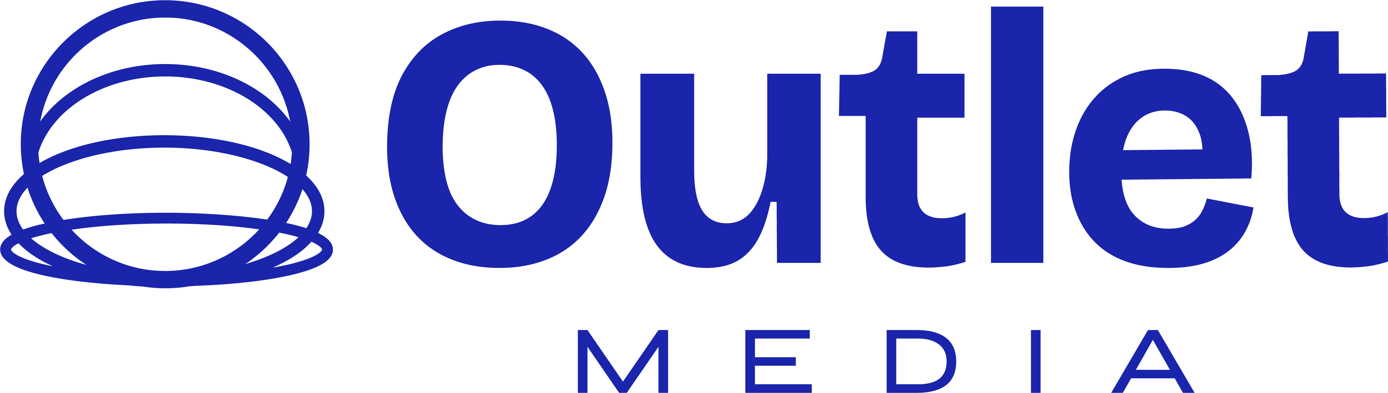
PERFORMANCE PROOF
The prior tour produced a real ticket-revenue engine, not just cheap traffic.
The corrected purchase count uses Meta purchase actions only, with value from purchase action_values / purchase ROAS.
$92.7k
$403k
1,716
4.34x
3.64M
13.83M
OVERALL SPEND
REVENUE MADE
PURCHASES
ROAS
REACH
IMPRESSIONS
USA/Canada tour media
Tracked purchase value
$54 cost / purchase
Blended purchase ROAS
Account-level aggregate
3.8 frequency
Traffic quality
CTR
2.25%
The account delivered both scale and efficient attention: 311k total clicks, 145k inline link clicks, and a 2.25% CTR on 13.8M impressions.
Link CTR
1.05%
CPM
$7
CPC
$0
Meta Marketing API v21.0, date_preset=maximum. Ads Manager UI showed Maximum: Apr 11, 2023 - May 11, 2026.
02

Slide 3
LEG ECONOMICS
Leg 1 was the clean proof. The later leg stayed profitable, but the economics tightened.
This is the operating lesson for 2026: win the brief earlier, sequence markets, and avoid catching demand too late.
Leg 1
4.96x ROAS
Leg 2 / later
3.09x ROAS
Revenue made
$311k
Revenue made
$91.6k
Spend
$62.7k
Spend
$29.7k
Purchases
1,333
Purchases
383
CTR
2.04%
CTR
2.92%
Cost per purchase: $47
Cost per purchase: $77
Readout
Leg 2 kept a positive 3.09x return, but cost per purchase rose from $47 to $77. The 2026 pitch should sell earlier access and market planning as the performance lever.
Meta Marketing API v21.0, date_preset=maximum. Ads Manager UI showed Maximum: Apr 11, 2023 - May 11, 2026.
03

Slide 4
ACCOUNT + CAMPAIGN EVIDENCE
A4 was the efficiency engine; AA1 added volume and higher click engagement.
The data supports a full-tour ask, but 2026 should separate market launch, retargeting, and late-city rescue budgets.
Account / campaign
Spend
Made
Purchases
Reach
CTR
ROAS
CPP
A4 account total
$41.5k
$238k
886
2.07M
1.94%
5.72x
$47
AA1 account total
$51.2k
$165k
830
1.57M
2.60%
3.22x
$62
Account / campaign
Spend
Made
Purchases
Reach
CTR
ROAS
CPP
A4 - Don Omar Tour Sales - MAIN
$35.2k
$215k
816
1758k
1.83%
6.12x
$43
AA1 - Don Omar - Tour
$27.5k
$95.9k
517
738k
2.38%
3.49x
$53
AA1 - Don Omar Tour - Part 3
$23.7k
$68.9k
313
909k
2.96%
2.91x
$76
A4 - Don Omar - Main 2 Leg Tour
$6.0k
$22.7k
70
266k
2.82%
3.77x
$86
Note: reach is deduped inside each account-level aggregate, then summed across A4 + AA1 because cross-account deduping is not available from this pull.
Meta Marketing API v21.0, date_preset=maximum. Ads Manager UI showed Maximum: Apr 11, 2023 - May 11, 2026.
04

Slide 5
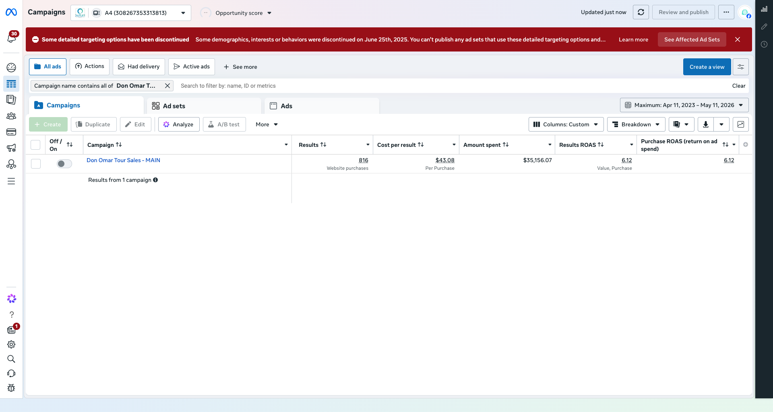
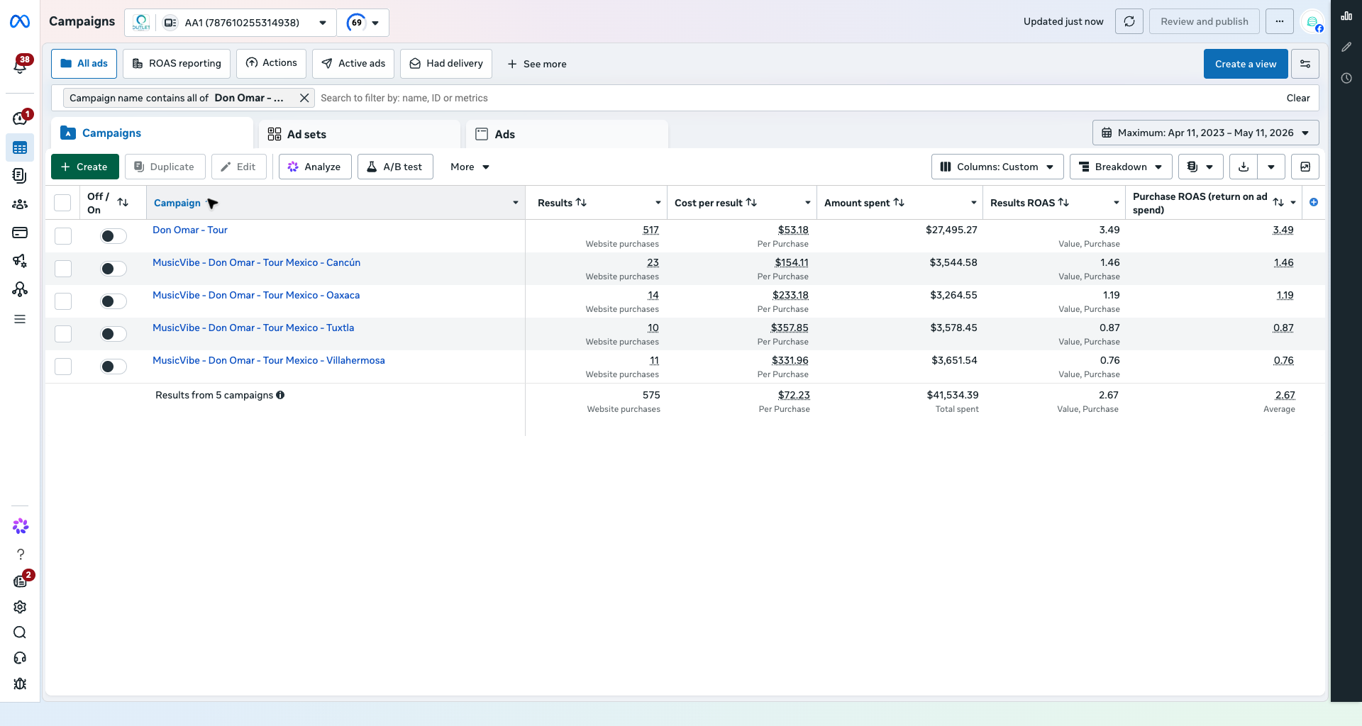
META PROOF
The screenshots tie the story back to Meta, not a custom report.
These are Ads Manager proof rows with spend, website purchases, and purchase ROAS visible in the same table.
A4 main: 816 purchases, $35.2k spend, 6.12x ROAS.
AA1 main: 517 purchases, $27.5k spend, 3.49x ROAS.
Correction baked in
Earlier API totals overcounted purchases by summing duplicate action types. This deck uses one Meta purchase action and purchase value only.
Meta Marketing API v21.0, date_preset=maximum. Ads Manager UI showed Maximum: Apr 11, 2023 - May 11, 2026.
05

Slide 6
2026 RECOMMENDATION
Go after the 2026 tour, but sell the operating system, not only ad buying.
The pitch should be: Outlet already proved paid demand. The next upside comes from earlier market access, controlled pacing, and city rescue triggers.
4.34x
blended ROAS from prior tour
$402k
tracked ticket revenue made
1,716
corrected website purchases
3.64M
account-level reach
01
Ask for the full USA/Canada tour
Use the prior campaign proof as the reason to own the tour instead of getting late-market scraps.
02
Lock city pacing before onsale pressure
Leg 2 still worked, but higher CPP shows why late access costs more.
03
Build budget by market condition
Separate launch, retargeting, and rescue money. Do not run every city with one blended rule.
04
Bring reporting as the close
Show Meta proof plus a weekly revenue bridge: spend, made, purchases, reach, CTR, ROAS, and city risk.
Close line
2026 ask: early access, pacing control, and weekly revenue reporting.
Meta Marketing API v21.0, date_preset=maximum. Ads Manager UI showed Maximum: Apr 11, 2023 - May 11, 2026.
06

