Slide 1

TOUR DEMAND ENGINE
DON OMAR USA/CANADA TOUR
A cleaner case for winning the 2026 tour.
The prior tour already proved paid demand. The next pitch should sell Outlet's operating control: early market access, city pacing, creative testing, and weekly revenue reporting.
$92.7k
$403k
4.34x
Decision
YES, WITH CONDITIONS
SPEND
MADE
ROAS
all tour media
tracked value
purchase return
Take it only if we control timing, reporting, and budget logic early enough to protect later markets.
Meta Marketing API v21.0 + Ads Manager proof screenshots. Scope: USA/Canada Don Omar tour campaigns, maximum range visible in Meta UI: Apr 11, 2023 - May 11, 2026.
01

Slide 2
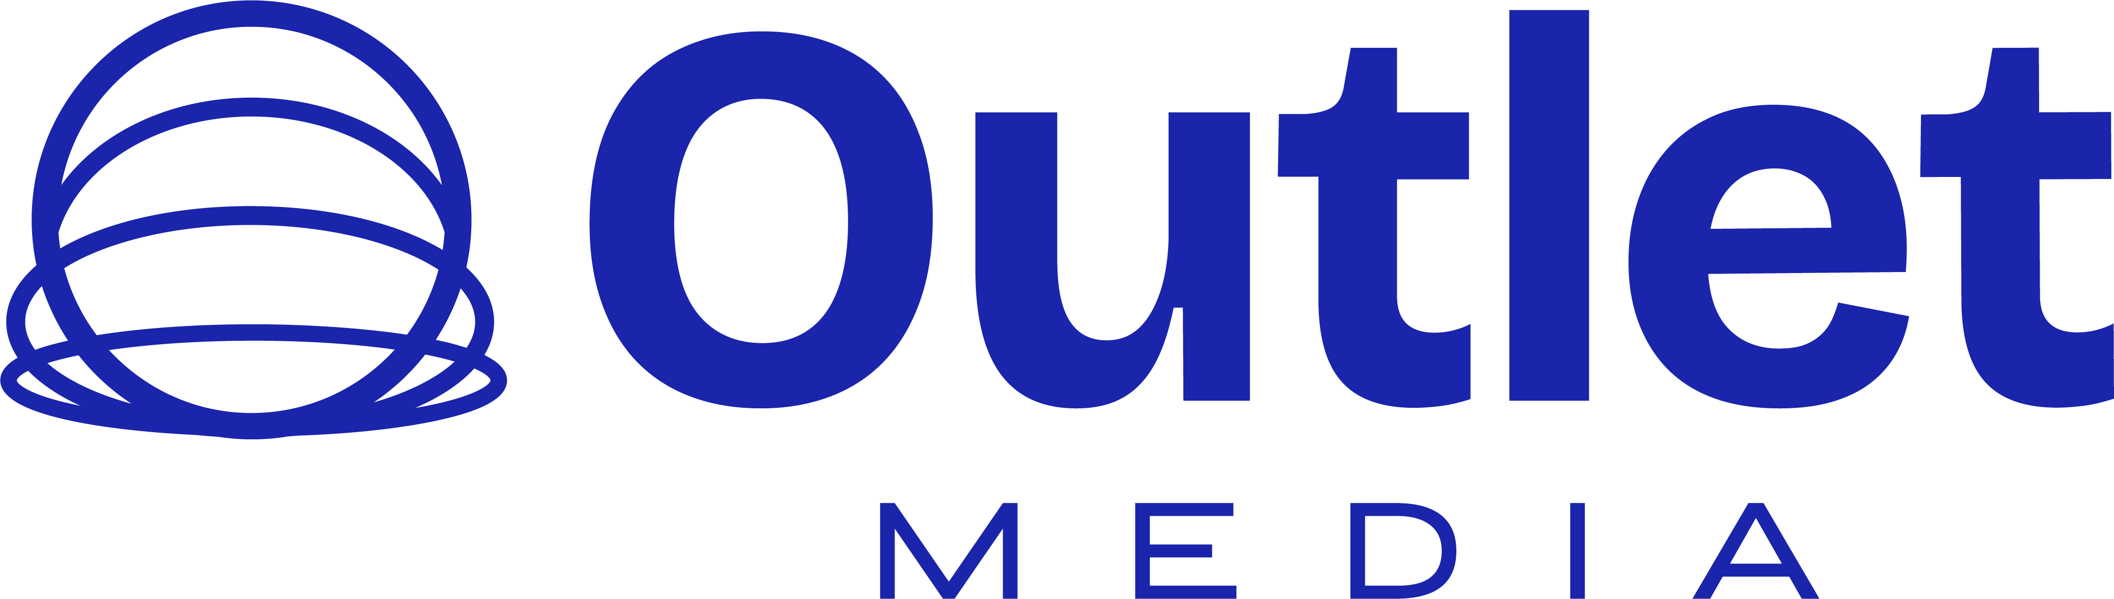
EXECUTIVE READ
The business case is not the spend. It is $402k made from controllable paid demand.
A 2026 pitch should lead with revenue proof, then show how we would make the next tour cleaner.
$92.7k
$403k
1,716
4.34x
3.64M
2.25%
OVERALL SPEND
MADE
PURCHASES
ROAS
REACH
CTR
Meta media
purchase value
$54 CPP
blended return
account-level
311k clicks
What it says
What to sell
The tour has enough demand to justify a full-service 2026 ask. But the profit story depends on controlling timing and market pressure, not just pushing more spend.
A weekly operating loop: spend, made, ROAS, reach, CTR, city risk, ad-set movement, and creative rotation. That makes Outlet look like the revenue control room.
Meta Marketing API v21.0 + Ads Manager proof screenshots. Scope: USA/Canada Don Omar tour campaigns, maximum range visible in Meta UI: Apr 11, 2023 - May 11, 2026.
02

Slide 3
DEMAND FUNNEL
The funnel shows scale, then where the 2026 operating plan has to tighten.
Reach was large enough. The opportunity is turning more of that attention into city-specific purchase pressure.
Impressions
13.83M
Conversion read
Reach
3.64M
1.18%
Clicks
311,132
purchase rate from inline link clicks
Link clicks
145,026
$235
Purchases
1,716
tracked value per purchase
Made
$403k
2026 implication: do not buy the same audience harder. Segment by market temperature and move budget only when each city proves purchase intent.
Meta Marketing API v21.0 + Ads Manager proof screenshots. Scope: USA/Canada Don Omar tour campaigns, maximum range visible in Meta UI: Apr 11, 2023 - May 11, 2026.
03

Slide 4
LEG ECONOMICS
Leg 1 was the proof. The later leg shows why timing is the margin lever.
The later leg still worked, but cost per purchase rose sharply. That is the reason to ask for earlier control in 2026.
Leg 1
4.96x ROAS
Leg 2 / later
3.09x ROAS
Revenue made
$311k
Revenue made
$91.6k
Spend
$62.7k
Spend
$29.7k
Purchases
1,333
Purchases
383
CTR
2.04%
CTR
2.92%
Cost per purchase: $47
Cost per purchase: $77
The leg 2 warning is useful in the pitch: when Outlet gets late access, it can still create revenue, but the campaign has to buy harder. Full-tour access is the performance unlock.
Meta Marketing API v21.0 + Ads Manager proof screenshots. Scope: USA/Canada Don Omar tour campaigns, maximum range visible in Meta UI: Apr 11, 2023 - May 11, 2026.
04

Slide 5
ACCOUNT PROOF
A4 gave the strongest efficiency signal; AA1 added volume and engagement.
The account split lets us explain where the return came from and how to structure reporting for 2026.
Account / campaign
Spend
Made
Purchases
Reach
CTR
ROAS
CPP
A4 account total
$41.5k
$238k
886
2.07M
1.94%
5.72x
$47
AA1 account total
$51.2k
$165k
830
1.57M
2.60%
3.22x
$62
Account / campaign
Spend
Made
Purchases
Reach
CTR
ROAS
CPP
A4 - Tour Sales - MAIN
$35.2k
$215k
816
1758k
1.83%
6.12x
$43
AA1 - Don Omar - Tour
$27.5k
$95.9k
517
738k
2.38%
3.49x
$53
AA1 - Tour - Part 3
$23.7k
$68.9k
313
909k
2.96%
2.91x
$76
A4 - Main 2 Leg Tour
$6.0k
$22.7k
70
266k
2.82%
3.77x
$86
Campaign tests spent $362 with no purchase value; kept out of the main proof but useful as a reminder to separate testing from the revenue engine.
Meta Marketing API v21.0 + Ads Manager proof screenshots. Scope: USA/Canada Don Omar tour campaigns, maximum range visible in Meta UI: Apr 11, 2023 - May 11, 2026.
05

Slide 6
2026 AD-SET ARCHITECTURE
The 2026 plan should look like an operating map, not one big campaign.
This is the visual we can use with the client: each lane has a job, a trigger, and a reporting metric.
01
Market launch / cold demand
02
High-intent retargeting
Open each city with broad concert demand, Latin music interest, and value-optimized purchase delivery. Goal: create early purchase signal before urgency pricing starts.
Retarget site visitors, add-to-cart, checkout starters, video viewers, and engaged social audiences. Goal: protect ROAS and lower cost per purchase.
03
City rescue / late pressure
04
Creative rotation / proof layer
Trigger only when city pacing falls behind: budget moves to the soft market, not the loudest one. Goal: avoid leg-2 style late inefficiency.
Separate artist/tour assets, city urgency, seat scarcity, and testimonial/proof units. Goal: avoid creative fatigue and see which story sells.
Reporting cadence
Every week: spend, made, purchases, reach, CTR, ROAS, CPP, winning ad sets, losing ad sets, and city risk.
Meta Marketing API v21.0 + Ads Manager proof screenshots. Scope: USA/Canada Don Omar tour campaigns, maximum range visible in Meta UI: Apr 11, 2023 - May 11, 2026.
06

Slide 7
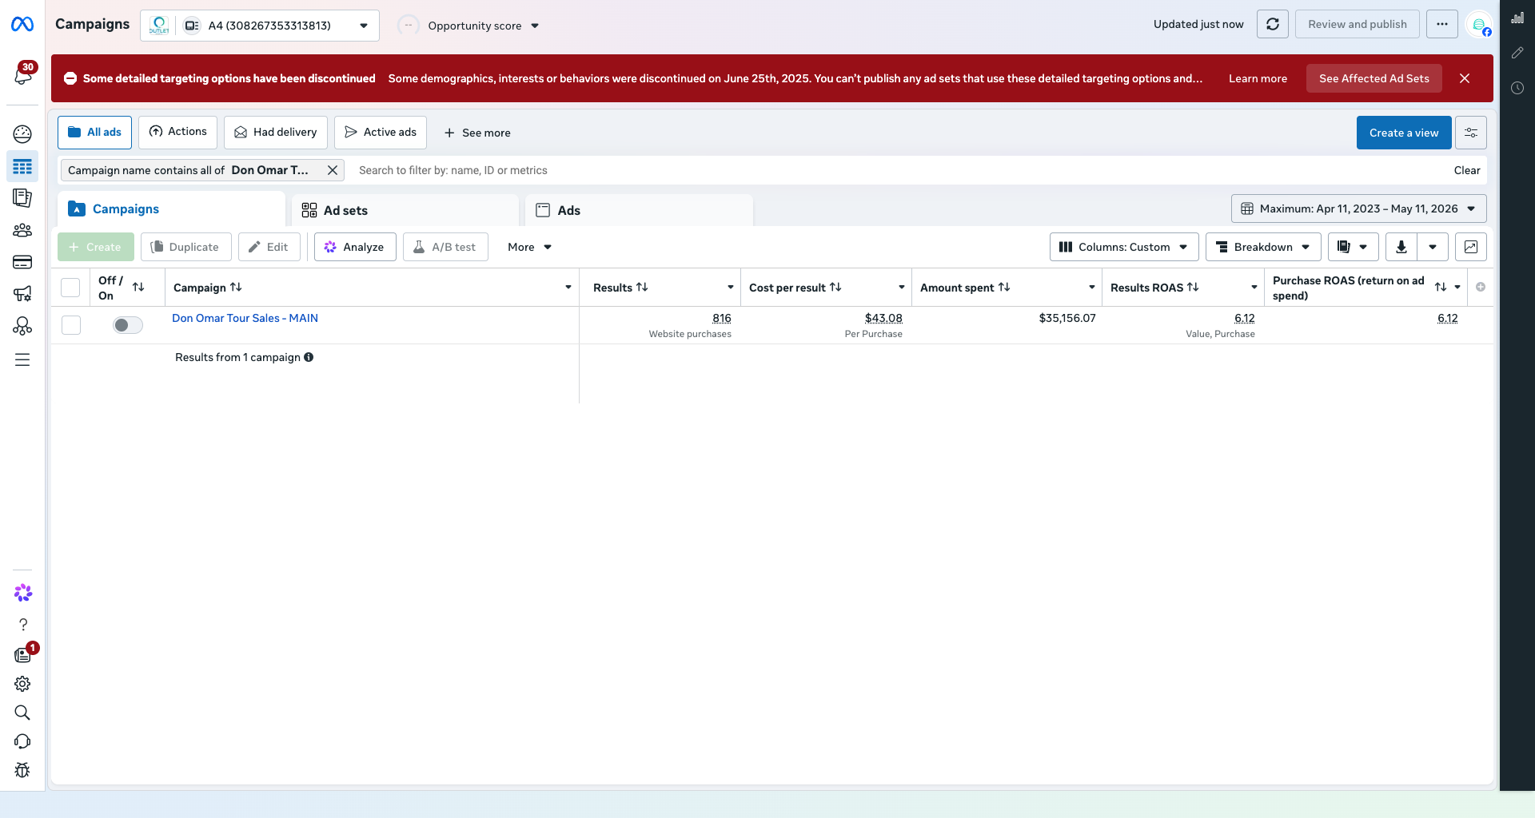
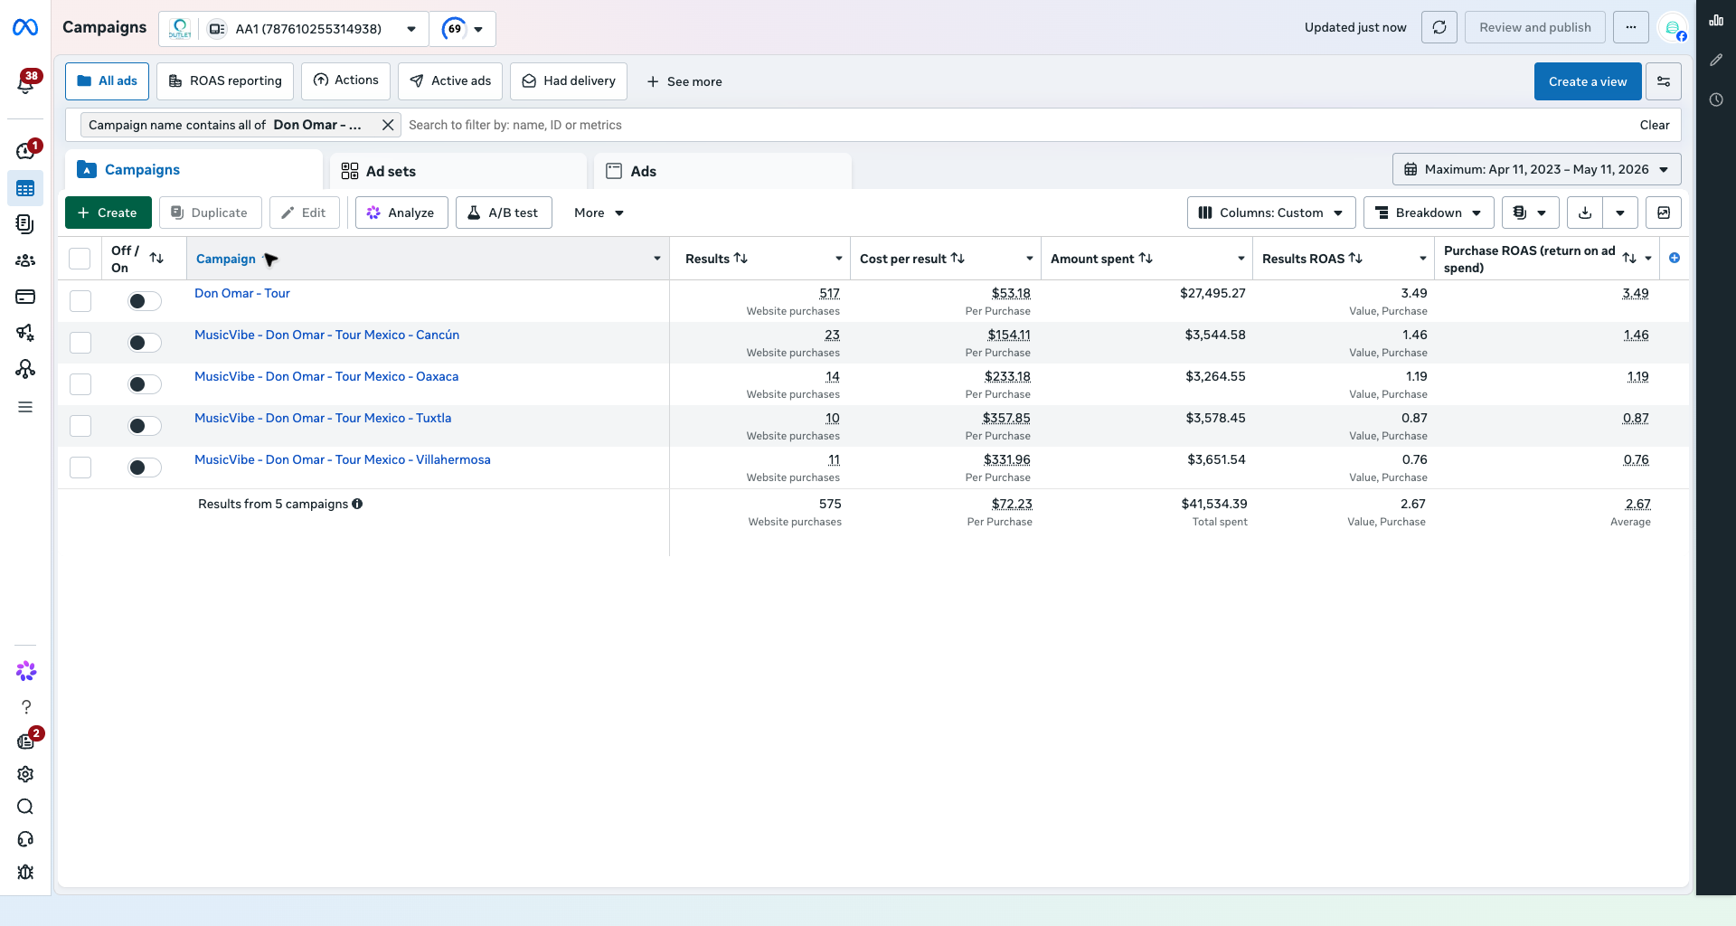
META-NATIVE PROOF
Keep the generated visuals polished, but let Meta carry the credibility.
The proof slides should show screenshots from Ads Manager, then the deck translates them into the business decision.
A4 main: 816 purchases, $35.2k spend, 6.12x ROAS.
AA1 main: 517 purchases, $27.5k spend, 3.49x ROAS.
Creative rule
Use generated visuals for polish and mood. Use real approved artist/tour assets and real Meta screenshots for anything that implies proof or identity.
Meta Marketing API v21.0 + Ads Manager proof screenshots. Scope: USA/Canada Don Omar tour campaigns, maximum range visible in Meta UI: Apr 11, 2023 - May 11, 2026.
07

Slide 8
CLOSING ASK
Ask for the tour. Sell control.
The story is not that Outlet spent money. The story is that Outlet converted paid attention into tracked ticket revenue, and the next tour can be managed with more discipline.
4.34x
$403k
3.64M
1,716
PROOF OF RETURN
PROOF OF REVENUE
PROOF OF REACH
PROOF OF DEMAND
prior tour ROAS
tracked purchase value
account-level audience
corrected purchases
01
Full USA/Canada tour scope
Do not pitch city-by-city scraps. Use prior proof to ask for the full calendar.
02
Early asset + URL access
We need ticket URLs, pixel verification, city dates, and approved creative before late pressure starts.
03
Budget rules by city risk
Each city gets launch, retargeting, and rescue budgets. Money moves by signal.
04
Weekly executive reporting
Spend, made, purchases, reach, CTR, ROAS, CPP, winning ad sets, and city risk.
Meta Marketing API v21.0 + Ads Manager proof screenshots. Scope: USA/Canada Don Omar tour campaigns, maximum range visible in Meta UI: Apr 11, 2023 - May 11, 2026.
08

