Slide 1

TOUR DEMAND ENGINE
DON OMAR USA/CANADA TOUR
A cleaner case for winning the 2026 tour.
The prior tour already proved paid demand. The next pitch should sell Outlet's operating control: early market access, city pacing, creative testing, and weekly revenue reporting.
$92.7k
$403k
4.34x
Decision
YES, WITH CONDITIONS
SPEND
MADE
ROAS
all tour media
tracked value
purchase return
Conditions: T-90 days before first on-sale, pixel verified, ticket URLs and city calendar locked, weekly reporting cadence agreed. Without these, scope and pricing change (see Conditions & Fallback).
Meta Marketing API v21.0 + Ads Manager proof screenshots. Scope: USA/Canada Don Omar tour campaigns, maximum range visible in Meta UI: Apr 11, 2023 - May 11, 2026.
01

Slide 2
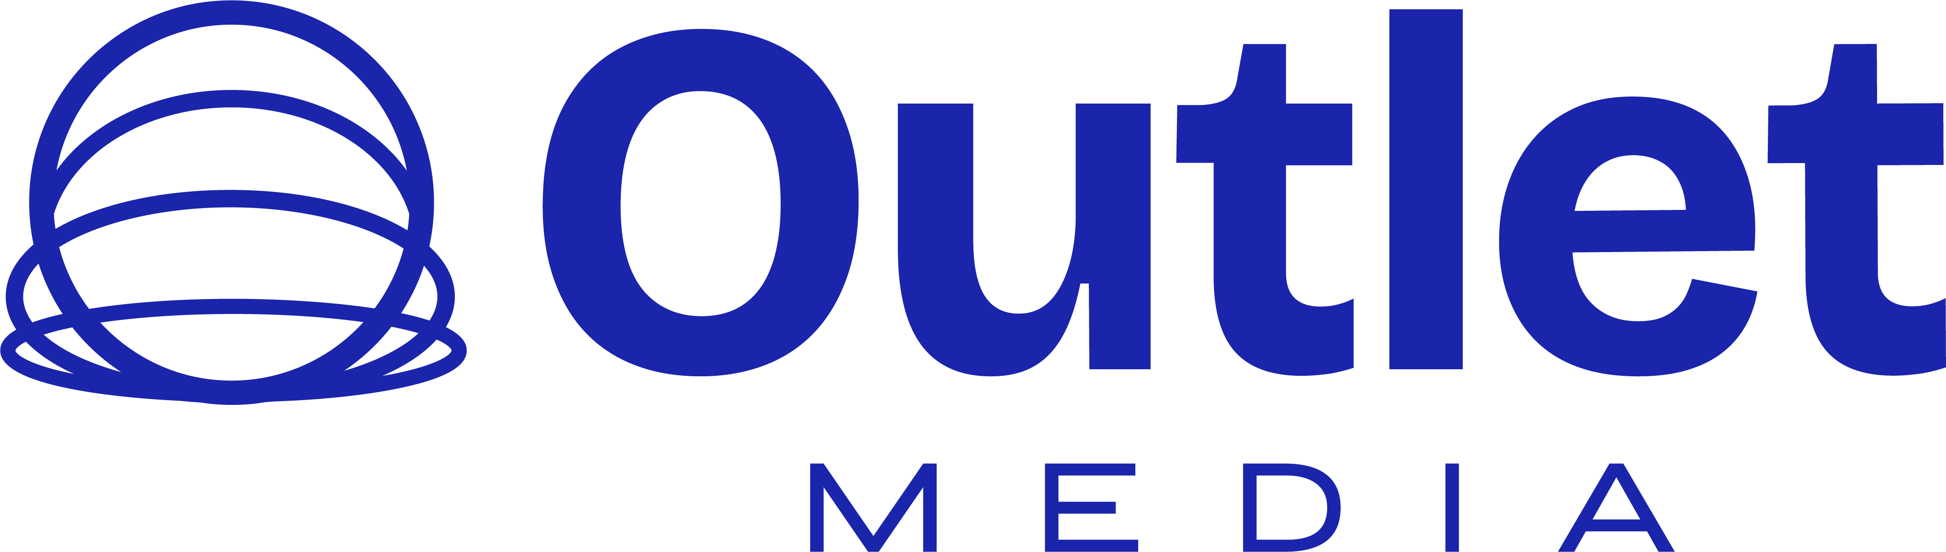
EXECUTIVE READ
The business case is not the spend. It is $402k made from controllable paid demand.
A 2026 pitch should lead with revenue proof, then show how we would make the next tour cleaner.
$92.7k
$403k
1,716
4.34x
3.64M
2.25%
OVERALL SPEND
MADE
PURCHASES
ROAS
REACH
CTR
Meta media
Meta-attributed value
$54 CPP
blended return
account-level
311k clicks
What it says
What to sell
Paid social on event ticketing typically returns 2-3x. The prior tour returned 4.34x blended and 6.12x on the lead campaign. Demand justifies a full 2026 ask; the profit story depends on controlling timing and city pressure.
A weekly operating loop: spend, made, ROAS, reach, CTR, city risk, ad-set movement, and creative rotation. Every revenue number reconciles to an Ads Manager screenshot; ticketing-platform recon available on request.
Meta Marketing API v21.0 + Ads Manager proof screenshots. Scope: USA/Canada Don Omar tour campaigns, maximum range visible in Meta UI: Apr 11, 2023 - May 11, 2026.
02

Slide 3
DEMAND FUNNEL
The funnel shows scale, then where the 2026 operating plan has to tighten.
Reach was large enough. The opportunity is turning more of that attention into city-specific purchase pressure.
Impressions
13.83M
Conversion read
Reach
3.64M
1.18%
Clicks
311,132
purchase rate from inline link clicks
Link clicks
145,026
$235
Purchases
1,716
tracked value per purchase
Made
$403k
2026 plan: open each city by market temperature, then move budget only when purchase intent shows. The funnel above is what gets rebuilt per city, not per tour.
Meta Marketing API v21.0 + Ads Manager proof screenshots. Scope: USA/Canada Don Omar tour campaigns, maximum range visible in Meta UI: Apr 11, 2023 - May 11, 2026.
03

Slide 4
LEG ECONOMICS
Late access cost the prior tour ~$55k. That is the 2026 ask.
Leg 1 returned 4.96x ROAS. Leg 2 dropped to 3.09x. At leg-1 efficiency, leg-2's $29.7k would have made ~$147k instead of $91.6k - about $55k of revenue lost to late market access.
Leg 1
4.96x ROAS
Leg 2 / later
3.09x ROAS
Revenue made
$311k
Revenue made
$91.6k
Spend
$62.7k
Spend
$29.7k
Purchases
1,333
Purchases
383
CTR
2.04%
CTR
2.92%
Cost per purchase: $47
Cost per purchase: $77
Full-tour access at leg-1 timing recovers that gap. Late access is not a creative problem; it is a calendar problem.
Meta Marketing API v21.0 + Ads Manager proof screenshots. Scope: USA/Canada Don Omar tour campaigns, maximum range visible in Meta UI: Apr 11, 2023 - May 11, 2026.
04

Slide 5
ACCOUNT PROOF
A4 - Tour Sales - MAIN: $35.2k spend -> $215k made -> 6.12x ROAS.
One campaign alone justifies handing Outlet the full 2026 calendar. The table below splits the rest of the proof by account and campaign.
Account / campaign
Spend
Made
Purchases
Reach
CTR
ROAS
CPP
A4 account total
$41.5k
$238k
886
2.07M
1.94%
5.72x
$47
AA1 account total
$51.2k
$165k
830
1.57M
2.60%
3.22x
$62
Account / campaign
Spend
Made
Purchases
Reach
CTR
ROAS
CPP
A4 - Tour Sales - MAIN
$35.2k
$215k
816
1758k
1.83%
6.12x
$43
AA1 - Don Omar - Tour
$27.5k
$95.9k
517
738k
2.38%
3.49x
$53
AA1 - Tour - Part 3
$23.7k
$68.9k
313
909k
2.96%
2.91x
$76
A4 - Main 2 Leg Tour
$6.0k
$22.7k
70
266k
2.82%
3.77x
$86
Campaign tests spent $362 with no purchase value; kept out of the main proof but useful as a reminder to separate testing from the revenue engine.
Meta Marketing API v21.0 + Ads Manager proof screenshots. Scope: USA/Canada Don Omar tour campaigns, maximum range visible in Meta UI: Apr 11, 2023 - May 11, 2026.
05

Slide 6
2026 AD-SET ARCHITECTURE
The 2026 plan should look like an operating map, not one big campaign.
Steady-state mix: 45 / 30 / 15 / 10. Rescue triggers only on signal; creative rotates against weekly fatigue checks. Each lane has a job, a trigger, and a reporting metric.
01
Market launch / cold demand · 45% of spend
02
High-intent retargeting · 30% of spend
Open each city with broad concert demand, Latin music interest, and value-optimized purchase delivery. Goal: create early purchase signal before urgency pricing starts.
Retarget site visitors, add-to-cart, checkout starters, video viewers, and engaged social audiences. Goal: protect ROAS and lower cost per purchase.
03
City rescue / late pressure · 15% of spend
04
Creative rotation / proof layer · 10% of spend
Trigger only when city pacing falls behind: budget moves to the soft market, not the loudest one. Goal: avoid leg-2 style late inefficiency.
Separate artist/tour assets, city urgency, seat scarcity, and testimonial/proof units. Goal: avoid creative fatigue and see which story sells.
Reporting cadence
Every week: spend, made, purchases, reach, CTR, ROAS, CPP, winning ad sets, losing ad sets, and city risk.
Meta Marketing API v21.0 + Ads Manager proof screenshots. Scope: USA/Canada Don Omar tour campaigns, maximum range visible in Meta UI: Apr 11, 2023 - May 11, 2026.
06

Slide 7
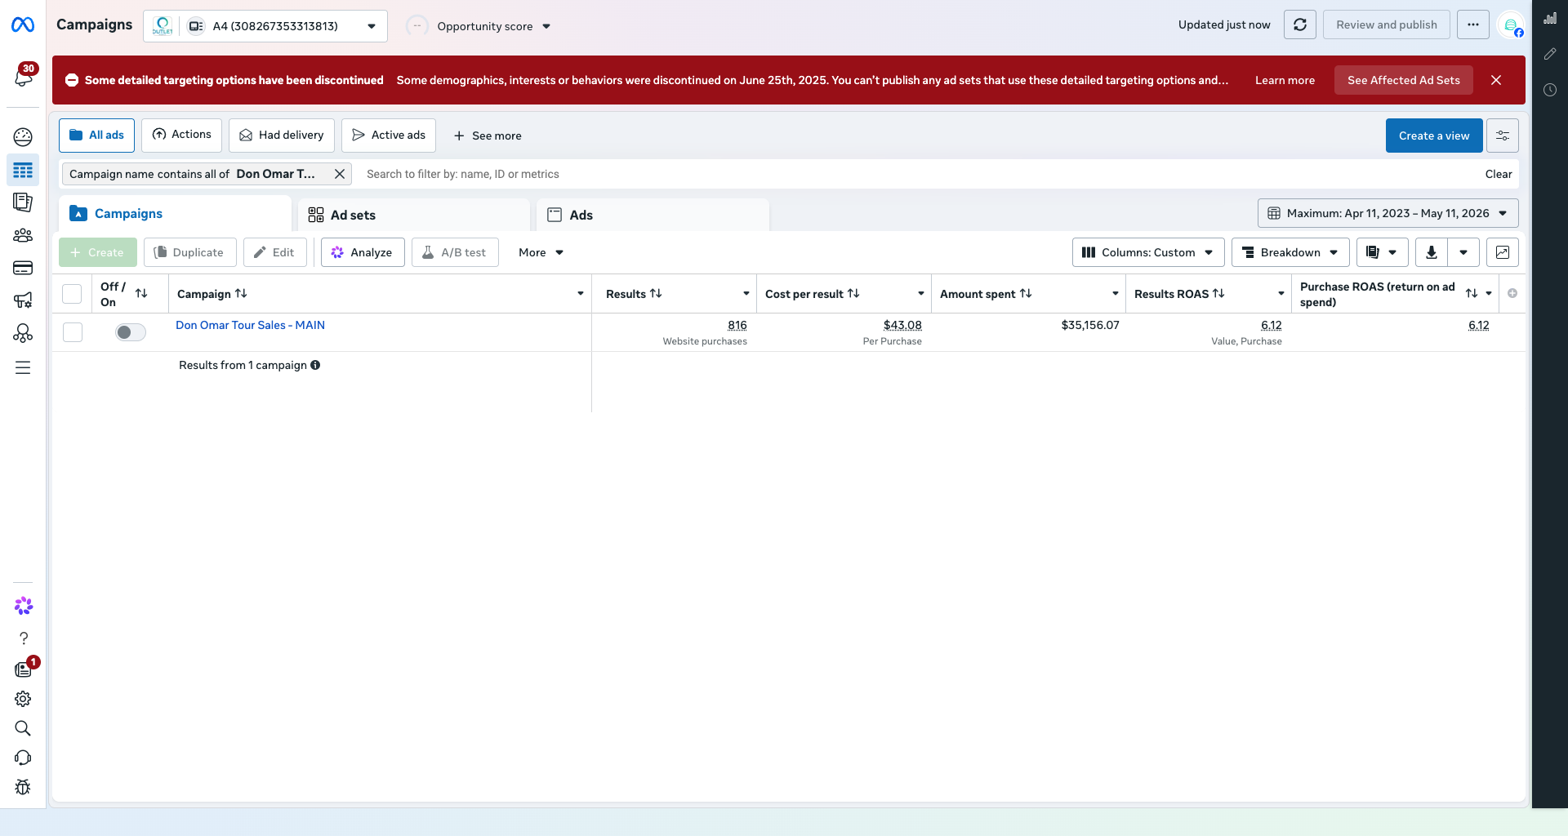
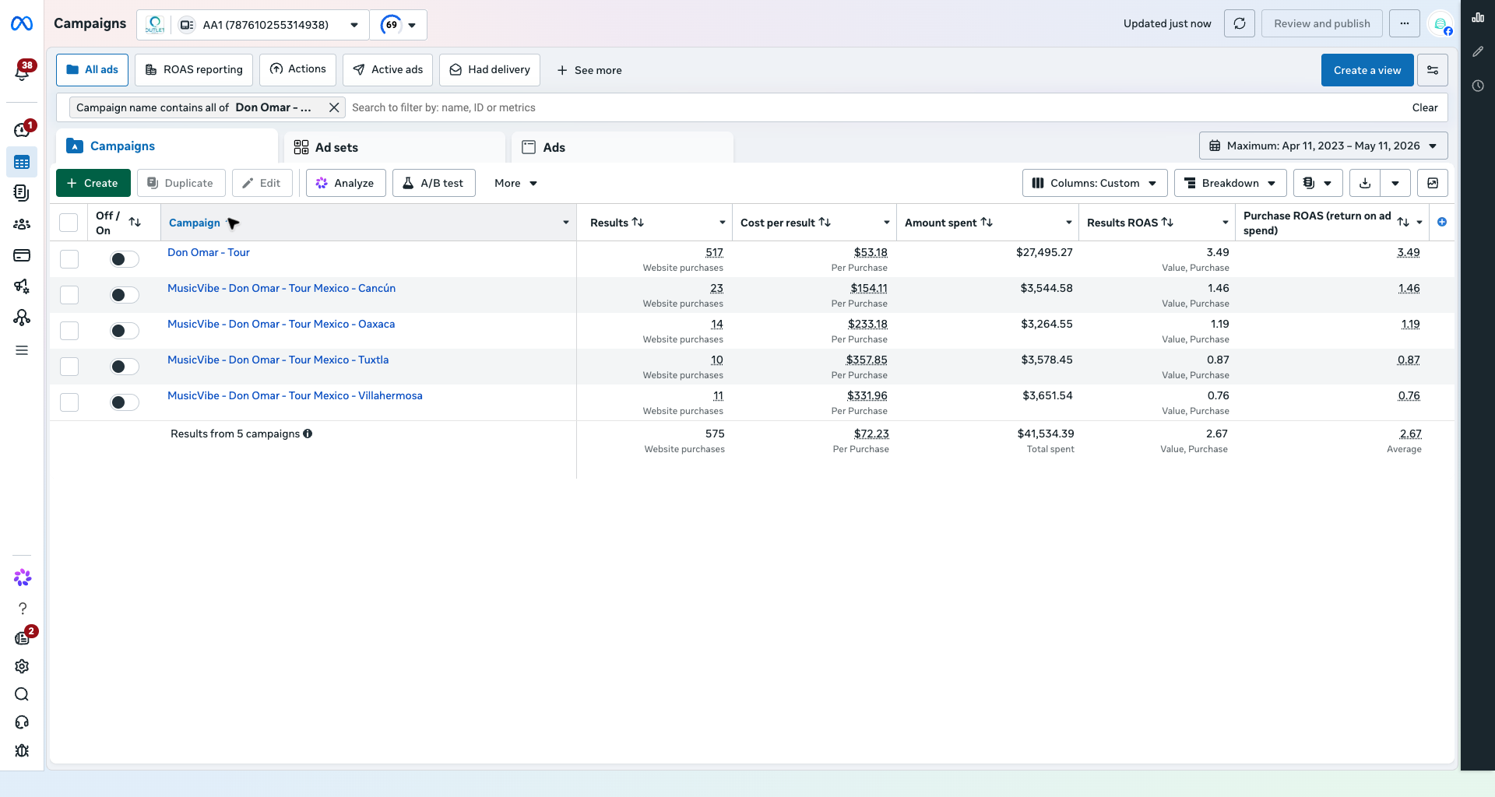
META-NATIVE PROOF
Meta carries the credibility. Generated visuals carry the polish.
Every revenue number in this deck reconciles to an Ads Manager screenshot. Ticketing-platform reconciliation available on request.
A4 main: 816 purchases, $35.2k spend, 6.12x ROAS.
AA1 main: 517 purchases, $27.5k spend, 3.49x ROAS.
Creative rule
Use generated visuals for polish and mood. Use real approved artist/tour assets and real Meta screenshots for anything that implies proof or identity.
Meta Marketing API v21.0 + Ads Manager proof screenshots. Scope: USA/Canada Don Omar tour campaigns, maximum range visible in Meta UI: Apr 11, 2023 - May 11, 2026.
07

Slide 8
CONDITIONS & FALLBACK
If the conditions move, the scope and price move with them.
Outlet does not buy late-access risk at full-service pricing. Four engagement modes, sorted by lead time. The first is the default.
01
Full-tour scope · preferred
02
Partial access · acceptable
All USA/Canada dates. T-90 onboarding. Weekly executive reporting. Engagement: % of spend + performance kicker. This is the bid.
Selected cities only. T-60 onboarding. Biweekly reporting. Retargeting and rescue lanes only; cold-demand lane scoped out. Engagement: % of spend, no kicker.
03
Late access · capped
04
Walk-away triggers
T-30 or later. Retargeting-only scope. Fixed monthly fee, not % of spend. Goal is revenue protection, not growth. Outlet does not promise leg-1 ROAS.
Pixel not delivered, ticket URLs delayed past T-30, or zero creative approvals 7 days from kickoff. Engagement pauses, fees stop, scope renegotiates.
Default position
Full-tour scope at T-90. Anything tighter trades 2026 upside for risk control. Late-access mode exists, but it does not unlock the operating margin.
Meta Marketing API v21.0 + Ads Manager proof screenshots. Scope: USA/Canada Don Omar tour campaigns, maximum range visible in Meta UI: Apr 11, 2023 - May 11, 2026.
08

Slide 9
ENGAGEMENT MODEL
Aligned fee structure. Outlet earns when the tour earns.
Three commercial components, one reporting cadence. No success fee until the tour clears its return floor.
01
Management fee
02
Performance kicker
15% of paid media spend (industry range 12-20%). Covers campaign operations, weekly reporting, creative QA, pixel/attribution stewardship, and account access.
2% of Meta-attributed revenue above a 4.0x ROAS floor. Below 4.0x, no kicker. Pays for over-delivery, not for showing up.
03
Setup
04
Reporting SLA
One-time $5k. Pixel verification, audience architecture, creative system, ticketing reconciliation onboarding, and weekly report template.
Every Monday, 10am ET. Spend, made, purchases, reach, CTR, ROAS, CPP, ad-set movers, city risk. Missed report credits next-week management fee.
Floor and ceiling
Outlet aligns to ROAS, not to spend. The kicker rewards above-floor performance; no kicker on under-performing weeks. Floor and percentages are anchored to industry benchmarks and editable on signature.
Meta Marketing API v21.0 + Ads Manager proof screenshots. Scope: USA/Canada Don Omar tour campaigns, maximum range visible in Meta UI: Apr 11, 2023 - May 11, 2026.
09

Slide 10
CLOSING ASK
Ask for the tour. Sell control.
$403k of tracked revenue at 4.34x ROAS. Give Outlet the full 2026 calendar T-90 days before first on-sale, on a weekly reporting cadence. Everything else is detail.
4.34x
$403k
3.64M
1,716
PROOF OF RETURN
PROOF OF REVENUE
PROOF OF REACH
PROOF OF DEMAND
prior tour ROAS
tracked purchase value
account-level audience
corrected purchases
01
Full USA/Canada tour scope
Do not pitch city-by-city scraps. Use prior proof to ask for the full calendar.
02
Early asset + URL access
T-90 days before first on-sale: ticket URLs delivered, pixel verified, city dates locked, and approved creative in hand.
03
Budget rules by city risk
Each city gets launch, retargeting, and rescue budgets. Money moves by signal.
04
Weekly executive reporting
Spend, made, purchases, reach, CTR, ROAS, CPP, winning ad sets, and city risk.
Meta Marketing API v21.0 + Ads Manager proof screenshots. Scope: USA/Canada Don Omar tour campaigns, maximum range visible in Meta UI: Apr 11, 2023 - May 11, 2026.
10

