Slide 1
DevOps

Slide 2
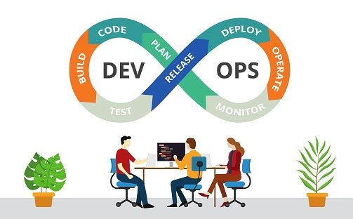
It is a combination of development and operational practices
It increases the speed in delivery of applications
Conflicts between DevOps
Need for change
Fear of change

Slide 3
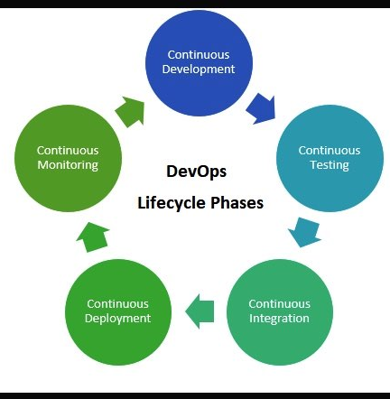
DEVOPS LIFE CYCLE

Slide 4
DEVOPS SKILLS
Linux fundamentals
Cloud computing
GIT
GIT HUB
Ansible
Docker
Kubernetes
Jenkins
Teraform

Slide 5
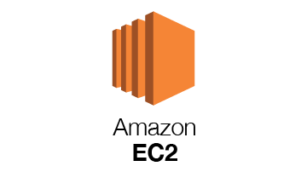

Slide 6
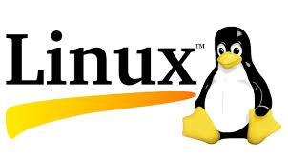

Slide 7
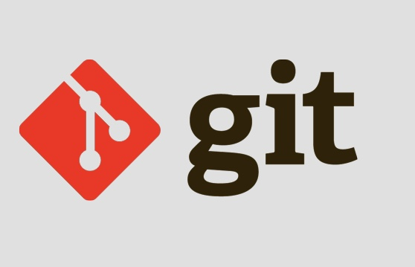
GIT
VCS
Version Control is a system that you can recall specific versions later
It is Used for non linear workflows
It allows you and your team to work on the same project from anywhere

Slide 8
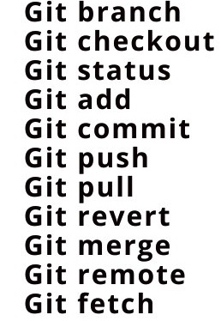
GIT COMMANDS

Slide 9
GIT FEATURES
Economical
Integrity
Robustness
Branching
Speed
Distributed

Slide 10
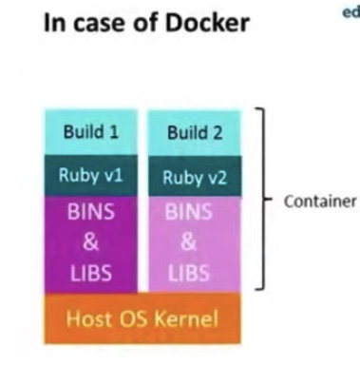
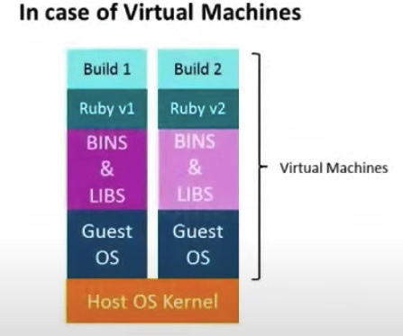
DOCKER
Caption

Slide 11
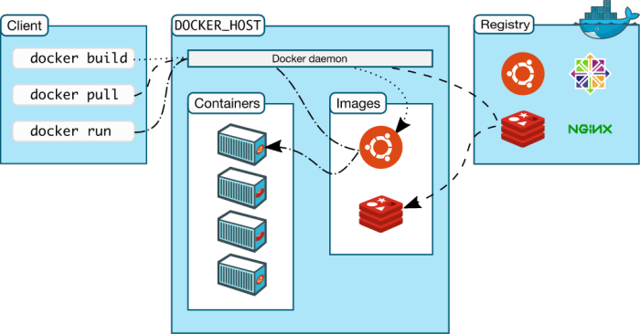

Slide 12
DOCKER COMMANDS
docker info : gives the information about docker.
docker stop : it is used to stop the running containers.
docker —help : helps about docker commands.
docker rm : it is used to remove the containers.
docker —version : gives the version of docker in your local machine.
docker rmi : it is used to remove one or images
docker login : used to login to your docker hub account.

Slide 13
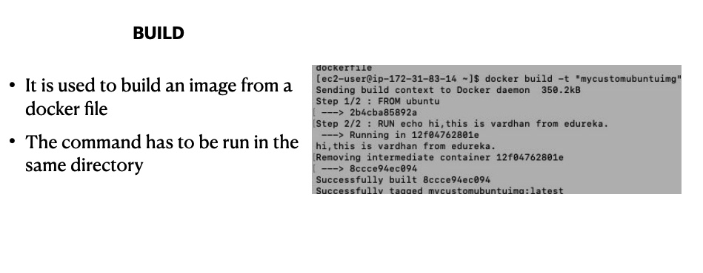

Slide 14
DOCKER FEATURES
Portability
Performance
Scalability
Isolation
Agility

Slide 15
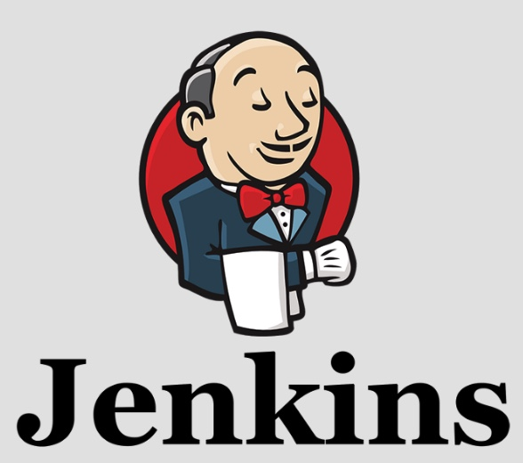
JENKINS
It is a CI/CD tool
It is written in java language
It helps automate the parts of software development related to building, testing, and deploying

Slide 16
JENKINS FEATURES
Easy installation
Distributed
Plugins
Easy Configuration

Slide 17
Thank you

