Slide 1
RESEARCHOS
A question needs memory and evidence.
The conclusion has to say whether that evidence supports the claim.
1 / 9

Slide 2
PROBLEM AND USERS
Notes and papers never meet.
Who A researcher checking one claim against a paper corpus and their own earlier conclusions.
The work The question is plain language. No paper id, and no model name. The demo is post-quantum cryptography.
What breaks A new question starts from zero, or repeats a conclusion the papers no longer support.
What a model does It can name papers that were never retrieved. Nothing says whether the evidence supports the claim.
2 / 9

Slide 3
SOLUTION
One question. Four panes. One assessment.
SUPPORTED The relevant evidence agrees, and none of it denies the question.
CONTRADICTED The relevant evidence denies the question, and none of it agrees.
MIXED Some evidence agrees and some denies it.
INSUFFICIENT No supplied evidence is about the question.
Every cited paper id has to be in the memories or the Zetaris rows that were sent.
3 / 9

Slide 4
AGENT WORKFLOW
Recall, then evidence, then a stop.
Question
H-MEM recall
Markovian, at most 3
Zetaris
Nemotron
Contradiction check
Store the finding
On a warm run the first chunk already holds the recalled memory, so Search memory is not repeated.
Each chunk asks Zetaris once. Nemotron assesses that chunk plus the evidence gathered so far.
The loop stops when the assessment is not INSUFFICIENT and nothing is still open, or at chunk 3.
4 / 9

Slide 5
TECHNICAL STACK
Vendored engines, one local model call.
Page Node and tsx. Run research calls POST /api/research.
H-MEM Vendored Meterless engine. Prior claims live in .memory.
Markovian Vendored. Chunk size 2000, at most 3 chunks, 128 carryover tokens.
Zetaris Current papers, notes, and experiments.
Nightshift Local runtime. Model nvidia/nemotron-3.5-lightning-30b-a3b.
Offline reasoner The same four assessments, with Nightshift stopped.
5 / 9

Slide 6
ZETARIS AND METERLESS
The corpus stays in Zetaris. The loop is Meterless.
Zetaris Each chunk queries it once: schemes, one paper, or conflicting evidence, and only for work not already completed.
H-MEM Recalls prior findings into the first chunk, then stores the new finding once.
Markovian Carries completed work, what is still open, decisions, and context from chunk to chunk.
Nightshift The only model call. The NVIDIA key stays there and never enters this repo.
The reference engines are vendored. They were not rewritten.
6 / 9

Slide 7
WHAT IS UNIQUE
The loop stops, and it may only cite what it was given.
Warm is shorter H-MEM text enters the first chunk only. A cold run takes 3 chunks. A warm run takes 2.
Later chunks stay open They do not see that reinjection. They search memory for what is still unresolved.
No invented papers Supporting and conflicting ids have to be in the memories or the Zetaris rows that were sent.
A contradiction has a consequence CONTRADICTS always recommends revising the existing conclusion.
7 / 9

Slide 8
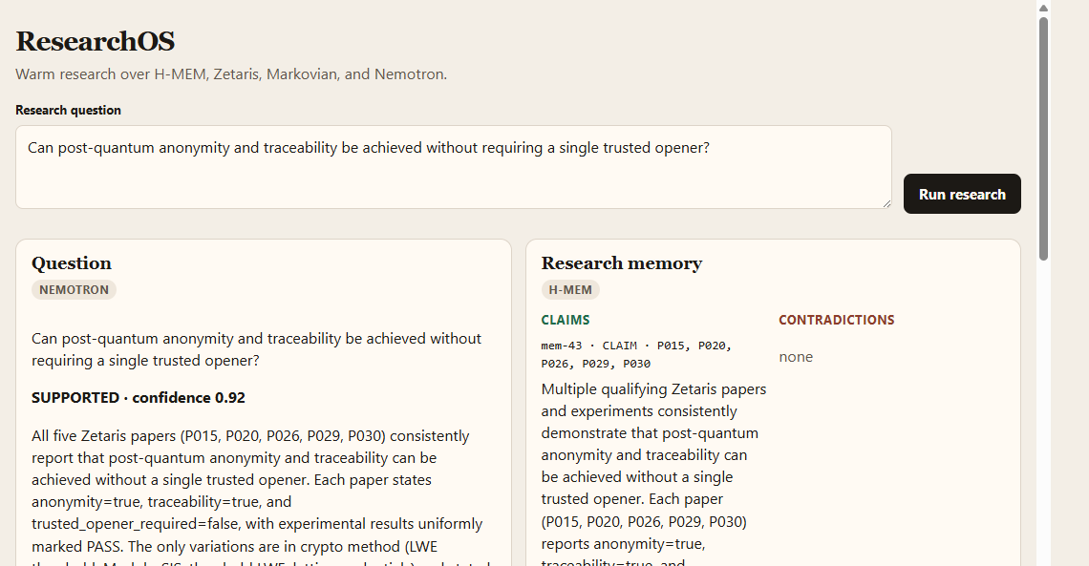
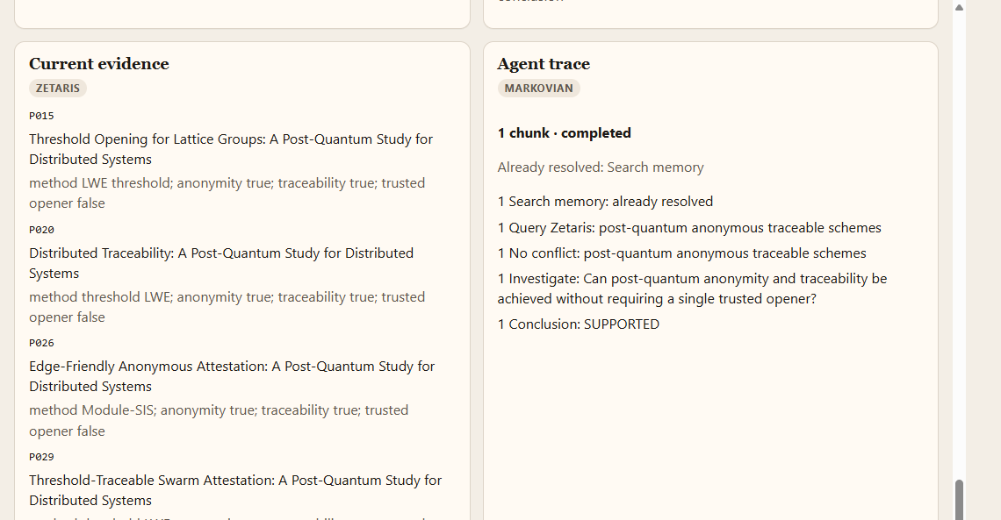
PRODUCT
One warm run, on the page.
Question, Nemotron, and H-MEM.
Zetaris papers and the Markovian trace.
Trusted-opener question. Assessment SUPPORTED, from P015, P020, P026, P029, and P030.
8 / 9

Slide 9
FUTURE
What the next runs should show.
A visible contradiction The evaluator already marks CONTRADICTS in tests. The page should show that case, not only agreement.
A researcher edit Accept or revise a stored finding before the next warm run uses it.
Open questions that persist Carry one unanswered question into a later run, still inside the 3-chunk cap.
An export The assessment, with the paper ids it was allowed to cite.
9 / 9

