Slide 1

CROWPI CLUB
Build it. Code it. Break it. Fix it.
22 club days · Your own Raspberry Pi 5 kit · Real sensors, real code
Middle School Technology Club
Notes:
Welcome everyone! Quick intro: your name, that you run your own Minecraft server and build computers, and that everyone gets their OWN kit all semester. Gold star in the corner of a slide = last slide of that day, stop there.

Slide 2




How the Club Works
Your kit = your responsibility
Every case has a number. Same kid, same kit, every week. Check it in at the end of class.
Shut down the right way
Click Shut down in the lesson (or Menu > Shutdown) before unplugging. Pulling the power cord can wreck the SD card.
Close the lesson when you're done
Click Close (bottom left of every lesson). It closes the lesson and Thonny, and you're back at CrowPi Lessons.
Stuck for 5 minutes? Ask.
Try to fix it yourself first, then raise your hand. Helping each other counts too.
Notes:
Spend real time on the shutdown rule — corrupted SD cards from hard power-offs will be your #1 tech problem. Live-demo proper shutdown. Assign kit numbers TODAY on a roster.

Slide 3
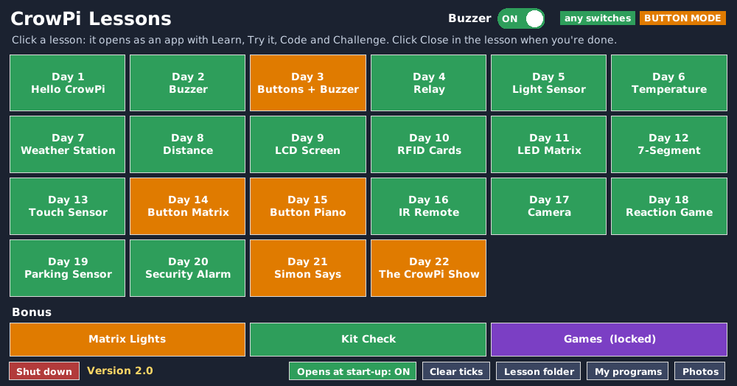
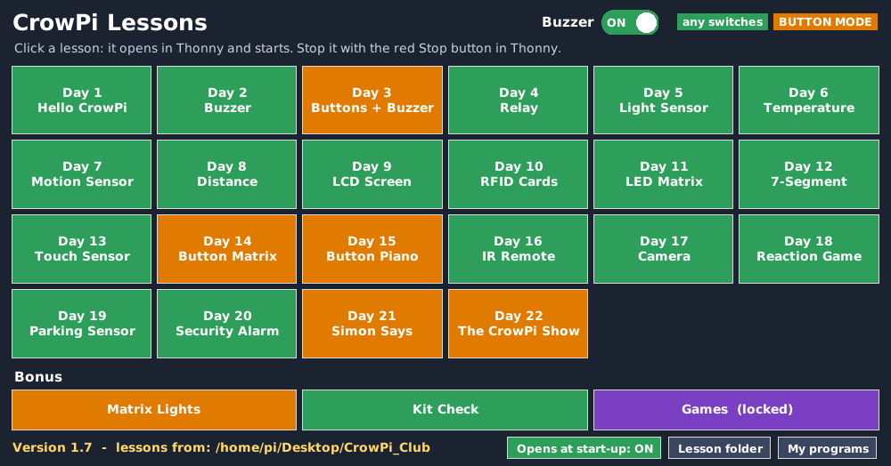
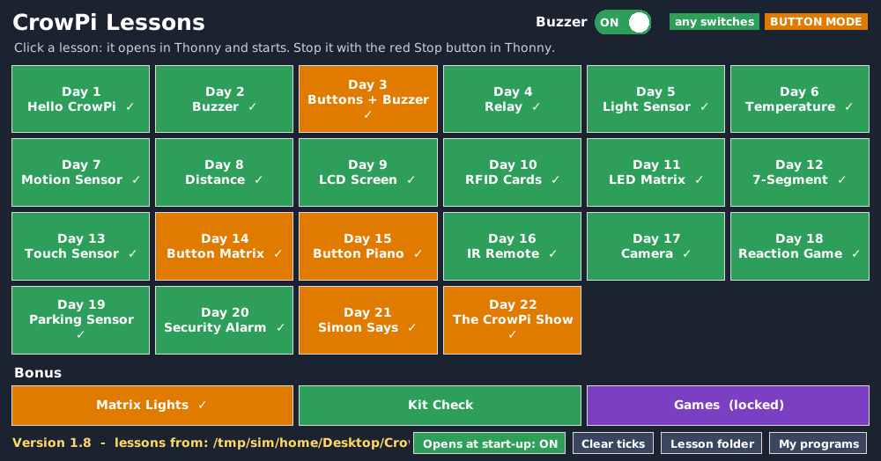
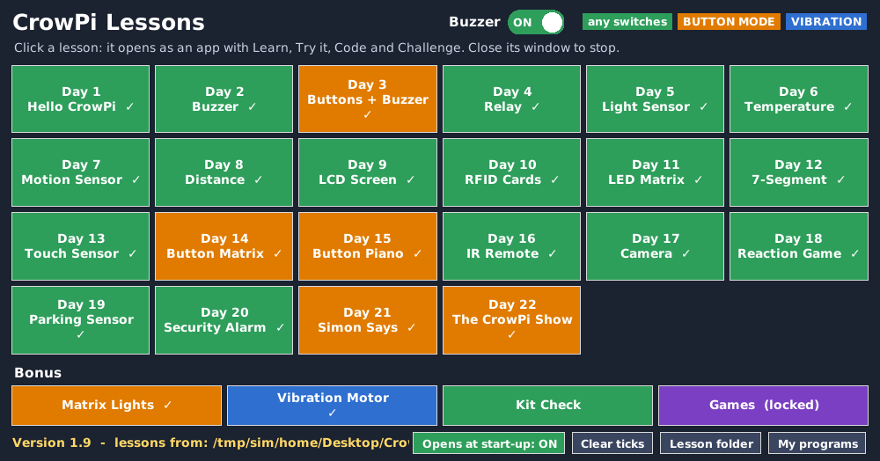
Your App: CrowPi Lessons
1
Click your day
The lesson opens as its own app window.
2
Close and Shut down
Bottom left of every lesson. Next > (bottom right) = next tab.
3
Buzzer switch
Top of the app. OFF = lessons run quietly.
It opens by itself when the kit starts. Every lesson is one big button: green = any switches, orange = BUTTON MODE.
4
Four tabs per lesson
Learn, Try it, Code, Challenge. Code tab: change the yellow values only.
Notes:
Show this on the projector on Day 1. Every lesson opens as an app with Learn, Try it, Code and Challenge tabs - nobody needs to type code. Close (bottom left) ends a lesson and closes Thonny; Shut down turns the kit off properly. Games can be locked with the admin password (set by the installer - see the cheat sheet).

Slide 4
DAY
1
Meet Your Computer
Your kit is already built. Connect the keyboard and mouse, then power on.
TODAY YOU'LL LEARN
PARTS WE USE
What the parts of a computer actually are (CPU, RAM, storage)
How the keyboard and mouse connect (one tiny USB dongle)
How a computer boots from an SD card
Your assembled CrowPi kit
Wireless keyboard + mouse
USB dongle (inside the mouse)
SD card (preloaded)
Notes:
PREP: the kits arrive assembled. Before class, check each kit powers on and the keyboard/mouse dongle connects. Nothing is removed or installed on Day 1.

Slide 5

DAY
1
Meet Your Computer — What You Need to Know
The three things from the last slide, actually explained.
What the parts of a computer actually are
1
The CPU is the brain (does the math), RAM is the desk (holds what it's working on right now), storage is the backpack (keeps everything when the power's off). Your Pi 5 has all three on one small board.
How the keyboard and mouse connect
2
Take the battery cover off the mouse and find the small USB dongle. Plug it into a USB port on the Pi. The keyboard and mouse talk to it wirelessly, so there are no cables to tangle.
How a computer boots from an SD card
3
The SD card holds the operating system — the Pi's whole personality. On power-up, the Pi reads the card step by step until the desktop appears. No card (or a corrupted one) = no boot. That's why we shut down properly.

Slide 6

DAY
1
Meet Your Computer — Start It Up
Follow the steps in order. Nothing gets installed, just connected and turned on.
Open the case lid. The kit is already assembled, so there is nothing to install
Turn the kit on with its power switch
1
4
Take the battery cover off the mouse and find the USB dongle inside
Wait for the desktop to appear
2
5
Plug the dongle into a USB port on the Pi
Move the mouse. Desktop on screen = you're running a computer!
3
6
Notes:
Demo the dongle first: battery cover off, dongle in a USB port. The most common problem is a dongle in the wrong port or batteries that are dead. If the screen stays dark, check the power switch and the adapter plug.

Slide 7
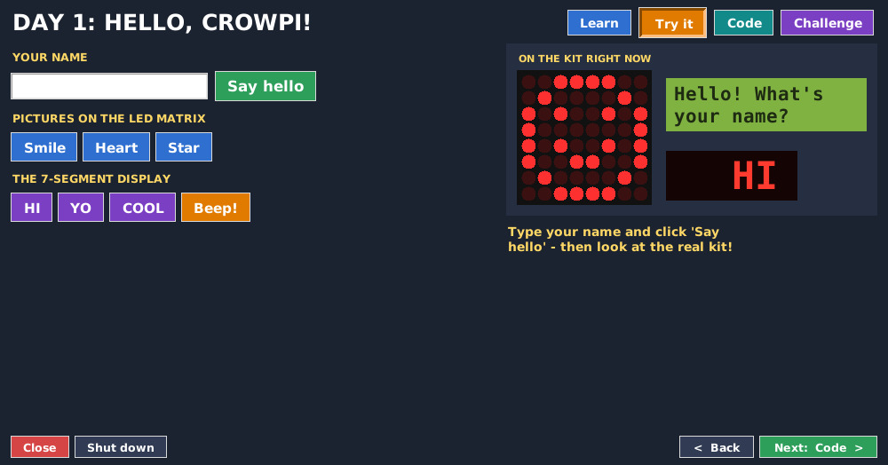
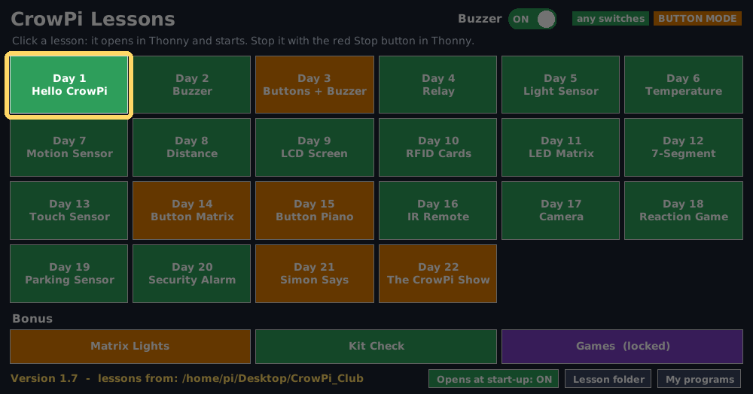
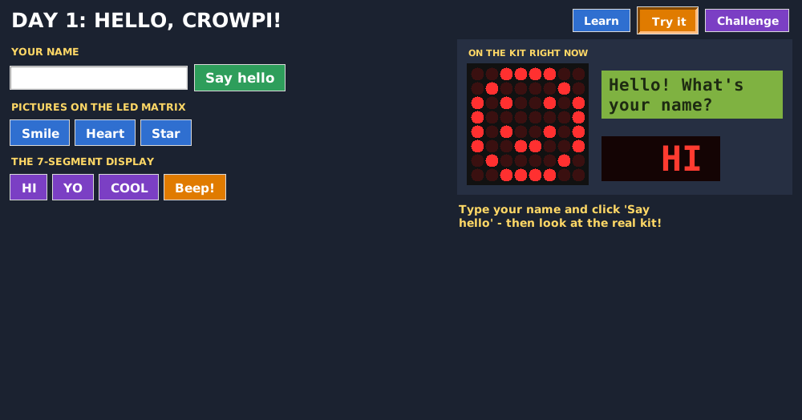
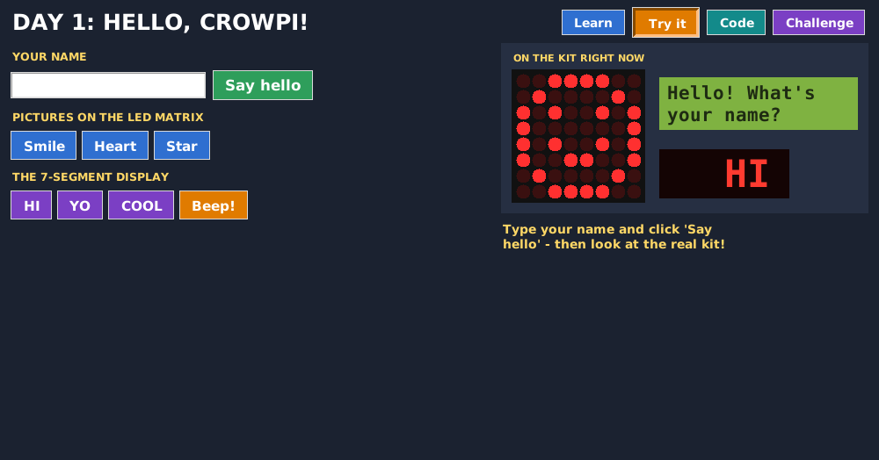
DAY
1
Meet Your Computer — Open the Lesson
Click Day 1 in CrowPi Lessons: it opens as an app. Type your name and the kit says hello!
THE LESSON APP
1. Learn: read the 5 cards.
2. Try it: play with the part.
3. Code: change the yellow values, then Upload to kit.
4. Challenge: the kit checks you - LESSON COMPLETE!
Next > (bottom right) = the next tab. Close = done.
Notes:
Before the club starts, set up every kit with install_crowpi.py (about a minute per kit). It installs the lessons, makes CrowPi Lessons the only icon on the Desktop and opens it at every start-up.

Slide 8


DAY
1
Meet Your Computer — Challenge
Got it running? Now prove it. Then push it further.
MAIN CHALLENGE
WIN OF THE DAY
Shut your computer down properly, then turn it back on, all by yourself with no help.
Every single person boots their own machine before we leave. High-five your neighbor when their screen turns on.
CODE MISSION (CODE TAB)
Open Day 1 again, go to the Code tab: Make the kit beep exactly 5 times and show a HEART.
Shutdown drill, kits checked in — see you next time!
Notes:
The solo shutdown and restart proves everyone can run their own kit. Write kit numbers on the roster while they do it.

Slide 9
DAY
2
Alert Tones: Buzzer
CrowPi Lesson 1 — Alert tones via the Buzzer.
TODAY YOU'LL LEARN
PARTS WE USE
ON makes a sound
Timing is everything
Patterns: doorbell, alarm, SOS
Buzzer
CrowPi Lessons app

Slide 10
DAY
2
Alert Tones: Buzzer — What You Need to Know
The three things from the last slide, actually explained.
ON makes a sound
1
The buzzer makes a sound while the program keeps it ON, and stops when it turns it OFF.
Timing is everything
2
A short ON = a short beep. Change how long it stays ON and how long it waits, and you can make patterns like a doorbell or SOS.
Can't hear it?
3
Check the buzzer switch in the CrowPi Lessons app is ON.

Slide 11
DAY
2
Alert Tones: Buzzer — Try It
Follow the steps in the lesson app. Watch the REAL kit, not just the screen.
Click Day 2 in CrowPi Lessons: the Buzzer app opens
Drag the slider: make the beep longer, then shorter
1
4
Read the 3 cards on the Learn tab
Play every pattern: Doorbell, Alarm, SOS, One long
2
5
Try it tab: click 'Beep once' and listen
Challenge tab: count the beeps, name the pattern
3
6
Notes:
Everything happens in the lesson window - no code to type. If nothing reacts on the kit, check the part (and BUTTON MODE for orange lessons). The Next button (bottom right) walks through the tabs; Close (bottom left) ends the lesson and closes Thonny.

Slide 12
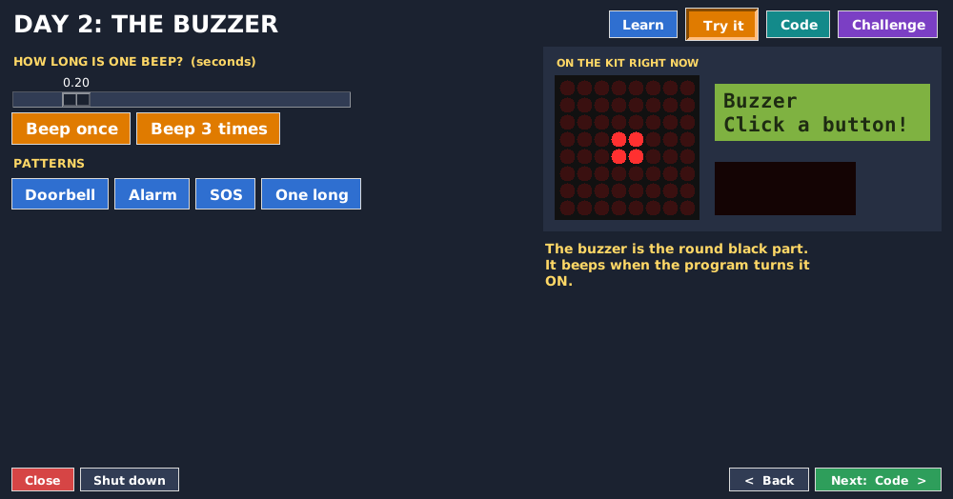
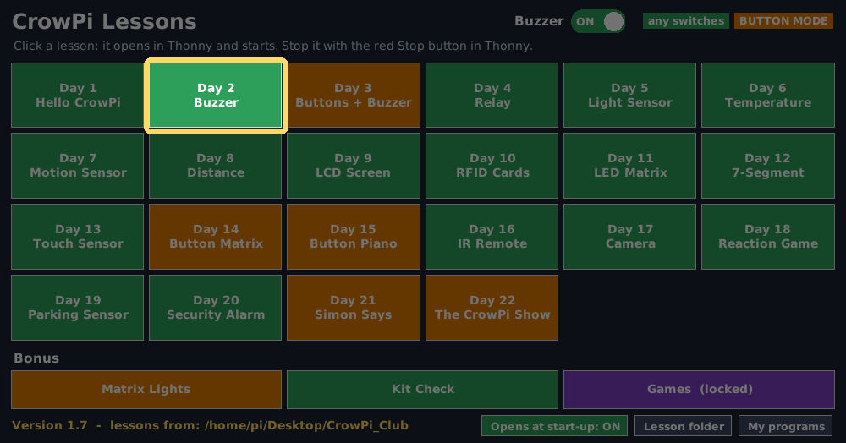
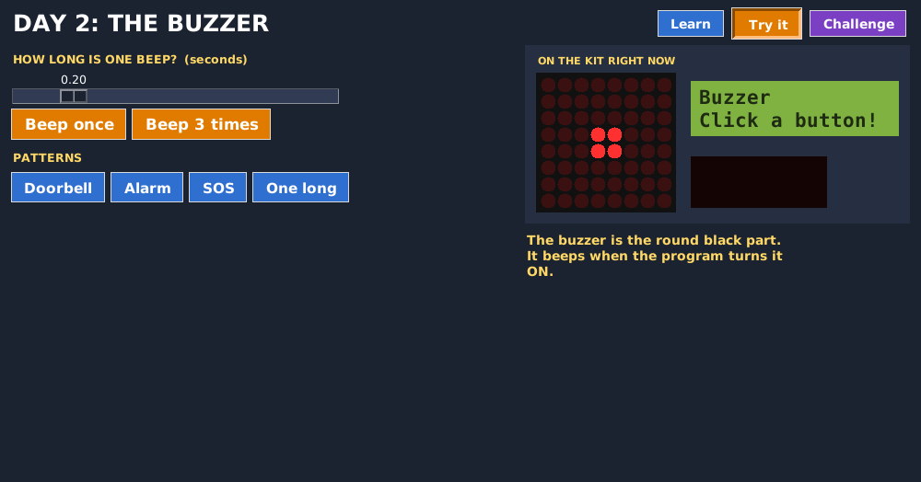
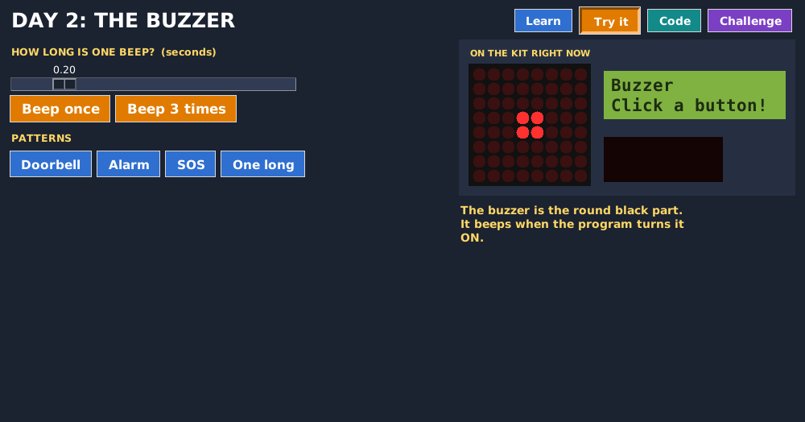
DAY
2
Alert Tones: Buzzer — Open the Lesson
Click Day 2 in CrowPi Lessons: it opens as an app. Switches: any.
THE LESSON APP
1. Learn: read the 5 cards.
2. Try it: play with the part.
3. Code: change the yellow values, then Upload to kit.
4. Challenge: the kit checks you - LESSON COMPLETE!
Next > (bottom right) = the next tab. Close = done.
Notes:
Click Day 2 in CrowPi Lessons. The lesson opens in its own window - Thonny opens behind it, nobody needs to touch it.

Slide 13
DAY
2
Alert Tones: Buzzer — Challenge
The Challenge tab checks you. Then push it further.
MAIN CHALLENGE
WIN OF THE DAY
Challenge tab: Count the beeps · Short or long? · Name that pattern · Fast or slow? · Which is longer?. All done = LESSON COMPLETE!
Your first lesson app - and you can hear the code working.
CODE MISSION (CODE TAB)
Make 3 LONG beeps: each one at least 1 second.
Shutdown drill, kits checked in — see you next time!
Notes:
The Challenge tab checks each task by itself - walk around and help. Fast finishers: the Code tab mission (change only the yellow values, then Upload to kit). Buzzer chaos? Flip the Buzzer switch in CrowPi Lessons OFF for quiet practice.

Slide 14
DAY
3
Catching Inputs: Buttons
CrowPi Lesson 2 — Catching user inputs using Buttons.
TODAY YOU'LL LEARN
PARTS WE USE
Inputs and outputs
Press = do something
BUTTON MODE
Push buttons
Buzzer
CrowPi Lessons app
Notes:
Concept of the day: inputs vs outputs. Write it on the board and point at it all session.

Slide 15
DAY
3
Catching Inputs: Buttons — What You Need to Know
The three things from the last slide, actually explained.
Inputs and outputs
1
A button is an INPUT: it tells the program something. The buzzer is an OUTPUT: the program tells it what to do.
Press = do something
2
The program keeps checking: is a button pressed? When it is, it beeps and shows that arrow.
BUTTON MODE
3
The arrow buttons only work when the DIP switches are set to BUTTON MODE.

Slide 16

DAY
3
Catching Inputs: Buttons — Try It
Follow the steps in the lesson app. Watch the REAL kit, not just the screen.
Set BUTTON MODE, click Day 3, press an arrow on Switch Check
Watch the tile light up on screen as you press
1
4
Read the Learn cards: inputs vs outputs
Listen: every arrow beeps a different length
2
5
Try it: press each arrow button on the kit
Challenge tab: all 4 arrows, UP x3, follow the arrows
3
6
Notes:
Everything happens in the lesson window - no code to type. If nothing reacts on the kit, check the part (and BUTTON MODE for orange lessons). The Next button (bottom right) walks through the tabs; Close (bottom left) ends the lesson and closes Thonny.

Slide 17
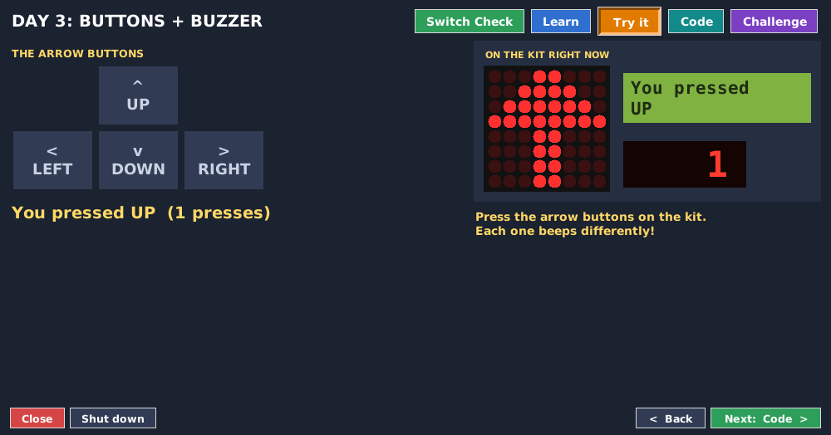
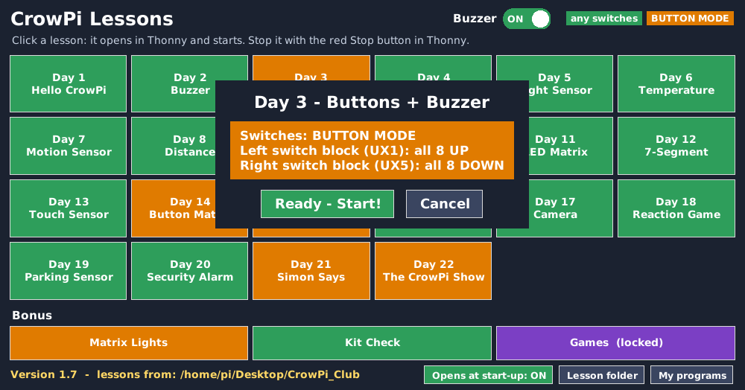
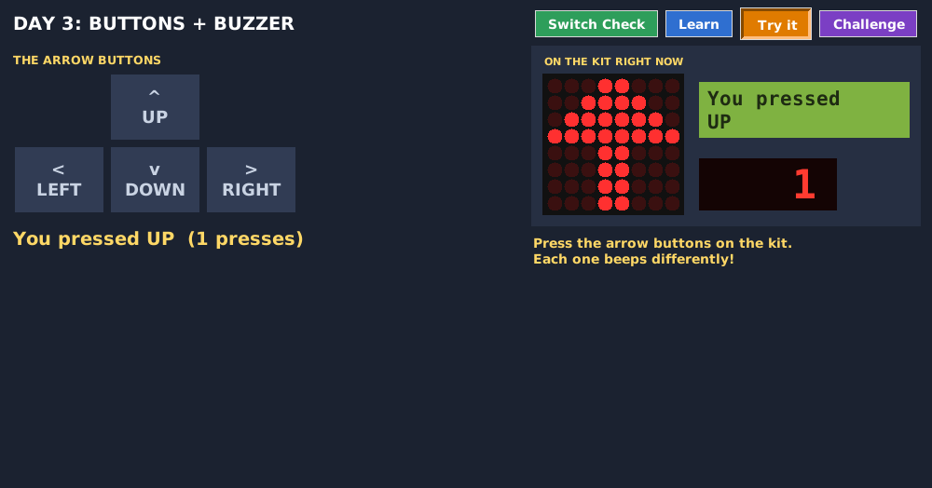
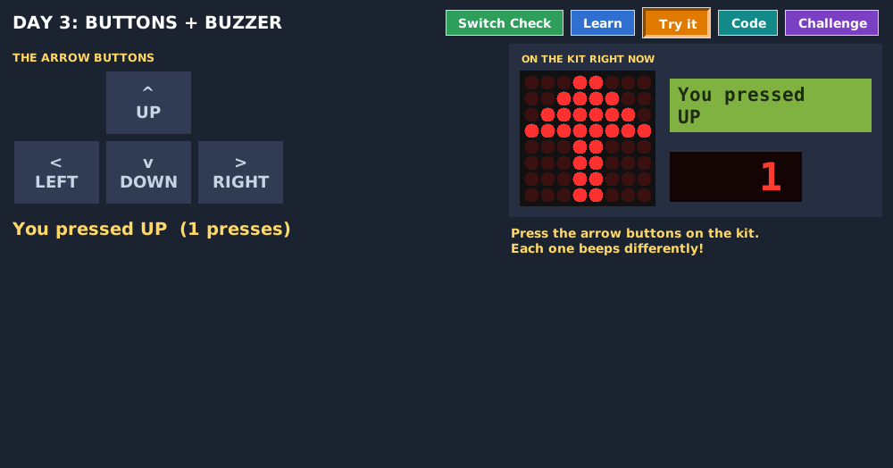
DAY
3
Catching Inputs: Buttons — Open the Lesson
Click Day 3 in CrowPi Lessons: it opens as an app. BUTTON MODE first.
THE LESSON APP
1. Learn: read the 5 cards.
2. Try it: play with the part.
3. Code: change the yellow values, then Upload to kit.
4. Challenge: the kit checks you - LESSON COMPLETE!
Next > (bottom right) = the next tab. Close = done.
Notes:
Click Day 3 in CrowPi Lessons. The lesson opens in its own window - Thonny opens behind it, nobody needs to touch it. First BUTTON MODE day: orange lessons show a Get ready window with the exact switches. Walk the class through the switches once.

Slide 18
DAY
3
Catching Inputs: Buttons — Challenge
The Challenge tab checks you. Then push it further.
MAIN CHALLENGE
WIN OF THE DAY
Challenge tab: Press all 4 arrows · UP three times · Follow the arrows · Arrow code · Ten presses. All done = LESSON COMPLETE!
Inputs + outputs: you pressed, the kit answered.
CODE MISSION (CODE TAB)
Make LEFT say your name, then press LEFT on the kit.
Shutdown drill, kits checked in — see you next time!
Notes:
The Challenge tab checks each task by itself - walk around and help. Fast finishers: the Code tab mission (change only the yellow values, then Upload to kit).

Slide 19
DAY
4
Big Switch: Relay
CrowPi Lesson 3 — Triggering high-voltage loops via the Relay.
TODAY YOU'LL LEARN
PARTS WE USE
A switch the computer flips
Small signal, big job
Watch the light
Relay module
Your ears
CrowPi Lessons app
Notes:
SAFETY TALK (30 seconds): we click the relay, we NEVER wire real high-voltage to it in club. The lesson is the concept.

Slide 20
DAY
4
Big Switch: Relay — What You Need to Know
The three things from the last slide, actually explained.
A switch the computer flips
1
A relay is a switch inside a little box. The program flips it ON and OFF - you hear it CLICK.
Small signal, big job
2
Real relays let a tiny computer switch big things like lamps, fans and pumps.
Watch the light
3
The little light next to the relay shows when it's ON.

Slide 21
DAY
4
Big Switch: Relay — Try It
Follow the steps in the lesson app. Watch the REAL kit, not just the screen.
Click Day 4: the Relay app opens
Watch the little light next to the relay
1
4
Read the Learn cards: a switch the computer flips
Click 'Fast clicks' and count them
2
5
Try it: click ON and OFF - listen for the CLICK
Challenge tab: count clicks, ON or OFF, touch light switch
3
6
Notes:
Everything happens in the lesson window - no code to type. If nothing reacts on the kit, check the part (and BUTTON MODE for orange lessons). The Next button (bottom right) walks through the tabs; Close (bottom left) ends the lesson and closes Thonny.

Slide 22
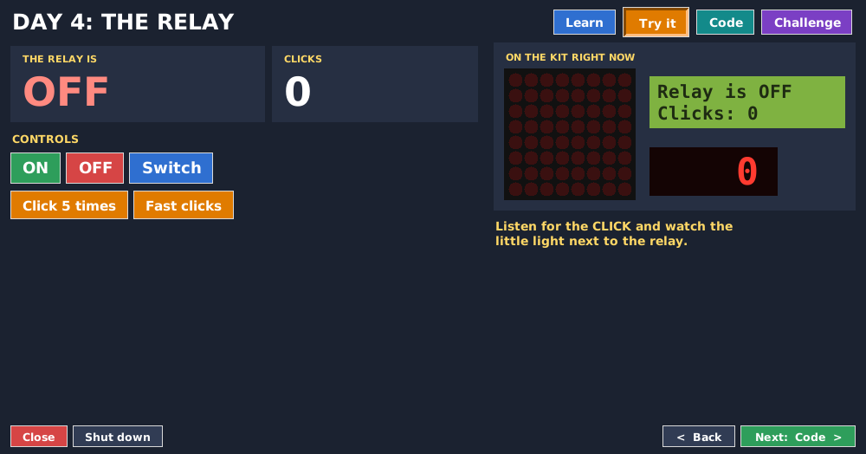
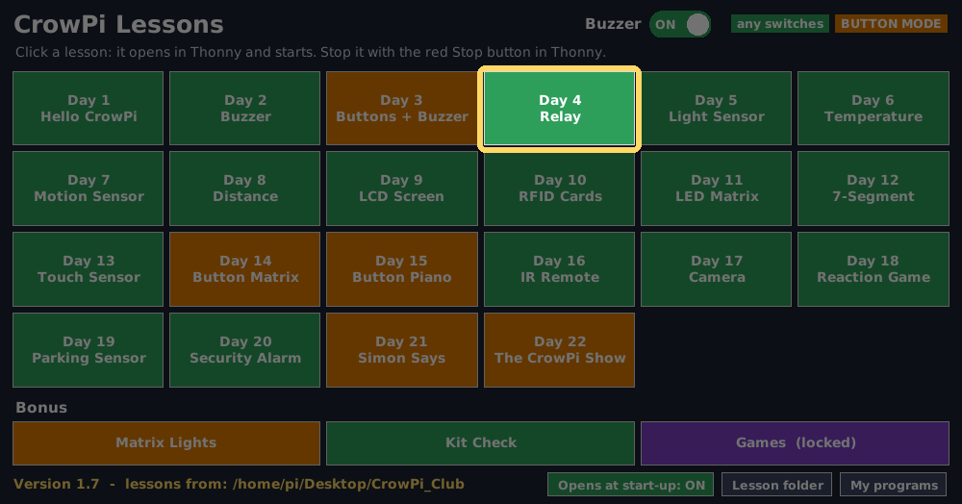
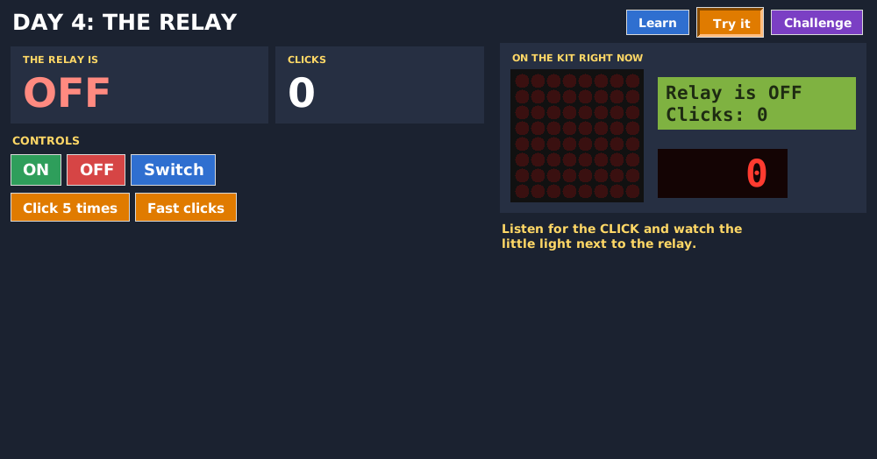
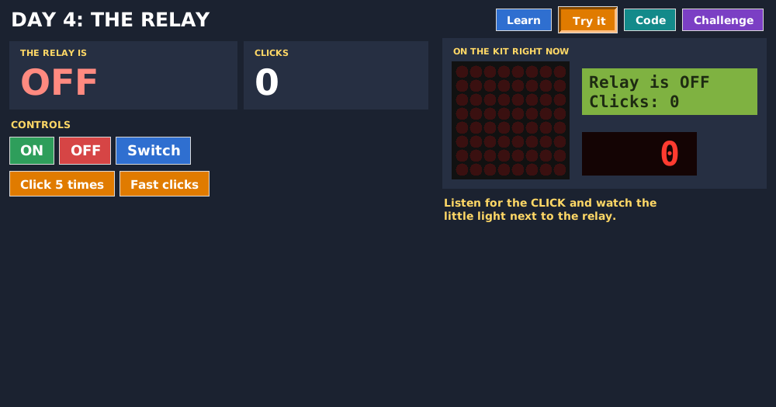
DAY
4
Big Switch: Relay — Open the Lesson
Click Day 4 in CrowPi Lessons: it opens as an app. Switches: any.
THE LESSON APP
1. Learn: read the 5 cards.
2. Try it: play with the part.
3. Code: change the yellow values, then Upload to kit.
4. Challenge: the kit checks you - LESSON COMPLETE!
Next > (bottom right) = the next tab. Close = done.
Notes:
Click Day 4 in CrowPi Lessons. The lesson opens in its own window - Thonny opens behind it, nobody needs to touch it.

Slide 23
DAY
4
Big Switch: Relay — Challenge
The Challenge tab checks you. Then push it further.
MAIN CHALLENGE
WIN OF THE DAY
Challenge tab: Count the clicks · ON or OFF? · Make a light switch · Fast or slow clicks? · Hold it ON. All done = LESSON COMPLETE!
A computer flipping a real switch - that's how smart homes work.
CODE MISSION (CODE TAB)
Make a heartbeat: 10 clicks, faster than 0.2 seconds OFF.
Shutdown drill, kits checked in — see you next time!
Notes:
The Challenge tab checks each task by itself - walk around and help. Fast finishers: the Code tab mission (change only the yellow values, then Upload to kit). SAFETY: we only listen to the click - never connect real power to the relay.

Slide 24
DAY
5
Light Tracking: Light Sensor
CrowPi Lesson 4 — Environmental tracking using the Light Sensor.
TODAY YOU'LL LEARN
PARTS WE USE
It measures light
Dark to bright
Machines that see light
Light sensor
LED matrix
CrowPi Lessons app
Notes:
Thresholds come back on Day 19 (parking sensor) — call that out. Skills repeating across sensors is the curriculum working.

Slide 25
DAY
5
Light Tracking: Light Sensor — What You Need to Know
The three things from the last slide, actually explained.
It measures light
1
The light sensor measures how bright it is, in LUX.
Dark to bright
2
A dark cupboard is about 1 lux, a classroom about 300, and sunshine over 10,000!
Machines that see light
3
Phones use one to dim the screen. Street lights use one to turn on at night.

Slide 26
DAY
5
Light Tracking: Light Sensor — Try It
Follow the steps in the lesson app. Watch the REAL kit, not just the screen.
Click Day 5: the Light Sensor app opens
Cover the sensor - watch the graph drop
1
4
Read the Learn cards: what lux means
Turn on 'Night light' and make it dark
2
5
Try it: watch the live lux number and the graph
Challenge tab: dark, bright, then exactly halfway
3
6
Notes:
Everything happens in the lesson window - no code to type. If nothing reacts on the kit, check the part (and BUTTON MODE for orange lessons). The Next button (bottom right) walks through the tabs; Close (bottom left) ends the lesson and closes Thonny.

Slide 27
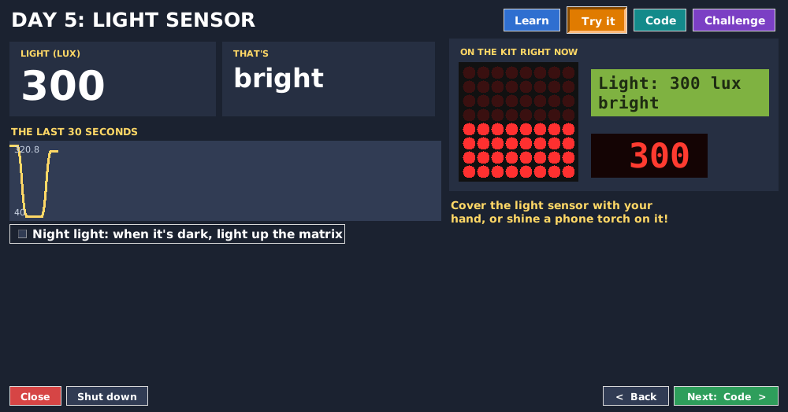
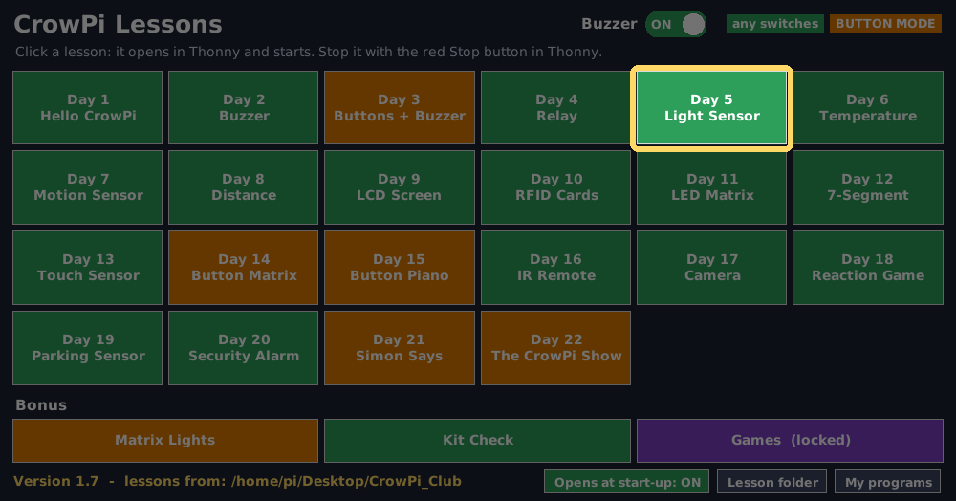
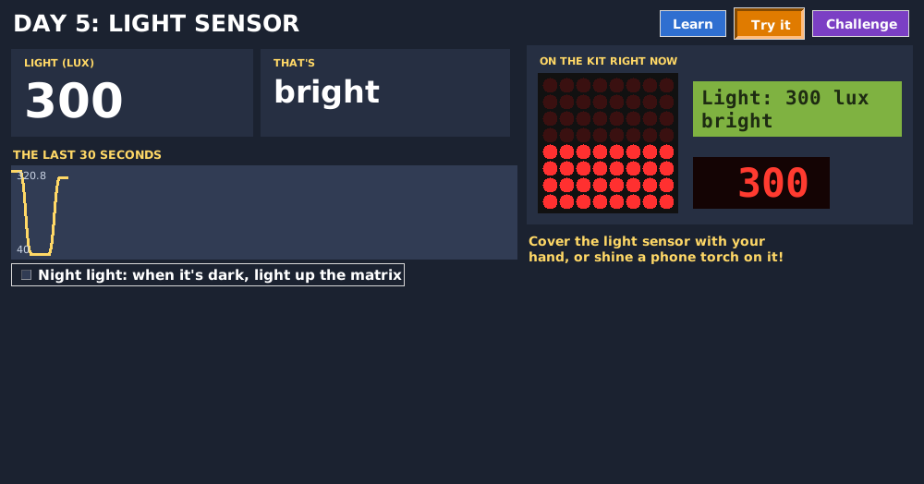
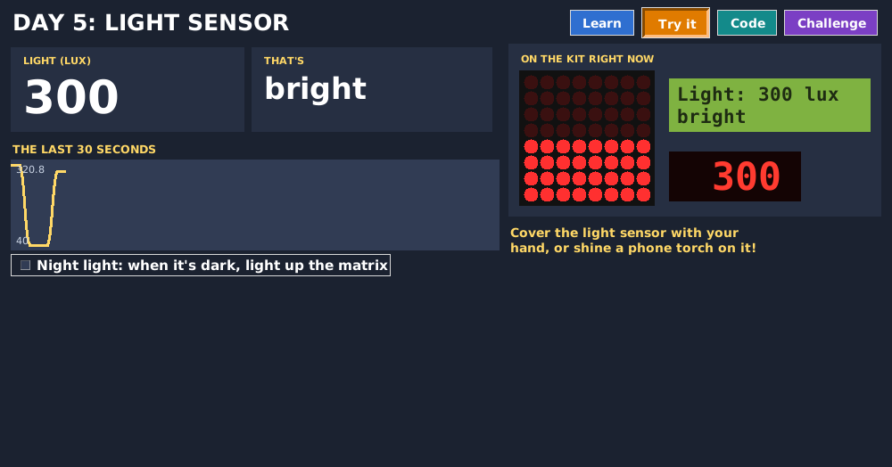
DAY
5
Light Tracking: Light Sensor — Open the Lesson
Click Day 5 in CrowPi Lessons: it opens as an app. Switches: any.
THE LESSON APP
1. Learn: read the 5 cards.
2. Try it: play with the part.
3. Code: change the yellow values, then Upload to kit.
4. Challenge: the kit checks you - LESSON COMPLETE!
Next > (bottom right) = the next tab. Close = done.
Notes:
Click Day 5 in CrowPi Lessons. The lesson opens in its own window - Thonny opens behind it, nobody needs to touch it.

Slide 28
DAY
5
Light Tracking: Light Sensor — Challenge
The Challenge tab checks you. Then push it further.
MAIN CHALLENGE
WIN OF THE DAY
Challenge tab: Make it dark · Make it bright · Halfway · Blink the light · Super dark. All done = LESSON COMPLETE!
Your kit can see light now.
CODE MISSION (CODE TAB)
Change the night picture to FULL and make it say Night time when you cover the sensor.
Shutdown drill, kits checked in — see you next time!
Notes:
The Challenge tab checks each task by itself - walk around and help. Fast finishers: the Code tab mission (change only the yellow values, then Upload to kit).

Slide 29
DAY
6
Atmosphere Data: DHT20
CrowPi Lesson 5 — Reading atmosphere data with the DHT20.
TODAY YOU'LL LEARN
PARTS WE USE
Two readings in one
Celsius
Your breath is warm and wet
DHT20 temp/humidity
sensor
Output window
Notes:
Science tie-in day — invite the science teacher to drop by. Great ally for the club.

Slide 30
DAY
6
Atmosphere Data: DHT20 — What You Need to Know
The three things from the last slide, actually explained.
Two readings in one
1
The DHT20 sensor measures the TEMPERATURE (how warm) and the HUMIDITY (how much water is in the air).
Celsius
2
Room temperature is about 20 C. Water freezes at 0 C and boils at 100 C.
Your breath is warm and wet
3
Breathe on the sensor and both numbers go up!

Slide 31

DAY
6
Atmosphere Data: DHT20 — Try It
Follow the steps in the lesson app. Watch the REAL kit, not just the screen.
Click Day 6: the Temperature app opens
Breathe gently on the sensor - watch both rise
1
4
Read the Learn cards: temperature AND humidity
Turn on 'Show Fahrenheit' and compare
2
5
Try it: read both numbers and the two graphs
Challenge tab: read it, breathe on it, humid or dry?
3
6
Notes:
Everything happens in the lesson window - no code to type. If nothing reacts on the kit, check the part (and BUTTON MODE for orange lessons). The Next button (bottom right) walks through the tabs; Close (bottom left) ends the lesson and closes Thonny.

Slide 32
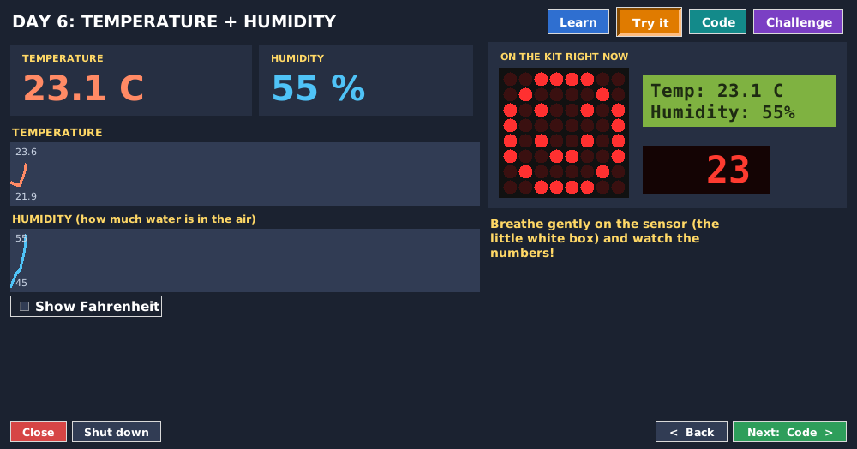
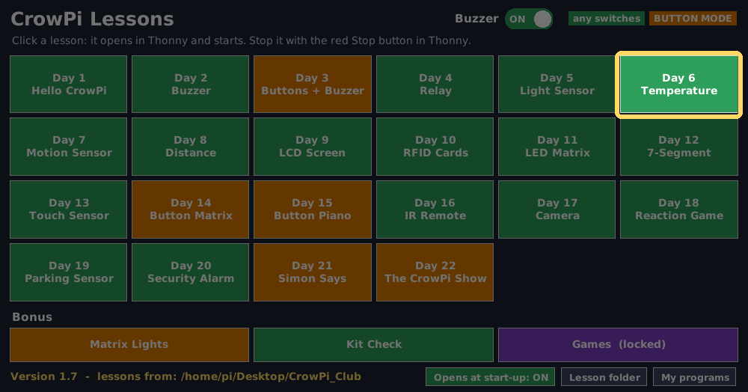
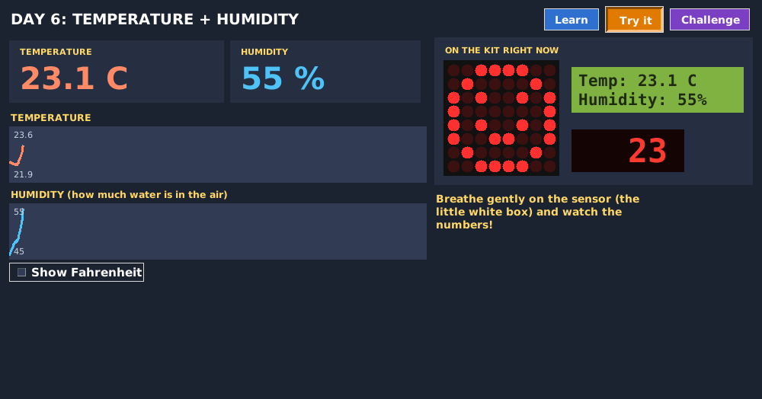
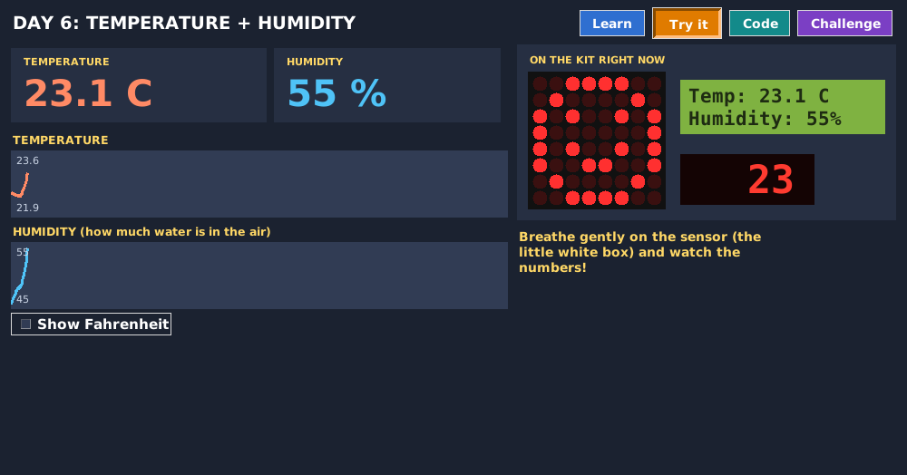
DAY
6
Atmosphere Data: DHT20 — Open the Lesson
Click Day 6 in CrowPi Lessons: it opens as an app. Switches: any.
THE LESSON APP
1. Learn: read the 5 cards.
2. Try it: play with the part.
3. Code: change the yellow values, then Upload to kit.
4. Challenge: the kit checks you - LESSON COMPLETE!
Next > (bottom right) = the next tab. Close = done.
Notes:
Click Day 6 in CrowPi Lessons. The lesson opens in its own window - Thonny opens behind it, nobody needs to touch it.

Slide 33
DAY
6
Atmosphere Data: DHT20 — Challenge
The Challenge tab checks you. Then push it further.
MAIN CHALLENGE
WIN OF THE DAY
Challenge tab: Read the temperature · Breathe on it · Cool down · Humid or dry? · Celsius to Fahrenheit. All done = LESSON COMPLETE!
Real weather data, measured by you.
CODE MISSION (CODE TAB)
Make it say TOO HOT in this room (set too_hot lower than the temperature).
Shutdown drill, kits checked in — see you next time!
Notes:
The Challenge tab checks each task by itself - walk around and help. Fast finishers: the Code tab mission (change only the yellow values, then Upload to kit).

Slide 34
DAY
7
Weather Station
CrowPi Lesson 6 — Your own weather station: temperature, humidity and light.
TODAY YOU'LL LEARN
PARTS WE USE
All together
Readings take turns
Day or night?
Comfort zone
Real weather stations
Temperature sensor (DHT20)
Light sensor
LCD, 7-segment, LED matrix
Notes:
Three sensors in one app: the temperature sensor (Day 6), the light sensor (Day 5) and every screen. Real weather stations work exactly like this.

Slide 35
DAY
7
Weather Station — What You Need to Know
The three things from the last slide, actually explained.
All together
1
A weather station reads several sensors and reports them all: temperature, humidity and light.
Readings take turns
2
The LCD only has two lines, so the station shows one reading at a time, every 3 seconds.
Day or night?
3
The light sensor tells the station if it's day or night - under 10 lux shows the moon.

Slide 36
DAY
7
Weather Station — Try It
Follow the steps in the lesson app. Watch the REAL kit, not just the screen.
Click Day 7: the Weather Station app opens
Give your station a name - watch the LCD
1
4
Read the Learn cards: three sensors in one station
Cover the light sensor: the moon comes out
2
5
Try it: read temperature, humidity and light
Challenge tab: name it, read it, night, breathe
3
6
Notes:
Everything happens in the lesson window - no code to type. If nothing reacts on the kit, check the part (and BUTTON MODE for orange lessons). The Next button (bottom right) walks through the tabs; Close (bottom left) ends the lesson and closes Thonny.

Slide 37
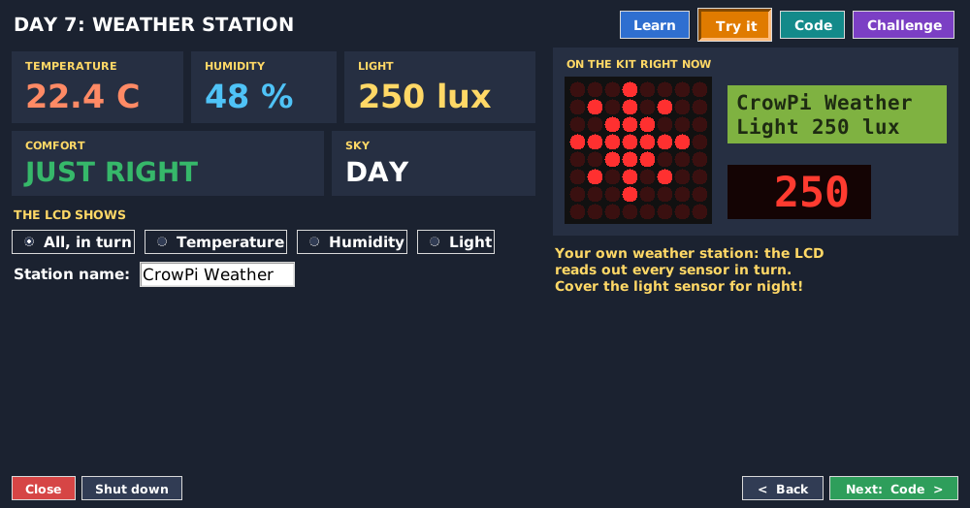
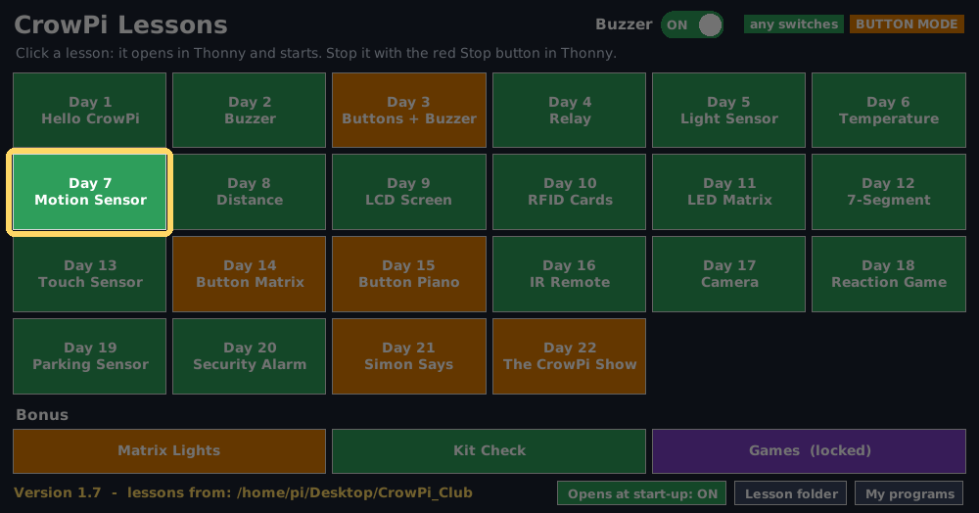
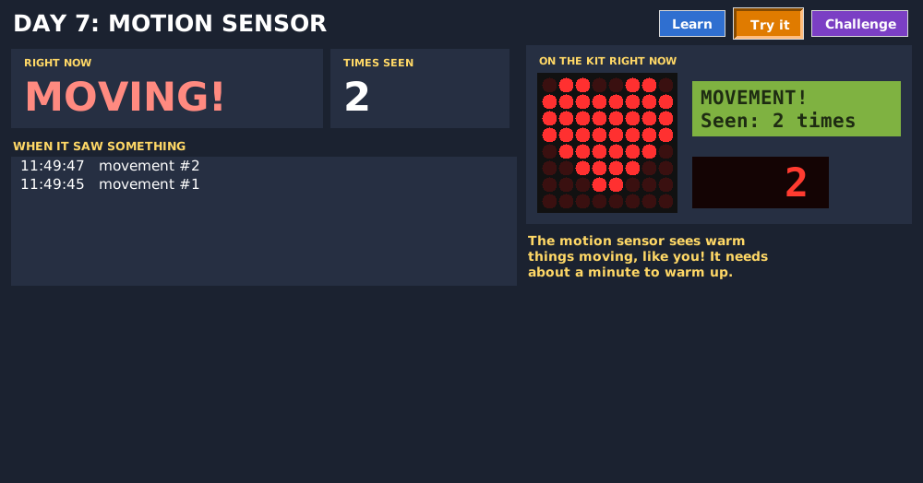
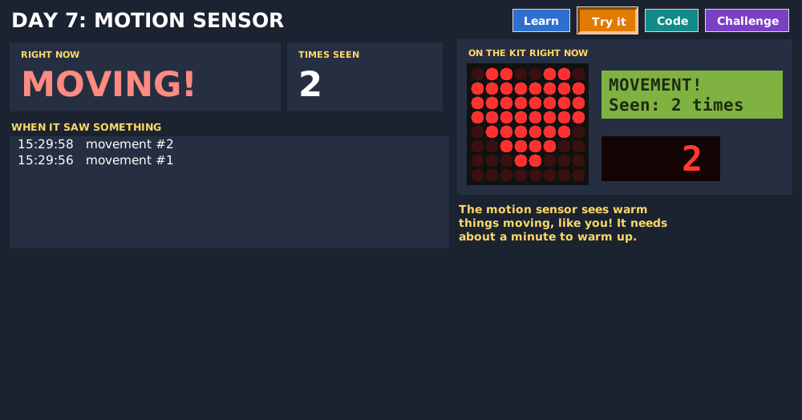
DAY
7
Weather Station — Open the Lesson
Click Day 7 in CrowPi Lessons: it opens as an app. Switches: any.
THE LESSON APP
1. Learn: read the 5 cards.
2. Try it: play with the part.
3. Code: change the yellow values, then Upload to kit.
4. Challenge: the kit checks you - LESSON COMPLETE!
Next > (bottom right) = the next tab. Close = done.
Notes:
Click Day 7 in CrowPi Lessons. The lesson opens in its own window - Thonny opens behind it, nobody needs to touch it. Uses the Day 5 and Day 6 sensors together - call that out.

Slide 38
DAY
7
Weather Station — Challenge
The Challenge tab checks you. Then push it further.
MAIN CHALLENGE
WIN OF THE DAY
Challenge tab: Name your station · Read the weather · Comfort check · Make it night · Change the weather. All done = LESSON COMPLETE!
Your own weather station, reporting live.
CODE MISSION (CODE TAB)
Give your station its own name, make the night picture a HEART - then cover the light sensor.
Shutdown drill, kits checked in — see you next time!
Notes:
The Challenge tab checks each task by itself - walk around and help. Fast finishers: the Code tab mission (change only the yellow values, then Upload to kit).

Slide 39
DAY
8
Ping Radar: Ultrasonic
CrowPi Lesson 7 — Calculating distances via Ultrasonic Ping Radar.
TODAY YOU'LL LEARN
PARTS WE USE
It uses sound
Echo time = distance
Like a bat!
Ultrasonic sensor
Buzzer
CrowPi Lessons app

Slide 40
DAY
8
Ping Radar: Ultrasonic — What You Need to Know
The three things from the last slide, actually explained.
It uses sound
1
The ultrasonic sensor sends out a sound too high for us to hear and listens for the echo.
Echo time = distance
2
The longer the echo takes to come back, the further away the thing is.
Like a bat!
3
Bats and dolphins find things the same way.

Slide 41

DAY
8
Ping Radar: Ultrasonic — Try It
Follow the steps in the lesson app. Watch the REAL kit, not just the screen.
Click Day 8: the Distance app opens
Watch the graph and the bar follow your hand
1
4
Read the Learn cards: sound out, echo back
Find the closest and furthest it can see
2
5
Try it: move your hand closer and further
Challenge tab: really close, just right, far away
3
6
Notes:
Everything happens in the lesson window - no code to type. If nothing reacts on the kit, check the part (and BUTTON MODE for orange lessons). The Next button (bottom right) walks through the tabs; Close (bottom left) ends the lesson and closes Thonny.

Slide 42
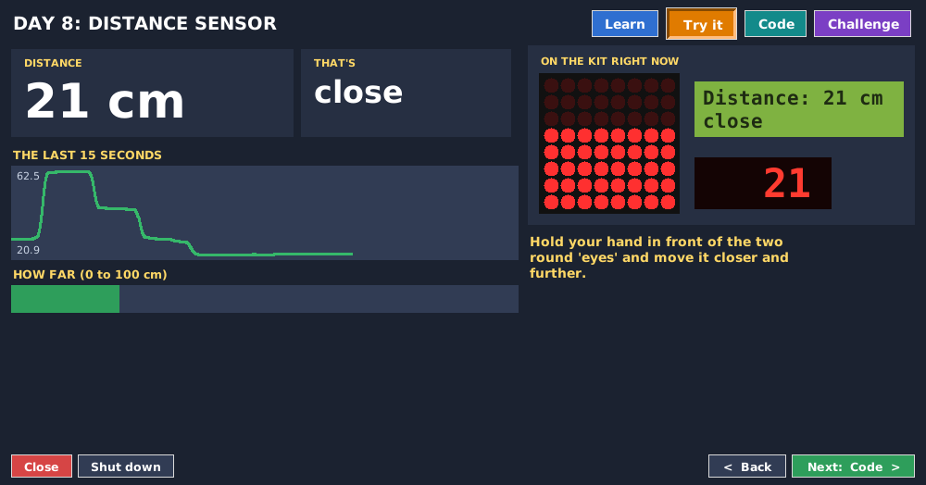
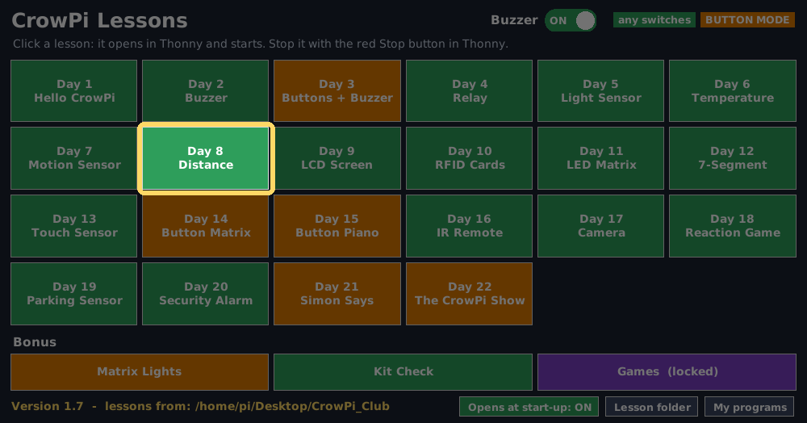
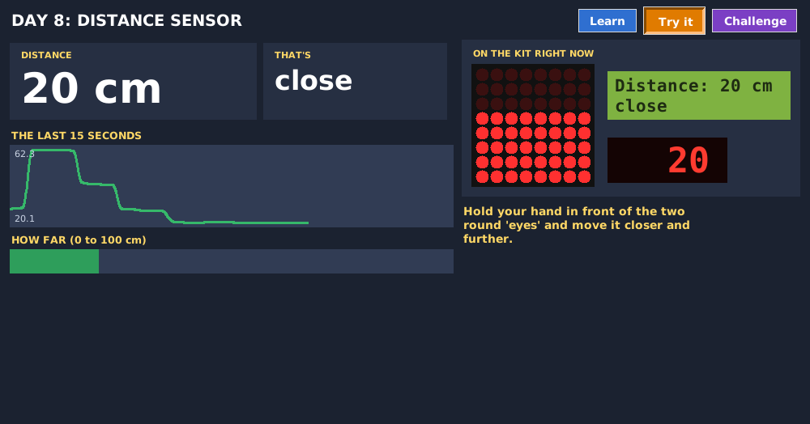
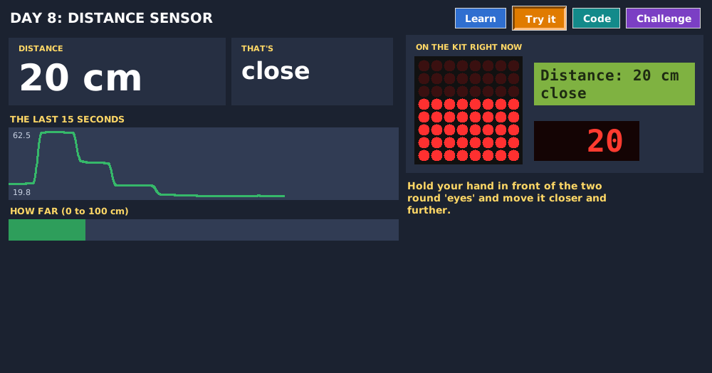
DAY
8
Ping Radar: Ultrasonic — Open the Lesson
Click Day 8 in CrowPi Lessons: it opens as an app. Switches: any.
THE LESSON APP
1. Learn: read the 5 cards.
2. Try it: play with the part.
3. Code: change the yellow values, then Upload to kit.
4. Challenge: the kit checks you - LESSON COMPLETE!
Next > (bottom right) = the next tab. Close = done.
Notes:
Click Day 8 in CrowPi Lessons. The lesson opens in its own window - Thonny opens behind it, nobody needs to touch it.

Slide 43
DAY
8
Ping Radar: Ultrasonic — Challenge
The Challenge tab checks you. Then push it further.
MAIN CHALLENGE
WIN OF THE DAY
Challenge tab: Really close · Just right · Far away · Exactly 15 · Zoom in. All done = LESSON COMPLETE!
Bats do this in the dark. Now your kit can too.
CODE MISSION (CODE TAB)
Make it warn you at 30 cm with the FULL picture, then test it with your hand.
Shutdown drill, kits checked in — see you next time!
Notes:
The Challenge tab checks each task by itself - walk around and help. Fast finishers: the Code tab mission (change only the yellow values, then Upload to kit).

Slide 44
DAY
9
Words on Screen: LCD
CrowPi Lesson 8 — Interfacing strings to the LCD Display.
TODAY YOU'LL LEARN
PARTS WE USE
Words on a screen
The program sends letters
Light behind it
16x2 LCD display
CrowPi Lessons app
Notes:
LCD is the workhorse: from today on, 'show it on the LCD' upgrades every project.

Slide 45
DAY
9
Words on Screen: LCD — What You Need to Know
The three things from the last slide, actually explained.
Words on a screen
1
The LCD shows letters and numbers: 2 lines of 16 letters each.
The program sends letters
2
Your program sends the letters one at a time over two little wires (called I2C).
Light behind it
3
The backlight can be turned ON and OFF.

Slide 46
DAY
9
Words on Screen: LCD — Try It
Follow the steps in the lesson app. Watch the REAL kit, not just the screen.
Click Day 9: the LCD app opens
Type something too long - what happens?
1
4
Read the Learn cards: 2 lines of 16 letters
Click 'Scroll line 1', then the light ON/OFF
2
5
Try it: type two lines and click 'Show it'
Challenge tab: your name, secret word, two lines
3
6
Notes:
Everything happens in the lesson window - no code to type. If nothing reacts on the kit, check the part (and BUTTON MODE for orange lessons). The Next button (bottom right) walks through the tabs; Close (bottom left) ends the lesson and closes Thonny.

Slide 47
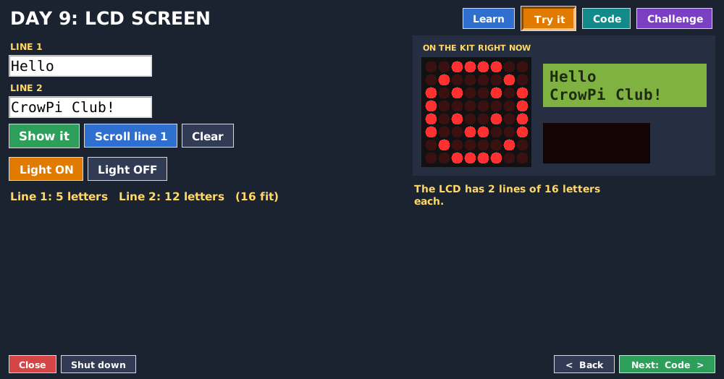
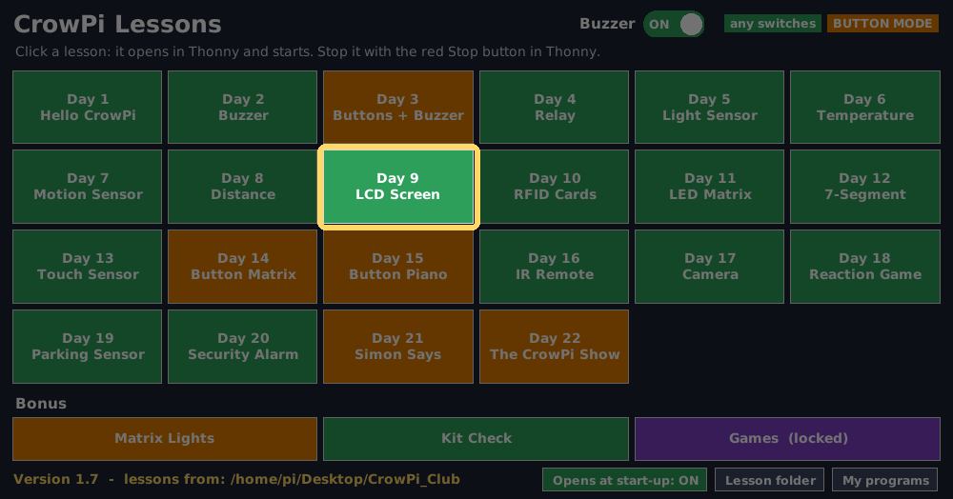
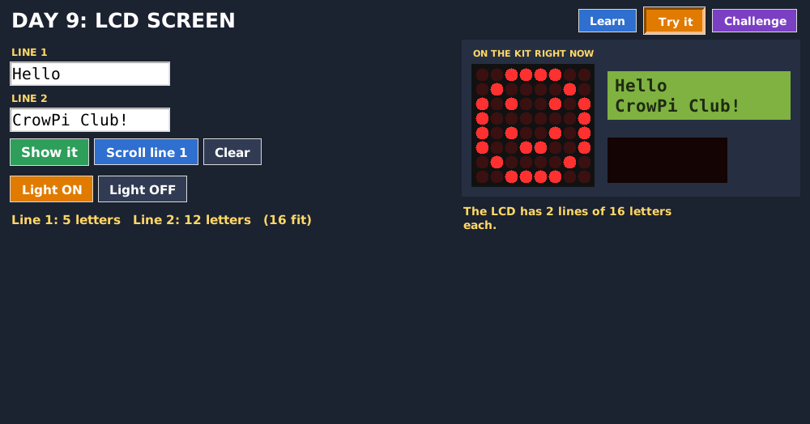
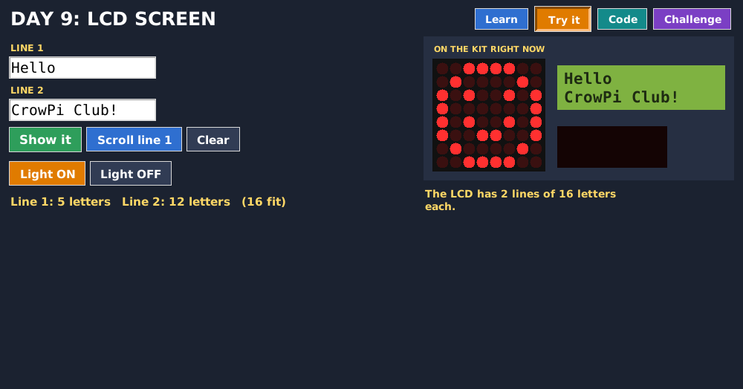
DAY
9
Words on Screen: LCD — Open the Lesson
Click Day 9 in CrowPi Lessons: it opens as an app. Switches: any.
THE LESSON APP
1. Learn: read the 5 cards.
2. Try it: play with the part.
3. Code: change the yellow values, then Upload to kit.
4. Challenge: the kit checks you - LESSON COMPLETE!
Next > (bottom right) = the next tab. Close = done.
Notes:
Click Day 9 in CrowPi Lessons. The lesson opens in its own window - Thonny opens behind it, nobody needs to touch it.

Slide 48
DAY
9
Words on Screen: LCD — Challenge
The Challenge tab checks you. Then push it further.
MAIN CHALLENGE
WIN OF THE DAY
Challenge tab: Hi there! · Secret word · Two lines · Which line? · How many letters?. All done = LESSON COMPLETE!
Words on a real screen - from you.
CODE MISSION (CODE TAB)
Write a 2-screen joke: question on screen 1, answer on screen 2.
Shutdown drill, kits checked in — see you next time!
Notes:
The Challenge tab checks each task by itself - walk around and help. Fast finishers: the Code tab mission (change only the yellow values, then Upload to kit).

Slide 49
DAY
10
Keycards: NFC / RFID
CrowPi Lesson 9 — Log-ins and security cards using NFC/RFID Tags.
TODAY YOU'LL LEARN
PARTS WE USE
Every tag has a unique ID burned in
Comparing values: IF scanned ID equals MY ID, unlock
This is literally how school badges and hotel keys work
RFID card + fob
RFID reader
Buzzer + matrix
Notes:
Keep each kit's card/fob with its own kit — mixed cards = mixed IDs = chaos.

Slide 50
DAY
10
Keycards: NFC / RFID — What You Need to Know
The three things from the last slide, actually explained.
Every tag has a unique ID
1
Each RFID card and fob has a serial number burned in at the factory — no two alike. The reader powers the card wirelessly (no battery in it!) and the card answers with its ID.
Comparing values to unlock
2
The lock is one line: if scanned_id == my_id: unlock(). The double equals == means 'is equal to?' — a question, not an assignment. Get that ID right, character for character.
How school badges really work
3
Badge readers, hotel doors, and tap-to-pay all run this exact check against a list of approved IDs. The only difference from your build: their list lives on a server.

Slide 51

DAY
10
Keycards: NFC / RFID — Try It
Follow the steps in the lesson app. Watch the REAL kit, not just the screen.
Get the white card or blue tag, click Day 10
Type a message and click 'Write it'
1
4
Read the Learn cards: a chip with no battery
Click 'Read it' and hold the card still
2
5
Try it: tap the card - its number appears
Challenge tab: tap, write your name, read it back
3
6
Notes:
Everything happens in the lesson window - no code to type. If nothing reacts on the kit, check the part (and BUTTON MODE for orange lessons). The Next button (bottom right) walks through the tabs; Close (bottom left) ends the lesson and closes Thonny.

Slide 52
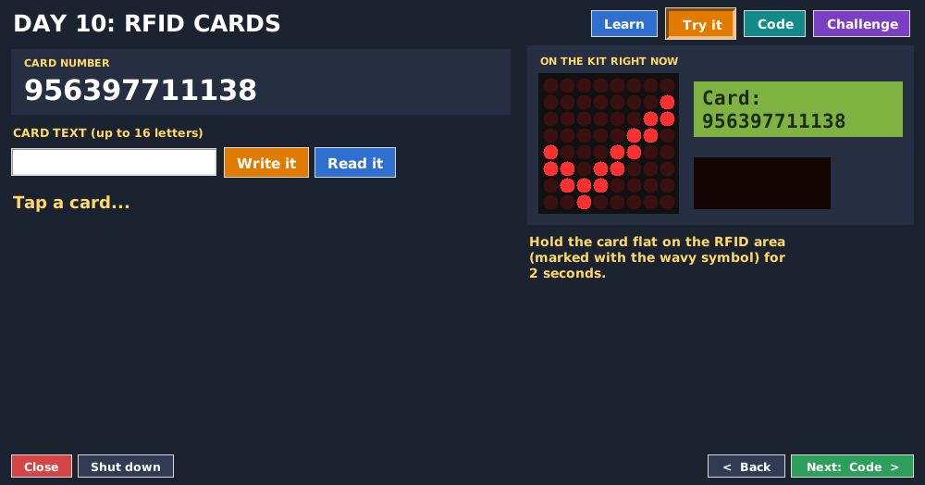
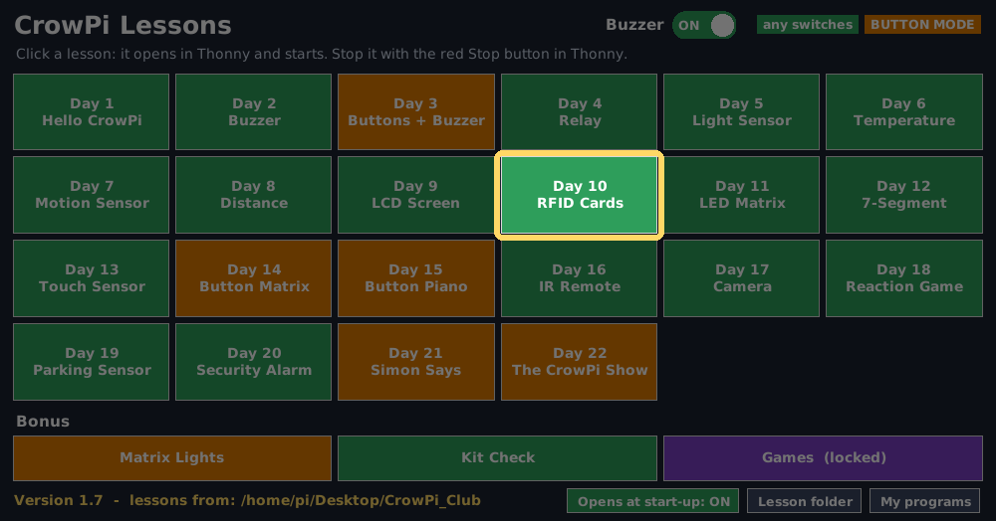
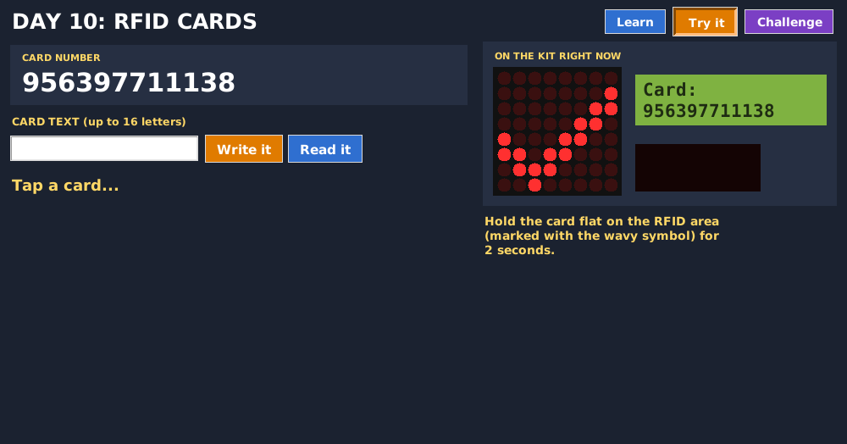
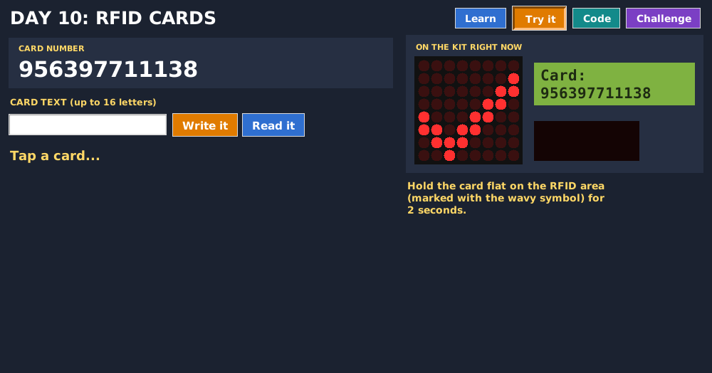
DAY
10
Keycards: NFC / RFID — Open the Lesson
Click Day 10 in CrowPi Lessons: it opens as an app. Have the white card or blue tag ready.
THE LESSON APP
1. Learn: read the 5 cards.
2. Try it: play with the part.
3. Code: change the yellow values, then Upload to kit.
4. Challenge: the kit checks you - LESSON COMPLETE!
Next > (bottom right) = the next tab. Close = done.
Notes:
Click Day 10 in CrowPi Lessons. The lesson opens in its own window - Thonny opens behind it, nobody needs to touch it. Keep each kit's card and tag with its own kit.

Slide 53
DAY
10
Keycards: NFC / RFID — Challenge
The Challenge tab checks you. Then push it further.
MAIN CHALLENGE
WIN OF THE DAY
Challenge tab: Tap a card · Write on the card · Read it back · Tap three times · Hold it still. All done = LESSON COMPLETE!
A card that remembers your name - just like a bus pass.
CODE MISSION (CODE TAB)
Make the card show a HEART and say your own welcome, then tap it.
Shutdown drill, kits checked in — see you next time!
Notes:
The Challenge tab checks each task by itself - walk around and help. Fast finishers: the Code tab mission (change only the yellow values, then Upload to kit).

Slide 54
DAY
11
Animations: 8x8 Matrix
CrowPi Lesson 10 — Dynamic character animations on the 8x8 Matrix LED.
TODAY YOU'LL LEARN
PARTS WE USE
64 little lights
Pictures from dots
Moving words
8x8 LED matrix
Graph paper (helps!)
CrowPi Lessons app
Notes:
Hand out graph paper — sketching 8x8 on paper first saves everyone 15 minutes of confusion.

Slide 55
DAY
11
Animations: 8x8 Matrix — What You Need to Know
The three things from the last slide, actually explained.
64 little lights
1
The LED matrix has 8 rows and 8 columns of red lights = 64 lights.
Pictures from dots
2
Turn on the right dots and you get a picture: a smile, a heart, letters.
Moving words
3
Move the picture one dot at a time and words scroll across.

Slide 56
DAY
11
Animations: 8x8 Matrix — Try It
Follow the steps in the lesson app. Watch the REAL kit, not just the screen.
Click Day 11: the LED Matrix app opens
Try the ready-made pictures and 'Flip colours'
1
4
Read the Learn cards: 64 little lights
Type a word and click 'Scroll'
2
5
Try it: click the dots to draw on the real matrix
Challenge tab: which picture, draw 10 lights, corners
3
6
Notes:
Everything happens in the lesson window - no code to type. If nothing reacts on the kit, check the part (and BUTTON MODE for orange lessons). The Next button (bottom right) walks through the tabs; Close (bottom left) ends the lesson and closes Thonny.

Slide 57
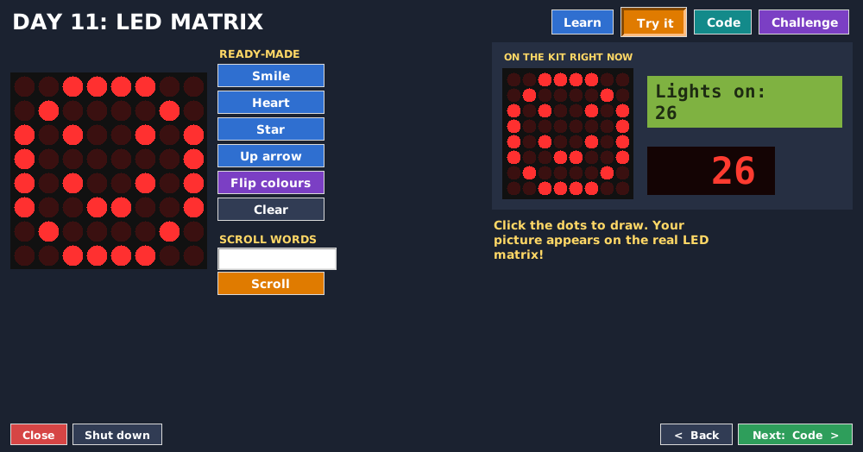
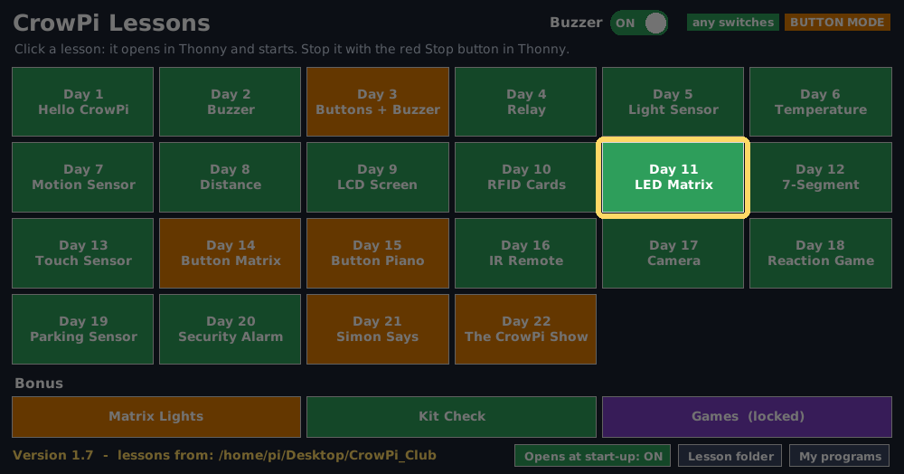
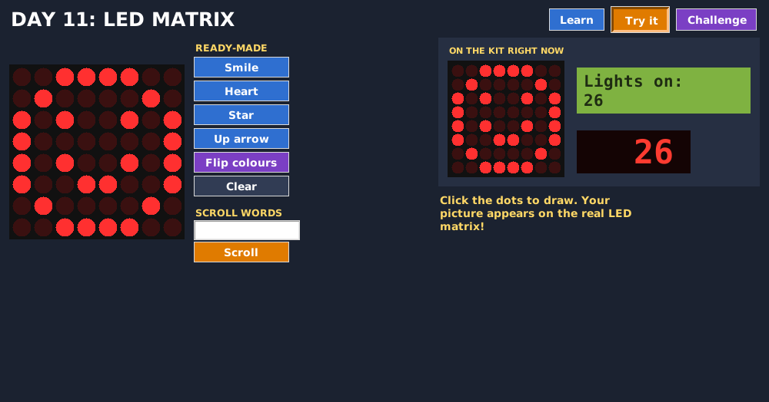
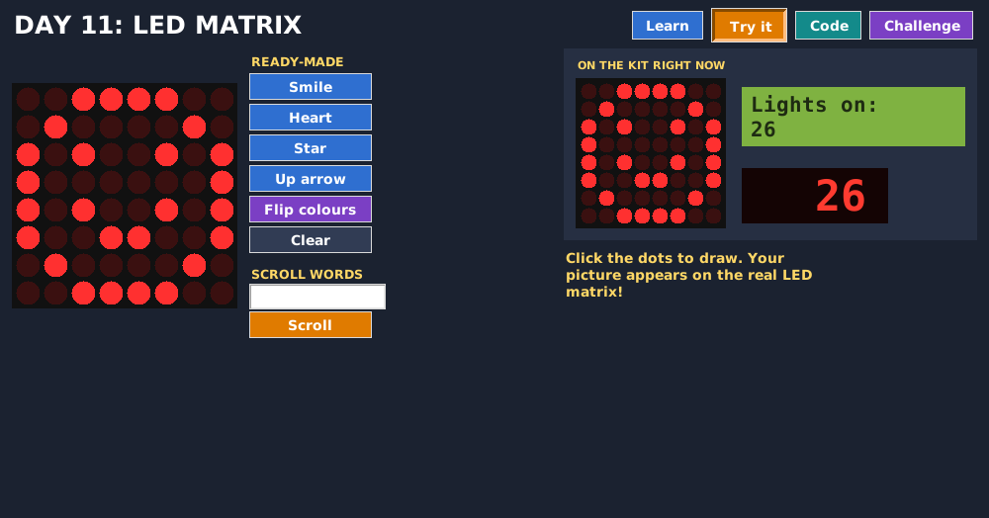
DAY
11
Animations: 8x8 Matrix — Open the Lesson
Click Day 11 in CrowPi Lessons: it opens as an app. Switches: any.
THE LESSON APP
1. Learn: read the 5 cards.
2. Try it: play with the part.
3. Code: change the yellow values, then Upload to kit.
4. Challenge: the kit checks you - LESSON COMPLETE!
Next > (bottom right) = the next tab. Close = done.
Notes:
Click Day 11 in CrowPi Lessons. The lesson opens in its own window - Thonny opens behind it, nobody needs to touch it.

Slide 58
DAY
11
Animations: 8x8 Matrix — Challenge
The Challenge tab checks you. Then push it further.
MAIN CHALLENGE
WIN OF THE DAY
Challenge tab: Which picture? · Draw something · Four corners · Top row · A frame. All done = LESSON COMPLETE!
64 lights, and you control every one.
CODE MISSION (CODE TAB)
Make a fast blink: speed under 0.1 and FULL as the second picture.
Shutdown drill, kits checked in — see you next time!
Notes:
The Challenge tab checks each task by itself - walk around and help. Fast finishers: the Code tab mission (change only the yellow values, then Upload to kit).

Slide 59
DAY
12
Counting: 7-Segment
CrowPi Lesson 11 — Counting numbers using the 7-Segment Display.
TODAY YOU'LL LEARN
PARTS WE USE
Numbers from bars
4 places
Everywhere!
4-digit 7-segment
display
CrowPi Lessons app
Notes:
Short, punchy lesson — good day to also catch up anyone who fell behind.

Slide 60
DAY
12
Counting: 7-Segment — What You Need to Know
The three things from the last slide, actually explained.
Numbers from bars
1
Each number is made of 7 little bars (segments). Turning on different bars makes 0 to 9.
4 places
2
This display has 4 places, so it can show 0 to 9999 - or a time like 12:30.
Everywhere!
3
Microwaves, alarm clocks and scoreboards use them.

Slide 61
DAY
12
Counting: 7-Segment — Try It
Follow the steps in the lesson app. Watch the REAL kit, not just the screen.
Click Day 12: the 7-Segment app opens
Click 'Count up', 'Countdown 10' and 'Clock'
1
4
Read the Learn cards: numbers from 7 bars
Roll the dice a few times
2
5
Try it: type a number and click 'Show'
Challenge tab: read it, up or down, show 2026
3
6
Notes:
Everything happens in the lesson window - no code to type. If nothing reacts on the kit, check the part (and BUTTON MODE for orange lessons). The Next button (bottom right) walks through the tabs; Close (bottom left) ends the lesson and closes Thonny.

Slide 62
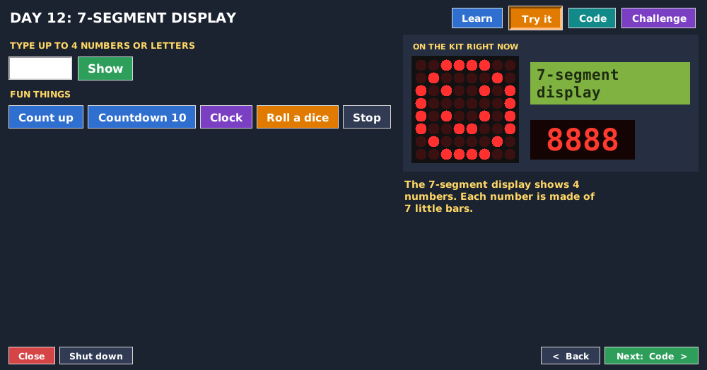
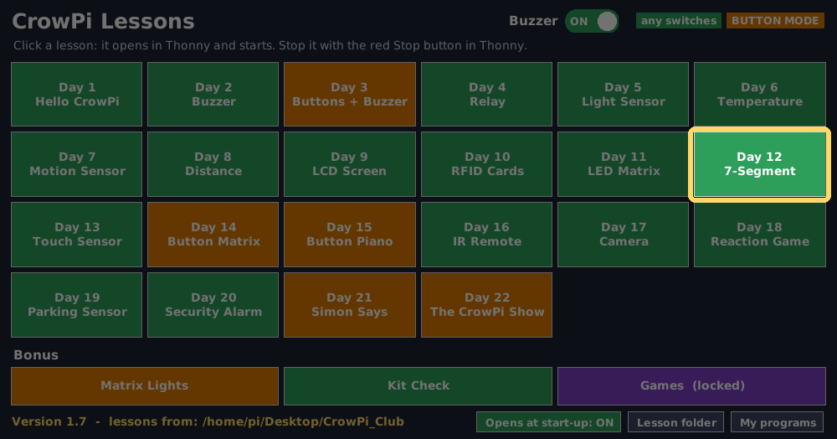


DAY
12
Counting: 7-Segment — Open the Lesson
Click Day 12 in CrowPi Lessons: it opens as an app. Switches: any.
THE LESSON APP
1. Learn: read the 5 cards.
2. Try it: play with the part.
3. Code: change the yellow values, then Upload to kit.
4. Challenge: the kit checks you - LESSON COMPLETE!
Next > (bottom right) = the next tab. Close = done.
Notes:
Click Day 12 in CrowPi Lessons. The lesson opens in its own window - Thonny opens behind it, nobody needs to touch it.

Slide 63
DAY
12
Counting: 7-Segment — Challenge
The Challenge tab checks you. Then push it further.
MAIN CHALLENGE
WIN OF THE DAY
Challenge tab: Read the number · Up or down? · Show 2026 · Say HELP · Count the bars. All done = LESSON COMPLETE!
Microwaves and scoreboards use exactly this.
CODE MISSION (CODE TAB)
Make a countdown from 10 to 0 (start 10, step -1, count 11).
Shutdown drill, kits checked in — see you next time!
Notes:
The Challenge tab checks each task by itself - walk around and help. Fast finishers: the Code tab mission (change only the yellow values, then Upload to kit).

Slide 64
DAY
13
State Breaks: Touch Sensor
CrowPi Lesson 12 — Capturing state breaks using the Touch Sensor.
TODAY YOU'LL LEARN
PARTS WE USE
It feels your finger
No moving parts
In your pocket
Touch sensor pad
LED matrix
CrowPi Lessons app
Notes:
Capacitive touch = same tech as their phone screens. That one fact hooks them.

Slide 65
DAY
13
State Breaks: Touch Sensor — What You Need to Know
The three things from the last slide, actually explained.
It feels your finger
1
The touch pad notices your finger because your body holds a tiny bit of electricity.
No moving parts
2
Unlike a button, nothing moves - just touch it.
In your pocket
3
Phone screens are touch sensors too!

Slide 66
DAY
13
State Breaks: Touch Sensor — Try It
Follow the steps in the lesson app. Watch the REAL kit, not just the screen.
Click Day 13: the Touch Sensor app opens
Hold your finger on it - watch the timer
1
4
Read the Learn cards: it feels your finger
Turn on 'Lamp mode': each tap switches the relay
2
5
Try it: tap the pad and watch the taps count
Challenge tab: 3 taps, hold 2 s, 5 fast taps
3
6
Notes:
Everything happens in the lesson window - no code to type. If nothing reacts on the kit, check the part (and BUTTON MODE for orange lessons). The Next button (bottom right) walks through the tabs; Close (bottom left) ends the lesson and closes Thonny.

Slide 67




DAY
13
State Breaks: Touch Sensor — Open the Lesson
Click Day 13 in CrowPi Lessons: it opens as an app. Switches: any.
THE LESSON APP
1. Learn: read the 5 cards.
2. Try it: play with the part.
3. Code: change the yellow values, then Upload to kit.
4. Challenge: the kit checks you - LESSON COMPLETE!
Next > (bottom right) = the next tab. Close = done.
Notes:
Click Day 13 in CrowPi Lessons. The lesson opens in its own window - Thonny opens behind it, nobody needs to touch it.

Slide 68
DAY
13
State Breaks: Touch Sensor — Challenge
The Challenge tab checks you. Then push it further.
MAIN CHALLENGE
WIN OF THE DAY
Challenge tab: Three taps · Hold it · Speed tapper · Ten taps · Double tap. All done = LESSON COMPLETE!
Same idea as your phone screen.
CODE MISSION (CODE TAB)
Set the goal to 10 and reach it.
Shutdown drill, kits checked in — see you next time!
Notes:
The Challenge tab checks each task by itself - walk around and help. Fast finishers: the Code tab mission (change only the yellow values, then Upload to kit).

Slide 69
DAY
14
Multi-Key: Button Matrix
CrowPi Lesson 13 — Multi-key operations using the Button Matrix Layout.
TODAY YOU'LL LEARN
PARTS WE USE
16 buttons, 8 wires
Scanning
BUTTON MODE
4x4 button matrix
Buzzer + LCD
CrowPi Lessons app

Slide 70
DAY
14
Multi-Key: Button Matrix — What You Need to Know
The three things from the last slide, actually explained.
16 buttons, 8 wires
1
The 16 buttons are wired in 4 rows and 4 columns, so only 8 wires are needed.
Scanning
2
The program checks one column at a time, very fast, to find the pressed button.
BUTTON MODE
3
The buttons only work when the DIP switches are set to BUTTON MODE.

Slide 71
DAY
14
Multi-Key: Button Matrix — Try It
Follow the steps in the lesson app. Watch the REAL kit, not just the screen.
Set BUTTON MODE, click Day 14, press a button on Switch Check
Find the row and column of each button
1
4
Read the Learn cards: 16 buttons, 8 wires
Watch the square light up on the LED matrix
2
5
Try it: press buttons - the screen shows which one
Challenge tab: 1 then 16, corners, hit the lit one
3
6
Notes:
Everything happens in the lesson window - no code to type. If nothing reacts on the kit, check the part (and BUTTON MODE for orange lessons). The Next button (bottom right) walks through the tabs; Close (bottom left) ends the lesson and closes Thonny.

Slide 72




DAY
14
Multi-Key: Button Matrix — Open the Lesson
Click Day 14 in CrowPi Lessons: it opens as an app. BUTTON MODE first.
THE LESSON APP
1. Learn: read the 5 cards.
2. Try it: play with the part.
3. Code: change the yellow values, then Upload to kit.
4. Challenge: the kit checks you - LESSON COMPLETE!
Next > (bottom right) = the next tab. Close = done.
Notes:
Click Day 14 in CrowPi Lessons. The lesson opens in its own window - Thonny opens behind it, nobody needs to touch it.

Slide 73
DAY
14
Multi-Key: Button Matrix — Challenge
The Challenge tab checks you. Then push it further.
MAIN CHALLENGE
WIN OF THE DAY
Challenge tab: First and last · Four corners · Hit the lit button · First row · Diagonal. All done = LESSON COMPLETE!
16 buttons on only 8 wires - clever wiring.
CODE MISSION (CODE TAB)
Make button 16 the secret, then find it on the kit.
Shutdown drill, kits checked in — see you next time!
Notes:
The Challenge tab checks each task by itself - walk around and help. Fast finishers: the Code tab mission (change only the yellow values, then Upload to kit).

Slide 74
DAY
15
Make Music: Button Piano
CrowPi Lesson 14 — Every button plays a different note.
TODAY YOU'LL LEARN
PARTS WE USE
What a frequency is: how fast the buzzer clicks
Higher number = higher note
A dictionary: one button, one note
16-button grid
Buzzer
LCD screen
Notes:
Ten pianos at once is LOUD. Use the Buzzer switch (top of the app) for quiet practice, then switch it ON for the concert. The CrowPi buzzer is built for beeping, so notes sound buzzy — that's normal.

Slide 75
DAY
15
Make Music: Button Piano — What You Need to Know
The three things from the last slide, actually explained.
What a frequency is
1
A sound is the buzzer clicking on and off very fast. Frequency = clicks per second, measured in hertz (Hz). 440 Hz means 440 clicks every second.
Higher number = higher note
2
Button 1 plays C at 262 Hz, button 16 plays a top D at 1175 Hz. Double the frequency and you go up one octave: 262 to 523 is low C to high C.
A dictionary: button to note
3
NOTES = {1: ("C", 262), ...} is a dictionary: look up a button number, get its note. Change a number in it and that button plays a new note.

Slide 76
DAY
15
Make Music: Button Piano — Try It
Follow the steps in the lesson app. Watch the REAL kit, not just the screen.
Set BUTTON MODE, click Day 15
Click 'Play Mary had a little lamb' and copy it
1
4
Read the Learn cards: sound is shaking air
Find the lowest and the highest note
2
5
Try it: hold a button to play its note
Challenge tab: the scale, Mary, higher or lower
3
6
Notes:
Everything happens in the lesson window - no code to type. If nothing reacts on the kit, check the part (and BUTTON MODE for orange lessons). The Next button (bottom right) walks through the tabs; Close (bottom left) ends the lesson and closes Thonny.

Slide 77




DAY
15
Make Music: Button Piano — Open the Lesson
Click Day 15 in CrowPi Lessons: it opens as an app. BUTTON MODE first.
THE LESSON APP
1. Learn: read the 5 cards.
2. Try it: play with the part.
3. Code: change the yellow values, then Upload to kit.
4. Challenge: the kit checks you - LESSON COMPLETE!
Next > (bottom right) = the next tab. Close = done.
Notes:
Click Day 15 in CrowPi Lessons. The lesson opens in its own window - Thonny opens behind it, nobody needs to touch it.

Slide 78
DAY
15
Make Music: Button Piano — Challenge
The Challenge tab checks you. Then push it further.
MAIN CHALLENGE
WIN OF THE DAY
Challenge tab: Play the scale · Mary had a little lamb · Higher or lower? · Twinkle twinkle · Down the scale. All done = LESSON COMPLETE!
You made music with a computer.
CODE MISSION (CODE TAB)
Make button 1 play the note A (440 Hz), then play it.
Shutdown drill, kits checked in — see you next time!
Notes:
The Challenge tab checks each task by itself - walk around and help. Fast finishers: the Code tab mission (change only the yellow values, then Upload to kit).

Slide 79
DAY
16
Wireless: IR Remote
CrowPi Lesson 15 — Decoding signals from the handheld wireless IR Remote.
TODAY YOU'LL LEARN
PARTS WE USE
Invisible light
A secret code
Point it!
Range
Every key has a number
IR remote (in box)
IR receiver
Everything else!
Notes:
The phone-camera IR trick is the hook — most phone cams see IR as purple flashes. Test yours beforehand.

Slide 80
DAY
16
Wireless: IR Remote — What You Need to Know
The three things from the last slide, actually explained.
Invisible light
1
The remote flashes infrared light - too red for our eyes to see.
A secret code
2
Each key flashes a different code. The receiver reads the code and the program knows which key it was.
Point it!
3
Point the remote at the receiver. It's like a TV remote.

Slide 81
DAY
16
Wireless: IR Remote — Try It
Follow the steps in the lesson app. Watch the REAL kit, not just the screen.
Plug in the IR receiver, get the remote, click Day 16
Watch the key history fill up
1
4
Read the Learn cards: invisible light
How far away does it still work? Test it
2
5
Try it: point the remote and press a key
Challenge tab: 3 keys, press the number, secret code
3
6
Notes:
Everything happens in the lesson window - no code to type. If nothing reacts on the kit, check the part (and BUTTON MODE for orange lessons). The Next button (bottom right) walks through the tabs; Close (bottom left) ends the lesson and closes Thonny.

Slide 82




DAY
16
Wireless: IR Remote — Open the Lesson
Click Day 16 in CrowPi Lessons: it opens as an app. Plug in the IR receiver, get the remote.
THE LESSON APP
1. Learn: read the 5 cards.
2. Try it: play with the part.
3. Code: change the yellow values, then Upload to kit.
4. Challenge: the kit checks you - LESSON COMPLETE!
Next > (bottom right) = the next tab. Close = done.
Notes:
Click Day 16 in CrowPi Lessons. The lesson opens in its own window - Thonny opens behind it, nobody needs to touch it. Point the remote AT the receiver; kids will point it at the screen like a TV.

Slide 83
DAY
16
Wireless: IR Remote — Challenge
The Challenge tab checks you. Then push it further.
MAIN CHALLENGE
WIN OF THE DAY
Challenge tab: Three different keys · Press the number · Secret code · Countdown · Volume up. All done = LESSON COMPLETE!
Invisible light carried your button press.
CODE MISSION (CODE TAB)
Make CH+ turn the relay ON and CH- turn it OFF, then try it.
Shutdown drill, kits checked in — see you next time!
Notes:
The Challenge tab checks each task by itself - walk around and help. Fast finishers: the Code tab mission (change only the yellow values, then Upload to kit).

Slide 84
DAY
17
Vision: Camera
CrowPi Lesson 16 — Vision scripts using the CrowPi camera.
TODAY YOU'LL LEARN
PARTS WE USE
Light into numbers
Red, green, blue
Saved as a file
CrowPi camera
CrowPi Lessons app

Slide 85
DAY
17
Vision: Camera — What You Need to Know
The three things from the last slide, actually explained.
Light into numbers
1
A camera has millions of tiny light sensors. Each one measures one dot (pixel) of the picture.
Red, green, blue
2
Every pixel is saved as three numbers: how red, how green, how blue.
Saved as a file
3
Your photos are saved in Pictures > CrowPi_Photos.

Slide 86
DAY
17
Vision: Camera — Try It
Follow the steps in the lesson app. Watch the REAL kit, not just the screen.
Click Day 17: the Camera app opens
Look at your photo on the screen
1
4
Read the Learn cards: millions of light sensors
Find it in Pictures > CrowPi_Photos
2
5
Try it: click 'Take a photo' and smile at 1
Challenge tab: a selfie, then your favourite thing
3
6
Notes:
Everything happens in the lesson window - no code to type. If nothing reacts on the kit, check the part (and BUTTON MODE for orange lessons). The Next button (bottom right) walks through the tabs; Close (bottom left) ends the lesson and closes Thonny.

Slide 87




DAY
17
Vision: Camera — Open the Lesson
Click Day 17 in CrowPi Lessons: it opens as an app. Photos go to Pictures > CrowPi_Photos.
THE LESSON APP
1. Learn: read the 5 cards.
2. Try it: play with the part.
3. Code: change the yellow values, then Upload to kit.
4. Challenge: the kit checks you - LESSON COMPLETE!
Next > (bottom right) = the next tab. Close = done.
Notes:
Click Day 17 in CrowPi Lessons. The lesson opens in its own window - Thonny opens behind it, nobody needs to touch it. Photos are saved in Pictures > CrowPi_Photos (the Photos button in CrowPi Lessons).

Slide 88
DAY
17
Vision: Camera — Challenge
The Challenge tab checks you. Then push it further.
MAIN CHALLENGE
WIN OF THE DAY
Challenge tab: Selfie! · Favourite thing · Silly face · Team photo. All done = LESSON COMPLETE!
Your kit can see now - photos saved forever.
CODE MISSION (CODE TAB)
Give yourself a 10 second countdown and take the photo.
Shutdown drill, kits checked in — see you next time!
Notes:
The Challenge tab checks each task by itself - walk around and help. Fast finishers: the Code tab mission (change only the yellow values, then Upload to kit).

Slide 89
DAY
18
Speed Test: Reaction Game
CrowPi Lesson 17 — How fast are your fingers?
TODAY YOU'LL LEARN
PARTS WE USE
Measuring time
Milliseconds
No cheating!
Touch sensor
Buzzer + 7-segment
LCD screen
Notes:
Run a class leaderboard on the board. Typical times are 200-400 ms. This day reuses the touch sensor (Day 13) and the 7-segment display (Day 12).

Slide 90
DAY
18
Speed Test: Reaction Game — What You Need to Know
The three things from the last slide, actually explained.
Measuring time
1
The program notes the time of the BEEP and the time of your touch. The difference is your reaction time.
Milliseconds
2
1 second = 1000 milliseconds (ms). Most people react in 200 to 400 ms.
No cheating!
3
Touch before the beep and it says TOO EARLY.

Slide 91
DAY
18
Speed Test: Reaction Game — Try It
Follow the steps in the lesson app. Watch the REAL kit, not just the screen.
Click Day 18: the Reaction Game opens
Too early? It says TOO EARLY - wait for it
1
4
Read the Learn cards: milliseconds
Play 5 rounds and check your best time
2
5
Play tab: wait for GREEN and the beep, then touch
Challenge tab: under 500 ms, then under 350 ms
3
6
Notes:
Everything happens in the lesson window - no code to type. If nothing reacts on the kit, check the part (and BUTTON MODE for orange lessons). The Next button (bottom right) walks through the tabs; Close (bottom left) ends the lesson and closes Thonny.

Slide 92




DAY
18
Speed Test: Reaction Game — Open the Lesson
Click Day 18 in CrowPi Lessons: it opens as an app. Switches: any.
THE LESSON APP
1. Learn: read the 5 cards.
2. Play: the full game.
3. Code: change the yellow values, then Upload to kit.
4. Challenge: the kit checks you - LESSON COMPLETE!
Next > (bottom right) = the next tab. Close = done.
Notes:
Click Day 18 in CrowPi Lessons. The lesson opens in its own window - Thonny opens behind it, nobody needs to touch it.

Slide 93
DAY
18
Speed Test: Reaction Game — Challenge
The Challenge tab checks you. Then push it further.
MAIN CHALLENGE
WIN OF THE DAY
Challenge tab: Practice taps · Faster than 600 ms · Faster than 500 ms · Faster than 400 ms · Faster than 350 ms. All done = LESSON COMPLETE!
Measured in thousandths of a second.
CODE MISSION (CODE TAB)
Make the wait between 1 and 10 seconds so nobody can guess it.
Shutdown drill, kits checked in — see you next time!
Notes:
The Challenge tab checks each task by itself - walk around and help. Fast finishers: the Code tab mission (change only the yellow values, then Upload to kit). Run a class reaction-time leaderboard on the board. Typical times: 200-400 ms.

Slide 94
DAY
19
Beep Beep: Parking Sensor
CrowPi Lesson 18 — Like the sensor in a real car.
TODAY YOU'LL LEARN
PARTS WE USE
Turning distance into beep speed
Filling a display bit by bit
Danger zones with if / elif / else
Ultrasonic sensor
Buzzer + LED matrix
7-segment display
Notes:
Use a book as the wall. Real cars use exactly this idea. Reuses the distance sensor (Day 8), LED matrix (Day 11) and 7-segment (Day 12).

Slide 95
DAY
19
Beep Beep: Parking Sensor — What You Need to Know
The three things from the last slide, actually explained.
Distance to beep speed
1
The pause between beeps = distance divided by 100 seconds. 50 cm is a 0.5 s pause, 10 cm is 0.1 s. Closer = shorter pause = faster beeps.
A bar that fills up
2
The LED matrix lights one more row for every 5 cm closer, from 45 cm down to 5 cm. It turns a number into a picture you can read instantly.
Danger zones
3
Over 50 cm: quiet. Under 50 cm: beeping. Under 5 cm: STOP, with a big X and one long beep. Each zone is one if or elif.

Slide 96
DAY
19
Beep Beep: Parking Sensor — Try It
Follow the steps in the lesson app. Watch the REAL kit, not just the screen.
Click Day 19: the Parking Sensor app opens
Watch the car on screen and the matrix fill up
1
4
Read the Learn cards: closer = faster beeps
Go under 5 cm: STOP sign and non-stop beep
2
5
Try it: back your hand-car in slowly
Challenge tab: park it, too close, drive away
3
6
Notes:
Everything happens in the lesson window - no code to type. If nothing reacts on the kit, check the part (and BUTTON MODE for orange lessons). The Next button (bottom right) walks through the tabs; Close (bottom left) ends the lesson and closes Thonny.

Slide 97




DAY
19
Beep Beep: Parking Sensor — Open the Lesson
Click Day 19 in CrowPi Lessons: it opens as an app. Switches: any.
THE LESSON APP
1. Learn: read the 5 cards.
2. Try it: play with the part.
3. Code: change the yellow values, then Upload to kit.
4. Challenge: the kit checks you - LESSON COMPLETE!
Next > (bottom right) = the next tab. Close = done.
Notes:
Click Day 19 in CrowPi Lessons. The lesson opens in its own window - Thonny opens behind it, nobody needs to touch it.

Slide 98
DAY
19
Beep Beep: Parking Sensor — Challenge
The Challenge tab checks you. Then push it further.
MAIN CHALLENGE
WIN OF THE DAY
Challenge tab: Park it · Too close! · Drive away · Slow approach · Hold at 20. All done = LESSON COMPLETE!
A real car feature, built by you.
CODE MISSION (CODE TAB)
Make it say STOP at 15 cm and start beeping at 80 cm.
Shutdown drill, kits checked in — see you next time!
Notes:
The Challenge tab checks each task by itself - walk around and help. Fast finishers: the Code tab mission (change only the yellow values, then Upload to kit).

Slide 99
DAY
20
Guard Mode: Security Alarm
CrowPi Lesson 19 — RFID key card + a distance-sensor tripwire.
TODAY YOU'LL LEARN
PARTS WE USE
Three parts together
States
Only your card
Real alarms
The countdown
Distance sensor (the tripwire)
RFID reader + card
Buzzer + LCD
Notes:
The alarm is loud: test with the Buzzer switch OFF, then turn it ON for the real thing. The distance sensor is the tripwire - anything closer than 30 cm sets it off.

Slide 100
DAY
20
Guard Mode: Security Alarm — What You Need to Know
The three things from the last slide, actually explained.
Three parts together
1
The RFID reader is the KEY, the distance sensor is the TRIPWIRE and the buzzer is the ALARM.
States
2
The alarm is always in one state: waiting for a key, arming, watching, ringing, or off.
Only your card
3
The first card you tap becomes the key. Other cards are WRONG CARD.

Slide 101
DAY
20
Guard Mode: Security Alarm — Try It
Follow the steps in the lesson app. Watch the REAL kit, not just the screen.
Get a card, click Day 20: the Alarm app opens
Wait for the 10 second countdown
1
4
Read the Learn cards: key, tripwire and alarm
Hand near the distance sensor - INTRUDER!
2
5
Try it: tap your card - it becomes the KEY
Tap the key card to stop it, then the Challenge tab
3
6
Notes:
Everything happens in the lesson window - no code to type. If nothing reacts on the kit, check the part (and BUTTON MODE for orange lessons). The Next button (bottom right) walks through the tabs; Close (bottom left) ends the lesson and closes Thonny.

Slide 102




DAY
20
Guard Mode: Security Alarm — Open the Lesson
Click Day 20 in CrowPi Lessons: it opens as an app. Have the white card or blue tag ready.
THE LESSON APP
1. Learn: read the 5 cards.
2. Try it: play with the part.
3. Code: change the yellow values, then Upload to kit.
4. Challenge: the kit checks you - LESSON COMPLETE!
Next > (bottom right) = the next tab. Close = done.
Notes:
Click Day 20 in CrowPi Lessons. The lesson opens in its own window - Thonny opens behind it, nobody needs to touch it. The distance sensor is the tripwire: keep things more than 30 cm away while it watches.

Slide 103
DAY
20
Guard Mode: Security Alarm — Challenge
The Challenge tab checks you. Then push it further.
MAIN CHALLENGE
WIN OF THE DAY
Challenge tab: Save your key card · Wrong card · Set it off! · Stop the alarm · Arm it again. All done = LESSON COMPLETE!
Three parts working together as one system.
CODE MISSION (CODE TAB)
Give yourself 5 seconds to leave, then set the alarm off.
Shutdown drill, kits checked in — see you next time!
Notes:
The Challenge tab checks each task by itself - walk around and help. Fast finishers: the Code tab mission (change only the yellow values, then Upload to kit).

Slide 104
DAY
21
Memory Game: Simon Says
CrowPi Lesson 20 — Watch the lights, repeat the pattern.
TODAY YOU'LL LEARN
PARTS WE USE
A memory game
Lists
BUTTON MODE
16-button grid
LED matrix
Buzzer + LCD
Notes:
BUTTON MODE. Let the best scorer explain how the list grows — it's the best warm-up for the finale.

Slide 105
DAY
21
Memory Game: Simon Says — What You Need to Know
The three things from the last slide, actually explained.
A memory game
1
The kit shows a pattern. You copy it. Each round the pattern gets one longer.
Lists
2
The program keeps the pattern in a LIST and adds a new button to the end each round.
BUTTON MODE
3
The button grid needs the DIP switches set to BUTTON MODE.

Slide 106
DAY
21
Memory Game: Simon Says — Try It
Follow the steps in the lesson app. Watch the REAL kit, not just the screen.
Set BUTTON MODE, click Day 21
Press the same buttons in the same order
1
4
Read the Learn cards: a memory game with a list
How many rounds can you remember?
2
5
Play tab: watch the corners light up
Challenge tab: reach round 3, then round 5
3
6
Notes:
Everything happens in the lesson window - no code to type. If nothing reacts on the kit, check the part (and BUTTON MODE for orange lessons). The Next button (bottom right) walks through the tabs; Close (bottom left) ends the lesson and closes Thonny.

Slide 107




DAY
21
Memory Game: Simon Says — Open the Lesson
Click Day 21 in CrowPi Lessons: it opens as an app. BUTTON MODE first.
THE LESSON APP
1. Learn: read the 5 cards.
2. Play: the full game.
3. Code: change the yellow values, then Upload to kit.
4. Challenge: the kit checks you - LESSON COMPLETE!
Next > (bottom right) = the next tab. Close = done.
Notes:
Click Day 21 in CrowPi Lessons. The lesson opens in its own window - Thonny opens behind it, nobody needs to touch it.

Slide 108
DAY
21
Memory Game: Simon Says — Challenge
The Challenge tab checks you. Then push it further.
MAIN CHALLENGE
WIN OF THE DAY
Challenge tab: Reach round 2 · Reach round 3 · Reach round 4 · Reach round 5 · Reach round 6. All done = LESSON COMPLETE!
Your memory vs the computer's list.
CODE MISSION (CODE TAB)
Beat a pattern of 6 using all 16 buttons.
Shutdown drill, kits checked in — see you next time!
Notes:
The Challenge tab checks each task by itself - walk around and help. Fast finishers: the Code tab mission (change only the yellow values, then Upload to kit). Let the best player explain how the pattern list grows - great warm-up for the finale.

Slide 109







Day 22: The CrowPi Show App
Switch Check
Checks the DIP switches for you
Dashboard
Every sensor, live
The Show
12 acts, one for every part
Games
On the screen AND the kit
Notes:
Show this before the Day 22 finale. The Games tab asks for the admin password when the installer locked the games. Close (bottom left) ends the show.

Slide 110
DAY
22
Grand Finale: The CrowPi Show
CrowPi Lesson 21 — One app that uses every part.
TODAY YOU'LL LEARN
PARTS WE USE
How a big app is built from small parts
Checking the DIP switches automatically
Reading every sensor live on a dashboard
Every part from the club
IR remote + RFID card
Camera (finale photo)
Notes:
Last day! Put the show on the projector. Kids take turns doing the 12 acts; unlock the Games tab (password admin) for the last 10 minutes.

Slide 111
DAY
22
Grand Finale: The CrowPi Show — What You Need to Know
The three things from the last slide, actually explained.
Big apps = small parts
1
The show is every lesson you did, glued into one app: 12 acts, a live dashboard and 4 games. You already know how every piece works.
The app checks the switches
2
In the wrong mode all four arrow wires read 'pressed'. The Switch Check spots that, says which block to flip, then waits for one arrow press to confirm BUTTON MODE.
A dashboard reads everything
3
A background loop reads every sensor many times a second while the screen updates. The kit mirror on the screen copies the LED matrix, LCD and 7-segment.

Slide 112
DAY
22
Grand Finale: The CrowPi Show — Try It
Follow the steps in the app. Watch the REAL kit, not just the screen.
BUTTON MODE, then click Day 22 in CrowPi Lessons
The Show: click Start and do all 12 acts
1
4
Switch Check: press an arrow to confirm
Smile for the camera finale photo
2
5
Dashboard: wave, touch, cover the light sensor
Games: teacher unlocks, beat the high scores
3
6

Slide 113


DAY
22
Grand Finale: The CrowPi Show — Open the Lesson
Click Day 22 in CrowPi Lessons: the show app opens. BUTTON MODE, remote and RFID card ready.
THE SHOW APP
1. Switch Check
2. Dashboard: every sensor live.
3. The Show: 12 acts.
4. Games (teacher password).
Close (bottom left) = done.

Slide 114
DAY
22
Grand Finale: The CrowPi Show — Challenge
Finished the build? Prove it. Then push it further.
MAIN CHALLENGE
WIN OF THE DAY
Finish all 12 acts as a team — one person per act, as fast as you can. Then beat the class high score in Snake.
22 days ago this was a box of parts. Now one app you understand uses all of it.
BONUS (SPEEDRUNNERS ONLY)
Run the show again and try to finish it without one skip - then beat the class high score in Snake.
Club complete — kits checked in. Congratulations!

Slide 115
Club Leader Cheat Sheet
(this slide is for you — hide it before presenting)
Before every session
Pacing (each day = 5 slides)
Kits open CrowPi Lessons by themselves. Install / update / remove: run install_crowpi.py (downloads from pi.thematesgame.com). Games password: admin
Intro (2 min) · Know slide = your mini-lecture (5 min) · Try-It steps in the lesson app · the Open slide shows the app · Challenge tab (10 min) · shutdown drill. Stop at the gold star.
The 3 fixes for 90% of problems
If a whole lesson flops
1) Re-seat the SD card 2) Full power cycle with proper shutdown 3) Swap in the spare SD card.
Fall back to Minecraft lessons — there are 16 on the kit and they always land. No shame in the audible.
Notes:
Your emergency kit: one fully set-up backup CrowPi, one spare cloned SD card and small screwdrivers. Re-flash corrupted cards the night before, never during class. Quiet room? Flip the Buzzer switch at the top of CrowPi Lessons to OFF. Install, update or remove the lessons on a kit with install_crowpi.py (it also asks whether to lock the games - Minecraft, Doom and the club games - with the admin password: admin). Type reset in the games password box to clear the high scores.

